Slide 1

Fundraising Committee
May 11, 2024

Slide 2

Our Linkspiration

Slide 3
Jazz Brunch 2024 Discussion Points from Sponsorship
Add robust information about our chapter programming to sponsorship levels.
Reach out to current sponsors early and have them consider increasing their sponsorship level.
Have sponsorship packet ready with design by the May 2024 Chapter Meeting.
Maintain the Sponsorship Cover design elements & layout of the sponsorship brochure.
Proposal to move forward with a sponsorship level increase.
We added one level of sponsorship, for 2024, White Rose - $15,000
We maintained the current named levels of sponsorships to keep current sponsors engaged.
Our cost analysis per sponsorship package showed that the number of tickets per sponsorship level cut into our funds raised.

Slide 4
Jazz Brunch Status Updates
We will send the 15th Annual Jazz Brunch invitations and Sponsorship packets later today.
The Eventbrite will be live this evening.
We are working to create a donate button for the chapter website with assistance from the technology committee (and approval from Foundation).

Slide 5
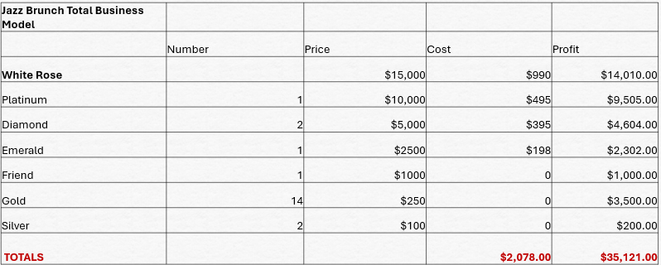
2024 Jazz Brunch Business Model
Notes:
Rationale- We are gifting too many seats and therefore eating into our profit. The seat allocation is more in line with industry standards for events.

Slide 6

Sponsorship Packet Preview

Slide 7
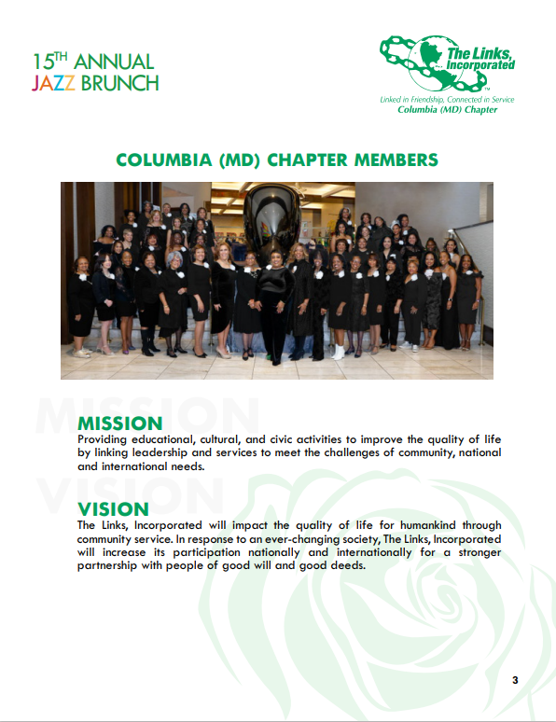

Slide 8
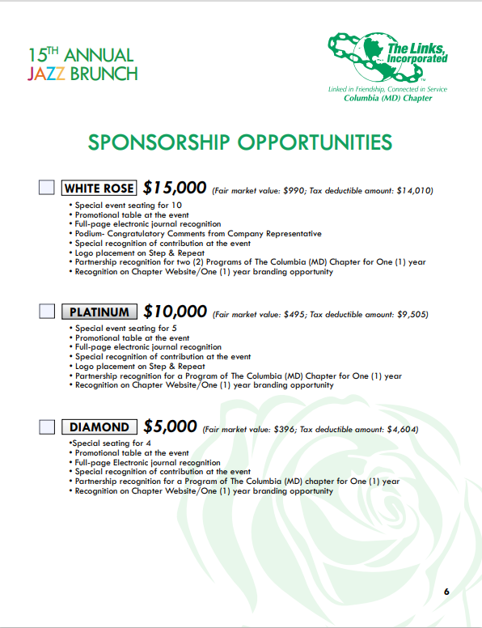

Slide 9
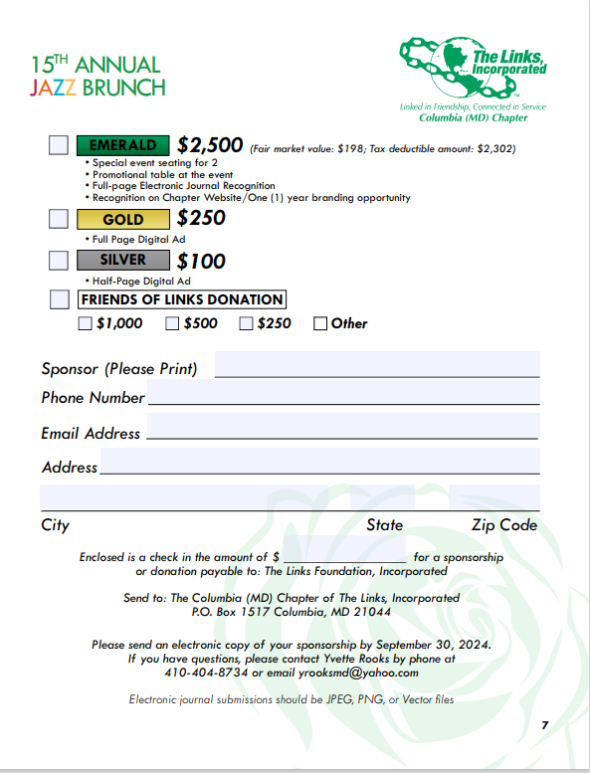

Slide 10

2024 Invitation Preview

Slide 11

Thank you, for your continued support!

