Slide 1
January 2025
Chapter Meeting
Link Lisa Cooper-Lucas, President

Slide 2
National Pledge: All Links stand
I do solemnly pledge myself to all the ideals, purposes, and true meaning of the word friendship as embodied in the name of Links. I shall earnestly endeavor to uphold these standards and do my share toward serving my community and my chapter to the best of my ability. And this I promise. ~Sarah Strickland Scott

Slide 3
National Pledge: All Links stand
I do solemnly pledge myself to all the ideals, purposes, and true meaning of the word friendship as embodied in the name of Links. I shall earnestly endeavor to uphold these standards and do my share toward serving my community and my chapter to the best of my ability. And this I promise. ~Sarah Strickland Scott

Slide 4
The National Song of The Links, Incorporated
We strive to do some good each year For those who need our aid; It binds us close and brings us joy. And so we feel repaid. We’re each a Link in friendship’s chain, And loyal to our creed Of doing good through work and play; Together we’ll succeed. Lyrics: Frances Atkinson Music: Marietta Hall Cephas

Slide 5
President’s Report

Slide 6
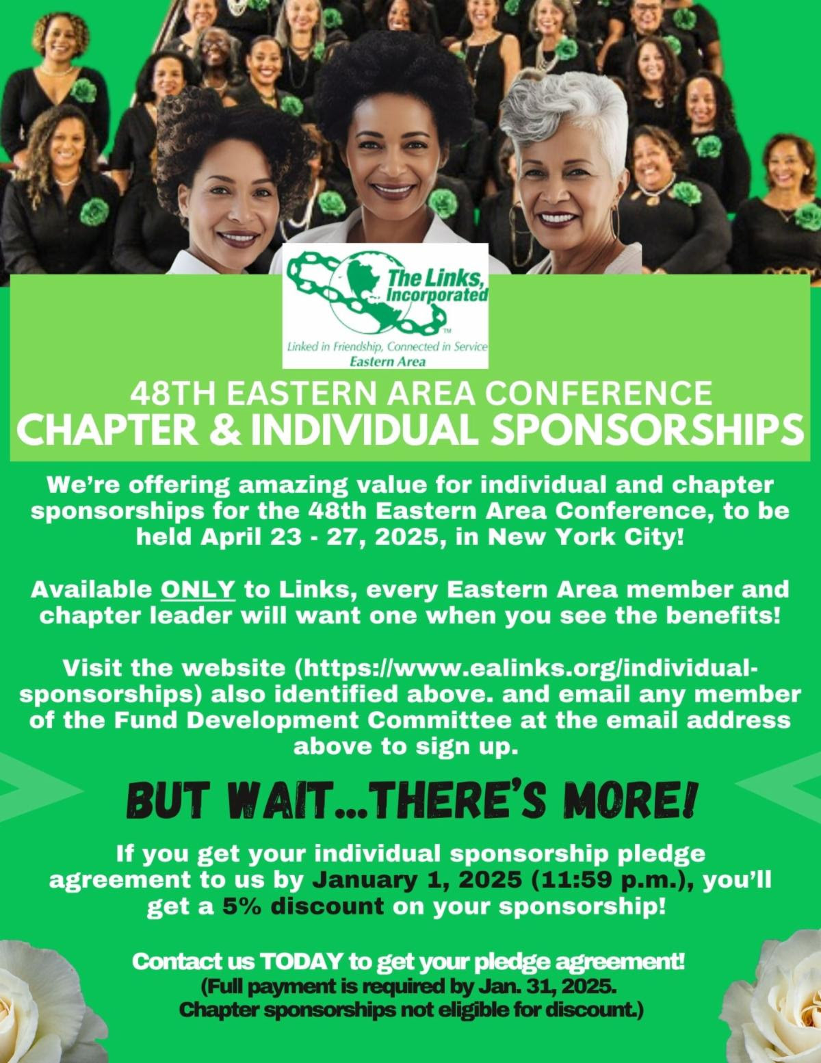
President’s Report

Slide 7
President’s Report
Chapter Sponsorships $2,000
Full page color advertisement in souvenir journal
Web page placement
Signage on electronic screen in lobby areas hall
Chapter picture with Madam Eastern Area Director

Slide 8
President’s Report
Oral History
Oral History Video Project Presentation Deck: This is the presentation we previously provided outlining the Oral History Video Project, due January 31, 2025.
The Consent and Release Form should be signed by all Interviewees for the Oral History Video Project.
Oral History Proposal Form are still being accepted

Slide 9
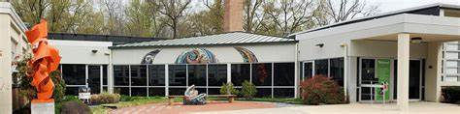
President’s Report
Black Box Theather-D9
8510 High Ridge Road, Ellicott City

