Slide 1
50th Anniversary Committee
Link Rochelle Michaux-Conway – Chair
Link Diane Martin – Co-Chair
March 8, 2025

Slide 2
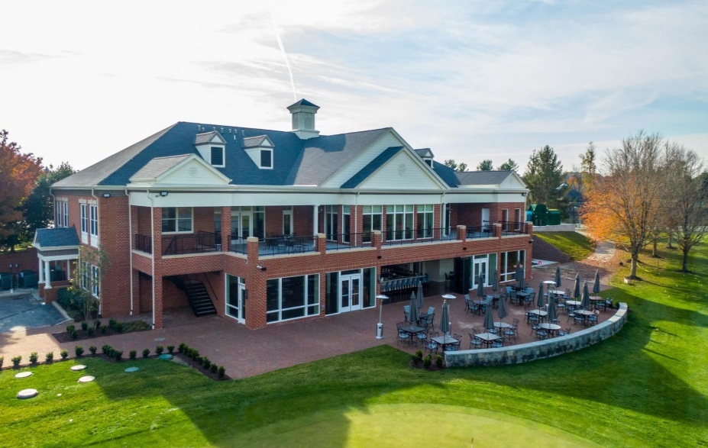
50th Anniversary Celebration
Cattail Creek Country Club
Date
- Sunday, June 22, 2025, 2:00-5:00 pm
Upper level reserved with access to the entire Veranda
Menu food tasting on March 25th
Evite will be sent out by March 30th to confirm attendance and entrée option selection
Additional event tickets will be available for purchase based upon our final count
Entertainment and photography options under review
More to come !!!!

