Slide 1
Columbia (MD) Chapter Links Incorporated Strategic Plan (Programming) 2024-2025
July 10, 2024
Link Judy L. Smith
Strategic Planning Chair

Slide 2
FY205-FY2030 Strategic Planning

Slide 3

Link Core Priorities from the 44th National Assembly
Civil And Voting Rights
Women’s Health Equity
Education
Equal Pay and Economic Empowerment
Social Justice and Public Safety
Environmental Justice and Climate Change

Slide 4
National Strategic Plan 2025-2030 Priorities
Priority 1: Amplify Our culture of friendship and engagement
Priority Lead: Link Regina Clay, Chapter Vice President
Priority 2: Amplify 0ur culture of transformational community service
Priority Lead: Link Regina Little-Hollis, Chapter Membership Chair
Priority 3: Amplify Our culture of fiscal responsibility
Priority Lead: Link Elizabeth Adams, Chapter Treasurer
Priority 4: Amplify our culture of operational excellence and alignment
Priority Lead: TBD (Unsure of Training Chair, maybe Technology Chair)
Priority 5: Amplify our culture of brand awareness
Priority Lead: TBD ( Communications Committee Chair)
Priority 6: Amplify our culture of leadership and professional development
Priority Lead: TBD (Unsure of Leadership Development Programs)

Slide 5
Organizational Recommendations

Slide 6
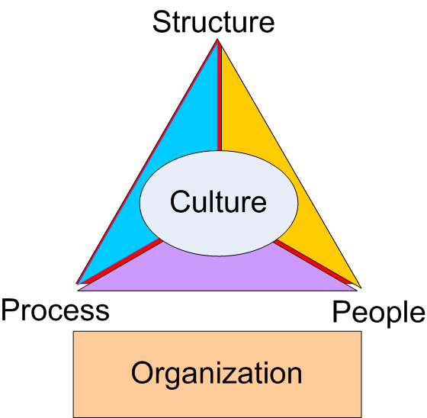
How Culture Impacts the Organization
What Have We Been Doing to Impact our Chapter Culture?
Our Structure is in Place
We focused on Further Engagement of our Chapter Members (People dimension)
During the Last Year, We have ventured to Improve Processes
Consent Agenda
MailChimp
Transition Documents for:
Treasurer
Corresponding Secretary
Recording Secretary
Audit Committee
Others?
This Photo by Unknown Author is licensed under CC BY-SA

Slide 7
Let’s Talk Strategic Planning Focusing our Meeting Content
Forecasting (in years)
Looking Ahead (year or more)
Are we moving in the right direction
Executive Committee Meeting
Strategic Planning
Chapter Meeting
Looking Ahead but in months or quarters
Discuss and Vote on topics that that Facet and Committees Bring forth
Tactical Decision Making
Operations
This is where the work gets done
Facet/Committee Member engagement
Member Engagement
Facet and Committee Meetings
Operational Execution

Slide 8
Proposed Refinement to How We Operate (draft)
Executive Committee Meeting
Chapter Governance
Discuss Strategic Topic of Concern to the Chapter
Discuss Strategic Programs
Discussion Status of the 5 Chapter Strategic Priorities
Chapter Meeting
Facets and Committees Highlight (1 page PowerPoint summary of facet/committee report) the following:
Recent Accomplishments
Any Votes, issues or topic of focus
Plans for Next Month
Facet and Committee Meetings
Facet and Committee Business
Answering Questions and Concerns of Chapter Members

Slide 9
FY24-FY25 Strategic Agenda

Slide 10
Chapter’s Strategic Change Agenda
From
To
Broad Range of Silo’d,
Unconnected Services
Program
Focus on multi-year impactful, integrated programming
This is how we have always done it
Membership
Dynamic, multi-generational sisters
Stagnant- “My Mother’s Organization”
Brand
Relevant, agile, making a difference
Reinvent the wheel every administration
Organizational Excellence
Chapter Process Guides
Limited Efforts
Fund Development
Focused, Connected Funding Strategy
10

Slide 11
Process for Each Strategic Priority Lead (DRAFT)
July 2024 –
Present Strategic Questions to Each Strategic Priority Lead
July 2024 to August 2024 –
Strategic Priority Leads work with Identified Secondary Responsible Parties to Develop the Strategic Priority Implementation Plan
Strategic Planning Committee will Provide Support to the Facet and Committees
August 2024 Executive Committee Meeting
Review each of the 5 Implementation Plans for the Strategic Priorities
Adjust as Needed
Develop Draft of the Chapter FY24-FY25 Strategic Plan
Finalize the Chapter FY24-FY25 Strategic Plan

Slide 12
Strategic Priority 1 – Promote a Culture of Friendship and Engagement
Columbia (MD) Chapter Implementation Plan - Year 1 (DRAFT)
Priority 1 - Promote a culture of friendship and engagement
Goal 1: Promote a culture of friendship and engagement
 |  | Year 1 |  |  |  | Year 2 | Year 3
Key Activities | Current State/Activities | Q1 | Q2 | Q3 | Q4 |  |  | Outcomes | Responsible Person(s)
- Identify friendship activities ( e.g., happy hour, card night, bowling, etc.,) that the Chapter can participant in about every 6 to 8 weeks
- Identify a POC for each activity
- Generate activity plans
- Review and approve activity plans
- Implement activity plans
Goal 2: Increase participation in membership Chapter meetings, average 80% in attendance in 2023-2025
Key Activities | Current State/Activities | Q1 | Q2 | Q3 | Q4 | Year 2 | Year 3 | Outcomes | Responsible Person(s)
- Identify activities and/or ice breakers to add to Chapter meetings
- Work with the President to modify the Chapter meeting agenda to include some type of networking and/or activity into each meeting
- Implement the new agenda
- Develop a measurement method to gauge the success of the added activities
- Measure
- Adjust agenda as needed

Slide 13
2024-2025 Priorities Discussion
Promote a culture of friendship and engagement
Moving To the Next Level
How do we further engage our Chapter membership?
How can we increase Chapter participation?
How can we further encourage members to accept leadership roles?
What are the measures of success and how are those measures developed?
How can We Define, Plan, Execute, and Measure Our Chapter Engagement?

Slide 14
Strategic Priority 2 – Promote a Culture of Transformational Community Service
Priority 2 -Promote a culture of transformational community service
Goal 1: Plan, implement an umbrella program; align with National priorities by 2023-2025
Key Activities | Current State/Activities | Q1 | Q2 | Q3 | Q4 | Year 2 | Year 3 | Outcomes | Responsible Person(s)
- Look at the environmental data and community needs and identify a project that is relevant and value added
- Identify programming that is relevant and value-added
- Determine the need and if it is fundable
- Determine an associated funding plan
- Test to see if the funding plan is reasonable
- If yes, work with the Finance Committee for the budget and the fundraising committee for ways to raise the money
- If no, start over from step 1
- Develop and present a plan to the Executive Committee and Chapter
- Begin Executing the plan ( Identify fundraising sources and develop those sources)
Goal 2: Plan, implement one or more integrated programs, align with National priorities 2023-2025
Key Activities | Current State/Activities | Q1 | Q2 | Q3 | Q4 | Year 2 | Year 3 | Outcomes | Responsible Person(s)
- Look at the environmental data and determine community gaps and compare against Chapter goals and interests
- Identify an umbrella program
_ working with Facets and Committees, determine if all Facets have a role
- If so, begin to define program
- If not, start over and find another program
- Work with Finance Committee and Fundraising Committee to develop a budget and activities for the integrated program
- Work with each Facet and Committee to determine what activities will be started, stopped, and continued as a result of the integrated program
- Adjust Committee and Facet activities and align
- Begin Execution

Slide 15
2024-2025 Priorities Discussion
Promote a culture of transformational community service
Moving To the Next Level
How would the Next Level Umbrella Program Look?
Can We Integrate the Arts and International Facets?
Can we Achieve 100% Participation in Our Umbrella and Integrated Programs?
Can We Further Integrate NTS?
How Will An Integrated Program Look?
How can Define, Plan, Execute, and Measure Our Chapter Impact (through Transformational Programs) on the Top Priorities of Howard County?

Slide 16
Strategic Priority 3 – Promote a Culture of Fiscal Responsibility
Priority 3 - Promote a culture of fiscal responsibility
Goal 1: Double our existing programs budget by 2025
Key Activities | Current State/Activities | Q1 | Q2 | Q3 | Q4 | Year 2 | Year 3 | Outcomes | Responsible Person(s)
- Work with the Facet and Fundraising Chair to determine a roadmap for creating programming that satisfies community need and Chapter interest
- Develop a budget for those activities
- facets and Committees integrate these activities into their current plans
Begin to execute that programming
- At the end of the Discal year Evaluate Program
- Adjust the Programming for the Upcoming Year
Goal 2: Double our existing scholarship budget by 2025
Key Activities | Current State/Activities | Q1 | Q2 | Q3 | Q4 | Year 2 | Year 3 | Outcomes | Responsible Person(s)
- Work with the Service to Youth Facet Chair to update the fundraising plan to identify the types of new scholarships
- Develop a plan ( see old scholarship plan - e.g., 3 new $15,000 scholarships) and time phase the plan
- Work with the Fundraising Committee to identify new fundraising activities that will lead to raising the identified new funds
- Develop and finalize the new scholarship and fundraising plans

Slide 17
2024-2025 Priorities Discussion
Promote a culture of fiscal responsibility
Moving To the Next Level
How should we work with Facets and Committees to Refine Budget Submissions?
What type of measures of success will be needed?
How will Fiscal Support Be provided to Fundraising Efforts?
How we will finalize the following:
Process for Overage
Process for Allocating Fundraising Dollars Between Programs and Scholarships
How can Define, Plan, Execute, and Measure Our Chapter Impact?

Slide 18
Strategic Priority 4 - Promote a Culture of Organizational Excellence and Alignment
Priority 4 - Promote a culture of organizational excellence and alignment
Goal 1: Create an environment that fosters engagement, measured by 90% engagement satisfaction of the chapter by 2025
Key Activities | Current State/Activities | Q1 | Q2 | Q3 | Q4 | Year 2 | Year 3 | Outcomes | Responsible Person(s)
- Identify a consultant ( preferably a Link)
- Develop a training approach (team building)
- Develop a after training satisfaction questionnaire
- Administer the training (team building event, maybe one like DISC or Strength Finder)
- Administer the training questionnaire, analyze the questionnaire, report results to executive Committee and Chapter
- Identify any "quick hits" to implement
- Work with the appropriate Facet/Committee to implement
- Retake the engagement survey
- Determine if improvement since last survey

Slide 19
2024-2025 Priorities Discussion
Promote a culture of organizational excellence and alignment
Moving To the Next Level
What types of training should the Chapter pursue next?
Post “Birds”
What processes are needed to be revisited, updated, documented and implemented
How can Define, Plan, Execute, and Measure Our Chapter Impact?

Slide 20
Strategic Priority 5 – Promote a Culture of Brand Awareness
Priority 5 - Promote a culture of brand awareness
Goal 1: Increase utilization of strategically targeted media by 20% from 2023-2025
Key Activities | Current State/Activities | Q1 | Q2 | Q3 | Q4 | Year 2 | Year 3 | Outcomes | Responsible Person(s)
- Identify a Marketing and Communications Chair
- Identify Committee Members
- Baseline current media outlets, to include, audience reached and usage metrics; tie to programs and fundraising
- Prioritize media outlets based on programming and fundraising goals
- Develop a media communications toolkit
- Develop a communications approach to include measures of success
- Begin outreach to 50% of media outlets
- Measure success; adjust approach and materials
- Outreach to the remaining 50% of media outlets
Goal 2: Increase our social media followers by 10% by 2025
Key Activities | Current State/Activities | Q1 | Q2 | Q3 | Q4 | Year 2 | Year 3 | Outcomes | Responsible Person(s)
- Using the engagement survey, identify three major themes such as positivity, accountability and transparency
- Working with Marketing and Communications Committee, create messaging for the three major these
- On a monthly basis (Chapter) meeting have a 5 minute movement on one of the 3 themes
- Work with the President and Executive Committee and Membership Committee to integrate the 5 minute moments into each meeting and all internal communications
- Measure the impact of the 5 minute moments and adjust messaging as needed

Slide 21
2024-2025 Priorities Discussion
Promote a culture of brand awareness
Moving To the Next Level
Can the fundraising prototype communications plan be used for the Chapter?
How do we further promote our brand?
What communications channels will be most effective for the Chapter?
What messages is the Chapter trying communicate?
How can Define, Plan, Execute, and Measure Our Chapter Impact?

Slide 22
Next Steps
Obtain Concurrence on FY24-FY25 Approach
Work with the Facet and Committee to Develop Their Implementation Plans From July 11 through August 6 2024

Slide 23
BACKUP

Slide 24
Goals Aligned to Priorities
Promote a culture of friendship and engagement
Goal 1 Enhance harmony and friendship with the Columbia (MD) Chapter, increasing participation in friendship activities by at least 20% by 2025
Goal 2 Increase participation in membership Chapter meetings, averaging 80% in attendance by 2023-2025
Promote a culture of transformational community service
Goal 1 Plan, implement an umbrella program; align with National priorities by 2023-2025
Goal 2 Plan, implement one or more integrated programs, align with National priorities by 2023-2025
Promote a culture of fiscal responsibility
Goal 1 Double our existing program budget by 2025
Goal 2 Double our existing scholarship budget by 2025
Promote a culture of organizational excellence and alignment
Goal 1 Create an environment that fosters engagement, measured by 90% engagement satisfaction of the Chapter by 2025
Promote a culture of brand awareness
Goal 1 Increase utilization of strategically targeted media by 20% from 2023-2025
Goal 2 Increase our social media followers by 10% by 2025

Slide 25
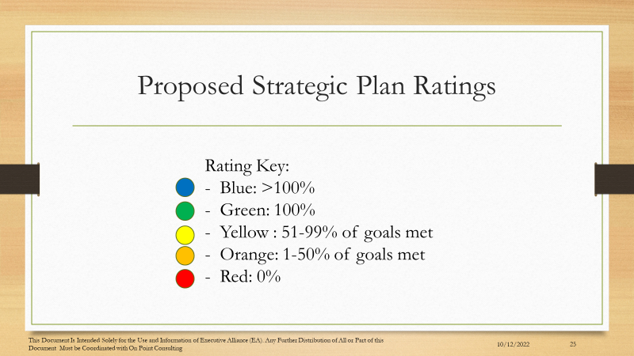
Strategic Plan Rating Scale

Slide 26

Strategic Priority #1
Promote a Culture Friendship and Engagement
Enhance harmony and friendship with the Columbia (MD) Chapter, increasing participation in friendship activities by at least 20% by 2025
Increase participation in membership Chapter meetings, averaging 80% in attendance by 2023-2025
Primary Responsibility
Membership Committee
Link Regina Clay
Secondary Responsibility
Executive Committee

Slide 27
Strategic Priority #3
Primary Responsibility
Finance Committee
Link Elizabeth Adams
Secondary Responsibility
Fundraising Committee
Link Rebecca Reed
Promote a Culture Fiscal Responsibility
Double our exiting program budget by 2025
Double our existing scholarship budget by 2025

Slide 28
Strategic Priority #2
Promote a Culture of Transformational Community Service
Plan and implement an umbrella program; align with National priorities by 2023-2025
Plan and implement one or more integrated programs, align with National priorities by 2023-2025
Primary Responsibility
Programming Committee
Link Regina Little-Hollis
Secondary Responsibility
Arts Facet
Health and Human Services Facet
International Trends Facet
National Trends Facet
Service To Youth Facet

Slide 29
Strategic Priority #4
Promote a Culture of Organizational Excellence and Alignment
Create an environment that fosters engagement, measured by 90% engagement satisfaction of the Chapter by 2025National priorities by 2023-2025
Primary Responsibility
President
Link Lisa Cooper Lucas
Secondary Responsibility
Executive Committee
Membership Committee Programming Committee
Strategic Planning Committee

Slide 30
Strategic Priority #5
Promote a Culture of Brand Awareness
Increase utilization of strategically targeted media by 20% from 2023-2025
Increase our social media followers by 10% by 2025
Primary Responsibility
Marketing and Communications Committee
Link Myra Smith
Secondary Responsibility
Technology Committee

