Slide 1

Fundraising Committee
November 9, 2024

Slide 2

ONE MORE DAY

Slide 3

Know Before You Go!
09:00 AM Committee Members Arrival
10:00 AM Chapter Members Arrival & Check-in
11:30 AM Bar Opens for optional Prosecco purchase
12:00 PM Brunch and Live Music
Attire: The dress code for chapter members - Black (please wear your white rose).

Slide 4

https://www.signupgenius.com/go/10C0D4AA8A722AA8-52813374-jazz#/
Notes:
We hope everyone has signed up for a volunteer slot on Sign-up Genius to make set-up on Sunday smooth.

Slide 5
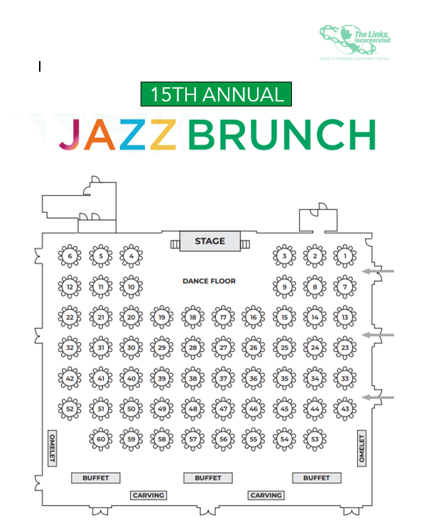
2024
SEATING CHART
Notes:
Please let your guest know your table number. Additionally, we will have signage and Link Sisters working as hostesses to escort them to their tables if needed.

Slide 6
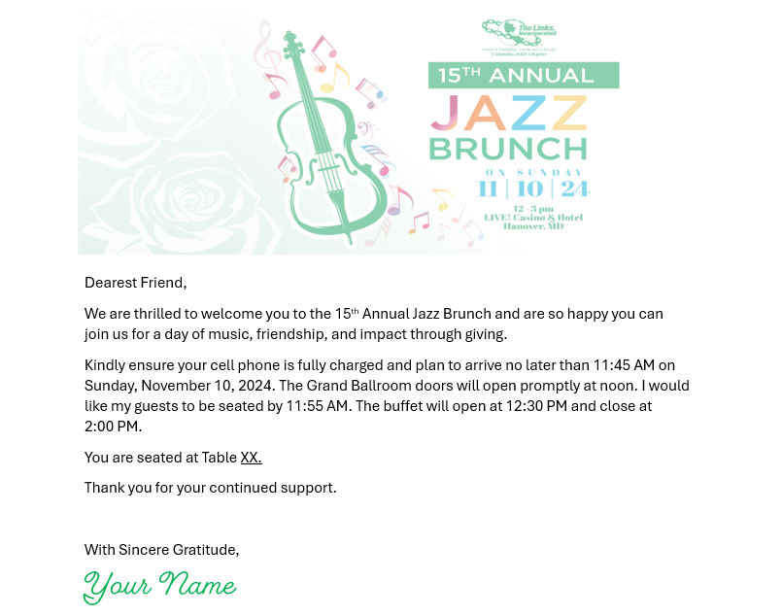
Notes:
Guest Instruction Letter. Feel free to customize.

Slide 7
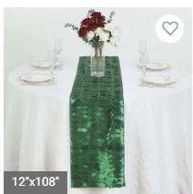
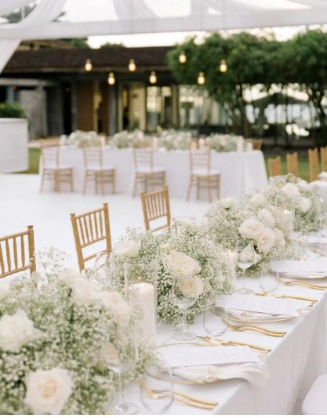
Notes:
Upon arrival, please check in with a Fundraising Committee member for your table runner, floral arrangement and white flower if you do not have one. If you already have a white fabric flower, please wear it.

Slide 8


$48
$60
Notes:
Available for purchase at the bar with ice buckets. This year the buffet will include complimentary juices with a coffee station.

Slide 9
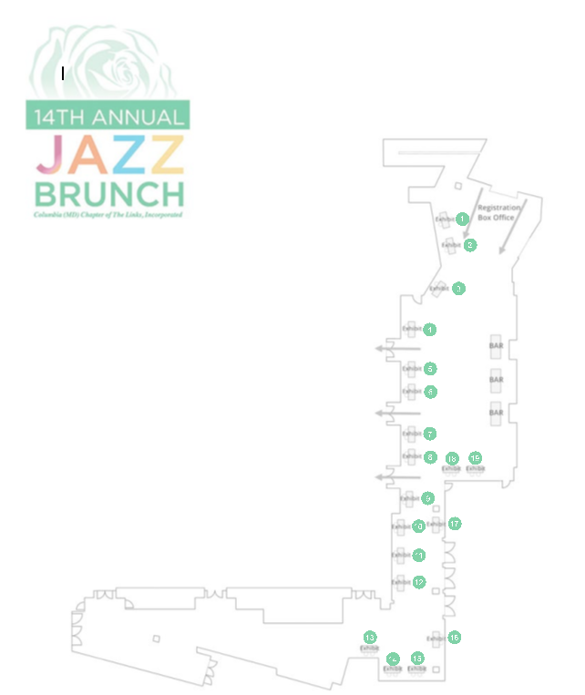
Vendor Floor Plan

Slide 10
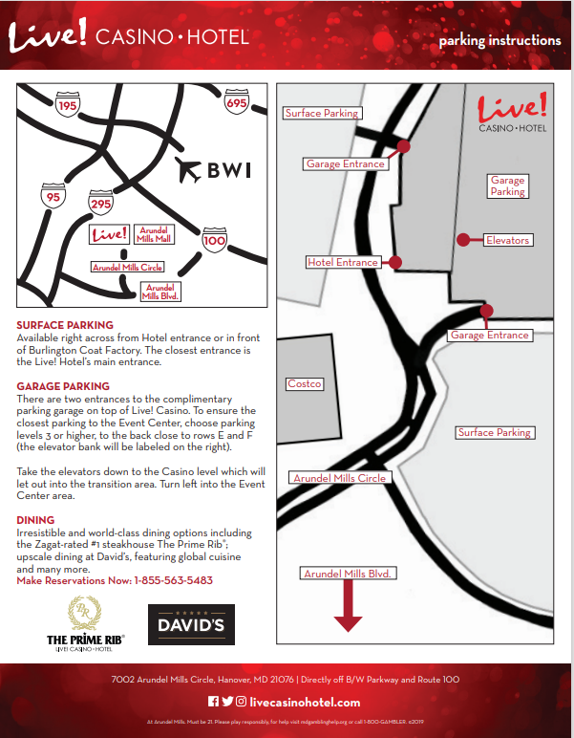
EVENT PARKING
Please share with your guests to ensure they do not inadvertently walk through the casino.
Notes:
Please share with your guests to ensure they do not inadvertently walk through the casino. As a reminder, valet is available at the hotel entrance for $30 per car.

Slide 11

Thank you, for your continued support!

