Slide 1
Columbia (MD) Chapter Links Incorporated
(Draft) Strategic Plan
2022-2025
June 12, 2024
Link Judy L. Smith
Strategic Planning Chair

Slide 2

Table of Contents
Strategic Plan Journey Map
Mission and Vision
2023-2025 Chapter Strategy
Strategic Plan 2023-2024 Results
Refreshed Environmental Data (Representing 2023)
2024-2025 Strategic Priorities Discussion By Reflecting Upon 2023-2024
Set High Level 2024-2025 Strategic Priorities
Summary and Next Steps

Slide 3
Strategic Planning Journey Map
PHASE 1
May- August 2022
PHASE 2
Sept-Dec 2022
PHASE 3
Jan-April 2022
Finalize Budget
Report
Change Agenda
Smart Goals
Prioritize Programs
Refine
Chapter Assessment
Evaluate Progress
Identify Resources
Mission & Vision
High Level Programming
Outcomes/
Deliverables
SWOT
Change Agenda
SMART Goals
Service Delivery Model
Budget
Metrics
Monthly Check-Ins
Submit Chapter Strategic Plan/April 30th

Slide 4
Mission and Vision
Mission: Friends Transforming Communities through Service
Vision: Enrich communities and improve the quality of life for people of African descent, particularly women and children who need our aid, through friendship and service
4

Slide 5
2023-2025 Chapter Strategy

Slide 6
Chapter’s Strategic Change Agenda
From
To
Broad Range of Silo’d,
Unconnected Services
Program
Focus on multi-year impactful, integrated programming
This is how we have always done it
Membership
Dynamic, multi-generational sisters
Stagnant- “My Mother’s Organization”
Brand
Relevant, agile, making a difference
Reinvent the wheel every administration
Organizational Excellence
Chapter Process Guides
Limited Efforts
Fund Development
Focused, Connected Funding Strategy
6

Slide 7
Goals Aligned to Priorities
Promote a culture of friendship and engagement
  Goal 1 Enhance harmony and friendship with the Columbia (MD) Chapter, increasing participation in friendship activities by at least 20% by 2025
  Goal 2 Increase participation in membership Chapter meetings, averaging 80% in attendance by 2023-2025
Promote a culture of transformational community service
  Goal 1 Plan, implement an umbrella program; align with National priorities by 2023-2025
  Goal 2 Plan, implement one or more integrated programs, align with National priorities by 2023-2025
Promote a culture of fiscal responsibility
  Goal 1 Double our existing program budget by 2025
  Goal 2 Double our existing scholarship budget by 2025
Promote a culture of organizational excellence and alignment
  Goal 1 Create an environment that fosters engagement, measured by 90% engagement satisfaction of the Chapter by 2025
Promote a culture of brand awareness
  Goal 1 Increase utilization of strategically targeted media by 20% from 2023-2025
  Goal 2 Increase our social media followers by 10% by 2025

Slide 8

Strategic Priority #1
Promote a Culture Friendship and Engagement
  Enhance harmony and friendship with the Columbia (MD) Chapter, increasing participation in friendship activities by at least 20% by 2025
  Increase participation in membership Chapter meetings, averaging 80% in attendance by 2023-2025
Primary Responsibility
Membership Committee
Link Regina Clay
Secondary Responsibility
Executive Committee

Slide 9
Strategic Priority #3
Primary Responsibility
Finance Committee
Link Elizabeth Adams
Secondary Responsibility
Fundraising Committee
Link Rebecca Reed
Promote a Culture Fiscal Responsibility
  Double our exiting program budget by 2025
  Double our existing scholarship budget by 2025

Slide 10
Strategic Priority #2
Promote a Culture of Transformational Community Service
  Plan and implement an umbrella program; align with National priorities by 2023-2025
  Plan and implement one or more integrated programs, align with National priorities by 2023-2025
Primary Responsibility
Programming Committee
Link Regina Little-Hollis
Secondary Responsibility
Arts Facet
Health and Human Services Facet
International Trends Facet
National Trends Facet
Service To Youth Facet

Slide 11
Strategic Priority #4
Promote a Culture of Organizational Excellence and Alignment
  Create an environment that fosters engagement, measured by 90% engagement satisfaction of the Chapter by 2025National priorities by 2023-2025
Primary Responsibility
President
Link Lisa Cooper Lucas
Secondary Responsibility
Executive Committee
Membership Committee
Programming Committee
Strategic Planning Committee

Slide 12
Strategic Priority #5
Promote a Culture of Brand Awareness
  Increase utilization of strategically targeted media by 20% from 2023-2025
  Increase our social media followers by 10% by 2025
Primary Responsibility
Marketing and Communications Committee
Link Myra Smith
Secondary Responsibility
Technology Committee

Slide 13
Methods to Measure Goals
Goals Aligned to Priorities | Metrics | Data Source
Goal 1 Enhance harmony and friendship with the Columbia (MD) Chapter, increasing participation in friendship activities by at least 20% by 2025 Goal 2 Increase participation in membership Chapter meetings, averaging 80% in attendance by 2023-2025 | Meeting attendance Chapter meetings Facet and Committee meetings Friendship activities | Meeting minutes, Attendance lists Survey results
Goal 1 Plan, implement an umbrella program; align with National priorities by 2023-2025 Goal 2 Plan, implement one or more integrated programs, align with National priorities by 2023-2025 | Resources contributed by each facet Numbers served | Program Service Delivery Model
Goal 1 Double existing program budget by 2025 Goal 2 Double existing scholarship budget by 2025 | 2024-2025 program budget increases to 16k 2024-2025 scholarship budget increases to $40k | Revised 2024-2025 program budget 4 scholarships are awarded
Goal 1 Create an environment that fosters engagement, measured by 90% engagement satisfaction of the Chapter by 2025 | Annual Engagement Survey results- friendship, engagement and programs | Chapter Engagement Survey
Goal 1 increase utilization of targeted media by 20% by 2025 Goal 2 increase our social media followers by 10% by 2025 | Chapter website hits Instagram followers Targeted marketing hits | Chapter website and social media

Slide 14
2023-2024 Strategic Plan Results

Slide 15
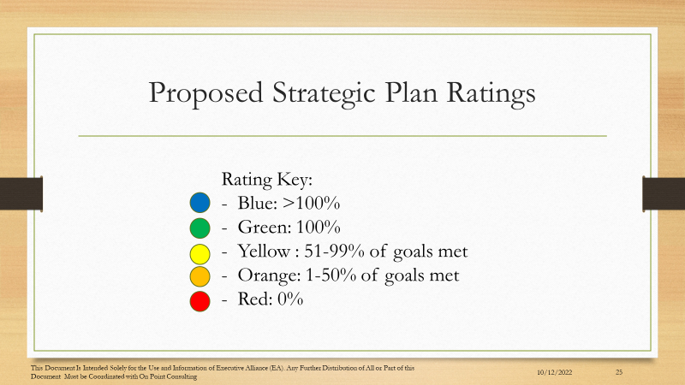
Strategic Plan Rating Scale

Slide 16
Strategic Priority 1 – Promote a Culture of Friendship and Engagement
Columbia (MD) Chapter Implementation Plan - Year 1 (DRAFT)
Priority 1 - Promote a culture of friendship and engagement
Goal 1: Promote a culture of friendship and engagement
 |  | Year 1 |  |  |  | Year 2 | Year 3
Key Activities | Current State/Activities | Q1 | Q2 | Q3 | Q4 |  |  | Outcomes | Responsible Person(s)
- Identify friendship activities ( e.g., happy hour, card night, bowling, etc.,) that the Chapter can participant in about every 6 to 8 weeks
- Identify a POC for each activity
- Generate activity plans
- Review and approve activity plans
- Implement activity plans
Goal 2: Increase participation in membership Chapter meetings, average 80% in attendance in 2023-2025
Key Activities | Current State/Activities | Q1 | Q2 | Q3 | Q4 | Year 2 | Year 3 | Outcomes | Responsible Person(s)
- Identify activities and/or ice breakers to add to Chapter meetings
- Work with the President to modify the Chapter meeting agenda to include some type of networking and/or activity into each meeting
- Implement the new agenda
- Develop a measurement method to gauge the success of the added activities
- Measure
- Adjust agenda as needed

Slide 17
Strategic Priority 2 – Promote a Culture of Transformational Community Service
Priority 2 -Promote a culture of transformational community service
Goal 1: Plan, implement an umbrella program; align with National priorities by 2023-2025
Key Activities | Current State/Activities | Q1 | Q2 | Q3 | Q4 | Year 2 | Year 3 | Outcomes | Responsible Person(s)
- Look at the environmental data and community needs and identify a project that is relevant and value added
- Identify programming that is relevant and value-added
- Determine the need and if it is fundable
- Determine an associated funding plan
- Test to see if the funding plan is reasonable
- If yes, work with the Finance Committee for the budget and the fundraising committee for ways to raise the money
- If no, start over from step 1
- Develop and present a plan to the Executive Committee and Chapter
- Begin Executing the plan ( Identify fundraising sources and develop those sources)
Goal 2: Plan, implement one or more integrated programs, align with National priorities 2023-2025
Key Activities | Current State/Activities | Q1 | Q2 | Q3 | Q4 | Year 2 | Year 3 | Outcomes | Responsible Person(s)
- Look at the environmental data and determine community gaps and compare against Chapter goals and interests
- Identify an umbrella program
_ working with Facets and Committees, determine if all Facets have a role
- If so, begin to define program
- If not, start over and find another program
- Work with Finance Committee and Fundraising Committee to develop a budget and activities for the integrated program
- Work with each Facet and Committee to determine what activities will be started, stopped, and continued as a result of the integrated program
- Adjust Committee and Facet activities and align
- Begin Execution

Slide 18
Strategic Priority 3 – Promote a Culture of Fiscal Responsibility
Priority 3 - Promote a culture of fiscal responsibility
Goal 1: Double our existing programs budget by 2025
Key Activities | Current State/Activities | Q1 | Q2 | Q3 | Q4 | Year 2 | Year 3 | Outcomes | Responsible Person(s)
- Work with the Facet and Fundraising Chair to determine a roadmap for creating programming that satisfies community need and Chapter interest
- Develop a budget for those activities
- facets and Committeess inctegrate these activites into their current plans
Begin to execute that programming
- At the end of the Discal year Evaluate Program
- Adjust the Programming for the Upcoming Year
Goal 2: Double our existing scholarship budget by 2025
Key Activities | Current State/Activities | Q1 | Q2 | Q3 | Q4 | Year 2 | Year 3 | Outcomes | Responsible Person(s)
- Work with the Service to Youth Facet Chair to update the fundraising plan to identify the types of new scholarships
- Develop a plan ( see old scholarship plan - e.g., 3 new $15,000 scholarships) and time phase the plan
- Work with the Fundraising Committee to identify new fundraising activities that will lead to raising the identified new funds
- Develop and finalize the new scholarship and fundraising plans

Slide 19
Strategic Priority 4 - Promote a Culture of Organizational Excellence and Alignment
Priority 4 - Promote a culture of organizational excellence and alignment
Goal 1: Create an environment that fosters engagement, measured by 90% engagement satisfaction of the chapter by 2025
Key Activities | Current State/Activities | Q1 | Q2 | Q3 | Q4 | Year 2 | Year 3 | Outcomes | Responsible Person(s)
- Identify a consultant ( preferably a Link)
- Develop a training approach (team building)
- Develop a after training satisfaction questionnaire
- Administer the training (team building event, maybe one like DISC or Strength Finder)
- Administer the training questionnaire, analyze the questionnaire, report results to executive Committee and Chapter
- Identify any "quick hits" to implement
- Work with the appropriate Facet/Committee to implement
- Retake the engagement survey
- Determine if improvement since last survey

Slide 20
Strategic Priority 5 – Promote a Culture of Brand Awareness
Priority 5 - Promote a culture of brand awareness
Goal 1: Increase utilization of strategically targeted media by 20% from 2023-2025
Key Activities | Current State/Activities | Q1 | Q2 | Q3 | Q4 | Year 2 | Year 3 | Outcomes | Responsible Person(s)
- Identify a Marketing and Communications Chair
- Identify Committee Members
- Baseline current media outlets, to include, audience reached and usage metrics; tie to programs and fundraising
- Prioritize media outlets based on programming and fundraising goals
- Develop a media communications toolkit
- Develop a communications approach to include measures of success
- Begin outreach to 50% of media outlets
- Measure success; adjust approach and materials
- Outreach to the remaining 50% of media outlets
Goal 2: Increase our social media followers by 10% by 2025
Key Activities | Current State/Activities | Q1 | Q2 | Q3 | Q4 | Year 2 | Year 3 | Outcomes | Responsible Person(s)
- Using the engagement survey, identify three major themes such as positivity, accountability and transparency
- Working with Marketing and Communications Committee, create messaging for the three major these
- On a monthly basis (Chapter) meeting have a 5 minute movement on one of the 3 themes
- Work with the President and Executive Committee and Membership Committee to integrate the 5 minute moments into each meeting and all internal communications
- Measure the impact of the 5 minute moments and adjust messaging as needed

Slide 21
Refreshed Environmental Data
(2023 Update)

Slide 22
Priority Initiatives
National Programs
Howard County Needs
Howard County Needs (continued)
The Arts
Classics Through The Ages
National Poster Art
Transforming Communities Thru Film
Young Mater Writers & Artist Competition
Health & Human Services
Diabetes
Child Obesity
HIV and Hepatitis
Walk for Healthy Living
International Trends
Education Across Miles
Jamaica Mission
Life Signature
National Trends
Ally Wallet Wise
Dressing Her From Inside Out
LAMBS
Peace Program
Service to Youth
Linked to Success
Love HBCUs
National Mentoring Program
The Arts
Adequate Space for the Arts
Arts not Perceived to Add Value
Unorganized Voice of the Arts Community
Inadequate Partnership Development
Health and Human services
Healthy lifestyles activities related to prevention and care for gestational diabetes, maternal and infant health and prevention of pediatric obesity
Healthy Living: Health promotion related to chronic disease prevention and care increased movement and healthier food and beverage choices
Healthy Minds: Health promotion for social engagement and support to mental health
International
TBD
National Trends
African Americans 20.1% of HC population
40% of African American Living in Poverty
447 Howard County Public School System Students experience Homelessness and 63% of them were African American
54% of 648 households that called the homeless services were African American
52% of the CAC food recipients were African American
46% of the students that received free and reduced meals in the school system were Black
Lack of employment opportunities that align with skills of population experiencing poverty
Service To Youth
24.8% of HCPSS students are African American
Economically disadvantaged students continue to be chronically absent at disproportionately higher rates than their peers
African American saw an increase of 1.97% in graduation rates which is much lower than other disadvantaged groups
Less than 62% of African American students demonstrated post secondary readiness
African American students receiving special education services and students receiving free and reduced prices meals more than double the average of suspension rates

Slide 23
2024-2025 Strategic Priorities Discussion By Reflecting Upon 2023-2024

Slide 24
Breakout Sessions
You will be placed in a breakout room
Quickly review the:
  Strategic Priority You Were Assigned
  Review 2023-2024 Results
  Discuss Strategic Priority Results
  Discuss the Howard County Data
  Discuss Questions on Page 52 entitled, “2024-2025 Strategic Priorities Discussion”
  Summarize Your Discussion and Report Out

Slide 25
2024-2025 Priorities Discussion
Promote a culture of friendship and engagement
  - Is it Reasonable to Increase participation in friendship activities by at least 30% by 2025?
  - Is It Reasonable to Try Increase participation in membership Chapter meetings, averaging 90% in attendance by 2024-2025?
Promote a culture of transformational community service
  How would the Next Level Umbrella Program Look?
  Can We Integrate the Arts Facet?
  Can we Achieve 100% Participation in Our Umbrella and Integrated Programs?
  Can We Further Integrate NTS?
  How Will An Integrated Program Look?
Promote a culture of fiscal responsibility??
  - Is it still reasonable to Try to Double our existing program budget by 2025?
  - Is It Still Reasonable to Try to Double our existing scholarship budget by 2025?
Promote a culture of organizational excellence and alignment
  - Is it Reasonable to Expect Full Chapter Engagement by 2025?
  - Will Intake Be an Option By 2025?
Promote a culture of brand awareness
  Is it Reasonable to Assume our Marketing and Communications Activities will Increase By 50%?
  Is it Reasonable to Assume that our Marketing and Communications will be integrated into the Facet and Committee Activities?

Slide 26
Set High Level 2024-2025 Strategic Priorities

Slide 27
Next Steps- Detailed Action and Implementation Planning
(TBD)
ACTION PLAN (By FACET AND COMMITTEE)
Activity | Target Date | Resources Required | Lead Person(s) | Anticipated Product or Result | Progress Notes

Slide 28
Summary and Next Steps

Slide 29
Summary and Next Steps
We are Off to An Excellent Start
To Stay on Track with the Strategic Journey Map, We Will Have To:
  Meet One Per Month Through August
  Align the Strategic Plan with our Facet and Committee Activities
  Begin to Plan a September Retreat

Slide 30
BACKUP

Slide 31
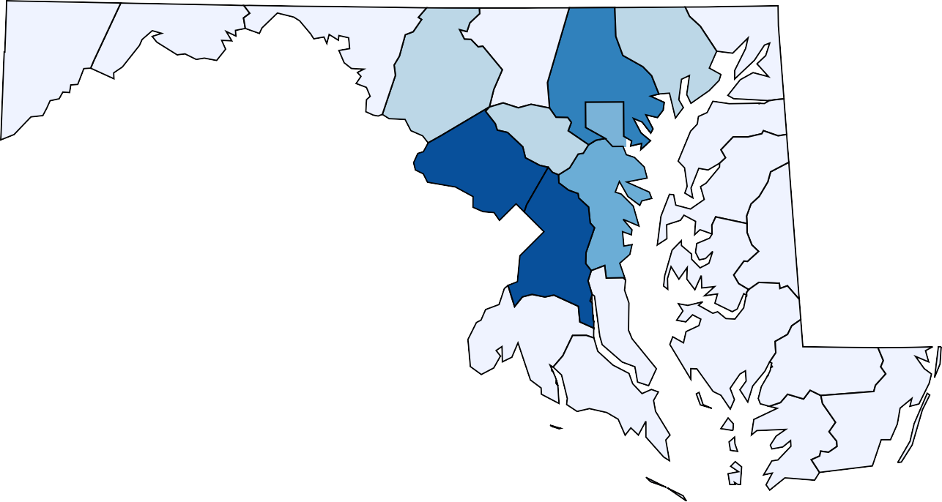
Overview: State Population
Maryland Population by County, 2020
2
This report primarily explores system and
social determinants that lead to racial disparity and inequity in Howard County, Maryland. Data at the state level and from selected jurisdictions are included for additional context and comparison where appropriate. Where these cross-jurisdictional analyses are made, they refer to the five most populous jurisdictions or counties in the state. Population data comparisons for these jurisdictions are provided in the table below.
70057
28852
151146
256805
103419
265161
169092
826017
586131
19192
328200
6,055,802
1051816
582777
51167
MD Total Population
909612
36972
33492
164436
93072
31853
114687
103990
County | Population | % MD Population
1. Montgomery | 1,051,816 | 17.4%
2. Prince George’s | 909,612 | 15.0%
3. Baltimore County | 826,017 | 13.6%
4. Baltimore City | 586,131 | 9.7%
5. Anne Arundel | 582,777 | 9.6%
6. Howard | 328,200 | 5.4%
52403
25453
Population
< 210,363
210,363 - 420,726 420,726 - 631,089
70.7%
These six jurisdictions account for almost three-fourths of the MD population
631,089 - 841,452
> 841,452

Slide 32
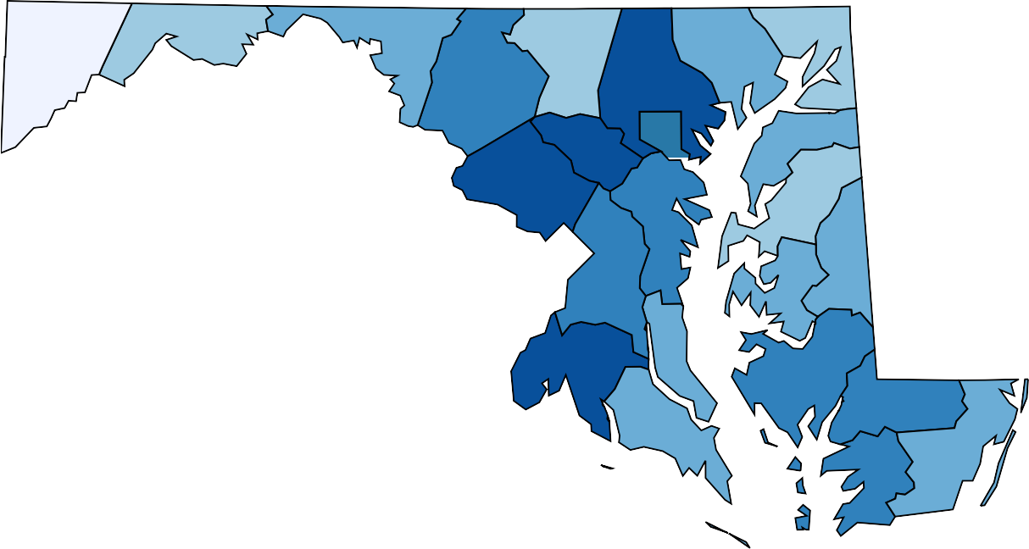
Overview: Inequity and Diversity
Maryland Racial/Ethnic Diversity Index, 2020
Inequities are those differences that occur between groups that are avoidable, unnecessary and unjust. These differences happen in communities largely due to social determinants that include housing, health, education, income, environment, and safety that influence individual health behaviors and conditions. Racial and ethnic status often are associated with these inequities.
According to the 2020 US Census, Maryland is now the most racially diverse state on the east coast and the 4th most diverse in the country behind Hawaii, California, and Nevada³. With a diversity index score of 69.6% (see map note for definition), Howard County ranks behind Montgomery County as the 2nd most diverse county in the state.
9.4
26.8
42.5
34.1
Note: The diversity index (DI) score tells us the chance that two people chosen at random will be from different racial and ethnic groups. The US has a DI of 61.1%.
51.4
27.4
63.2
46
69.6
59.1
41.4
67.3%
73.5
56.5
29.1
Maryland Divsersity
Index Score
59
44.9
41.9
63.9
42.8
54.5
47.5
58.2
57.6
36.1
Diversity Index Score
< 12 12 - 24
24 - 36
36 - 49
49 - 61
> 61
However, research has shown that communities high in diversity - differences in race, ethnicity, gender, age, sexual orientation, socioeconomic status, religion - do not necessarily translate to being racially integrated, equitable or inclusive. While Maryland has seen an increase in the diversity of its population, issues of inequality, discrimination, segregation, and disparity still exist.

Slide 33
Introduction to Howard County
In 2021, Howard County was ranked as the Healthiest Community in Maryland and 8th best among counties across the US by
U.S. News & World Report. Communities in Howard County have been widely recognized and voted as some of the best places
to live in Maryland and consistently ranked in the top 10 places to live in the country. Howard County also continues to be identified as a great place to raise a family and has proven to be one of the healthiest jurisdictions compared to other counties across the State.
These facts contribute to the widely held perception that residents of Howard County are in good health, have a great quality of life, and financial stability. While this is true for many residents, this perception is not the reality for all. This report highlights demographic and geographic disparities and inequities that contribute to poorer health and quality of life outcomes for certain groups within the communities. These facts are not always raised when discussing Howard County's profile. Hopefully, bringing these issues to the forefront will help increase understanding of the differences, barriers and needs of various county resident groups. This should move the conversation forward in a way that promotes advocacy and policy change so that all have the opportunity to experience the best that Howard County has to offer.
Howard County ranked as the heathiest community in MD and 8th healthiest county in the US by U.S. News & World Report⁴.
In 2021, Money Magazine ranked Ellicott City as the best place to live in Maryland and 10th overall in the US. Columbia ranked 5th best in the US in the 2020 survey and ranked No. 1 overall in 2016.⁵
In a survey comparing over 180 cities, WalletHub ranked Columbia as the 5th best place in the US to raise a family in 2021.⁶
2021
2021
2021
Healthiest
Best Place
Best Place to
Community
to Live
Raise a Family

Slide 34
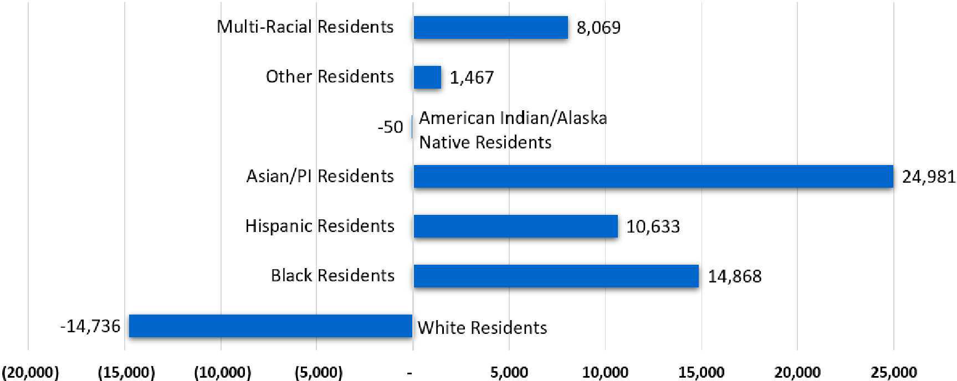

Introduction to Howard County
With a population of more than 300,000 residents, Howard County is the 6th most populous county in Maryland.⁷ Over the last decade (2010-2019) the county has experienced the highest population rate growth (11.3%) compared to other counties across the state. Though the population has grown overall, the growth has varied by race and ethnicity. The Asian population in Howard County has shown the most growth between 2010 and 2020, increasing by almost 25,000 and is the largest in the state. During this same time period, the NH White population has decreased by almost 15,000 people.
2
Change in Howard County Population by Race/Ethnicity, 2010-2020
51.1%
Of residents are Female
24.4%
Under 18 years old
8
21.2%
Foreign born
Multiracial: 3.8 %
Population by Race and Ethnicity
Asian: 19.0 %
25.9%
Speak language other
than English at home
NH White: 49.5 %
Hispanic: 7.2 %
American Indian / Alaska Native: 0.4 %
NH Black: 20.1 %

Slide 35
Jurisdictional Comparison of Socioeconomic Indicators
BA/BS Degree or Higher, 2020
100%
The three typically used indicators of socioeconomic status are education, income and employment. These factors impact people's health, well-being, and quality of life.
Compared to Maryland overall, and select jurisdictions,
residents of Howard County generally have better socioeconomic status. A greater percentage of residents have a bachelor's degree or higher and a greater median household income compared to the state and noted jurisdictions. Howard County also has one of the lowest unemployment rates in the state at 5.1%. 9, 10
75%
62.7%
59.2%
50%
40.9%
43%
39.8%
32.9%
34.4%
25%
0%
Maryland
Howard
Baltimore Prince Montgomery City George's
Anne Arundel
Baltimore County
Median Household Income, 2016-2020
Annual Unemployment Rate, 2020
$150,000
15%
$124,042
$111,812
$103,225
$100,000
$87,063
$86,994
10%
8.7%
$78,724
8%
6.7%
6.2%
5.8%
6.8%
$50,000
$52,164
5%
5.1%
$0
Maryland
Howard
Baltimore Prince Montgomery City George's
Anne Arundel
Baltimore County
0%
Maryland
Howard
Baltimore City
Prince George's
Montgomery
Anne Arundel
Baltimore County
10

Slide 36
Jurisdictional Comparison of Socioeconomic Indicators
Poverty Rate, 2020 ⁹ Comparison of Poverty Rate vs. Home Ownership Rate by County
30%
100%
75%
20%
20%
50%
10%
9%
9.5%
8.9%
25%
5.5%
6.7%
5.2%
0%
0%
Maryland
Howard
Baltimore City
Prince George's
Montgomery
Anne Arundel
Baltimore County
Maryland
Howard
Baltimore City
Prince George's
Montgomery
Anne Arundel
Baltimore County
Poverty Rate Home Ownership Rate
Additional factors such as poverty rate and home ownership are also indicators of the socioeconomic well-being of residents within a community. Home ownership is considered one of the primary ways for families to build generational wealth. This allows families to improve their financial outlook by providing opportunity to build equity, to capitalize on housing appreciation and to have the ability to manage housing costs for the long term.
Home Ownership Rate, 2016-2020 ⁹
100%
75%
67.1%
72.7%
74.3%
62.1%
65.6%
66.1%
50%
47.7%
The line graph above shows the correlation between home ownership and poverty rates across select counties in the state. The graph indicates there is a divergent relationship between poverty and home ownership for Maryland and the highlighted jurisdictions.
25%
0%
Maryland
Howard
Baltimore Prince Montgomery City George's
Anne Arundel
Baltimore County

Slide 37
Jurisdictional Comparison of Life Expectancy
Population Life Expectancy, 2020
Life expectancy at birth is a primary indicator of population health. It is often used to infer the general living conditions of individuals in a specific community, state, or country.
100yrs
78.6
82.7
78.4
84.2
79
77.5
75yrs
71.8
Howard County has the second highest life expectancy at birth (82.7) in the state of Maryland, behind only Montgomery County.¹¹This the case for both NH White and NH Black residents. However, when examining the gap in life expectancy between NH Black and NH White residents within Howard County, it is second only to Baltimore City, which ranks the lowest among these jurisdictions.
50yrs
25yrs
0yrs
Maryland
Howard
Baltimore City
Prince George's
Montgomery
Anne Arundel
Baltimore County
Location | All Residents | NH White | NH Black
Maryland | 78.6 | 79.6 | 75.9
Howard Co. | 82.7 | 82.9 | 79.8
Baltimore City | 71.8 | 75.7 | 69.7
Prince George’s Co. | 78.4 | 80.0 | 77.8
Montgomery Co. | 84.2 | 84.3 | 81.9
Anne Arundel Co. | 79.0 | 79.3 | 76.8
Baltimore Co. | 77.5 | 78.0 | 75.5
Comparison of Life Expectancy Gap Between NH Black and NH White Populations, 2020
10yrs
7.5yrs
6yrs
5yrs
3.7yrs
3.1yrs
2.5yrs
2.2yrs
2.4yrs
2.5yrs
2.5yrs
0yrs
Maryland
Howard
Baltimore City
Prince Montgomery Anne George's Arundel
Baltimore County

Slide 38
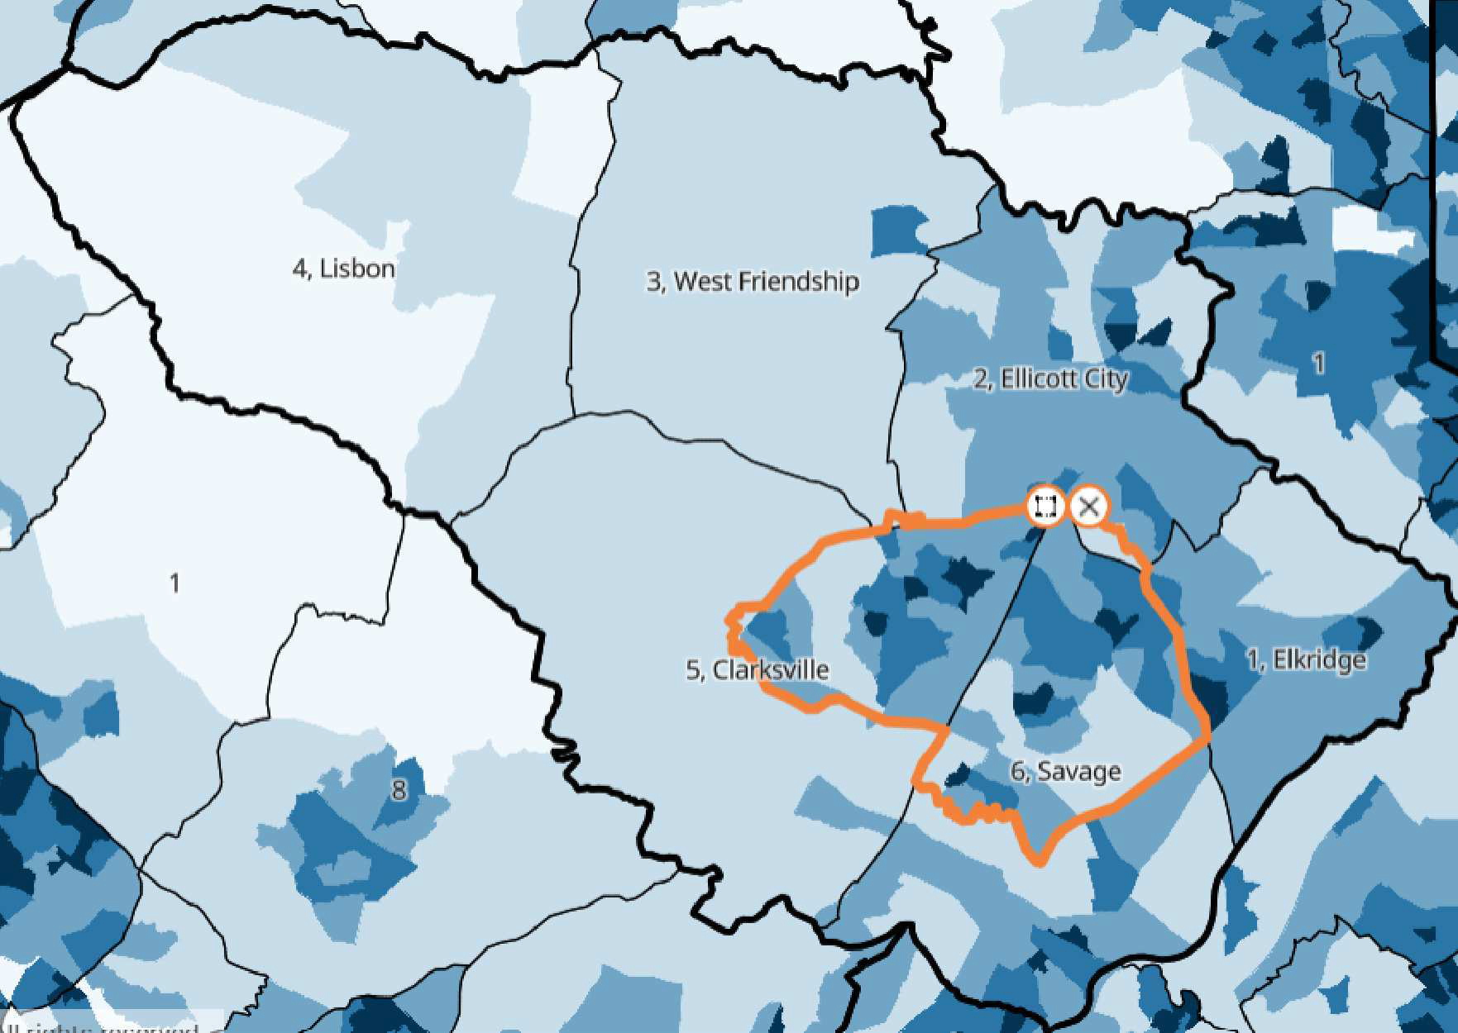
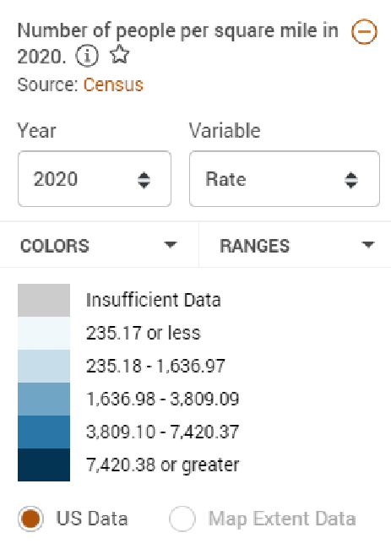




Comparison of Howard County Geographic Subdivisions
Population Density
The US Census Bureau divides Howard County into 6 subdivisions identified as (number does not reflect ranking)⁸:
Elkridge
Ellicott City
West Friendship
Lisbon
Clarksville
Savage
These subdivisions, along with Columbia, will be used to highlight demographic and socioeconomic disparities that exist across these boundaries.
Columbia
Lisbon and West Friendship have the smallest population percentages in the county yet are two of the three largest subdivisions by land mass (62.9 sq miles; 44.1 sq miles)¹.²⁻¹⁹
Howard County Population by Subdivision, 2019
Ellicott City: 21.2%
Savage: 30.5%
104,681 Howard County residents live in Columbia, MD, an unincorporated community that crosses four (Ellicott City; West Friendship; Clarksville; Savage) of the six county subdivisions within Howard County and accounts for 31.5% of the county population.
Elkridge: 16%
W. Friendship: 5.8%
Clarksville: 22%
Lisbon: 4.5%

Slide 39
Comparison of Howard County Geographic Subdivisions
Race and Ethnicity
Howard County Race and Ethnicity by Subdivision, 2019
Location | Size (Sq Mi) | Population per Sq. Mile
Howard County | 250.9 Sq Miles | 1,284.7
Columbia | 31.9 Sq Miles | 3,301
Elkridge | 19.8 Sq Miles | 2,488
Ellicott City | 31.1 Sq Miles | 2,197.3
West Friendship | 44.1 Sq Miles | 399.7
Lisbon | 62.9 Sq Miles | 237.4
Clarksville | 56.1 Sq Miles | 1,282.9
Savage | 36.9 Sq Miles | 2,714.4
Howard County
46.7
19.6
8.2
20.3
5.2
Elkridge
43.8
20.9
10
20.3
5
Ellicott City
48.9
10.2 4.7
31.6
4.6
W. Friendship
60.3
6.2 3.1
26
4.4
Lisbon
77.6
4.2 4.4 8.8 5
Clarksville
48.2
20.3
6.9
19.1
5.5
The above table lists the size and population density for each subdivision in the county. The racial composition of each subdivision is worth noting. NH White residents account for more than 60% of the population in Lisbon and West Friendship. In each of the remaining subdivisions and Columbia, NH Whites account for less than 50% of the population.¹²⁻¹⁹
Savage
38.5
29.9
12.2
13.9 5.5
White Black
Hispanic Asian Other
Columbia
44.5
27.5
9.4
13.3 5.3
0%
20% 40% 60% 80%
Non-White Population by Subdivision, 2019
100%
100
The racial and ethnic diversity in <50% subdivision varies. Savage (29.9%) and Columbia (27.5%) have the largest NH Black populations in the county. Savage (12.2%), Elkridge(10%) and Columbia (9.4%) have the greatest number of Hispanic residents, while Ellicott City (31.6%) and West Friendship (26%) have the largest Asian populations. Howard County residents of other racial and ethnic groups account for approximately 5% of the population in each subdivision and Columbia.
53.3%
55.5%
56.2%
51.1%
51.8%
61.5%
50
39.7%
22.4%
0
Howard County
Columbia
Elkridge
Ellicott City
W. Friendship
Lisbon
Clarksville
Savage

Slide 40
Comparison of Howard County Geographic Subdivisions
Socioeconomic Indicators
West Friendship and Lisbon have the two highest median incomes, the two highest percent ownership and the two lowest poverty rates in the county.
Percent Home Ownership by Howard County Subdivision, 2016-2020
100%
85%
96%
73%
66%
73%
73%
72%
68%
Socioeconomic indicators across subdivisions point to higher median household incomes and lower rates of poverty in those places where home ownership is the highest, emphasizing the interplay and importance of these indicators and their place-based distribution.¹²⁻¹⁹
50%
0%
Howard County
Columbia
Elkridge
Ellicott City
W. Friendship
Lisbon
Clarksville
Savage
Residents of Savage are 8 times more
likely to be renters than residents of Lisbon
Median Household Income by Howard County Subdivision, 2019
Poverty Rate by Howard County Subdivision, 2016-2020
$200,000
$173,750
15%
_{$135,948} $144,092
$136,002
$124,042
_{$111,278} $119,050
$108,770
10%
$100,000
7.6%
6.6%
5%
5.1%
4.3%
4.4%
5.5%
3.8%
3.2%
$0
0%
Howard County
Columbia
Elkridge
Ellicott City
W. Friendship
Lisbon
Clarksville
Savage
Howard County
Columbia
Elkridge
Ellicott City
W. Friendship
Lisbon
Clarksville
Savage

Slide 41
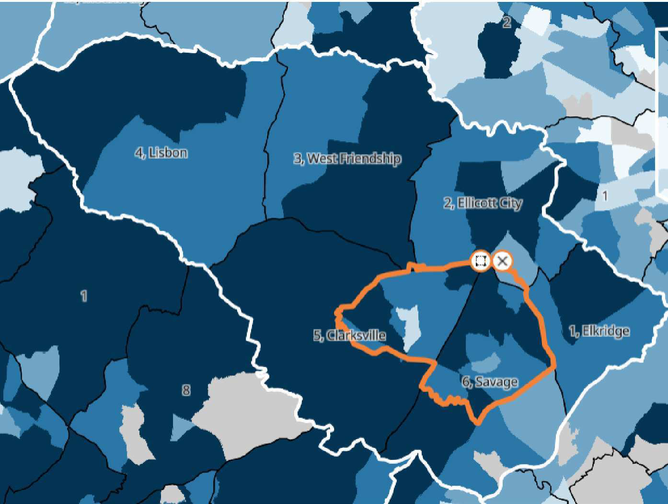
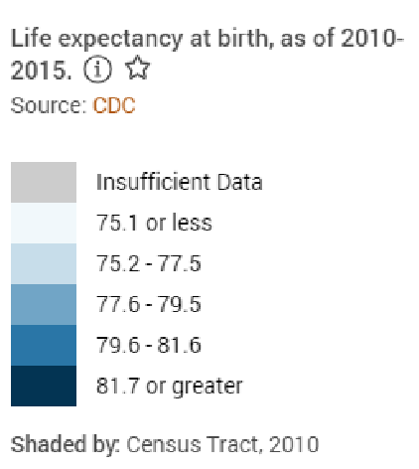
Comparison of Howard County Geographic Subdivisions
Life Expectancy
Percent Without Insurance Coverage by Subdivision, 2019
Range in Life Expectancy by Subdivision , 2010-2015
Columbia
Clarksville Savage
77-87
10yrs
77-86
9yrs
Columbia Savage Clarksville Elkridge Ellicott City
Lisbon
W. Friendship
5.3%
79-87
8yrs
5.4%
Ellicott City
Elkridge
79-84
5yrs
4%
3%
80-84
4yrs
2.3%
Lisbon
W. Friendship
80-83
3yrs
2.3%
82-83
1yr
2.2%
1yrs
0yrs 2.5yrs 5yrs 7.5yrs 10yrs 12.5yrs 15yrs Note: Chart shows the range of years between census tracts with the highest and lowest life expectancy in each district
0
2
4
6
8
10
Life expectancy in Howard County can vary according to where you live. The map to the right indicates differences in life expectancy by census tract within each district of the county. Columbia and Clarksville show the widest gap in life expectancy by census tract. The census tract with the lowest life expectancy years (77) falls within the boundary of both Clarksville and Columbia. In contrast the census tract with the highest life expectancy years (87) falls within the boundary of both Savage and Columbia. This difference in life expectancy within a small geographic area suggest the importance of place at a very localized level.²⁰
Comparisons show that higher income in these smaller subdivisions is associated with higher life expectancy. Several factors may influence this pattern but it is worth noting.

Slide 42

Race and Ethnicity Comparison of Education Indicators
In 2019, approximately 58,000 students were enrolled in Howard County schools. Though the school system has been ranked as 1st or 2nd best in the state, the educational experience and outcomes differ by race and ethnicity from the time that students first enter the school system in kindergarten through the completion of high school and beyond. NH Black and Hispanic students are at least twice as likely to have a negative academic experience compared to NH White students. Asian students are more likely to have academic outcomes that are similar to outcomes of NH White students.²¹
Finances Count! Students who are financially disadvantaged have worse academic outcomes than other student groups. 1 in 4 students who are homeless end up dropping out of school.
Howard County School Enrollment by Race, 2019 ²²
Multi-Racial: 6.2 % Native American: 0.2 %
NH Black: 24.0 %
Asian/Pacific Islander: 22.5 %
Hispanic: 11.2 %
NH White: 35.8 %
School Indicator | NH White | NH Black | Hispani c | Asian
Kindergarten Ready | 69% | 44% | 35% | 62%
On Track 9th Grade | 91.3% | 73.7% | 74% | 93.5%
Well Rounded Curriculum Access | 88.3% | 70.9% | 70.2% | 92.8%
Post-Secondary Readiness | 88.4% | 61.4% | 56.5% | 91.2%
Suspension/Expulsion K-12 | 1.1% | 5.6% | 2.2% | 0.6%
Chronic Absenteeism | 10.5% | 20.3% | 23.5% | 8.2%
Drop Out Rate | 3.0% | 6.1% | 15.8% | 3.0%
Graduation Rate | +95% | 88.7% | 79.3% | +95%
Proficiency on HS State Assessments, 2019
100%
85.8%
70.3%
80.5%
75%
50%
47.4%
46.6%
25%
0%
All HS Students
NH Black
NH White
Hispanic
Asian
Note: Proficiency rate is composite of 2019 high school English language arts (ELA) and mathematics proficiency rates.

Slide 43
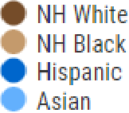
Race and Ethnicity Comparison of Education Indicators
White advantage can be defined as a condition or circumstance that places a White individual at a more advantageous or favorable position compared to others.
When examining education related outcomes, the data shows that NH Black and Hispanic students are between 2-5 times more likely to have a poor academic experience compared to NH White students within the school system. NH White students are only 20% as likely as NH Black students to be suspended or expelled from school in grades K-12.²¹NH White students are only 19% as likely to drop out of high school compared to Hispanic students in Howard County.
Likelihood of White Students to Experience Outcomes Compared to Black Students, 2019
100%
Relative Rate Index (% Likelihood)
White Advantage
50%
0%
Not Ready for Kindergarten
Not on Track in 9th Grade
Suspension and Expulsion in K-12
Chronically Absent in HS
Do not Have Access to Well Rounded HS Curriculum
Drop Out of HS
Not Ready for Post Secondary Education
Times More Likely to Have Poor Education Experience Compared to NH White Students, 2019
Likelihood of White Students to Experience Outcomes Compared to Hispanic Students, 2019
Relative Rate Index (Times More Likely to Have Worse Outcome)
Not Ready for Kindergarten
1.8
2.1
100%
3
3
Relative Rate Index (% Likelihood)
Not on Track in 9th Grade
White Advantage
No Access to Well Rounded HS
Curriculum
2.5
2.5
50%
Not Ready for Post Secondary Education
3.3
3.8
Suspension and Expulsion in K-12
2
1.9
2.2
2
5.1
0%
Not Ready for Kindergarten
Not on Track in 9th Grade
Suspension and Expulsion in K-12
Chronically Absent in HS
Chronically Absent in HS
Do not Have Access to Well Rounded HS Curriculum Drop Out of HS
Not Ready for Post Secondary Education
Drop Out of HS
5.3
0
2
4
6
8
10

Slide 44

Race and Ethnicity Comparison of Health Indicators
Birth Related Outcomes
As noted earlier, birth outcomes are a strong indicator of overall well-being of a population. The information here highlights some of the racial and ethnic comparisons within Howard County.
Asian women in Howard County are 1.7 times more likely to have a baby born at low birth weight compared to NH White women.
Rate of Pregnancy and Birth Outcomes by Race/Ethnicity, 2019
11, 23
60%
40%
40.4
32.7
_{29.5 30.2} 31.7
20%
14.5
10.3
7.2
8.5
5.5 5.7
9.5
9.8
5.1
4.4
3.8
2.7
3.6
NH Black women in Howard County are
2.3 times more likely to experience an infant death than NH White women.
Hispanic and NH Black women in Howard County are 5.3 and 3.6 times more likely to receive late or no prenatal care compared to White women.
Similarly to NH Black women across the US, those in Howard County have higher rates of C-section deliveries than other women. Research has shown that C- Sections increase the risk of delivery complications.
State and Jurisdictional Comparison: At a mortality rate of 10.3 per 1000 births, Black women in Howard County have an Infant death rate higher than the state average (9.3) and Montgomery (6.2), Prince George's (7.3) and Anne Arundel (8.3) Counties.
0%
Infant Mortality
Low Birth Weight
Late or No Prenatal Care
C-Section Birth
All
NH Black
NH White
Hispanic
Asian
Likelihood of NH White Women to Experience Birth Outcomes Compared to NH Black Women
100%
Relative Rate Index (% Likelihood)
White Advantage
50%
0%
Infant Mortality
Low Birth Weight
Late/No Prenatal Care NH White C-Section Birth

Slide 45

Race and Ethnicity Comparison of Health Indicators
Mental Health
Mental health is one of the leading causes of disability world wide, with suicide being a leading cause of death among young people ages 15-29. Additionally, people with mental illness face stigma, poorer physical health, and die on average 10-25 years earlier than the general population².⁵
Felt Stressed or Worried in Last 12 Months About Having Money for Basic Needs, 2021
Felt Depressed/Hopeless Everyday for Past 2 weeks, 2021
40%
30%
20%
21%
17%
10%
8%
7%
3%
100%
0%
NH
Black
NH
White
Hispanic
Asian
Other
46%
57%
57%
50%
33%
44%
Child In Household Diagnosed with Depression/Anxiety, 2021
40%
0%
NH Black NH White Hispanic Asian Other
Parents in Howard County with less than a high school diploma had the highest likelihood of having a child experiencing or diagnosed with depression/anxiety.²⁴
Hispanic residents were 5.7 times more likely than NH White residents and 2.1 times more likely than NH Black residents to report feeling depressed or hopeless
24
everyday for 2 or more weeks at a time.
30%
30%
24%
23%
20%
10%
8%
0%
NH Black
NH White
Asian
Other
20

Slide 46
Race and Ethnicity Comparison Health Indicators
Student Mental Health
Hispanic students in Howard County report worse mental and emotional health experiences than students of other racial and ethnic groups. They are 5 times more likely to skip school because they do not feel safe and 3 times more likely to report being threatened with a weapon compared to NH White students. ²⁶
For students across the state, a greater percent of each group reported feeling unsafe or threatened with a weapon compared to students in Howard County. However, the within county difference in experiences among students was greater than the state overall (refer to table below).
Mental and Emotional Well-Being of Howard County HS Students, 2019
40%
39.2%
28.4%
30.8%
26.4%
20%
_{16.5%} 18.3% _{15.6%} 18.4%
20.6%
15.9% 16%
13.6%
0%
Felt Sad/Hopeless
Had Suicidal Thoughts
Made a Suicide Plan
All Students
Black Students
White Students
Hispanic Students
Social Safety and Well-Being of Howard County HS Students, 2019
40%
At the state level Hispanic students are 2 times more likely to feel unsafe and 1.4 times as likely to have been threatened compared to NH White
students.
Population | Felt Unsafe | RRI Scor e | Threatene d | RRI Score
Maryland | 9.2% |  | 7.8%
NH White | 6.7% | Ref. | 6.1% | Ref.
NH Black | 9.3% | 1.4 | 8.3% | 1.4
Hispanic | 13.1% | 2.0 | 8.3% | 1.4
Howard Co. | 4.6% |  | 5.4%
NH White | 2.2% | Ref. | 2.8% | Ref.
NH Black | 4.5% | 2.0 | 6.9% | 2.5
Hispanic | 11.9% | 5.4 | 8.8% | 3.1
20%
20%
21.9%
16.3%
18.2%
16.2%
16.3%
11.9%
14.1%
13.4%
_{5.4%} 6.9%
8.8%
4.6%
4.5%
2.2%
2.8%
0%
ref.
Skipped School...Felt Unsafe
Threatened w/Weapon At School
Bullied At School
Victim of Emotional Abuse
All Students
Black Students
White Students
Hispanic Students

Slide 47
Student Indicators of Mental Health
LGBTQ Student Mental Health
Students in Howard County who identify as LGBTQ are more likely to report poorer social and emotional experiences than heterosexual students.
Likelihood of LGBTQ Youth Experiencing Outcomes Compared to Heterosexual Youth, 2019
6x's
4x's
4x's
3.8x's
2.7x's
3.3x's
2.7x's
LGBTQ students are 4 times more likely to have thoughts of suicide and 3.8 times as likely to report skipping school because they felt unsafe.²⁷
1.9x's
2.3x's
2x's
1x's 1x's 1x's 1x's 1x's 1x's 1x's
0x's
Felt Sad/Hopeless
Had Suicidal Thoughts
Made a Suicide Plan
Bullied in School
Victim of Emotional Abuse
Skipped School...Felt Unsafe
Threatened w/Weapon at School
Social and Emotional Health Outcomes For LGTBQ and Heterosexual Youth , 2019
100%
Likelihood of Heterosexual Youth to Experience Outcomes Compared to LGBTQ Youth, 2019
63.9%
100%
50%
49.1%
39.9%
Heterosexual Advantage
28.3%
30.8%
23.4%
50%
12.4% _{11.4%}
12.2%12.2% ^{14.7%}
_{3.3%} 4.2%
13.4%
0%
LGBTQ Youth
Heterosexual Youth
0%
Felt Sad/Hopeless Suicidal Thoughts
Suicide Plan
Bullied in School
Felt Sad/Hopeless
Had Suicidal Thoughts
Made a Suicide Plan
Bullied in School
Skipped School...Felt Unsafe Victim of Emotional Abuse
Threatened w/ Weapon at School
Skipped School...Felt Unsafe
Victim of Emotional Abuse
Threatened w/Weapon at School

Slide 48
Race and Ethnicity Comparison of Health Indicators
Obesity is an important indicator of health as it is a common risk factor for health conditions including diabetes, heart disease and some cancers. A person is considered obese if they have a body mass index (BMI) above 30. In Howard County, NH Black residents are more likely to die of cancer and diabetes than NH White residents. Research has also shown that in high income countries like the US, obesity is often associated with low income and food insecure communities.²⁴
Diabetes Diagnosis, 2019
20%
15%
12.3%
10.8%
Reported Obesity Within the Population, 2021
10%
60%
6.1%
5%
50%
40%
37%
0%
Howard County
NH Black
NH White
30%
27%
27%
25%
NH Black residents are 2 times as likely to be diagnosed with diabetes compared to NH White residents.
NH Black residents are 4 times as likely to visit the ER due to diabetes complications than NH White residents. ²⁸
20%
10%
7%
0%
Howard County
NH Black
NH White
Asian
Other
Note: BMI= [(weight/height^2)*703]

Slide 49
Race and Ethnicity Comparison of Health Indicators
Percent of Residents Uninsured, 2016-2020
Healthcare Access
In their report on "The Uninsured and the ACA" the Kaiser Family Foundation discusses how insurance status is key to health, as those without insurance tend to put off seeking needed care or forego treatment services altogether.²⁹
Uninsured individuals are less likely to get preventative screenings and do not have regular providers or a place to go when medical care is needed.²⁴
12.5%
10%
10.4%
7.5%
5%
4.8%
4.8%
3.8%
2.5%
2.9%
2.1%
Percent of Residents Identifying the ER as Usual Healthcare Provider, 2021
0%
Howard County
NH
Black
NH
White
Asian
Native American
Other
15%
10%
9%
Howard County residents that make $50,000 or less are most likely to go to the ER when sick
5%
4%
4%
NH Black residents are 3 times as likely as NH White residents to use the ER as their usual healthcare provider
3%
2%
0%
Howard County
NH Black
NH White
Asian
Other

Slide 50
Race and Ethnicity Comparison of Socioeconomic Indicators
There are socioeconomic differences within the county, based on racial and ethnic identity. All people of color within the county have higher rates of unemployment than NH White residents. NH Black residents are approximately 4 times as likely to be in poverty and experience outcomes such as homelessness and food insecurity. ^{7, 26, 30}
Race and Ethnicity of Homelessness Students, 2019-2020 School Year
Financial Instability
Unemployment Rate by Race/Ethnicity, 2019
10%
7.5%
5%
5%
5%
Multi-Racial: 9.0 %
3.9%
4.1%
3.6%
NH White: 8.0 %
Asian: 2.0 %
3.2%
2.5%
0%
Howard County
NH Black
Hispanic
Asian
NH White
Native American
Hispanic: 18.0 %
NH Black: 63.0 %
Percent of Residents in Poverty by Race/Ethnicity, 2019
15%
Percent of Students Reporting Food Insecurity by Race and Ethnicity, 2019
50%
10.7%
10%
25%
23.8%
5.1%
5.6%
5.2%
4.8%
10.9%
16.4%
5%
2.9%
5.3%
0%
Howard County
NH Black
Hispanic
NH White
0%
Howard County
NH Black
Hispanic
Asian
NH White
Native American

Slide 51
Race and Ethnicity Comparison of Socioeconomic Indicators
Education and Income
In Howard County, 2 in 5 adults have a bachelors degree or higher. However a lower percentage of Hispanic and NH Black residents have a post secondary degree compared to other groups.⁷
Percent with BA/BS Degree or Higher, 2016-2020
Median Household Income by Race/Ethnicity, 2010-2019
$150,000
$134,635
$131,332
$121,160
$100,000
$94,192
$95,326
100%
$50,000
75%
71.9%
62.7%
63.4%
53.9%
$0
Howard County
NH Black
Hispanic
Asian
NH White
50%
40.7%
25%
High and Low Income Brackets by Race/Ethnicity, 2018
60%
0%
Howard County
NH Black
Hispanic
Asian
NH White
40%
25%
27%
A greater proportion of NH Black residents are represented in the lowest household income bracket compared to NH White, Asian and Hispanic residents while they also account for the smallest proportion of the highest household income bracket.³¹
20%
17%
15%
12%
8%
9%
8%
0%
NH Black
NH White
Asian
Hispanic
Low (<$30k)
High (>$200k)
26

Slide 52
Race and Ethnicity Comparison of Socioeconomic Indicators
Trend Median Household Income
In 2010, NH White households earned an income of
$111,133. This amount was $36,000 more than NH Black households, $31,000 more than Hispanic households and $1,896 more than Asian households in the county. A decade later that gap has disappeared for Asian households who now earn approximately $3,300 more than NH White households. However, for Hispanic and NH Black households the gap has widened.³⁰
Trend In Howard County Median Household Income, 2010-2019
$150,000
$125,000
$100,000
$75,000
In 2019, Hispanic households had an average household income that was approximately
$36,000 less than NH White households. This
gap has increased by almost $6,000 since 2010.
$50,000
$25,000
$0
2010 2011 2012 2013 2014 2015 2016 2017 2018 2019
NH Black households had an average household income that was approximately $37,000 less
than NH White households in 2019. This gap has
increased by almost $1,000 since 2010.
NH Black
NH White
Hispanic
Asian

Slide 53
Race and Ethnicity Comparison of Housing Indicators
Housing Cost Burden
Housing cost burden is defined as having rent or ownership costs that are 30% or more of household income. In Howard County 3 out of 5 residents are considered cost burdened.⁷
Percent of Howard County Racial/Ethnic Groups That Are Renters, 2020
100%
75%
50%
47%
38%
25%
27%
28%
Cost Burdened Residents in Howard County, 2016-2020
Cost Burdened Renters: 42%
19%
0%
All Renters
NH Black
NH White
Hispanic
Asian
Non Cost Burdened Residents: 39%
Cost Burdened Home Owners: 19%
Median Gross Rent, 2016-2020
$2,000
$1,731
In Howard County, 1 in 4 residents rent their homes. Renters pay the 2nd highest rent in the state, which is approximately $300 more than the state average. Hispanic and NH Black residents are 2-2.5 times more likely to be renters compared to NH White residents. Asian residents are
1.5 times as likely to rent their homes. ³²
$1,500
$1,415
$1,000
$500
Though 1 in 5 home owners are cost burdened, renters are twice as likely to be cost burdened compared to home owners.
$0
Maryland
Howard County

Slide 54
Race and Ethnicity Comparison of Housing Indicators
High Cost Home Loans
High Cost Home Loans are those loans where the annual percentage rate (APR) is 1.5 percentage points higher than the estimated average prime offer rate (APOR).³²
NH Black and Hispanic residents were twice as likely to be given a high cost loan in 2020 compared to White residents, even though White residents made up a greater proportion of loan recipients. Even as the percentage of high cost loans to each racial and ethnic group has risen and fallen over time, the gap between NH Black and Hispanic residents compared to NH White residents has persisted.
Percent of Total High Cost Loans, 2020
Other: 19.2 %
NH Black: 23.4 %
Asian: 10.7 %
Hispanic: 8.7 %
NH White: 37.9 %
Percent of Home Loans That Are High Cost by Race/Ethnicity, 2020
Trend in Home Loans That Are High Cost by Race/Ethnicity, 2010-2020
20%
Percent of Loans Made To Racial/Ethnic Group
15%
15%
10%
9.4%
10.6%
10%
5%
5%
4.7%
4.2%
3.3%
0%
2010 2011 2012 2013 2014 2015 2016 2017 2018 2019 2020
0%
All Loans
NH Black
NH White
Hispanic
Asian
NH Black
NH White
Hispanic
Asian

Slide 55
Race and Ethnicity Comparison of Housing Indicators
Home Loan Denials
For individuals applying for mortgage loans in Howard County, 8.6% were denied approval in 2020. Rates of loan denials varied by race and ethnicity, where NH Black, Hispanic, and Asian applicants are more likely to be denied loans compared to NH White applicants (3 times, 2.6 times, and 2.2 times respectively).³²
These differential experiences in a place like Howard County, where the median household income for NH Black and Hispanic residents is more than $90,000, demonstrate the systemic inequity in the home buying and lending process even among groups of higher socioeconomic status. These experiences have far reaching impact on family and community wealth building opportunities for NH groups.
Percent of Applicants Denied a Home Loan by Race/Ethnicity, 2020
20%
15.1%
13.2%
8.6%
11.2%
10%
5.1%
0%
All
Applicants
Black
Applicants
White
Applicants
Hispanic Applicants
Asian
Applicants
Likelihood of NH Whites Experiencing Housing Outcomes, 2020
100%
Relative Rate Index (% Likelihood)
75%
White Advantage vs. NH Black
White Advantage vs. Hispanic
White Advantage vs. Asian
NH Whites are likely to be denied a home loan at one-third the rate of NH Black residents and half as likely to be given a high-cost loan.
50%
For every 5 Hispanic residents denied a home loan or given a high-cost loan, 2 NH White
residents are denied or given a high-cost loan.
25%
NH White residents are half as likely to be denied a home loan compared to Asian residents.
0%
Loan Denial
High Cost Loan
Loan Denial
High Cost Loan
Loan Denial
High Cost Loan
30

Slide 56
Race and Ethnicity Comparison of Health Indicators
Obesity is an important indicator of health as it is a common risk factor for health conditions including diabetes, heart disease and some cancers. A person is considered obese if they have a body mass index (BMI) above 30. In Howard County, NH Black residents are more likely to die of cancer and diabetes than NH White residents. Research has also shown that in high income countries like the US, obesity is often associated with low income and food insecure communities.²⁴
Diabetes Diagnosis, 2019
20%
15%
12.3%
10.8%
Reported Obesity Within the Population, 2021
10%
60%
6.1%
5%
50%
40%
37%
0%
Howard County
NH Black
NH White
30%
27%
27%
25%
NH Black residents are 2 times as likely to be diagnosed with diabetes compared to NH White residents.
NH Black residents are 4 times as likely to visit the ER due to diabetes complications than NH White residents. ²⁸
20%
10%
7%
0%
Howard County
NH Black
NH White
Asian
Other
Note: BMI= [(weight/height^2)*703]

Slide 57
Race and Ethnicity Comparison of Health Indicators
Percent of Residents Uninsured, 2016-2020
Healthcare Access
In their report on "The Uninsured and the ACA" the Kaiser Family Foundation discusses how insurance status is key to health, as those without insurance tend to put off seeking needed care or forego treatment services altogether.²⁹
Uninsured individuals are less likely to get preventative screenings and do not have regular providers or a place to go when medical care is needed.²⁴
12.5%
10%
10.4%
7.5%
5%
4.8%
4.8%
3.8%
2.5%
2.9%
2.1%
Percent of Residents Identifying the ER as Usual Healthcare Provider, 2021
0%
Howard County
NH
Black
NH
White
Asian
Native American
Other
15%
10%
9%
Howard County residents that make $50,000 or less are most likely to go to the ER when sick
5%
4%
4%
NH Black residents are 3 times as likely as NH White residents to use the ER as their usual healthcare provider
3%
2%
0%
Howard County
NH Black
NH White
Asian
Other

Slide 58
Race and Ethnicity Comparison of Socioeconomic Indicators
There are socioeconomic differences within the county, based on racial and ethnic identity. All people of color within the county have higher rates of unemployment than NH White residents. NH Black residents are approximately 4 times as likely to be in poverty and experience outcomes such as homelessness and food insecurity. ^{7, 26, 30}
Race and Ethnicity of Homelessness Students, 2019-2020 School Year
Financial Instability
Unemployment Rate by Race/Ethnicity, 2019
10%
7.5%
5%
5%
5%
Multi-Racial: 9.0 %
3.9%
4.1%
3.6%
NH White: 8.0 %
Asian: 2.0 %
3.2%
2.5%
0%
Howard County
NH Black
Hispanic
Asian
NH White
Native American
Hispanic: 18.0 %
NH Black: 63.0 %
Percent of Residents in Poverty by Race/Ethnicity, 2019
15%
Percent of Students Reporting Food Insecurity by Race and Ethnicity, 2019
50%
10.7%
10%
25%
23.8%
5.1%
5.6%
5.2%
4.8%
10.9%
16.4%
5%
2.9%
5.3%
0%
Howard County
NH Black
Hispanic
NH White
0%
Howard County
NH Black
Hispanic
Asian
NH White
Native American

Slide 59
Race and Ethnicity Comparison of Socioeconomic Indicators
Education and Income
In Howard County, 2 in 5 adults have a bachelors degree or higher. However a lower percentage of Hispanic and NH Black residents have a post secondary degree compared to other groups.⁷
Percent with BA/BS Degree or Higher, 2016-2020
Median Household Income by Race/Ethnicity, 2010-2019
$150,000
$134,635
$131,332
$121,160
$100,000
$94,192
$95,326
100%
$50,000
75%
71.9%
62.7%
63.4%
53.9%
$0
Howard County
NH Black
Hispanic
Asian
NH White
50%
40.7%
25%
High and Low Income Brackets by Race/Ethnicity, 2018
60%
0%
Howard County
NH Black
Hispanic
Asian
NH White
40%
25%
27%
A greater proportion of NH Black residents are represented in the lowest household income bracket compared to NH White, Asian and Hispanic residents while they also account for the smallest proportion of the highest household income bracket.³¹
20%
17%
15%
12%
8%
9%
8%
0%
NH Black
NH White
Asian
Hispanic
Low (<$30k)
High (>$200k)
26

Slide 60
Race and Ethnicity Comparison of Socioeconomic Indicators
Trend Median Household Income
In 2010, NH White households earned an income of
$111,133. This amount was $36,000 more than NH Black households, $31,000 more than Hispanic households and $1,896 more than Asian households in the county. A decade later that gap has disappeared for Asian households who now earn approximately $3,300 more than NH White households. However, for Hispanic and NH Black households the gap has widened.³⁰
Trend In Howard County Median Household Income, 2010-2019
$150,000
$125,000
$100,000
$75,000
In 2019, Hispanic households had an average household income that was approximately
$36,000 less than NH White households. This
gap has increased by almost $6,000 since 2010.
$50,000
$25,000
$0
2010 2011 2012 2013 2014 2015 2016 2017 2018 2019
NH Black households had an average household income that was approximately $37,000 less
than NH White households in 2019. This gap has
increased by almost $1,000 since 2010.
NH Black
NH White
Hispanic
Asian

Slide 61
Race and Ethnicity Comparison of Housing Indicators
Housing Cost Burden
Housing cost burden is defined as having rent or ownership costs that are 30% or more of household income. In Howard County 3 out of 5 residents are considered cost burdened.⁷
Percent of Howard County Racial/Ethnic Groups That Are Renters, 2020
100%
75%
50%
47%
38%
25%
27%
28%
Cost Burdened Residents in Howard County, 2016-2020
Cost Burdened Renters: 42%
19%
0%
All Renters
NH Black
NH White
Hispanic
Asian
Non Cost Burdened Residents: 39%
Cost Burdened Home Owners: 19%
Median Gross Rent, 2016-2020
$2,000
$1,731
In Howard County, 1 in 4 residents rent their homes. Renters pay the 2nd highest rent in the state, which is approximately $300 more than the state average. Hispanic and NH Black residents are 2-2.5 times more likely to be renters compared to NH White residents. Asian residents are
1.5 times as likely to rent their homes. ³²
$1,500
$1,415
$1,000
$500
Though 1 in 5 home owners are cost burdened, renters are twice as likely to be cost burdened compared to home owners.
$0
Maryland
Howard County

Slide 62
Race and Ethnicity Comparison of Housing Indicators
High Cost Home Loans
High Cost Home Loans are those loans where the annual percentage rate (APR) is 1.5 percentage points higher than the estimated average prime offer rate (APOR).³²
NH Black and Hispanic residents were twice as likely to be given a high cost loan in 2020 compared to White residents, even though White residents made up a greater proportion of loan recipients. Even as the percentage of high cost loans to each racial and ethnic group has risen and fallen over time, the gap between NH Black and Hispanic residents compared to NH White residents has persisted.
Percent of Total High Cost Loans, 2020
Other: 19.2 %
NH Black: 23.4 %
Asian: 10.7 %
Hispanic: 8.7 %
NH White: 37.9 %
Percent of Home Loans That Are High Cost by Race/Ethnicity, 2020
Trend in Home Loans That Are High Cost by Race/Ethnicity, 2010-2020
20%
Percent of Loans Made To Racial/Ethnic Group
15%
15%
10%
9.4%
10.6%
10%
5%
5%
4.7%
4.2%
3.3%
0%
2010 2011 2012 2013 2014 2015 2016 2017 2018 2019 2020
0%
All Loans
NH Black
NH White
Hispanic
Asian
NH Black
NH White
Hispanic
Asian

Slide 63
Race and Ethnicity Comparison of Housing Indicators
Home Loan Denials
For individuals applying for mortgage loans in Howard County, 8.6% were denied approval in 2020. Rates of loan denials varied by race and ethnicity, where NH Black, Hispanic, and Asian applicants are more likely to be denied loans compared to NH White applicants (3 times, 2.6 times, and 2.2 times respectively).³²
These differential experiences in a place like Howard County, where the median household income for NH Black and Hispanic residents is more than $90,000, demonstrate the systemic inequity in the home buying and lending process even among groups of higher socioeconomic status. These experiences have far reaching impact on family and community wealth building opportunities for NH groups.
Percent of Applicants Denied a Home Loan by Race/Ethnicity, 2020
20%
15.1%
13.2%
8.6%
11.2%
10%
5.1%
0%
All
Applicants
Black
Applicants
White
Applicants
Hispanic Applicants
Asian
Applicants
Likelihood of NH Whites Experiencing Housing Outcomes, 2020
100%
Relative Rate Index (% Likelihood)
75%
White Advantage vs. NH Black
White Advantage vs. Hispanic
White Advantage vs. Asian
NH Whites are likely to be denied a home loan at one-third the rate of NH Black residents and half as likely to be given a high-cost loan.
50%
For every 5 Hispanic residents denied a home loan or given a high-cost loan, 2 NH White
residents are denied or given a high-cost loan.
25%
NH White residents are half as likely to be denied a home loan compared to Asian residents.
0%
Loan Denial
High Cost Loan
Loan Denial
High Cost Loan
Loan Denial
High Cost Loan
30

Slide 64


Race and Ethnicity Comparison of Legal System Indicators
Traffic Stops
Traffic stops are a way to assess the relationship between residents and the legal system. In Howard County, NH White and NH Blacks each account for 40% of the traffic stops.
However, when you consider population size, NH Blacks are
2.5 times more likely to be stopped.³³
Traffic Stops by Howard County Police Dept, 2016-2020
Rate of Traffic Stops by Race/Ethnicity, 2016-2020
100%
50%
48.8%
19.3%
25.9%
Other: 5%
Asian: 7.4%
Hispanic: 7.6%
9.2%
0%
NH Black
NH White
Hispanic
Asian
NH Black: 40%
Percent of Traffic Stops by HCPD Resulting in Searches and Arrests, 2016-2020
10%
NH White: 40%
6.1%
5.7%
5.8%
Once stopped by police, NH Blacks are 1.5 times more likely to be searched and arrested. Hispanics account for 7.6% of traffic stops and are 1.3 times as likely as NH Whites to be stopped. They are also 1.6 times as likely to be searched and
1.9 times as likely to be arrested.
5%
4.5%
3.7%
4.5%
3.8%
3.1%
1.8%
1.5%
0%
Howard County
NH Black
NH White
Hispanic
Asian
Stops Resulting in Searches
Stops Resulting in Arrest

Slide 65
Race and Ethnicity Comparison of Legal System Indicators
Household Member Incarceration
Percent of Students Reporting Household Member Incarceration In Maryland, 2018-2019
Another indicator of the relationship to the legal system is incarceration. In Howard County, approximately 13% of students reported having a household member who had spent time in jail or prison. While this rate is one-half the rate across the state, the within county experiential difference between racial and ethnic groups was greater: 6.7% of NH White students reported having a household member who experienced incarceration compared to 21.1% of NH Black and 25.2% of Hispanic students.²⁶
60%
40%
33.3%
3x's
Black and Hispanic students in Howard County are 3x's as likely to report having an incarcerated household member
23.7%
25.2%
20%
17.2%
0%
Maryland NH Black NH White Hispanic
Percent of Students Reporting Household Member Incarceration In Howard County, 2018-2019
Likelihood of Household Member Incarceration, 2018-2019
60%
NH White
1.0
NH Black (MD)
1.9
40%
NH Black (HC)
3.3
22.1%
25.2%
Hispanic (MD)
1.5
20%
12.6%
6.7%
Hispanic (HC)
3.8
0%
0
1
2
3
4
5
6
7
8
Howard County
NH Black (HC)
NH White (HC)
Hispanic (HC)

Slide 66
Howard County Racial Differences in System Outcomes (Relative Rate Index)
Education and Healthcare Indicators
Indicator | NH White | NH Black | Hispanic | Asian
Education
No Access to Well-Rounded Curriculum | 1.0 | 2.5 | 2.5 | 0.6
Skipped School Because Felt Unsafe | 1.0 | 2.0 | 5.4 | -
Suspension or Expulsion K-12 | 1.0 | 5.1 | 2.0 | 0.5
Drop Out of School | 1.0 | 2.0 | 5.3 | 1.0
Not Ready For Post Secondary Education | 1.0 | 3.3 | 3.8 | 0.8
Health
Infant Mortality | 1.0 | 2.3 | - | -
Lack Prenatal Care | 1.0 | 3.6 | 5.4 | 1.3
Uninsured | 1.0 | 1.7 | - | 1.7
Emergency Room As Usual Provider | 1.0 | 3.0 | - | 0.7
NH Black students are 2.0-5.1 times more likely to have a negative educational experience compared to NH White students. The increased likelihood of suspension or expulsion for NH Black students clear a path to high school incompletion.
Hispanic students are 2.5-5.4 times more likely to have a poor educational experience compared to NH White students. The increased likelihood of skipping school due to being unsafe and to drop out are elements that reflect a weak school bonding experience.
Education is an established predictor of economic well-being so these differences point to potential long term systemic disparities.
The healthcare experiences of NH Blacks in Howard County are 1.7-3.5 times worse than NH White residents.
Note: When groups have equivalent experiences the RRI will be equal to 1.0 regardless of population size. When the RRI is not equal to 1.0, it can be said that one of the groups is receiving different treatment or having different experiences relative to the group of comparison. For all analysis, NH White is used as the reference group.

Slide 67
Howard County Racial Differences in System Outcomes (Relative Rate Index)
Economic, Housing and Legal Indicators
Indicator | NH White | NH Black | Hispanic | Asian
Economic
Food Insecurity | 1.0 | 4.5 | 3.1 | -
Poverty | 1.0 | 3.2 | 2.3 | 1.8
Unemployment | 1.0 | 2.5 | 1.9 | 1.0
Housing
Do Not Own A Home | 1.0 | 2.5 | 2.0 | 1.5
Denied Home Loan | 1.0 | 3.0 | 2.6 | 2.2
Received High Cost Loan | 1.0 | 2.2 | 2.5 | 0.8
Student Homelessness | 1.0 | 11.7 | 7.0 | -
Legal
Household Member Incarceration | 1.0 | 3.3 | 3.8 | -
Stopped During Traffic | 1.0 | 2.5 | 1.3 | 0.5
Arrested During Traffic Stop | 1.0 | 1.5 | 1.9 | 0.5
NH Black residents of Howard County are 2.5-4.5 times as likely to experience worse economic outcomes than NH White residents, while Hispanic residents are 1.9-3.2 times as likely.
NH Black residents of Howard County are 2.5-11.7 times as likely to experience worse housing outcomes than NH White residents, while Hispanic residents are 2.0-7.0 times as likely. Even though Asian residents have similar economic standing as NH White residents they are
2.2 times as likely to be denied a home loan and 1.5 times as likely to not own a home.
NH Black and Hispanic residents are more likely to come in contact with the legal system. Research has shown these experiences have far reaching impact, negatively affecting economic, education and housing outcomes for children and families.
Note: When groups have equivalent experiences the RRI will be equal to 1.0 regardless of population size. When the RRI is not equal to 1.0, it can be said that one of the groups is receiving different treatment or having different experiences relative to the group of comparison. For all analysis, NH White is used as the reference group.

