Slide 1
2026-2027 Programming
Current Description-
UMBRELLA PROGRAM:
The Columbia, MD Chapter Linked to Wellness Program seeks to strengthen and improve the health and well being of African Americans in Howard County, focused on critical issues negatively impacting the wellbeing of youth ages 17-25 in Howard County. When examining the environmental data for Howard County Maryland, mental wellness is a major concern for the County. Mental wellness is determined by the associated 5 non-medical factors that affect overall well being.. Those factors are health care access, education access economic stability, social and neighborhood environment. We will achieve improvements in Howard County target population well being by partnering with community based, faith based and national organizations , better equipping our target populations with information, strategies and resources that will positively impact their mental, physical and emotional well-being.
Target Participants:
  High school, college (identify partner schools, churches, and organizations)
Measures:
  Quantitative demographic data, qualitative survey data, community partner engagement,
National Alignment:
  Linked to Success, National Mental Health Initiative, Financial Literacy, Classics Through the Ages

Slide 2
UMBRELLA PROGRAM FACET PROPOSED ADDITIONS
HHS Facet
  Expand culminating mental health forum topics and speakers to incorporate other topics contributing to wellbeing
  Coordinate/launch Black Family Day in March 2027, establishing partnerships with community organizations including HCPSS, HCC focusing on providing resources and education on enhancing family wellness, including mental health
STY FACET
  Lead and expand successful virtual sessions incorporating other topics, possibly expanding to hybrid model Work Work with NTS to have the apprenticeship program be a feeder for the seminars that are conducted at HCC.
NTS FACET
  Develop financial literacy education sessions to be added to virtual seminars (leveraging financial literacy book)
  Work with STY to have the apprenticeship program be a feeder for the expanded virtual sessions
  Consider mentoring and other enhancements for the Apprenticeship program
  Recruit new businesses into the apprenticeship program
  Continue to address and potentially expand food insecurity with ITS at HCC
ITS FACET
  Continue to address and potential expand food insecurity with NTS at HCC
  Create awareness campaign for students with emergency needs
ARTS FACET
  Offer Art and or Music as Therapy during the enhanced Mental Health Forum/Black Family Day event
  Work with HCC to offer free Peabody student/faculty concerts/discussions at HCC during the school year

Slide 3
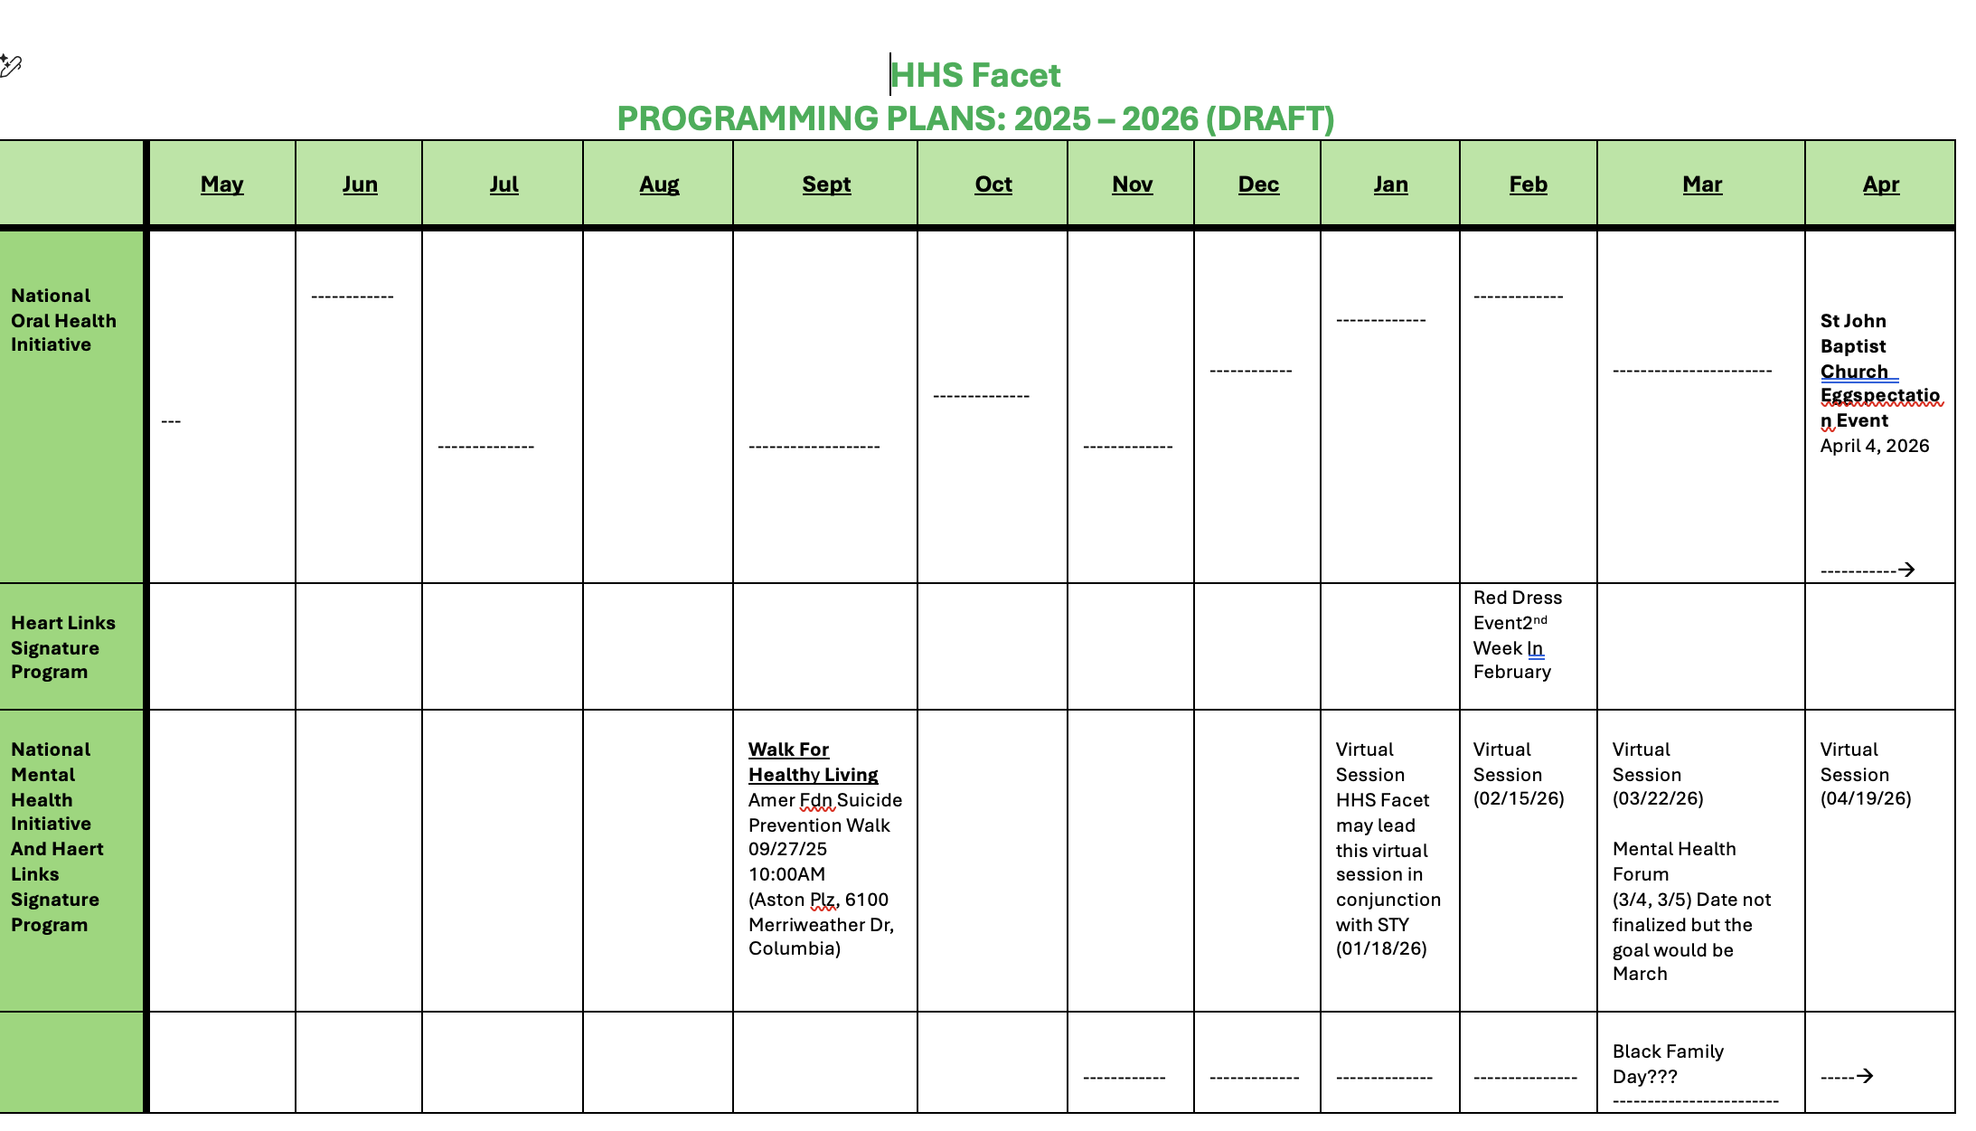

Slide 4
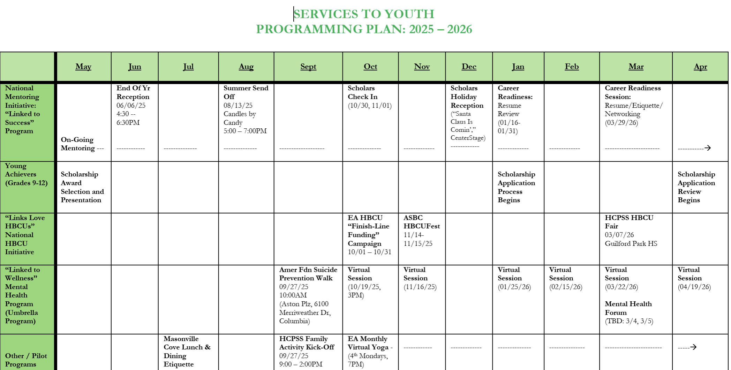

Slide 5
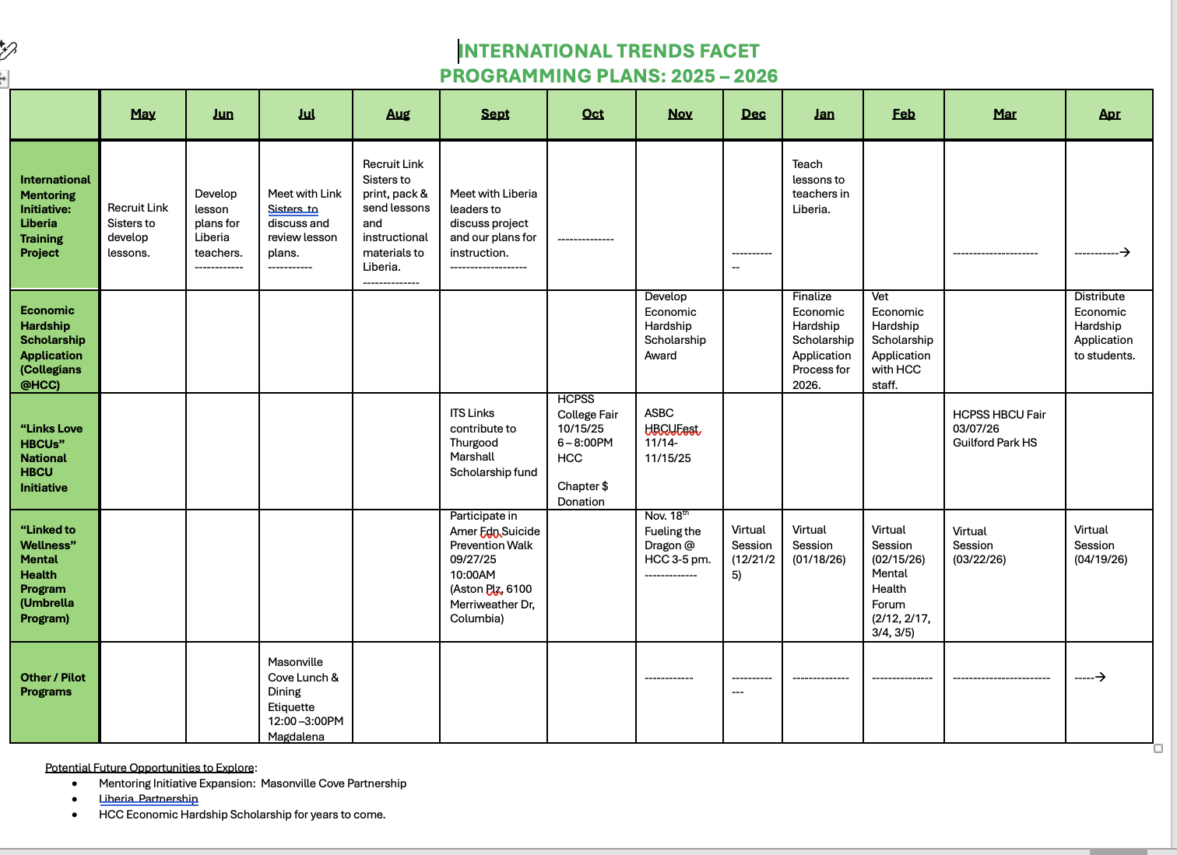

Slide 6
