Slide 1
National Trends and Services Facet
Link Rochelle Michaux-Conway – Chair
Link Paulette Scott – Co-Chair
April 11, 2026

Slide 2
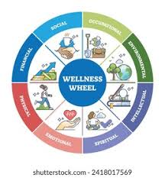

National Trends & Services Facet
LINKED to Wellness Umbrella Program – FY26
Howard Community College
  Fueling Dragons Food Insecurity and Education
  Tuesday, April 21st
  3:00-4:30 pm. Set up 2:30 pm
  Tuesday, March 3rd
  201 lbs. of food
  133 students visited
  Tuesday, November 18th
  284 lbs. of food
  153 students visited

Slide 3
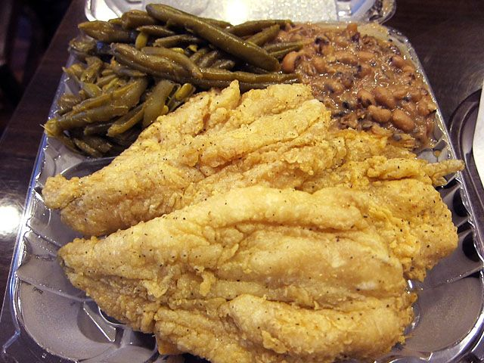
National Trends & Services Facet
Grassroots Intervention Crisis Center FY26
  Food Insecurity Initiative
    Child friendly food drop off March 19th
    Tuesday, April 14th at 3:30 pm (Fish Dinners)
    Child friendly food drop off April 23rd
  Positive Interactions – Game Night
    Tuesday, February 10th 6:30- 8:00 pm
      27 participants
    Tuesday, March 10th 6:30- 8:00 pm
      22 participants
    Tuesday, April 14th 6:30 – 8:00 pm

Slide 4
National Trends & Services Facet
HCPPS Apprenticeship Maryland Program - FY26
  March 9th & April 1st : Scholarship application information submitted
  April 1st : Invitation extended to our virtual Financial Literacy event on April 19th at 3:00 pm

Slide 5

National Trends & Services Facet
National Social Action Initiative Link Up The Vote – 2026
  Voter Registration Engagement & Education
    St. John Baptist Church Social Justice Ministry
    - Collaboration with local faith institutions
    - Volunteers dispersed through out Howard County at places of worship
    - Sundays: May 3rd, 17th, and 31st
    - Schedule
      St. John Baptist Church – 9:00 am and 11:30 am
      First Baptist Church of Gilford – 9:30 am and 1:00 pm
      Celebration Church – Awaiting confirmation
    Call To Action
    - Volunteers Needed (Text or call me)

