Slide 1
National Trends and Services Facet
Link Rochelle Michaux-Conway – Chair
Link Paulette Scott – Co-Chair
May 9, 2026

Slide 2
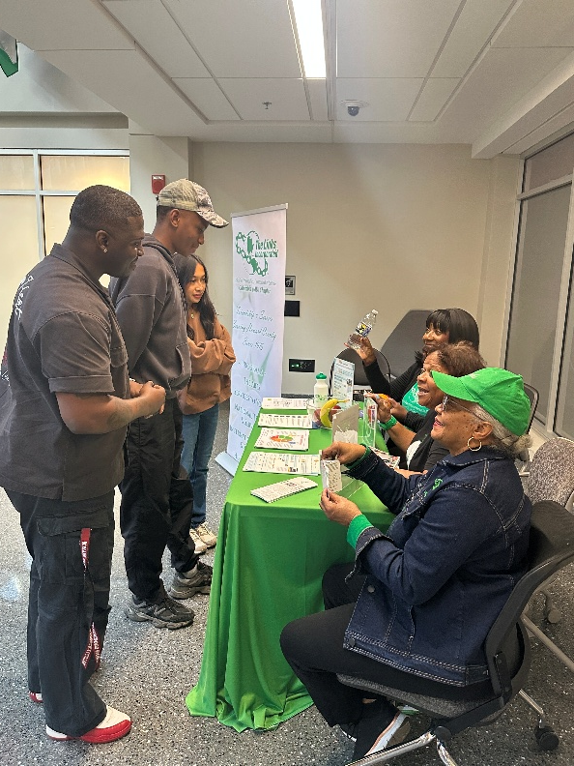
National Trends & Services Facet
LINKED to Wellness Umbrella Program – FY26
Howard Community College
  Fueling Dragons Food Insecurity and Education
  Why It Matters – Eating for Well-being
    Food impacts physical and mental health
    Improving diet can relieve symptoms of depression
  Impact
    Total STUDENTS Served – 456
    Food DONATED to Pantry – 625 lbs.
    Food and beverage nutritional education
  Survey Comments
    Having fresh fruits and veggies to take home always brings a smile to me and my family.
    I love the international food options.
    It helped me through times of food insecurity during the semester.

Slide 3
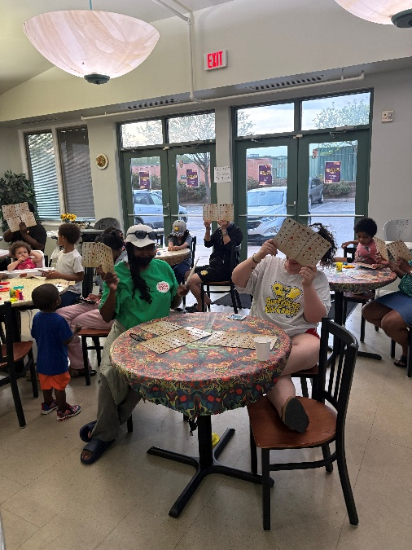
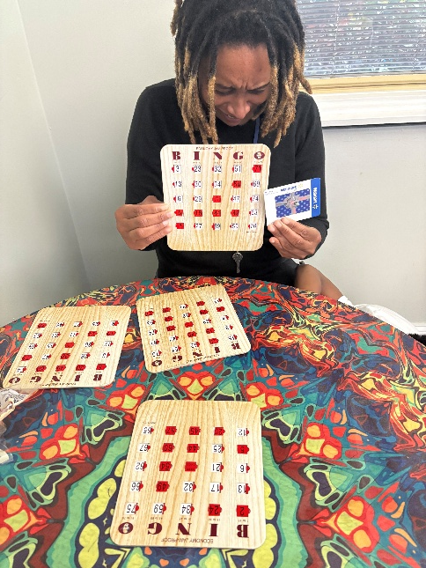
National Trends & Services Facet
Grassroots Intervention Crisis Center FY26
  Why It Matters
    Homelessness impacts mental health
    Social and economic factor are contributors
  Impact
    Minimize food insecurity
      Total RESIDENTS Impacted – 352
      Four Engagements
    Socialization- Positive Interactions
      Total RESIDENTS Impacted – 73
      Three Engagements
    Spreading Love Through Warmth
      Code Blue – 88 Blankets Delivered
  Survey Comments
    A fun community engagement focused activity that was rewarding.
    We were able to connect and have fun.
    Brings joy and laughter!
    Fun activity, I would like to do it again!

Slide 4

National Trends & Services Facet
National Social Action Initiative Link Up The Vote – FY27
  Voter Registration Engagement & Education
    Why It Matters
      Our Vote is Our Power
      Our Vote Can Create Long-Lasting Implications
    Engagement
      St. John Baptist Church Social Justice Ministry
        Collaboration with local faith institutions
        Volunteers dispersed through out Howard County at places of worship
        Sundays: May 3rd (Completed), 17th, and 31st
      Schedule
        St. John Baptist Church – 9:00 am and 11:30 am
        First Baptist Church of Gilford – 9:30 am and 1:00 pm
        Celebration Church – 8:45 am and 10:15 am
    Call To Action
      Volunteers Needed

Slide 5

National Trends & Services Facet
HCPPS Apprenticeship Maryland Program - FY27
  Opening Doors, Building Futures, Strengthening Communities
  Fundraising Initiatives To Begin

