Slide 1
National Trends and Services Facet
Link Rochelle Michaux-Conway – Chair
Link Paulette Scott – Co-Chair
November 18, 2025

Slide 2
National Trends & Services Facet
Agenda
Welcome/Linkspiration
Linked to Wellness - Umbrella Program
Grassroots Crisis Intervention Center Program
HCPPS Apprenticeship Maryland Program
Hands On Community Action
Link Up The Vote
Open Discussion

Slide 3


National Trends & Services Facet
LINKED to Wellness Umbrella Program
FY26 Initiatives
Howard Community College
Fueling Dragons Food Insecurity and Education
  (Completed) November 18, 3:00-5:00 pm
  Fresh fruit and international foods
  Considering personal hygiene products
  Statistics
  December 9th, 3:00-5:00 pm
Howard Community College Mental Health Summit
  Date to be determined

Slide 4
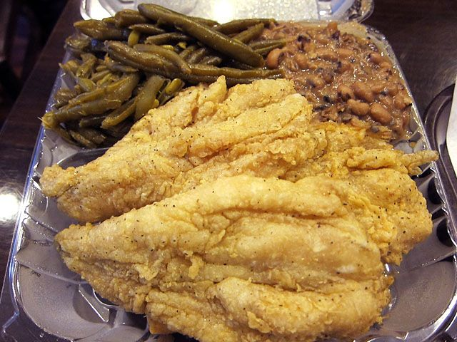

National Trends & Services Facet
Grassroots Intervention Crisis Center
Positive Interaction Game Night
  Tuesday, January 13th, 6:30 – 8:00 pm (Link Donna, Link Judy, Link Rochelle)
  Tuesday, February 10th, 6:30 – 8:00 pm (Link Jo Emily, Link Rochelle
  Tuesday, March 10th, 6:30 – 8:00 pm (Link Jo Emily, Link Rochelle
  Tuesday, April 14th, 6:30 – 8:00 pm (Link Jo Emily, Link Rochelle
  Food Insecurity Initiative/Housing Transition Kits
    3 Meal Events – Delivered November 6th, February, April)
    Housewarming Kits – TBD
  Spreading Love Through Warmth
    70 blankets (GOAL)
    Deliver 55 blankets on November 10th

Slide 5
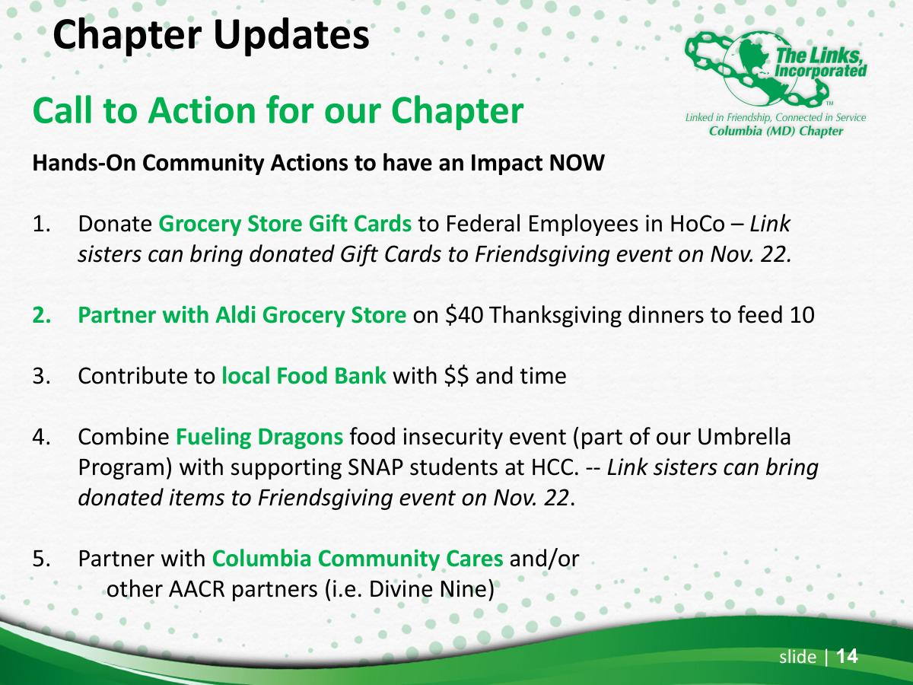
Hands On Community Action

Slide 6
National Trends & Services Facet
HCPPS Apprenticeship Maryland Program
  Updates Link Cathy Bell

Slide 7

National Trends & Services Facet
Link Up The Vote – FY26
  Voter Registration/Identification
    Local high schools (Class of 2026)
    Howard Community College
    Local faith institutions
  Voter Information
  Integrate voter information at events we host
  Host a candidates’ forum with other civic organizations
  Consider social media as opportunity to connect with our youth
  Voter Activation
  Get Out The Vote efforts are vital
  Volunteer at a local polling location
  Phone banking
  Printed materials
  Expand Our Partnerships
  League of Women Voters
  Panhellenic Council
  NCNW
  NAACP
  -
  -

Slide 8

National Trends and Services Facet
Meeting Dates
September 16, 2025 – 7::00 pm (Virtual)
October 21, 2025 – 7:00 pm (Virtual)
November 18, 2025 – 7:00 pm (Virtual)
January 20, 2026 – 7:00 pm (Virtual)
February 17, 2026 – 7:00 pm (Virtual)
March 17, 2026 – 7:00 pm (Virtual)
April 21, 2026 – 7:00 pm (Virtual)

Slide 9

National Trends and Services Facet
Committee Members
Chair – Link Rochelle Michaux-Conway
Co-Chair – Link Paulette Scott
Link Elizabeth Clark-Adams
Link Alice Gail Clark
Link Jewell Debnam
Link Jo Emily Knox
Link Muriel Mitchell
Link Rhonda Ricks
Link Donna Staton
Link Judy Smith
Link Myra Smith

Slide 10


