Slide 1
Welcome!
As you arrive, feel free to drop your name and where you are Zooming in from in the chat. We’ll get started soon!
Sector Support Series – November 2025

Slide 2
The problems that never go away
Working with the tensions that shape your nonprofit
Sector Support Series – November 2025

Slide 3


Hi, I’m Julia
I support people-centered transformation and participatory strategy development for nonprofits and foundations.
julia@peoplecenteredchange.com
Notes:
I’m new at this!

Slide 4
Today’s purpose & intended outcomes
Why are we here, and what do we hope to accomplish?
Purpose
To offer a practical and compassionate way to understand and navigate the persistent tensions that shape organizational life.
Intended outcomes
In service of this purpose, together we will…
Explore why some of the challenges we face in organizational life are not problems to be solved, but tensions to be managed.
Identify core, recurring tensions that show up most often in nonprofit organizations.
Learn about and work with a simple framework that helps us understand how to manage these tensions more productively.
Reflect on how organizational leadership and structure can help teams navigate these dynamics through shared understanding.

Slide 5

We all experience “either / or” tensions in our organizations – situations where we feel like we are pulled in two opposing directions where neither extreme feels quite right.
What is an example of an either / or tension that you’ve grappled with in your organization?

Slide 6
What are tensions, and how do they show up in nonprofit life?

Slide 7


First, let’s start by making a
distinction between problems and tensions.
Problems typically have a clear root cause and have a known or knowable answer. Problems can be effectively solved with the right solution.
Tensions typically have (at least) two valid, competing perspectives, reflect the reality of multiple stakeholders or values, and keep showing up even after you’ve “fixed” them. Tensions require ongoing management – they never go away.
Notes:
Examples:
A leaky faucet is a problem. It has a clear root cause, a knowable solution, and if you execute the solution well, you’ve fixed the leak.
Maintaining balancing on a bicycle is a tension. You don’t “fix” it once – you stay upright by constantly making small adjustments based on what’s happening around you.

Slide 8
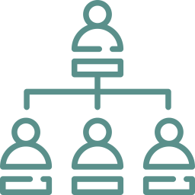



Four common sources of tension
Most of the tensions we experience in nonprofit organizations are rooted in one ore more common sources.
Structure
Values
People
Change
Tensions rooted in how an organization is designed.
Functional mandates, competing priorities, board/staff roles
Tension between what we believe and what we feel pressured to do.
Equity vs. efficiency, participation vs. urgency
Tensions that arise because people have different needs, identities, and realities.
Individual vs. collective needs, generational dynamics
Tensions triggered by planned or emergent growth, evolution, or directional shifts.
Legacy vs. innovation, emerging needs vs. existing programs
Notes:
Ask for examples of each

Slide 9
What can chronic tensions look like?
Persistent or entrenched conflicts between individuals and/or teams with different mandates.
Recognizing chronic tensions is critical, in part because of how easily blame for an undiagnosed tension can be (unfairly) assigned to a person or team.
“Oh, she’s just hard to get along with.”
“Those teams just can’t collaborate with each other.”
“Those people are just resistant to new ideas”.
Meta-conflicts that seem to sit right under the surface of day-to-day challenges.
The formation of organizational factions around critical issues or points of conflict.
Notes:
ASK: What does it look and feel like when your organization is dealing with an unmanaged tension?

Slide 10
Framework for understanding and managing tensions
Notes:
Managing between two viable choices

Slide 11
Using a Polarity Map to manage organizational tensions
Barry Johnson created the Polarity Map to help us more deeply understand, leverage, and manage the tensions or “polarities” that come up in organizational life. It focuses on helping drive shared understanding of a tension, how it manifests, and how to manage it, including:
The positive impact of each polar choice,
The potential negative results of over-focusing on one choice or another, and
What it looks like when you are managing the tension well.
Polarity Map® is a registered trademark of Barry Johnson & Polarity Partnerships, LLC. Commercial use is encouraged with permission.
Notes:
The importance of shard understanding – going back to how easy it is to diagnose a tension as an individual problem or flaw.

Slide 12
Greater purpose statement:
What can we gain by navigating this?
Values
Positive results of focusing on either the left or right pole
Choice A
and
Choice B
Fears
Negative results of over-focusing on one pole to the neglect of the other.
Deeper fear:
What do we lose if we fail?

Slide 13
Greater purpose statement:
Stay alive
Example
Staying alive through respiration
Oxygen flows into our blood stream
Expel toxic gas
Breathe in
and
Breathe out
Buildup of carbon dioxide in our bodies
Start to suffocate due to lack of oxygen
Deeper fear:
We die : /

Slide 14
Greater purpose statement:
???
Example
Balancing risk mitigation & innovation
Mitigate risk
and
Driving innovation
Deeper fear:
???

Slide 15
Greater purpose: Graceful improvement – improve and evolve
Values Good communication Streamlined processes No regulatory or compliance trouble Cost-saving Relieve some kinds of stress | Values Reach new audiences Deepen relationships with current audiences Trailblaze Staff energy and excitement First to market
Option A: Mitigating risk | Option B: Driving innovation
Fears The world leaves us behind Missed opportunities Internal frustration and potential turnover or loss of motivation | Fears BURNOUT We look scattered Forgetting purpose and mission Dry up annual reserves Regulatory trouble
Deeper fear: Crazy and chaotic
Notes:
Polarity Map® is a registered trademark of Barry Johnson & Polarity Partnerships, LLC. Commercial use is encouraged with permission.

Slide 16
Early warning signs
If tension management is all about finding balance near the middle, how do we know that we are over-investing in one choice to the detriment of the other?
Once you’ve mapped out the values and fears related to each choice, you have a clear sense of what you want to move toward and maximize, and what you want to avoid and mitigate.
Then, for each pole, you identify “early warning signs” – signals that you are starting to over-invest in one over the other.
Once you know what those early warning signs are, you can agree on how you want to respond when they show up.

Slide 17
Early warning signs that we are over-focusing on Option A Start to hear people grumbling, “oh we can’t do that because of x policy” We see someone in the market putting something out that we thought about but didn’t pursue Complacency
Greater purpose: Graceful improvement – improve and evolve
Values Good communication Streamlined processes No regulatory or compliance trouble Cost-saving Relieve some kinds of stress | Values Reach new audiences Deepen relationships with current audiences Trailblaze Staff energy and excitement First to market
Option A: Mitigating risk | Option B: Driving innovation
Fears The world leaves us behind Missed opportunities Internal frustration and potential turnover or loss of motivation | Fears BURNOUT We look scattered Forgetting purpose and mission Dry up annual reserves Regulatory trouble
Deeper fear: Crazy and chaotic
Early warning signs that we are over-focusing on Option B We incur costs we can’t cover Staff are spread too thin – more sick days, leveraging more PTO

Slide 18
Testing it out on a real example

Slide 19



Let’s give this a try
In groups, I’m inviting you to pick a real, live tension that you or one of your colleagues is facing and to explore how you might manage it using polarity mapping.
Identify a real tension one of you is facing
Ask clarifying questions to help the case owner flesh out their Polarity Map, including:
Greater purpose statement
Deeper fear
Values and fears related to each choice
Possible warning signs
Avoid problem solving – it’s hard but give it a try!

Slide 20
What was that like?
What did that experience feel like?
Did anything surprise you?
What did you learn?
What questions are you left with?

Slide 21
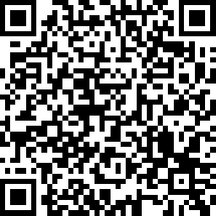
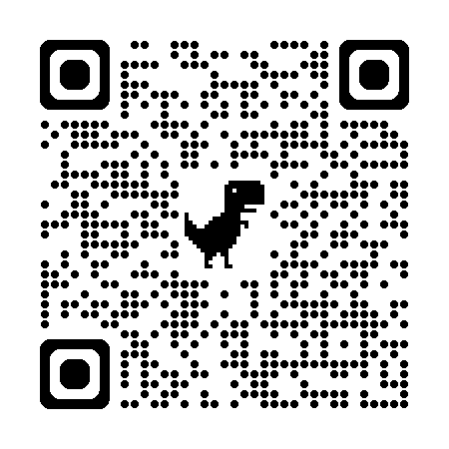
Continuing the conversation
Share feedback
I would love your feedback on this workshop and future topics you’d find valuable – use this QR code to get started!
Get pro bono support
If you want a thought partner to apply what you learned today at your own organization, use this link to sign up for pro-bono office hours!
Notes:
Office hours: https://calendly.com/julia-peoplecenteredchange/office-hours
Feedback: https://www.surveymonkey.com/r/C9FC9T5

Slide 22
Thank you!
It was such a pleasure to be here with you today!!

Slide 23
Early warning signs that we are over-focusing on Option A | Greater purpose: |  | Early warning signs that we are over-focusing on Option B
 | Values | Values
 | Option A: | Option B:
 | Fears | Fears
 | Deeper fear:
Notes:
Polarity Map® is a registered trademark of Barry Johnson & Polarity Partnerships, LLC. Commercial use is encouraged with permission.

