Slide 1




presents
The Dr. Anthony M. Kuchan Ethics Workshop for Psychologists
Beyond Good Intentions:
Ethics, Bias, and Professional Responsibility
Inspired by Jane Elliott’s Brown Eyes, Blue Eyes exercise, adapted for contemporary ethics education
Friday, November 13, 2026
9:00 AM-4:00 PM
Summit Place Office Building
Conference Room 2135
6737 W Washington St
West Allis, WI 53214
SCHEDULE
8:45 - 9:00 AM | Check-in
9:00 - 9:15 AM | Welcome & Introductions
9:15 - 10:30 AM | Session 1
10:30 - 10:45 AM | Break
10:45 -12:00 PM | Session 2
12:00 - 12:30 PM | Lunch (provided)
12:30 - 2:30 PM | Session 3
2:30 - 2:45 PM | Break
2:45 - 4:00 PM | Session 4 & Wrap-Up
Intended Audience: Psychologists, Graduate Students, Mental Health Professionals
FEES
WSPP Students: $15
WSPP Faculty: $25
WSPP Alumni & Other Students: $60
Professionals: $160
Registration and payment must be received by November 9, 2026
For additional information or special accommodations, please call
(414) 464-9777.
Register and pay online at: https://www.wspp.edu/events
OR Submit registration and fee (make check payable to WSPP) via postal mail to: Jodi Rollinger, 6737 W Washington St, Suite 3355 West Allis, WI 53214
Cancelation Policy: WSPP must be notified at least 3 business days prior to the workshop to qualify for a refund, less a $20.00 fee
WSPP is approved by the American Psychological Association to sponsor continuing education for psychologists. WSPP maintains responsibility for the program and its content. This program earns 6 CE credits for those who complete the program in its entirety.

Slide 2
Learning Objectives:
After attending this program, participants will be able to:
Recognize - Identify how bias, assumptions, and social identity can influence perceptions, decisions, and interactions.
Understand - Describe how power, privilege, and group dynamics can shape lived experience and professional behavior.
Reflect - Examine personal reactions, discomfort, and defensiveness in order to better understand individual perspectives and blind spots.
Connect - Link insights from the experience to ethical principles, cultural humility, and professional responsibility.
Evaluate - Consider how bias may affect clinical work, supervision, teaching, and workplace relationships.
Apply - Identify practical strategies to promote fairness, inclusion, accountability, and ethical decision making in professional roles.
        Presenter:
Craig Groskreutz, Psy.D., LPC
Dr. Groskreutz received his doctorate in Clinical Psychology from the Wisconsin School of Professional Psychology. Currently, Dr. Groskreutz works in private outpatient mental health clinics in West Bend and Hartford with Affiliated Clinical Services. In his current position, Dr. Groskreutz is the Director of Mental Health Services and supports the clinical operations of 20 therapists as well as advancing new programming and clinical initiatives to expand services. Additionally, he works with a clinical team to train undergraduate and graduate level students in the mental health field. He also is involved in outcome research with clients undergoing Transcranial Magnetic Stimulation (TMS) for the treatment of Major Depressive Disorders. Dr. Groskreutz is an adjunct instructor at Wisconsin School of Professional Psychology teaching courses on personality theories and social psychology.

Slide 3
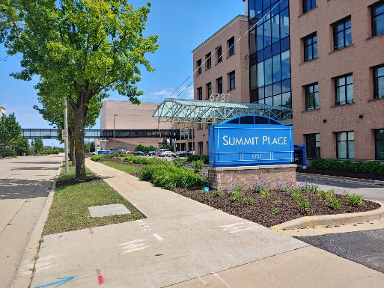
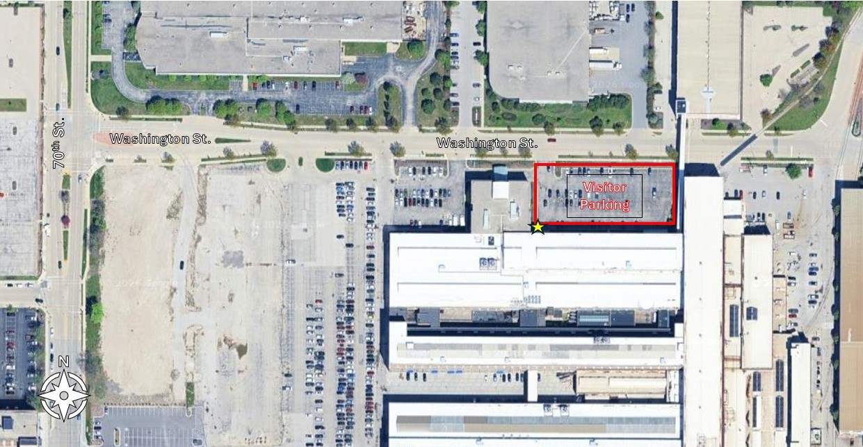
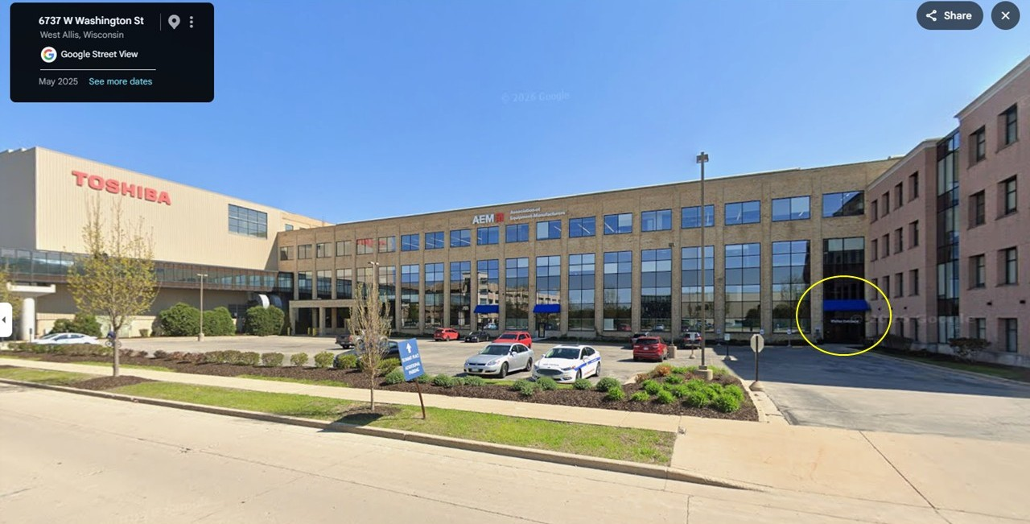
Summit Place Parking Instructions
6737 W Washington St. West Allis, WI is the address for the main entrance/exit to the Summit Place visitor parking area.
Visitor parking is located on the north side of the building just off of Washington St. in the lot located to the east of the large awning/entrance.
After parking in the Washington St. lot, enter the building through the Visitors Entrance under the blue awning on the west side of the parking lot (to the right if you are facing the building). The entrance is circled in yellow.
The conference room is located on the first floor to the southwest of the lobby area, just past the FreshChef Cafe.

