Slide 1

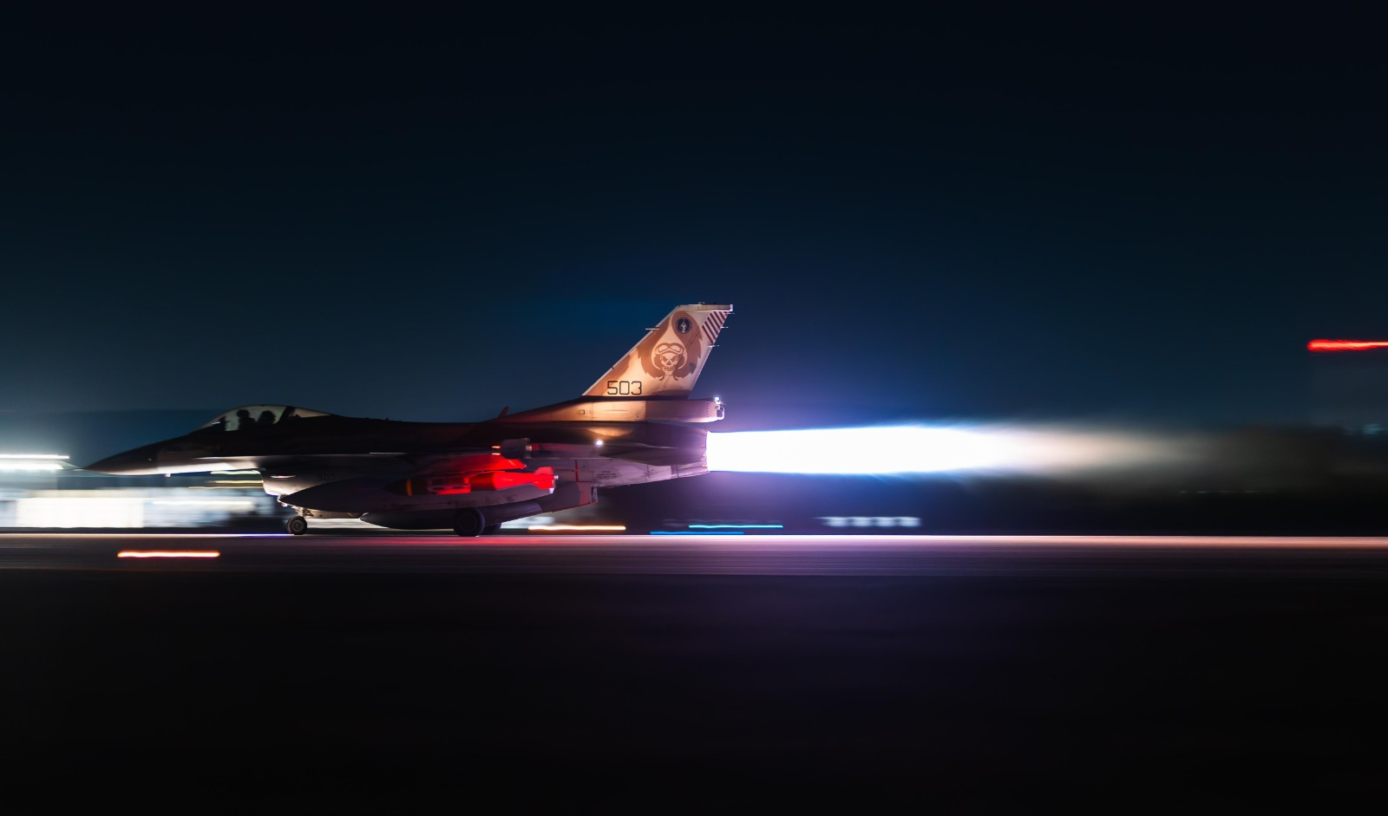
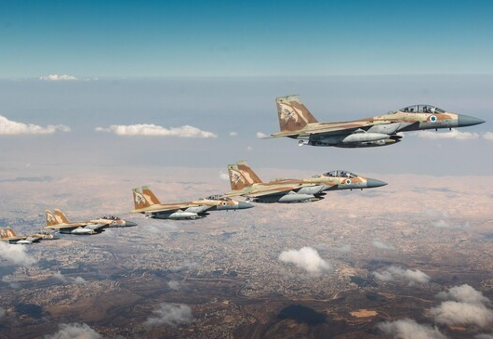
- U.S President. Donald John Trump
“The power of an air force is terrific when there is nothing to oppose it.”
The World News
Gal Spivak
06046321234
Israel strikes Iran’s nuclear sites
Israel launched blistering attacks on the heart of Iran’s nuclear and military structure
KILL TOP GENERALS AND SCIENTISTS
Israel asserted the barrage was necessary before its adversary got any closer to building an atomic weapon, although experts and the U.S. government have assessed that Iran was not actively working on such a weapon before the strikes.
Israel asserted the barrage was necessary before its adversary got any closer to building an atomic weapon, although experts and the U.S. government have assessed that Iran was not actively working on such a weapon before the strikes.
Iran retaliated by firing waves of ballistic missiles at Israel, where explosions flared in the skies over Jerusalem and Tel Aviv and

Slide 2
- U.S President. Donald John Trump
“The power of an air force is terrific when there is nothing to oppose it.”

Slide 3
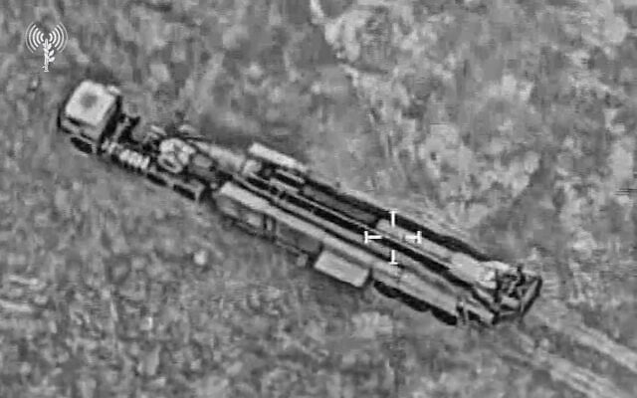
The World News
Gal Spivak
06046321234
The Operation Last Only 12 Days
“fully met, and even exceeded, all the objectives and goals” that it had set out before the operation, which lasted just 12 days.
ROCKET LAUNCHERS DESTROYED
In the following days, the IDF targeted additional Iranian nuclear facilities, eliminated more military commanders and nuclear scientists, and continued to work to thwart Iran’s attacks on Israel. The United States later joined on June 22 with its strikes on Iran’s nuclear sites, particularly the underground Fordo facility.
In the following days, the IDF targeted additional Iranian nuclear facilities, eliminated more military commanders and nuclear scientists, and continued to work to thwart Iran’s attacks on Israel. The United States later joined on June 22 with its strikes on Iran’s nuclear sites, particularly the underground Fordo facility.

Slide 4
Ballistic missile
In the following days, the IDF targeted additional Iranian nuclear facilities, eliminated more military commanders and nuclear scientists, and continued to work to thwart Iran’s attacks on Israel. The United States later joined on June 22 with its strikes on Iran’s nuclear sites, particularly the underground Fordo facility.

Slide 5
Timeline Of events
13.06 ROCKET LAUNCHERS DESTROYED
In the following days, the IDF targeted additional Iranian nuclear facilities, eliminated more military commanders and nuclear scientists, and continued to work to thwart Iran’s attacks on Israel. The United States later joined on June 22 with its strikes on Iran’s nuclear sites, particularly the underground Fordo facility.
In the following days, the IDF targeted additional Iranian nuclear facilities, eliminated more military commanders and nuclear scientists, and continued to work to thwart Iran’s attacks on Israel. The United States later joined on June 22 with its strikes on Iran’s nuclear sites, particularly the underground Fordo dis
14.06 ROCKET LAUNCHERS DESTROYED
In the following days, the IDF targeted additional Iranian nuclear facilities, eliminated more military commanders and nuclear scientists, and continued to work to thwart Iran’s attacks on Israel. The United States later joined on June 22 with its strikes on Iran’s nuclear sites, particularly the underground Fordo facility.
In the following days, the IDF targeted additional Iranian nuclear facilities, eliminated more military commanders and nuclear scientists, and continued to work to thwart Iran’s attacks on Israel. The United States later joined on June 22 with its strikes on Iran’s nuclear sites, particularly the underground Fordo facility.
15.06 ROCKET LAUNCHERS DESTROYED
In the following days, the IDF targeted additional Iranian nuclear facilities, eliminated more military commanders and nuclear scientists, and continued to work to thwart Iran’s attacks on Israel. The United States later joined on June 22 with its strikes on Iran’s nuclear sites, particularly the underground Fordo facility.
In the following days, the IDF targeted additional Iranian nuclear facilities, eliminated more military commanders and nuclear scientists, and continued to work to thwart Iran’s attacks on Israel. The United States later joined on June 22 with its strikes on Iran’s nuclear sites, particularly the underground Fordo facility.
15.06 ROCKET LAUNCHERS DESTROYED
In the following days, the IDF targeted additional Iranian nuclear facilities, eliminated more military commanders and nuclear scientists, and continued to work to thwart Iran’s attacks on Israel. The United States later joined on June 22 with its strikes on Iran’s nuclear sites, particularly the underground Fordo facility.
In the following days, the IDF targeted additional Iranian nuclear facilities, eliminated more military commanders and nuclear scientists, and continued to work to thwart Iran’s attacks on Israel. The United States later joined on June 22 with its strikes on Iran’s nuclear sites, particularly the underground Fordo facility.

