Slide 1
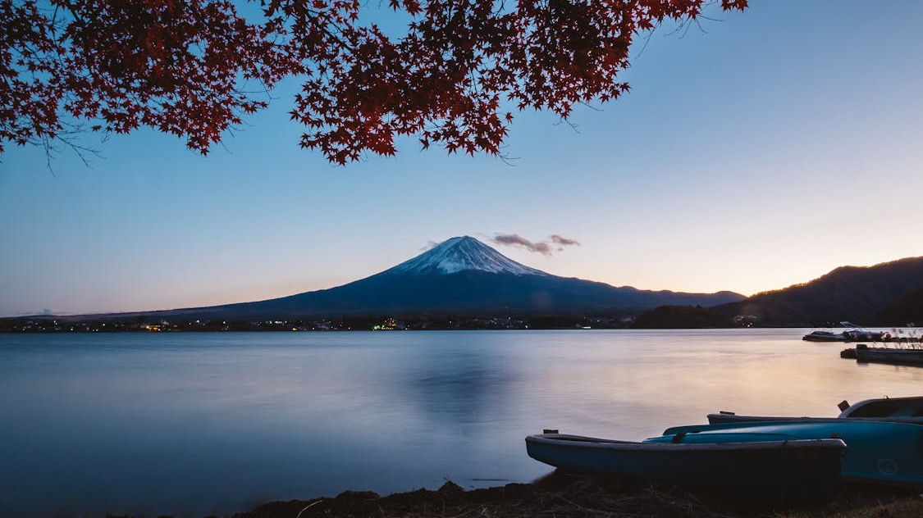
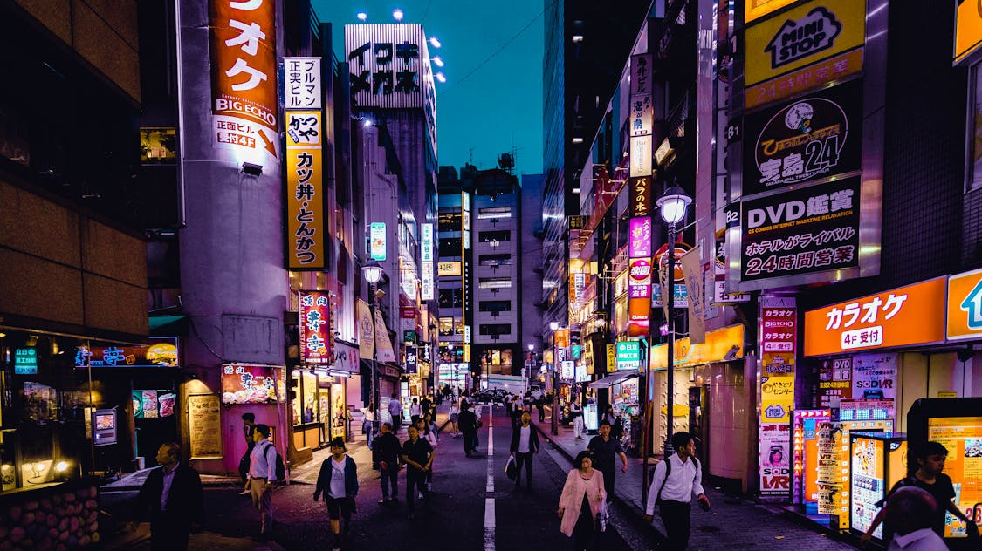
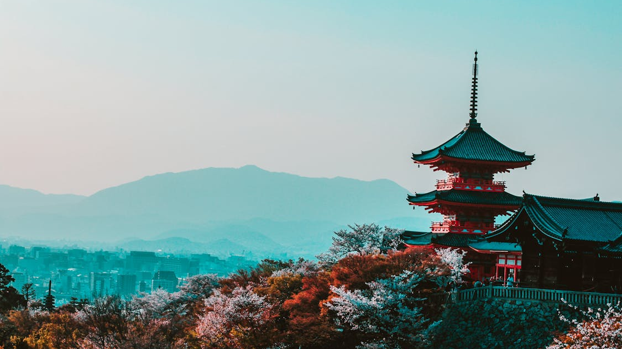
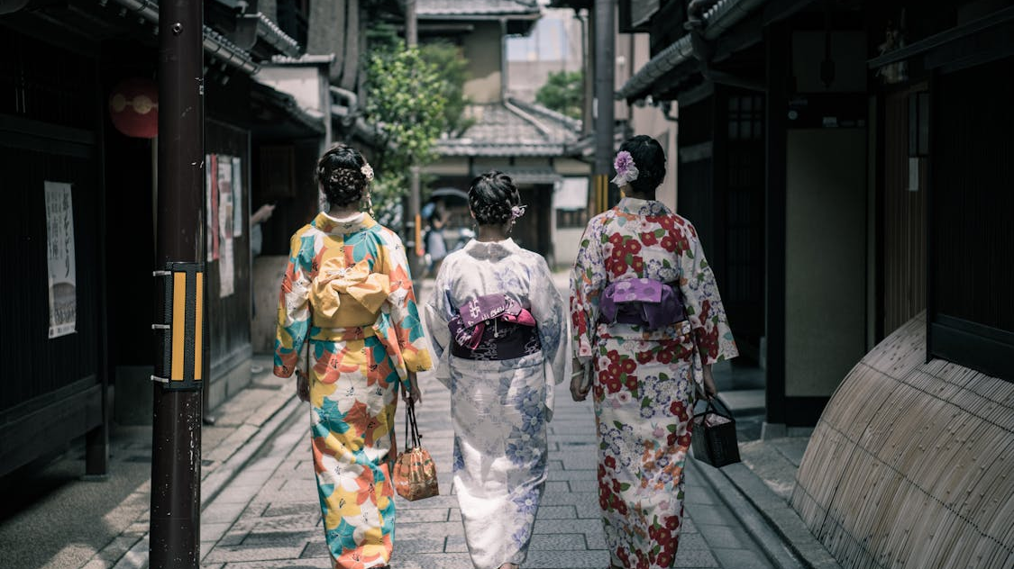
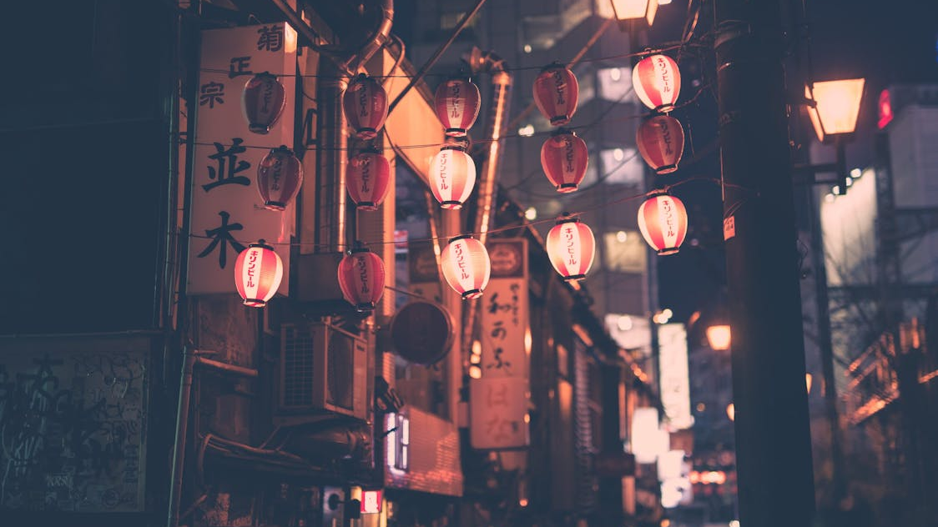
JAPAN
Modern humans arrived in Japan around 38,000 years ago (~36,000 BC)
by domestic flight to Nagasaki Airport. Stepping off of the airport limousine bus into the bustling city center, it was bewildering to imagine so

Slide 2
CULTURE
the morning had begun like any other - people went about their business as usual, with many school children having been mobilized to work at munitions Japan. What no-one on the ground tha

Slide 3
FUJI
bustling city center, it was bewildering to imagine so apparently normal a place becoming the scene of such a devastating event as that which befell the city on August 9, 1945.

Slide 4
TRADITION
by domestic flight to Nagasaki Airport. Stepping off of the airport limousine bus into the bustling city center, it was bewildering to imagine so apparently normal a place bec

Slide 5
STREETS
Modern humans arrived in Japan around 38,000 years ago (~36,000 BC)
ness as usual, with many school children having been mobilized to work at munitions factories located throughout the city, then one of the largest seaports in western Japan. What no-one on the ground that day could have known was that a second atomic bomb, ev

