Slide 1


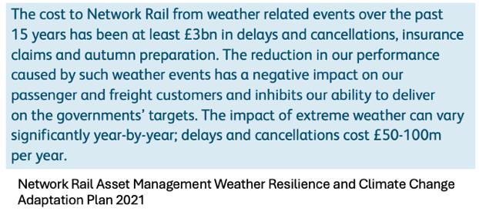
SIYTE for Flood Monitoring
Enhancing Safety & Operational Efficiency
Flooding has emerged as a major challenge for UK rail infrastructure - increasingly disrupting service, damaging assets and threatening passenger safety. The need for an efficient, effective flood monitoring and management system has never been more pressing and is outlined in the Weather Resilience and Climate Change Adaption (WRCCA) plans for Control Period 7.
Our SIYTE platform transforms how flooding is managed across UK Rail by unifying data from multiple, disparate sources into one intelligent view. The result is clearer visibility, enhanced situational awareness, predictive modelling, real-time alerts and actionable insights to support faster, more informed decision-making.
Flooding remains one of the most significant challenges facing critical infrastructure such as rail and transport networks. With extreme weather events becoming more frequent and severe due to climate change, the need for proactive flood management has never been greater.
Within the UK Rail WRCCA programme, around £540 million will be invested in drainage improvements alone. Yet, despite the high costs of flooding-related delays, many of these investments lack the necessary monitoring to help Route Control and asset teams assess drainage performance, detect issues such as blocked trash screens or anticipate when services may be disrupted. It is essential that new drainage infrastructure is paired with intelligent, integrated monitoring.
Modern monitoring systems should not only measure the success of drainage upgrades, but also identify early signs of failure, detect blockages and provide continuous performance feedback. However, traditional systems are often fragmented and reliant on manual processes - slowing responses and obscuring visibility of developing risks.
SIYTE overcomes these challenges by bringing together data from cameras, IoT sensors and third-party sources into a unified platform that delivers real-time insights and automated alerts - helping rail operators strengthen resilience, safety and operational reliability.

Slide 2



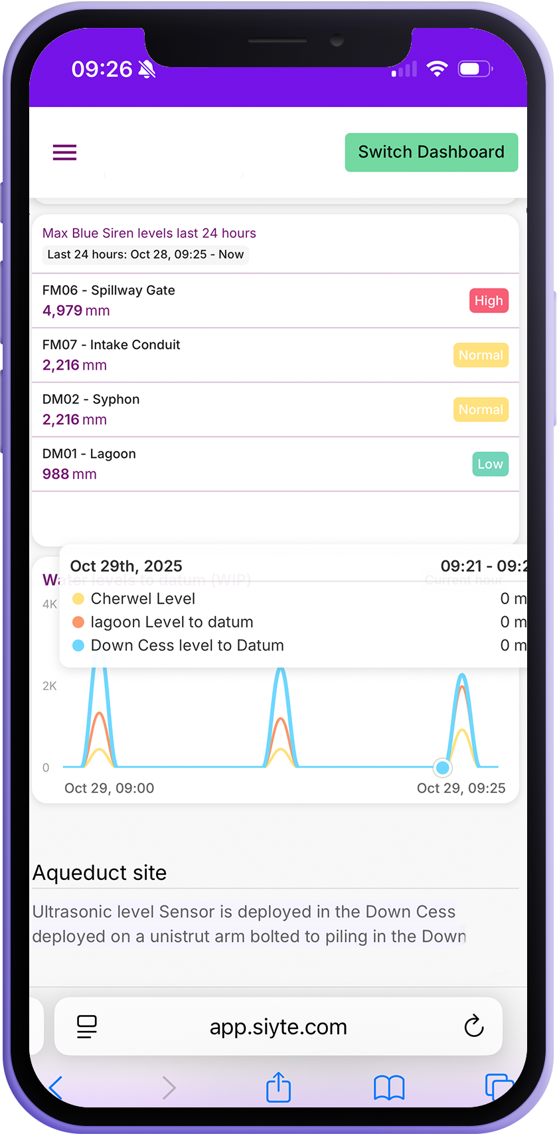
Impact of Flooding
Operational Disruption: Flooding can block railways and cause significant delays, leading to poor customer experience and lost revenue.
Infrastructure Damage: Floodwaters can cause damage to tracks, bridges, signalling systems, and associated equipment - resulting in costly repairs and additional delays.
Safety Risks: Flooding poses serious safety concerns for both passengers and workers, necessitating prompt action to mitigate risks.
Challenges of Traditional Monitoring
Traditional monitoring approaches are often disjointed and manual, with independent systems creating fragmented data streams and limited visibility. Reliance on site visits and manual reporting delays response times, increases costs and reduces the ability to act proactively.
System Overview
SIYTE provides an end-to-end Flood and Environmental Awareness solution, offering a unified platform that integrates live and historical data from multiple sources into a single interface. Teams can instantly access and analyse information across rainfall, groundwater, river and culvert levels, temperature, humidity, pump activity and more.
Data Aggregation
SIYTE consolidates data from cameras, IoT sensors, programmable logic controllers (PLCs), and third-party sources - creating a complete picture of flood conditions across sites and the wider network.
CCTV cameras provide real-time visual awareness and AI-assisted image analysis to detect flooding and anomalies.
IoT sensors monitor flow, water level, rainfall and pump performance - sending data continuously for proactive risk management.
PLCs enable automated responses such as activating pumps.
External data sources such as the Environment Agency, Met Office or local river trusts enhance predictive accuracy and situational awareness.

Slide 3
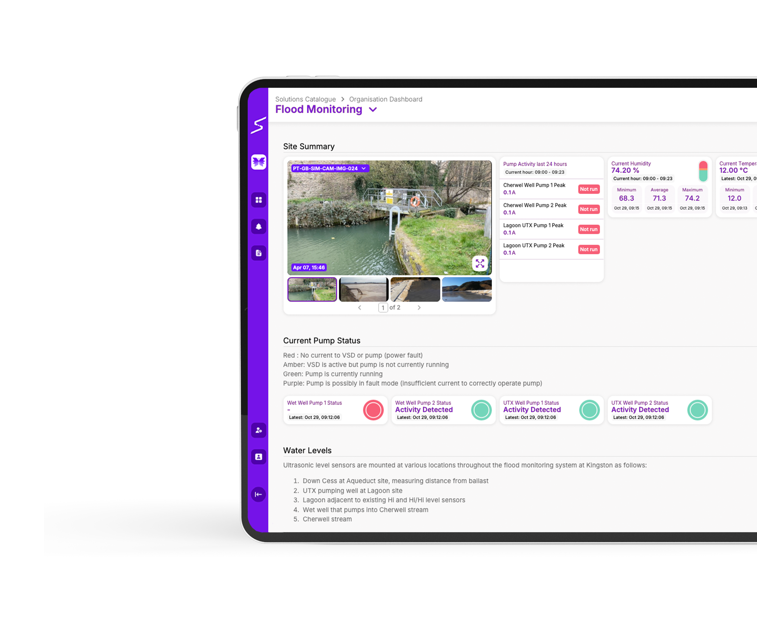
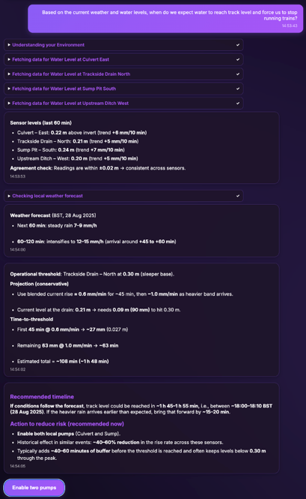
Unified Interface
SIYTE’s modular, configurable interface enables operators to visualise live and historical data, tailoring dashboards for specific roles, whether for Route Control, asset management or compliance teams. Mobile access allows field staff to view insights and respond in real-time.
Workflow and Alerting
Automated alerts are triggered when thresholds are breached, notifying teams through dashboards, SMS, email or the mobile app. Alerts include contextual data such as sensor readings and camera images, ensuring rapid understanding and response.
A no-code workflow builder allows any data combination to trigger an alert, for example, when rainfall exceeds a set level and the forecast predicts further precipitation.
Advanced Analytics
Machine learning and AI algorithms continuously analyse data, detecting anomalies and predicting flood risks. Historical pattern analysis improves forecasting and supports data-driven decision-making. Operators can also use SIYTE AI, a conversational agent, to query system data directly (e.g. “At what time will water reach the rail head at Chipping Sodbury?”).
Business Benefits
Whole-System Visibility: Unifies all relevant data into one platform for comprehensive understanding and faster, better-informed decisions.
Cost Reduction: Enables remote monitoring and early detection of blockages, reducing the need for manual inspections and costly emergency repairs.
Improved Response Times: Provides real-time alerts to Route Control and wider teams, helping prevent service disruption.

Slide 4
Predictive Analysis: Anticipates flooding events and models time-to-impact, allowing operators to take preventive action.
Regulatory Compliance: Supports adherence to environmental and safety standards with continuous monitoring and audit-ready records.
Sustainability: Promotes proactive flood management, protecting communities, assets, and ecosystems while supporting long-term resilience.
Implementation Approach
We deliver an end-to-end flood monitoring solution - combining technology, advisory services and deployment expertise to deliver measurable outcomes.
Site Assessment: Evaluate existing monitoring assets and identify high-risk areas along with existing devices that can be integrated into SIYTE.
Sensor Deployment: Deploy a LoRaWAN wireless network with long-range, low-power IoT sensors via secure protocols to provide multi-kilometre covers and battery life of up to 10 years.
Camera Integration: Install smart situational awareness cameras, powered by PoE or solar, integrating new and existing CCTV vide edge devices into the platform for real-time monitoring and enhanced analysis.
Dashboard Setup: Configure user-specific dashboards and reporting tools.
Alerting Workflow: Define triggers and notification channels for relevant stakeholders.
Training & Testing: Equip staff with platform training, run simulations and calibrate alerts to ensure reliable performance.
Conclusion
SIYTE represents a transformative step forward in flood monitoring and management. By integrating real-time data from cameras, sensors and third-party systems into a unified platform - it enables the rail industry to predict, prevent and respond to flooding events more effectively.
The solution enhances operational efficiency, improves passenger safety and delivers measurable cost savings - helping Network Rail and other operators strengthen resilience against climate change and extreme weather while upholding the highest standards of safety and service.
Our goal is to deliver outcomes, not just technology - providing advisory, deployment and ongoing monitoring to ensure every project achieves its intended results.
Explore the case study on our website to see how we supported Wales & Western at Chipping Sodbury.

