Slide 1
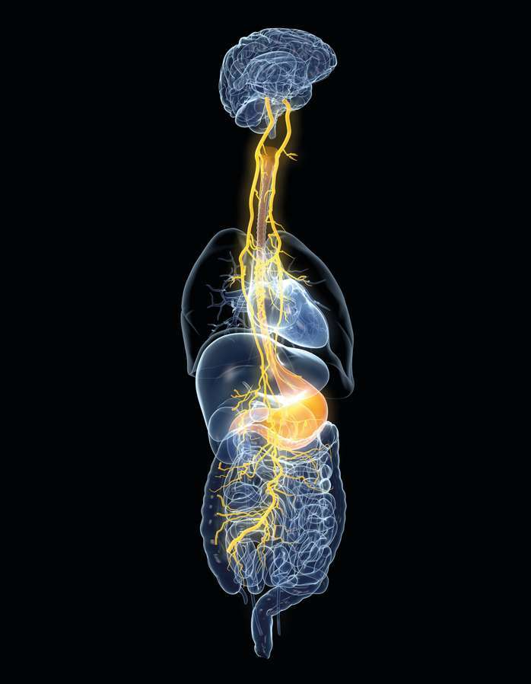

Addressing Patient Skepticism:
Practical GI-Psych Strategies for Clinical Practice
Dr. Julianna Di Miceli, PsyD
Notes:
Left Image credit: Nerva App 2023
Right Image credit: Shutterstock

Slide 2
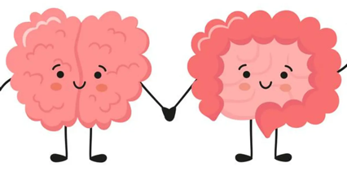
Overview
Topics:
What GI Psych is
Guiding frameworks for skeptical patients
Concrete examples
Workshop audience examples
Format and Context:
Text-heavy slides
A lot of options are presented
As with anything, take what fits best with your style and scope!
Please ask your questions as we go!
You are welcome to contact me for professional and personal questions afterwards
Image credits are in the presenter’s notes, which will be made available to you in the shared google slides file.
Notes:
Text-heavy slides
For quick reference for later or for people who are not able to attend live but look through the slides later
Questions
Eloise please interrupt me if I forget to pause and ask if there are questions!
Image credit: Healthy Women

Slide 3
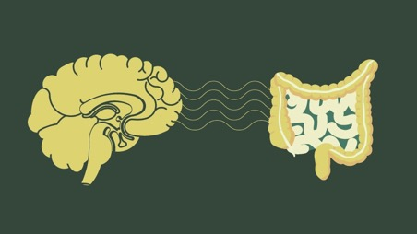
Foundational Strategy:
Legitimize GI Psych Outright
Know what GI Psych is and be able to skillfully articulate it to patients.
Do not make recommendations to patients about specific interventions, instead be aware of the general treatment experience of working with a GI Psych.
2. Use visuals and diagrams that include the brain and the GI tract
Notes:
Visual Aids:
Patient-centered research shows that patients - especially those who have experienced providers as being inattentive - highly value when providers use visual aids and take time to explain things
Practice being able to talk about the connection between the gut and brain in general, using the diagrams
Use this as a bridge to talk about GI Psych
Incorporate time to let the person ask questions
Image credit: www.antonioskoletsas.com

Slide 4
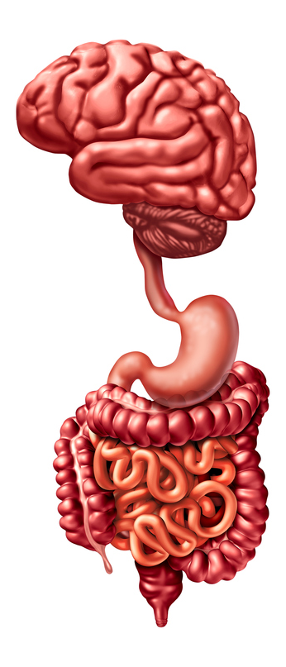

What is it?
Psychogastroenterology
GI Psych or GastroPsych is the practical application of psychology to gastrointestinal health, wellness, and disease management.
Front Seat or Back Seat of bother?
Often entails symptom-specific work
Includes general distress management that affects symptoms
Notes:
Left Image credit: VectorStock
Right Image credit: American Gastroenterological Association

Slide 5
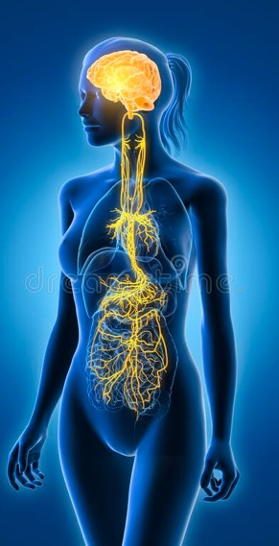
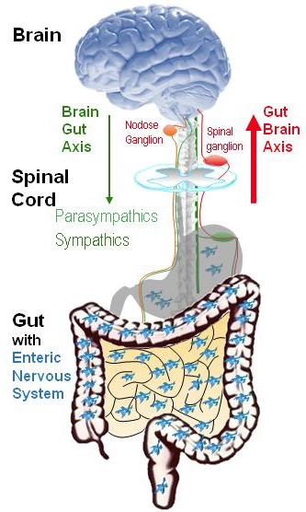
Brain-Gut/Gut-Brain Connection
Central Nervous System: Brain & Spinal Cord
Enteric Nervous System: the nervous system of the gut; “second brain”
Millions of nerves (including the vagus nerve)
Receptors directly in your gut
“Second brain” is also used to refer to our gut microbiome, which weighs roughly the same weight as our true brain
Vagus Nerve: 10th cranial nerve
Big part of parasympathetic nervous system (rest & digest)
peristalsis, basic functions (respiratory & heart rate)
These systems affect each other bidirectionally.
Notes:
Millions
Gut has more nerve tissue than the brain and spinal cord combined together
Receptors
For hormones and neurotransmitters including cortisol, adrenaline, glucocorticoids
The parts of your body that release these hormones (pineal gland, hypothalamus, pituitary, thyroid, adrenals, gonads) directly communicate with your gut.
_______________________
These relationships are bidirectional, meaning they affect each other reciprocally.
These are in constant communication; most of the time we aren’t aware of it. Sometimes we are:
excited= butterflies
nervous=stomach ache or throwing up
Changes in appetite (overeating, undereating, no appetite) due to depression, grief, anxiety
Changes in food taste/appeal
If someone brings up polyvagal theory: it’s a collection of psychologically interesting ideas that really break down when you look closely at the physiological claims. If you want to use the concepts from polyvagal theory, sure, but I don’t appreciate the efforts to make it seem scientific because there are too many assumptions and hypothetical leaps. I feel similarly about the work of Allan Schore and the claims he makes. It’s also stuff like this that makes psychology a soft science because we commandeer scientific words like “theory” and use them to describe good ideas that we have.
Left - Image credit:Prof. Simon Brookes, Flinders University, Adelaide, Australia.
Right - Image credit: Axel Kock | Dreamstime.com

Slide 6
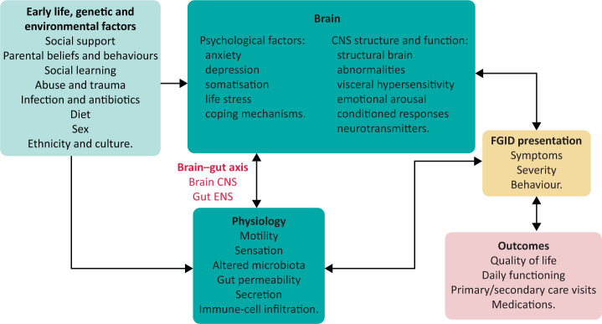
Biopsychosocial model of functional gastrointestinal disorders.
CNS = central nervous system; ENS = enteric nervous system; FGID = functional gastrointestinal disorders.
Biopsychosocial model of functional gastrointestinal disorders.
CNS = central nervous system; ENS = enteric nervous system; FGID = functional gastrointestinal disorders.
Notes:
Main point - Biopsychosocial framework of gut issues
Image Credit: Management of functional gastrointestinal disorders (2021)

Slide 7
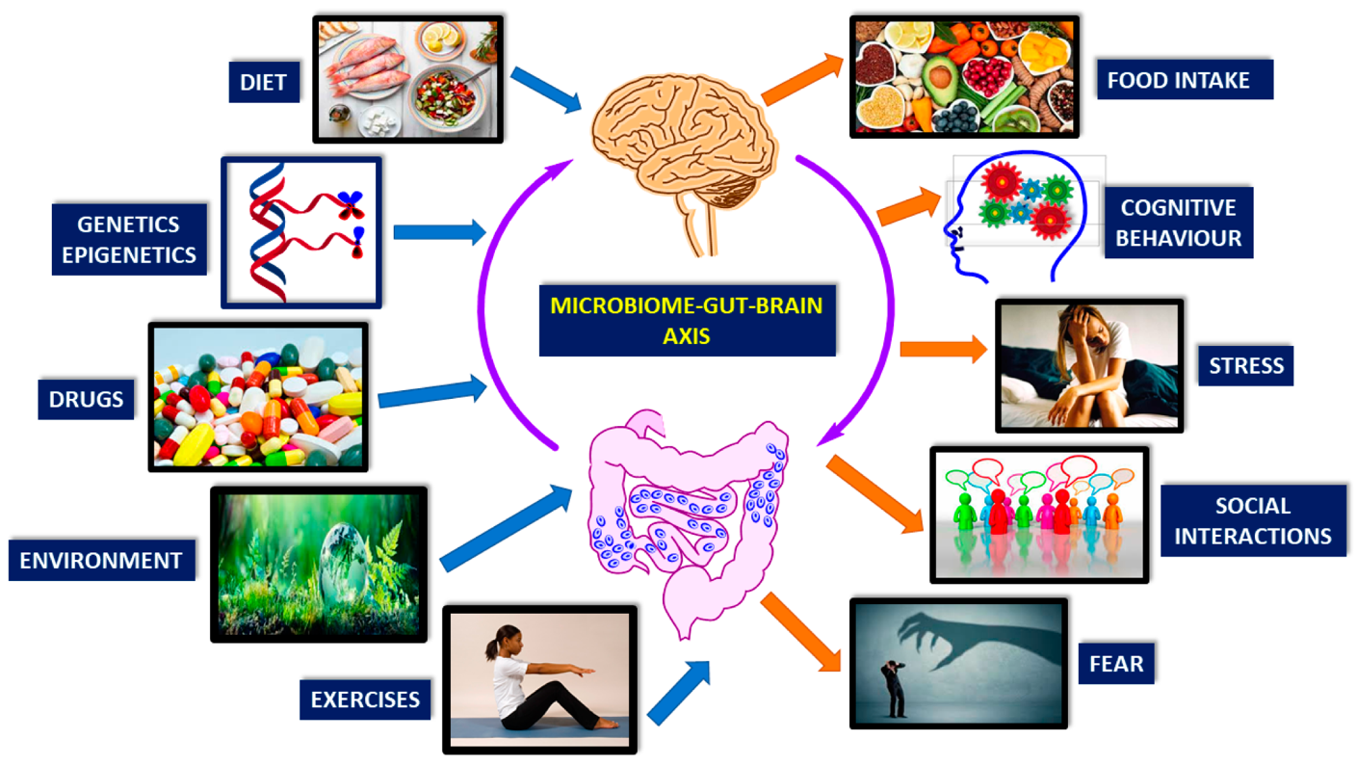
Gut-Brain-Microbiota Axis: Antibiotics and Functional Gastrointestinal Disorders
Notes:
Potentially helpful graphic to walk through with clients
Managing gut issues takes a biopsychosocial approach
GI Psychs can help with the psycho social aspects of treatment, which affect the bio aspects of treatment, and vice versa
Image Credit: Gut-Brain-Microbiota Axis: Antibiotics and Functional Gastrointestinal Disorders

Slide 8
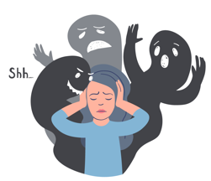


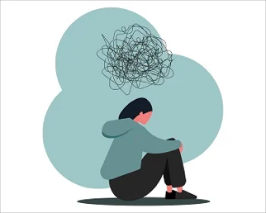
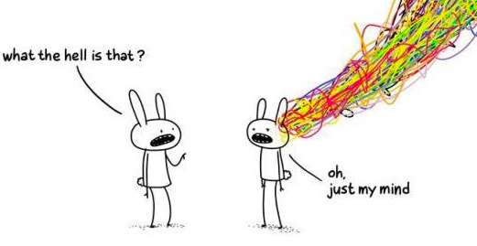
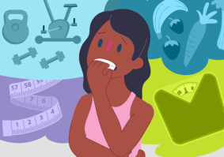
Provider Considerations for GI Psych Referrals
GI Psych can help with the overlap GI challenges and characteristics commonly associated with a variety of psychological challenges
Trauma
Anxiety
Problematic substance use
ADHD
Depression
Eating Disorders
Notes:
ADHD
long periods of time without eating due to hyperfocus & inconsistent meal time & meal size, can contribute to constipation, overeating, issues with stopping oneself from eating or abstaining from certain foods that are known to cause issues (ex: alcohol or overeating with reflux) due to not remembering or not being able to practice self-control
if hyperactive or combined type: can contribute to to slow digestion due to always “on the go” and with an activated sympathetic nervous system, scarfing food instead of chewing fully, there appears to be a correlation between ADHD and functional GI disorders
Anxiety
having anxiety can make people nauseous or lack appetite and eating irregularly or massively restricting food can cause GI and other medical problems
especially if anxiety is about assumed food-related GI symptoms, this can lead to a lot of restriction which massively increases GI symptoms (restriction can exacerbate constipation & also lead to binging); fearing foods can be an issue
Fearing foods and GI symptoms: it is rarely the food when it comes to FUNCTIONAL/DGBI, but often the circumstances around eating. Food sensitivities will be consistent and proportional.
Eating Disorders - can arise because of GI symptoms & food-related pain or discomfort, disordered eating behaviors exacerbate GI symptoms
Trauma
will absolutely impact GI symptoms to begin with but can also make it challenging to adapt to new diagnoses or guidelines (e.g. celiac being a simple dx and simple fix, but not straightforward for people with a trauma hx); trauma ACES increases likelihood of GI sx and certain kinds of GI problems
Depression - eating too much, overeating, eating “easy” foods that don’t help gut or brain health
Problematic substance use - so many aspects are affected; routines, relationships, employment, celebrations and grievances, financial aspects, other risky behaviors that can accompany substance use, ability to follow medical advice or take particular medications
Image credits: Depression (Anxiety & Depression Association of America); Trauma (BCS Group Integrated Mental and Emotional Well-being); Anxiety (Vecteezy); Eating Disorders (Kids Helpline); Problematic Substance Use (iStock); ADHD (Pinterest)

Slide 9
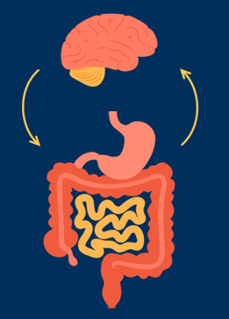
“Verbage” to Discuss GI Psych
“Our gut and brain talk with each other continuously, all day every day. When we have issues with one, we usually develop issues with the other. This also means that if we help one of them, we positively affect the other one too.
The things that caused your symptoms initially may not be the things that maintain them. Working with a GI Psych can help lessen or resolve these symptoms because of how their interventions affects the neurological communication between your gut and your brain.
In appointments, GI psychs can brainstorm and assess strategies with you, recommend specific interventions to try, and help connect you with other providers. Working with a GI Psych generally involves helping you with your present-day symptoms and related emotional distress.
What are your thoughts about this as a treatment option? ”
Notes:
BOLDED AT THE END BECAUSE: Important to end with a question that is NOT yes/no
Image credit: familymedicineaustin.com

Slide 10

Video: 5 General Strategies
Notes:
This is a 3-minute video that I made a couple of years ago.
I want to share with you because I still agree with the recommendations, I articulate them reasonably well, and you may want to reference the video later on.
There are a few amendments to some of the considerations, which I will elaborate on afterwards.

Slide 11
5 General Strategies - Additional Considerations
Align with the Skepticism
Talk to the provider openly about not wanting to be there
Expectation of Seeking Compatibility
1-3 Session Trial
The 5/10/15-minute Try
It’s not “all in your head”
But it is neurological
Neuroplasticity
Come back to it
Sometimes more a more forceful approach is appropriate
Notes:
2. Set the expectation that compatibility may not work out the first time
Sometimes you gotta try different providers!
Maybe not a good fit
But also not a fair “try” to meet with one person and say you don’t like it
Like listening to one style of music and deciding you don’t like music as a whole
3. The 5-minute Try
Ask them to meet with the GI Psych for 5 minutes to start
Either help the patient ask for this or communicate w/ the provider directly
Some psychologists are very versed in working with people who don’t want to see them, and others almost work exclusively with people who want to see them and do not know how to navigate this.
4. Sometimes the behaviors we do accidentally encourages our symptoms and sometimes it’s a deeper re-wiring of the neurological connection that needs to be addressed through GI Psych
GI Psych works through the action of neuroplasticity
5. Come back to it
Can be somewhat more forceful about it depending on the patient, which I will elaborate on in several more slides

Slide 12

Planting and Watering GI Psych Seeds for Patients
Bring it up in the beginning
Return to it as a treatment option
Practice neutral ways of revisiting the intervention that also acknowledge their earlier responses:
“I know that when I’ve brought up GI Psych in the past, you’ve said you’re [not interested…don’t trust psychologists…have had a bad experience before…don’t think your problems are in your head…]. Can we talk more about that today so I can understand your perspective and what’s happened for you that you want to avoid that part of treatment?”
“Honor the ambivalence”
Notes:
Beginning
Explain that there are several ways to treat whatever they’re managing
Explain how your specialty fits in with that treatment arm, maybe the “bio-psycho-social” model and language
Express that GI Psych is another arm of treatment that may be applicable
Image Credit: https://images.app.goo.gl/E8fzZiW5kMY3UeNj9

Slide 13

“Honor the Ambivalence”
Popular phrase in the psych world
“Ambivalence” means we go back and forth, change our minds
Honoring this means to recognize that our perspectives and opinions change, including those related to changing a behavior or trying something new, like a treatment option
Dynamic process! Look for “yessy-no’s”
Notes:
Phrase - popular in Motivational Interviewing and other psychological frameworks
Find yourself thinking ““well they’ve said no before and they seemed pretty certain, so I’m not going to bring it up again”
Fight against that
Dynamic process!
Answers can change
Consent is a little different here when it comes to accepting help
“I guess” shrugs “maybe” “If you really think so”
unless it’s a hard “no,” keep bringing it up, and even then, maybe bring it up again still and even consult w/ a psych

Slide 14
“Honor the Ambivalence”
What if they say to stop bringing it up? Appreciate, Bridge, and Double-Bind
Appreciate and Re-State
Appreciate them being honest with you about the specific topic
“Thank you being so straightforward with me that you don’t want me to bring up GI Psych again as a treatment option.”
Bridge
Bridge that back to them and to the future of possibility
“I want to return the honesty and say that I most likely will bring it up again because it is a part of treatment that we are not addressing and is out of my scope to help with. However, I want to figure out if it’s possible to make it palatable and reasonable for you. I’ll know that if you ever decide to try it, it’s because you’re willing to go out on a long limb and take a risk that I’m recommending, which I can see is a very uncomfortable option!”
Double Bind
Give them a double-bind option - they don’t choose whether or not it happens, but they can choose when it happens
“I can agree to not bring it up next session and maybe the following session. Would you rather me wait to bring it up in 2 sessions or 3 sessions from now?”
Notes:
But you think it’s still clinically indicated and are going to bring it up again

Slide 15
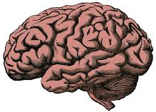
Framework: Backbrain and Forebrain
It is helpful to think about a person’s brain state in any given moment and what this means for your communication choices:
Forebrain
Able to process emotional and conceptual information
Communicate clearly, both expression and comprehension
Backbrain
Good fighter and survivor
Not good at understanding the perspectives of others
Great at detecting threats
Not good at understanding conceptual information accurately
Notes:
Image Credit: University of Cambridge

Slide 16

Strategies for Someone in Backbrain
Notice that the person is or might be in backbrain
State their perspective, ask for feedback
Ask to state or re-state your point of view
Ask them to re-state what you said
Overall message: slow down the communication

Slide 17
Strategies for Someone in Backbrain
Notice that the person is or might be in backbrain
The patient might “feel”
Lectured
Belittled
Ignored
The provider might see
Withdrawing or checking out, talking less or giving shorter answers
Anger or upset
As an aside, sometimes, the person feels relief for you bringing it up because they didn’t know how to!
To successfully talk about something that someone doesn’t want to talk about, you need to strategically communicate to balance forebrain and backbrain activity.
Notes:
“Feeling” in quotes because these aren’t actually feeling words

Slide 18
Strategies for Someone in Backbrain
State their perspective, ask for feedback
Pivot to (1) saying their perspective followed by (2) a complex question:
“I want to back up to make sure I understand your perspective. You’re saying that you don’t want me to bring up GI Psych anymore because you do not think you have any psychological problems that could be affecting your gut. I expect that you also might be thinking that I don’t really respect you or your opinions because I keep bringing this up.”
“Complex questions” require more than simple yes/no answers.
They elicit a longer response from the person, which recruits more forebrain.
Combine two yes/no questions to pull for a longer answer or choose a different question:
“Am I understanding that right or did I not quite get it?”
“Will you give me feedback on what I got accurately and what I need to fix to understand better?”
Notes:
After both points:
Sometimes choosing something a little bit more extreme than what you think is true is a strategy - on purpose exaggerate slightly so that they are the ones clarifying in a positive way - like the respect opinions comment here
Encourage to role play with each other or loved ones that are willing to so you can practice where to go with the conversation after that

Slide 19
Strategies for Someone in Backbrain
Ask to state or re-state your point of view
After you have the impression that they feel understood by you
Thank them
Ask if they are in the headspace where they can hear your perspective.
Give a cap to your perspective such as a number of points (3 points), number of sentences (ex: 2 sentences), or number of seconds (ex: 45 seconds)
“Thank you for clarifying your perspective so that I understand better. It is extremely helpful because then I really know where we are at and I appreciate that. Do you have the bandwidth for me to clarify my perspective in 2 points right now? Or would you rather me wait until our next appointment?”
Notes:
Thank them - really important for brains
Need to actually be grateful, so figure that out in your own self < if you cannot access this, then don’t say it because it’s insincere
Reinforcing that they’ll be up front with you next time as well

Slide 20
Strategies for Someone in Backbrain
Ask them to re-state what you said
Comprehension Check for a Functioning Forebrain: Ask them to say your points back.
“Can you please say back some sort of summary of what you heard me say so I can make sure we’re on the same page or clear up anything I didn’t explain well?”
Depending on how dysregulated the person is, their summary can vary widely from what you actually said. If they miss something, specifically reinforce what they got correct frist. Then prompt them or re-explain what they missed and ask them to summarize back to you.
Slowing the communication down like this is important if someone has a trauma history - including and especially medical trauma.
Notes:
Slowing down
Elaborate on this

Slide 21
Other Strategies to Encourage Patients
Offer a warm hand-off
Role plays or Rehearsals for What Ifs
Ask them about their concerns with meeting with a psychologist. Some common reasons include that they don’t want to talk about their childhood, they think it’s a waste of time, or they’ve tried seeing someone before and it was a waste of time and money.
Discuss these concerns and find agreement where appropriate, use humor (helpful for brains)
Help them practice what to say to providers up front or responses questions the patient does not want to discuss with a psychologist.
Notes:
Warm hand-off
Preference of patient: either talk w/ provider beforehand and circle back w/ pt
Or
Lead the joint session for the first 5-10 minutes
Discuss these concerns…
Exs: I agree, you shouldn’t be required to talk about things that aren’t relevant to your treatment/symptoms.
“They might think I’m crazy” “Well, we are all a little crazy, so that might be true!”
Help them practice…
Role play with them about their concerns
Very underused by extremely useful

Slide 22

5 Things to Remember
Providers have a lot of power!
“Bad” appointments
Really practice using correct pronouns for nonbinary patients
If time permits, collaborating with other professionals and/or doing a chart review before an appointment with a skeptical patient helps them feel respected, understood, and cared for, which makes them more likely to be open to recommendations that they are wary of.
Notes:
Your recommendations often carry a lot of weight;
Exs: Pts who do not leave their house because of the stress but they do it for doctors/medical appointments or because their providers say so
Patients may get angry/frustrated - not a bad thing necessarily
Think more about it later, talk to others about it who may reinforce what you were encouraging
I’ve learned to let go of what I think is “good” or “not good” session - people surprise me with their conclusions or change of mind/heart
In person, in or out of their presence, and in written correspondence. With NB pts - doing this can really help with reducing skepticism and making your relationship better with them
Image Credit: iStock

Slide 23
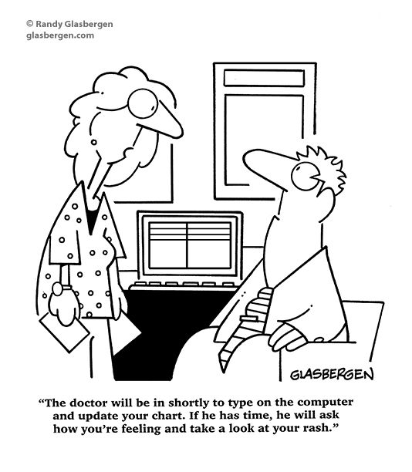
5. Skepticism in patients may be related to the medical system:
Logistical changes in the medical system have negatively affected provider-patient relationships
Compounded medical trauma and unresolved physical symptoms
Hot-potato, dismissal of medical complaints
Healthcare-seeking behaviors
Complex or unusual conditions
Psych can be helpful with managing the psychological burdens of navigating chronic health challenges
Notes:
Funny and Sad comic that captures how many patients feel, and sometimes ourselves when we are patients
LOGISTICAL
Doctors are under increasing pressure to do administrative work because of the digitization of patient records and expectation to see as many patients as possible; this leaves less time to spend with patients to learn how their experience of illness affects their daily life
Pts sometimes feel that their providers don’t care about their wellbeing
Sometimes the providers are burnt out and they feel like they’ve tried everything and that the patient isn’t giving their fullest effort or isn’t listening to the medical recommendations
Some research shows that providers feel unfulfilled in their work with patients that don’t seem to get better :(
COMPOUNDED
Referring someone to psych when they have these issues can make them feel like you’re hot-potato’ing them and dismissing their medical complaints even if you’re not
They may respond to a psych recommendation by requesting other tests, which may be seen as a “healthcare-seeking behavior”
Commonly hear things like “my doctor just hasn’t figured it out” or “the test was normal but I know it missed something”
sometimes other MH conditions (OCD, anxiety, trauma) affect their pursuit of healthcare
Sometimes they really do have complex conditions that are not being appropriately medically diagnosed and treated because of unidentified dysautonomia symptoms or unusual conditions like visceroptosis that do not have standardized testing and treatment

Slide 24
Pre-Work Questions
If you think you have good responses to any of the questions that your colleagues share, please offer them in the chat!
1. What fears or concerns do you have when introducing GI psychology interventions? (Example on next slide.)
2. What’s something you’ve heard from patients about GI psychology services that you wish you could handle more effectively?

Slide 25
Pre-Work Questions
Q1: What fears or concerns do you have when introducing GI psychology interventions?
Example: “I don’t want my patient to think I don’t believe them or that I think it’s all in their head.”
It can often be appropriate to explicitly bring up your relational concern with your patient.

Slide 26
Pre-Work Questions: Q1 Example
“I don’t want my patient to think I don’t believe them or that I think it’s all in their head.”
Practice a way to bring your concern up directly, incorporating 2 things:
If you state what you don’t want, then also state what you do want
Have a relational aspect or question that is not a yes/no question at the end of your upcoming spiel
“I want to bring up or revisit the GI Psych intervention, but I don’t want to give you the impression that I don’t believe your symptoms or that I think they are all in your head. I’m going to give this a shot and you can let me know if I accomplish this goal of wanting to talk about GI Psych in a way that feels respectful to you and your efforts. Are you up for that?”
“Are you up for that?” is a yes/no question, but the relational task of the patient giving feedback to the provider about whether or not they felt respected by the spiel is the more involved relational experience.
Remember to circle back to your feedback question at the end of your spiel!

Slide 27
Pre-Work Questions: Q1 Workshop
Q1: What fears or concerns do you have when introducing GI psychology interventions?
Answers from the audience?
Incorporate 2 Things:
If you state what you don’t want, then also state what you do want
Have a relational aspect or question that is not a yes/no question at the end of upcoming your spiel

Slide 28
Pre-Work Questions: Q2 Workshop
Q2: What’s something you’ve heard from patients about GI psychology services that you wish you could handle more effectively?

Slide 29


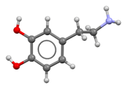
My PSA: Always Include Screen Time in your Assessment & Treatment Plan
Relationship to screen time is crucial for all people, patients, clients, and ourselves
Medical relevance: googling symptoms and treatments
Predatory chiropractors on YouTube and elsewhere
Highly restrictive or extreme diets - can increase hypervigilance without sx control
Distraction from sx as a management strategy
Includes video games, phone apps, movies, binge-watching shows
My Observation: Mental health challenges cannot be managed without this toolkit
Dopamine: enjoyment/satisfaction, motivation, baseline, peaks & troughs
30-day Dopamine fast of all spike-inducing activities (no replacements, first 2 weeks are rough, effective for anything dopamine-related for 80% of people)
Dopamine Nation: Finding Balance in the Age of Indulgence
Apps: One Sec and ScreenZen are good for phones; BreakTimer is good for computers.
Consider getting a dumb phone such as: the WisePhone or the Light Phone
For anyone still dependent on their parents, encourage screen time limitations!

Slide 30
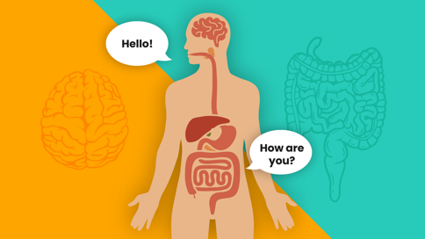
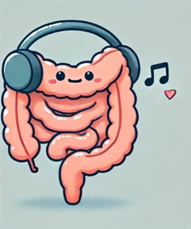
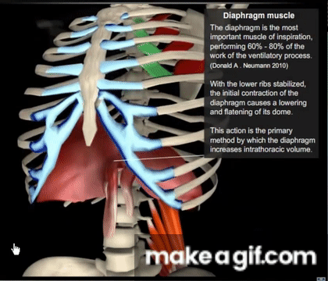

Julianna’s Compiled Resources
Mealtime Tips
Psychogastroenterology (books, websites, podcasts)
Gut-Directed Hypnosis
GI Tracking - Getting to Know Your Gut!
Diaphragmatic Breathing
Sleep Tips and Habits
Notes:
Image credit: Gut Performance, Diaphragm, Free Vector

Slide 31

Thank you!
Other resources:
Dr. Laurie Keefer on Brain Gut Psychogastroenterology (podcast)
Gut Feelings--Disorders of Gut-Brain Interaction and the Patient-Doctor Relationship: A Guide for Patients and Doctors (book, no audiobook available)
Follow-up volume: Gut Feelings--The Patient's Story: Personal Accounts of the Illness Journey
Resources that I’ve compiled (videos and written resources)
Post-Webinar Inquiry:
I’m interested in 1 or 2 specific, practical changes you took away or implemented based on the webinar 1 week and 3 weeks later.
My contact info:
Julianna Di Miceli
brains.and.julianna@gmail.com
925-639-7055 for texting, voicemails, and voice texts
Notes:
Image credit: Healthy Women

