Slide 1
Vaping Flavours Ban in Netherlands: How prohibition killed harm reduction & fuelled black market

Slide 2
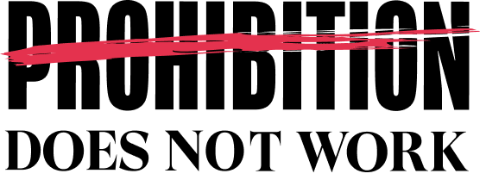
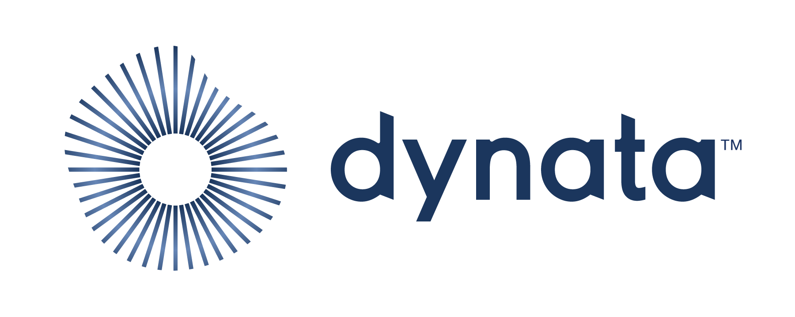
METHOD, SAMPLE AND FIELDWORK
METHOD
SAMPLE
FIELDWORK
Quantitative Research
Mix mod - CAWI (Computer assisted web interview) + CAPI (Computer assisted personal interview) data collection
Respondents were not aware what would be the subject of the research going in
N=1005
Current vapers - defined as person that uses e-vaping device at least once a month
29/12/2025 – 12/01/2026
Logic and data quality control done on 100% of the sample
Consumer Survey, December 2025 – January 2026

Slide 3
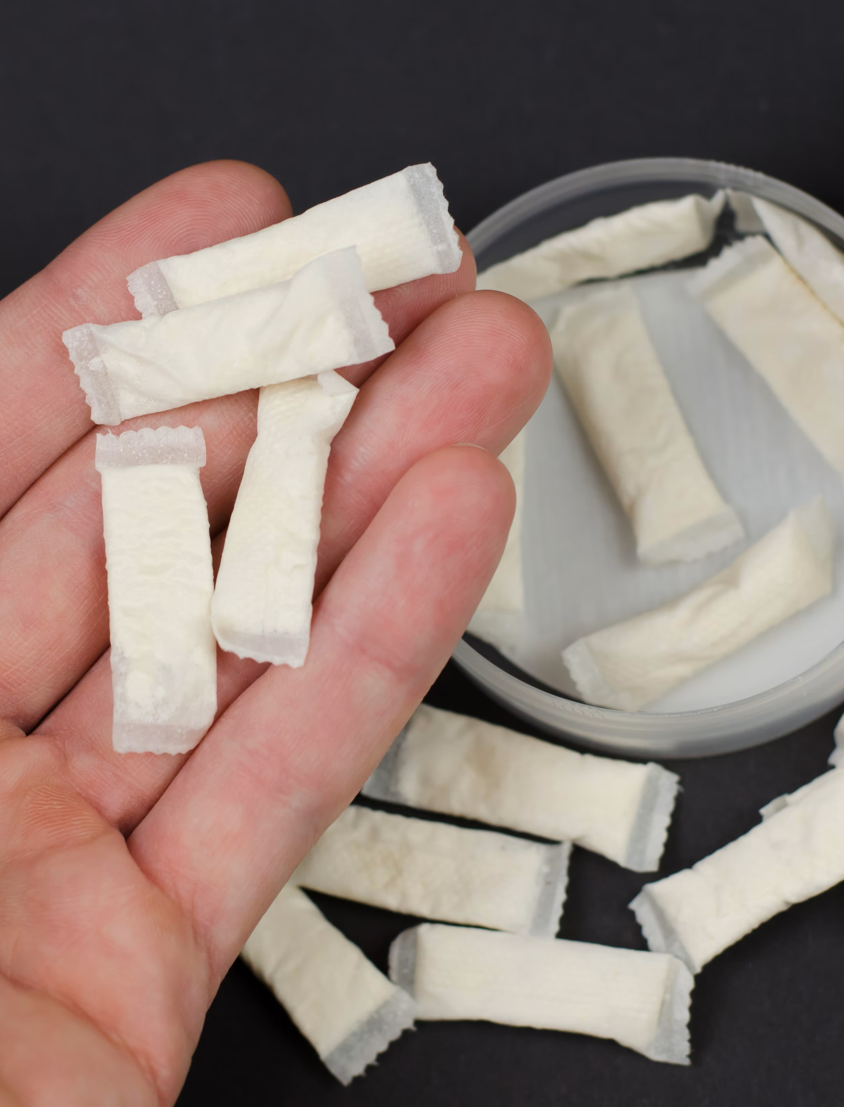
KEY FINDINGS
More than a half of vapers In Netherlands use them for health reasons, including to reduce or stop smoking.
The vast majority of Dutch vapers highlight that flavors are important to them when it comes to their decision to vape. Almost 50% of consumers say that flavors are very important.
Fruit and Menthol flavors are seen as the most important for switching and staying away from smoking.
Moreover, Fruit flavors specifically help almost two thirds of respondents to switch to safer alternatives.
Fruit and Menthol flavors used to be the most popular before the ban: more than a half of vapers use them for health reasons, including to reduce or stop smoking.
Consumer Survey, December 2025 – January 2026

Slide 4
KEY FINDINGS
More than a half of vapers (58%) are against the ban, while around one-third have a neutral opinion. One reason for this may be a lack of confidence in a ban being enforced.
95% of vapers in Netherlands highlight that it is still easy to buy illegal flavors. More than 3/4 have seen banned flavors available for sale during their last 10 purchases.
85% of vapers in Netherlands think the flavor ban might push vapers back to smoking. Half of them consider this very likely.
Vapers in Netherlands support alternative ways of preventing underaged access, primarily through stricter enforcement of underage access prevention.
Around three quarters of vapers in Netherlands believe the government should support safer alternatives to smoking.
Consumer Survey, December 2025 – January 2026

Slide 5
Reason for vaping
More than a half of vapers use them for health reasons, including to reduce or stop smoking. Almost every second person vapes because wants to reduce smoking.
55.4 Health related
44.6 Non-Health related
Data in %
Consumer Survey, December 2025 – January 2026
Q: Why do you vape?

Slide 6
Importance of vaping flavors
The vast majority of vapers in Netherlands highlight that flavors are important to them when it comes to their decision to vape. Almost a half of vapers say that flavors are very important.
Data in %
Consumer Survey, December 2025 – January 2026
Q: How important are flavors in your decision to vape?

Slide 7
Switching and staying away from smoking
Fruit and Menthol flavors are seen as the most important for switching and staying away from smoking. Moreover, Fruit flavors specifically help almost two thirds of respondents to switch to safer alternatives.
Switching from smoking to vaping
Staying away from smoking
Data in %
Consumer Survey, December 2025 – January 2026
Q: In your view, which flavors could help adult smokers first switch from smoking to vaping?
Q: In your view, which flavor(s) helps former smokers continue staying away from smoking?

Slide 8
THE SITUATION BEFORE FLAVOR BAN IN NETHERLANDS
Fruit and Menthol flavors used to be the most popular before the ban: more than a half of vapers use them for health reasons, including to reduce or stop smoking.
Usage of vaping before the flavor ban
Way of finding flavors
>80%
of those who vape
use flavors other than tobacco
Data in %
Consumer Survey, December 2025 – January 2026
Q: Which vaping flavor do you normally use before January 2024?
Q: Where you used to buy your vapes?

Slide 9
WHAT HAPPENED AFTER THE FLAVOR BAN
After the ban Fruit, Mint/Menthol and Sweet flavors are still used by two thirds of vapers in Netherlands (77%).
They buy illicit products online, across the boarder and even in local stores, presumably, due to a lack of the enforcement.
Usage of vaping after the flavor ban
Way of finding banned flavors
Data in %
Consumer Survey, December 2025 – January 2026
Q: Which vaping flavor do you normally use after January 2024?
Q: You mentioned that you use mint, menthol, fruit, sweet, dessert, or other flavors – how do you get them?

Slide 10
OPINION ON FLAVOR BAN
More than a half of vapers (58%) are against the ban, while around one-third have a neutral opinion.
One reason for this may be a lack of confidence in a ban being enforced.
86% of those who vape
do not support the flavor ban
Data in %
Consumer Survey, December 2025 – January 2026
Q: Starting from January 2024, your government imposed a ban to the use of vaping flavors other than tobacco. How do you feel about the ban?

Slide 11
Importance of vaping flavors
95% of vapers in Netherlands highlight that it is still easy to buy illegal flavors.
More than 3/4 have seen banned flavors available for sale during their last 10 purchases.
Data in %
Consumer Survey, December 2025 – January 2026
Q: How easy is it to get vaping flavors other than tobacco?
Q: During your last 10 purchases for e-cigarettes, were you able to purchase vaping flavors other than tobacco or did you see it on offer?

Slide 12
RISK OF Returning to cigarettes
85% of vapers in Netherlands think the flavor ban might push vapers back to smoking. Half of them consider this very likely.
85
Data in %
Consumer Survey, December 2025 – January 2026
Q: Do you believe the ban on flavours has sent people back to smoking cigarettes?
Notes:
Do you believe the ban on flavours has sent people back to smoking cigarettes?

Slide 13
Supports for alternatives to flavor ban
Vapers in Netherlands support alternative ways of preventing underaged access, primarily through stricter enforcement of underage access prevention.
Data in %
Consumer Survey, December 2025 – January 2026
Q: If you do not agree with the Netherlands current total prohibition on flavoured vaping products, which regulatory approach would you most support instead?

Slide 14
Supports for alternatives to cigarettes
Around three quarters of vapers in Netherlands believe the government should support
safer alternatives to smoking.
Data in %
Consumer Survey, December 2025 – January 2026
Q Smoking rate in Netherlands is 18,2%*. In your opinion, should the government be more supportive of switching to less harmful alternatives to cigarettes,
such as vaping, tobacco heating products, tobacco-free nicotine pouches, snus?

Slide 15
Thank you

