Slide 1
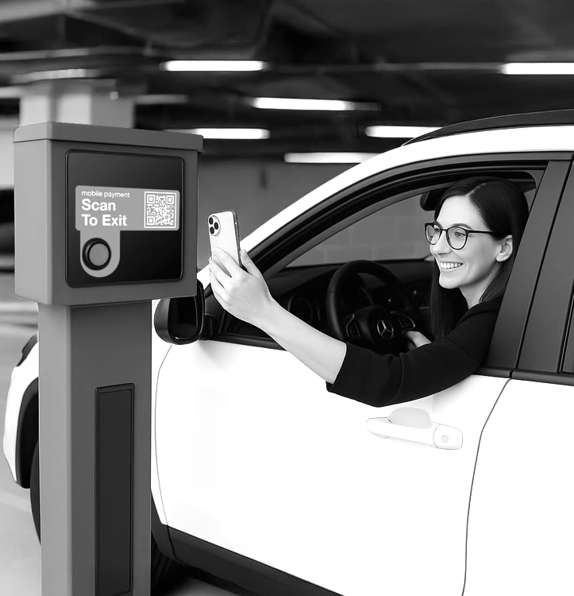

Bolt360
The Future of Seamless Parking

Slide 2

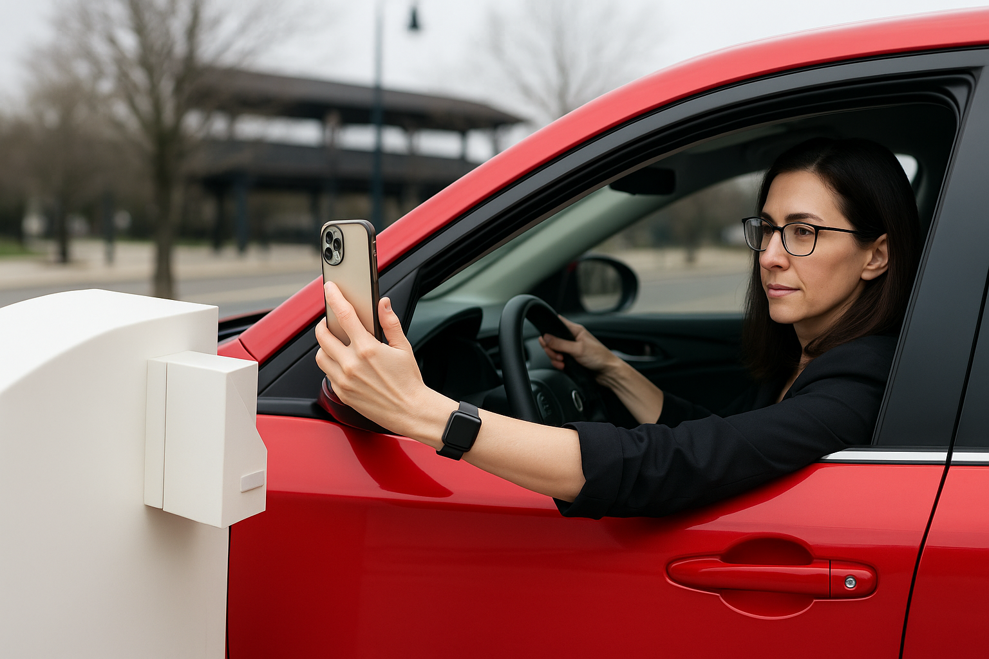
Why Contactless Access Matters Now More Than Ever
Parking guests today expect speed, simplicity, and a mobile-first experience — but outdated systems still rely on hardware, tickets, and slow entry.
Operators need a solution that modernizes access without driving up costs or disrupting operations.

Slide 3

Challenges Solved by Bolt360
Outdated systems frustrate guests and overburden operators. Bolt360 delivers smooth, app-free parking that eliminates hardware costs, speeds up entry and exit, and simplifies daily operations.
Problem
How Bolt360 Solves It
Clunky Entry Methods
App downloads, ticket machines, and kiosk delays cause guest frustration and long lines.
High Equipment Costs
Gated systems, kiosks, and maintenance drive up capital and operational expenses.
Limited Payment Flexibility
Slow, confusing payment options reduce conversions and delay exit.
Low Turnover, Lost Revenue
Exit congestion and friction reduce space utilization and cut into peak revenue.
Lack of Real-Time Visibility
No centralized data on guest behavior, session timing, or revenue trends.
App-Free QR Access
Guests scan to enter and exit — no apps, no tickets, no hardware barriers.
Zero Hardware Investment
Installs directly on gate arms — no construction or infrastructure upgrades required.
Instant Mobile Checkout
Guests receive a secure link via text and pay in seconds — no accounts or portals.
Faster Exit Flow
Quick scans and automatic payment increase turnover and minimize bottlenecks.
Live Usage & Revenue Data
Dashboards provide instant insights to optimize flow, staffing, and pricing.

Slide 4


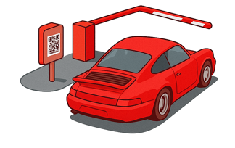

User Experience
How Bolt360 Works
Bolt360 makes parking fast, simple, and app-free. In four easy steps, guests enjoy contactless entry, quick mobile payment, and smooth exits — no apps, no machines, no confusion.
Step 1: Enter
Scan the QR code on the entry sign. A text appears — tap send and the gate opens.
Step 2: Park & Pay
Park your vehicle and receive a confirmation text with a link to pay via mobile.
Step 3: End Session
When ready to leave, scan the QR code at the exit gate and tap send again.
Step 4: Exit
Your payment is processed automatically and the gate opens — no delays, no confusion.

Slide 5
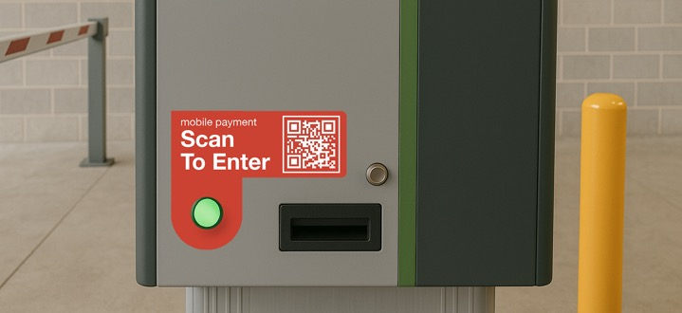
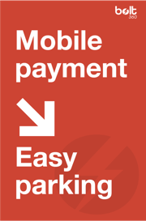
Signage & Onsite Experience
Clear, intuitive signage is integral to the Bolt360 experience — helping guests navigate entry and payment quickly while reducing confusion, guest support needs, and reliance on hardware or in-lane staff.
Simple QR Code Signs
Guests scan instructional signage at entry and exit — no screens, tickets, or confusion.
Fast Onboarding for First-Time Users
Step-by-step instructions help new guests complete payment quickly and easily.
Customizable for Each Location
Signage can be tailored to brand standards — including logo, color, layout, and messaging.
Reduces Support Needs
Clear guidance minimizes guest confusion and reduces on-site staff interventions or help requests.

Slide 6





Benefits Overview
Why Operators Choose Bolt360
Bolt360 gives parking operators an easier way to modernize access, streamline operations, and increase revenue without requiring major equipment upgrades or disruptive infrastructure changes.
Increased Revenue
Improves turnover, reduces drop-off, and boosts retention through stored payment history.
Frictionless Guest Experience
Delivers app-free entry, mobile payments, and fast exits for a smoother experience.
Real-Time Operational Insights
Live dashboards provide instant visibility into usage trends, session history, and revenue.
Lower Operational Costs
Eliminates equipment upgrades, app maintenance, and guest support for hardware issues.
Continuous Reliable Access
Ensures uninterrupted entry and payment flow — even if PARCS equipment goes offline.

Slide 7
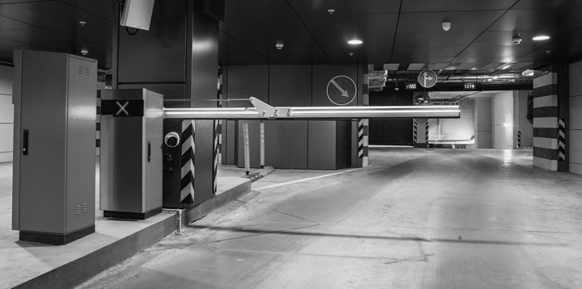
Benefit
Frictionless Guest Experience
Bolt360 removes friction from every part of the parking journey by replacing hardware, tickets, and apps with a fast, mobile-first experience that encourages guest satisfaction, repeat visits, and long-term loyalty.
App-Free Entry
Guests scan a QR code to enter — no apps, downloads, or login credentials required.
Text-Based Payments
A text link opens the secure mobile payment process with no account, login, or app setup.
No Hardware Interaction
Removes the need for guests to use kiosks or keypads, reducing confusion and delays.
Fast Exit Flow
Guests pay automatically and exit without stopping, improving turnover and reducing congestion.

Slide 8
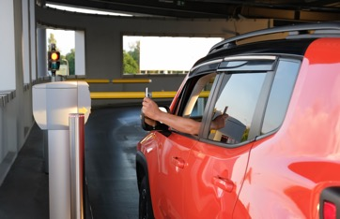





Zero Hardware Investment
Free to owners, Bolt360 installs on gate arms, reducing upfront and maintenance costs.
Benefit
Lower Operational Costs
Quick Installation
Deploy across your portfolio with no construction, downtime, or disruption to operations.
Bolt360 helps operators reduce equipment, software, and labor expenses by eliminating the need for app support, in-lane maintenance, and costly hardware upgrades across both gated and ungated locations.
No App Support Required
Eliminates the need to maintain, update, or troubleshoot guest apps across different devices.
Minimal Downtime
Operates independently of PARCS equipment, ensuring it stays live during outages.

Slide 9

Higher Turnover
Faster entry and exit flow allows more paid sessions per space during peak periods.
Improved Retention
Returning customers pay faster with saved information, encouraging loyalty and repeat visits.
Fewer Abandoned Sessions
App-free access and QR scanning prevent drop-off caused by slow apps or unclear instructions.
Optimized Rate Strategy
Real-time data helps operators adjust pricing dynamically to capitalize on demand.
Benefit
Increased Revenue
Bolt360 drives revenue by increasing parking turnover, reducing drop-off, and encouraging repeat visits — all while helping operators optimize pricing and recover revenue lost to friction in traditional systems.

Slide 10






Live Occupancy Tracking
Monitor real-time usage and peak patterns to manage flow, staffing, and pricing effectively.
Benefit
Real-Time Operational Insights
Session-Level Detail
Access transaction-level insights about guest behavior, stay durations, and usage trends.
Bolt360 provides operators with real-time performance data and guest behavior insights that support faster decision-making, smarter staffing, and continuous optimization across individual facilities and entire parking portfolios.
Revenue Performance Metrics
Track sales data by day, week, or month to identify trends and improve forecasting.
Customizable Dashboards
Filter, export, and visualize KPIs to support planning, reporting, and operational improvements.

Slide 11
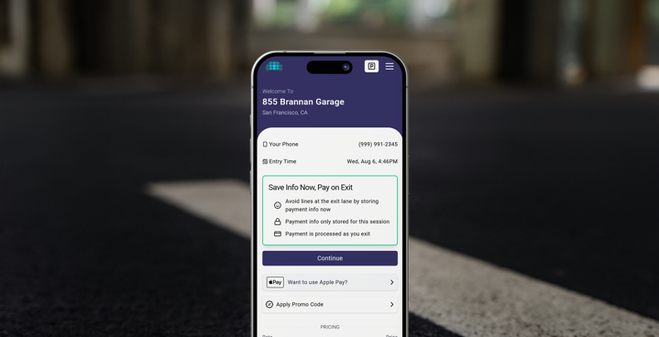



Benefit
Continuous Reliable Access
Bolt360 operates independently of PARCS equipment, ensuring access and payment systems remain live during outages — so operations continue, revenue is protected, and guest experiences stay uninterrupted even when other systems go offline.
Independent Gate Access
Guests can scan and pay normally, even if your PARCS controller or gate system is down.
Continuous Revenue Flow
Bolt360 keeps sessions active and prevents lost payments during equipment downtime.
Operational Resilience
Preserves uptime across access and payment systems, reducing service disruptions.

Slide 12
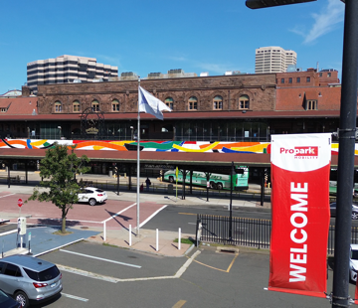


Use Cases
Where Bolt360 Works Best
Bolt360 works across a variety of asset types to improve flow, reduce equipment costs, and offer mobile-first access — without complex upgrades or disruptive transitions for staff, guests, or infrastructure.
Retail Centers
Reduce congestion and improve the guest experience with faster entry and mobile payment.
Event Venues
Speed up access and exit to reduce backups and support smooth high-volume operations.
Municipal Garages
Offer mobile-first access without PARCS replacement, reducing equipment costs and support needs.
Mixed-Use Developments
Support seamless transitions between parking types with frictionless access and payment.

Slide 13

FAQ
Common Questions About Bolt360
Bolt360 modernizes your parking access with simple, app-free technology. Here are the most common questions operators ask when considering how it fits into their locations, systems, and guest journey.
How does it work without an app?
Guests scan a QR code on signage and use a text link for mobile payment — no downloads or logins.
Do I need to replace my current equipment?
No, Bolt360 installs directly on your existing gate arms with no new equipment required.
Is the system secure?
Yes, Bolt360 uses a PCI-compliant payment processor and does not store guest payment data.
Can I use it with my current PARCS system?
Absolutely! Bolt360 works with your PARCS system and continues operating independently during outages.

Slide 14


Next Steps
Let’s Simplify Parking Together
Improve access. Reduce costs. Increase revenue.
Connect with us today inquiries@propark.com

