Slide 1
eGoldFax The Secure and Cost-Effective Alternative to MFP Fax Kits
[Presenter name
company name
presentation date here]

Slide 2
A Brief Introduction to eGoldFax
GoldFax is a 25+ year fax industry leader
Customers in nearly every sector of the market
Healthcare
Financial Services
Government
Education
Customers range from large, Fortune 1000 enterprises to small and mid-size businesses

Slide 3














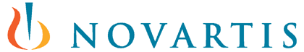







Notable Customers
Healthcare
Financial Services
Government
Education

Slide 4
The Benefits of Pure Cloud Faxing™

Slide 5
“[Cloud] fax services increase security, speed up the transmission of information, help with archiving and filing, reduce an organization's paper footprint, and decrease maintenance costs.”
Business.com, September 7, 2018

Slide 6
The Benefits of Pure Cloud Faxing™ (vs. traditional MFP Fax Kits)
Scalability
Reliability
Security
Universal Access
Reduced Maintenance
Greater Value

Slide 7
Scalability
NEVER miss an inbound fax due to a busy signal
”Just-in-time” capacity
Automatically scales up or down based on fluctuation in fax volumes
Grows with your business
Unlimited users
Unlimited MFPs

Slide 8
Reliability
NEVER miss an inbound fax due to a busy signal
Improved transmission success
Eliminates downtime due to fax card failures or telco outages
Greater redundancy and fault tolerance through network of carriers
Faster, error-free transmissions
Voice-quality PRI T1 voice circuits

Slide 9
Security & Compliance
Eliminates security risk of confidential documents sitting on a shared device
Built on Azure, the enterprise-class transmission backbone used by 90% of the Fortune 500
End-to-End encryption using TLS 1.2 encryption
Meets industry-specific security and compliance requirements
PCI-DSS Level 1 Certified data center
HIPAA, FERPA, GDPR, and more

Slide 10
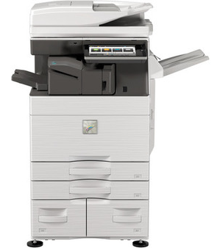
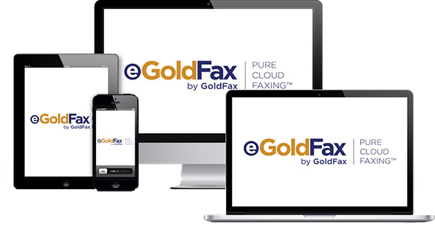
Universal Access
Fax from anywhere, on any device
Multi-Function Products
Desktop Computers
Mobile Devices
Improved productivity
Improved security

Slide 11
Reduced Maintenance
No fax hardware to install, maintain, or upgrade
No fax software to install or maintain
No user training – if you can email you can fax
Simplified installation
Cloud fax ready right out of the box

Slide 12
Greater Value
Reduced Costs
No analog fax lines or MFP fax hardware
No long distance charges in USA and Canada
No hardware or software maintenance costs
Flexible plans for specific needs
Added value built-in
Fault-tolerance
Disaster Recovery
Peak overflow scalability

Slide 13
eGoldFax vs. MFP Fax Kit Costs
Costs | eGoldFax | MFP Fax Kit
MFP fax hardware and installation | $0 | $
Analog phone lines | $0 | $
Telco transmission charges | $0 | $
MFP fax hardware maintenance | $0 | $
Notes:
Put $ in front of 0s on eGoldFax column

Slide 14
How Does it Work?
Fax directly from email and MFPs

Slide 15
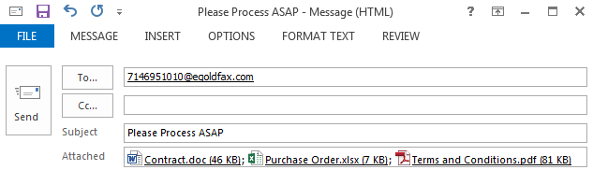
Faxing Direct from Email If you can email, you can fax
Create a new email message
Address to [faxnumber]@egoldfax.com
Attach any type of document (.doc, .xls, .pdf, etc.)
Send from any device
Desktop computer
Smart phone/tablet

Slide 16
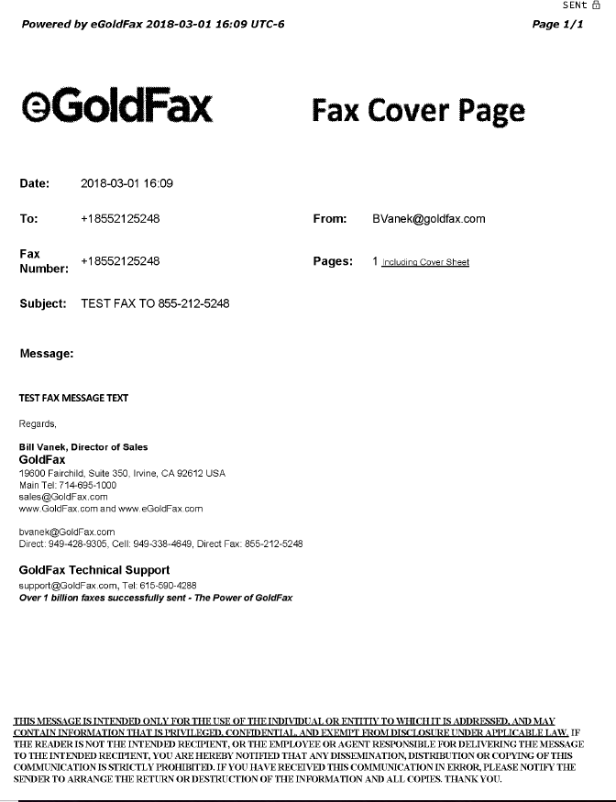
Faxing Direct from Email If you can email, you can fax
Subject and message text are included on customizable cover page
Email signature
Logos and other graphics
Confidentiality statements

Slide 17
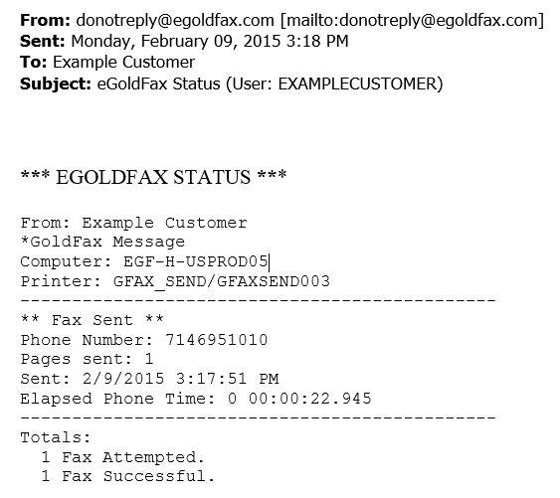
Faxing Direct from Email If you can email, you can fax
Receive notifications of fax status

Slide 18
Faxing Direct from Scan-to-Email MFPs Direct integration with the product you are already using
No MFP Fax Kit required
A savings of up to $1,000 per MFP
No fax telephone line required
A savings of $40+ per month per analog line
Supports the MFPs you are already using
Sharp
Kyocera
Xerox
Lexmark
Ricoh
Konica Minolta
…and more

Slide 19
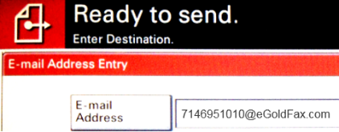
Faxing Direct from Scan-to-Email MFPs Direct integration with the product you are already using
Select eGoldFax from the MFP touch panel or select scan-to-email or Internet Fax
Enter FaxNumber@egoldfax.com in the “To:” field
Benefit from improved security and tighter accountability
Includes automatic fax cover pages
Records all fax transactions
Saves copy of all sent and received faxes
Notes:
Get higher res image

Slide 20

eGoldFax vs. MFP Fax Kit Benefits
Benefits | eGoldFax | MFP Fax Kit
Fax enable every MFP for no additional cost |  | X
On-demand scalability |  | X
Never miss a fax due to a busy signal |  | X
Enterprise-grade security and compliance |  | X
Zero training costs |  | X

Slide 21
What Makes eGoldFax Different?
Enterprise-class features at a small business price
Scalability when you need it – never miss a fax due to a busy signal
Custom integration with the MFPs you’re already using
Grows with your business – Unlimited users; unlimited MFPs
Improved security with end-to-end encrypted faxing

Slide 22
Enterprise-Class Features
FREE Fax Archive: optionally save sent and received faxes for up to 10 years
Admin Portal: manage user lists, fax routing rules, and more
Secure Fax Access: bypass email and access faxes via a secure HTTPS pull down
Advanced Fax Routing: Automatically route to folder, auto-print
Application Integration: Insert fax into your business applications and workflows

Slide 23
How Does Faxing Impact Your Business?
What types of documents do you send and receive by fax? Are these mission critical to your business?
What happens if you miss an inbound fax because of a busy signal?
How many pages a month do you fax?
How much are you spending on telco lines and transmission charges?
How much time do your employees spend printing, scanning, and faxing paper documents?

Slide 24
How Secure is Your Fax Environment?
Can you access and control your faxes around the clock?
Are you able to restrict unauthorized people from sending, receiving, viewing, and copying faxes?
Can you reproduce sent and received fax pages?
Can you easily report all fax transactions?
Are your inbound faxes received directly by the intended recipient without sitting on a shared fax device?
Do all sent faxes automatically include your fax cover page with contact information and confidentiality statement?
Can you send or receive faxes when your fax telephone service or fax devices fail?
If you answer “No” to any of these questions, you could be at risk of security and compliance violations

Slide 25
Q&A

Slide 26
Contact us for more information
[Your company contact information here]
Follow Us

