Slide 1

English Conversation
Class
Topic: Goals and Dreams
Intermediate

Slide 2

Introduce yourself and tell us whether your favourite time of day is sunrise or sunset!
My name is ………………………
My favourite time of day is …………… because ……………....

Slide 3

Goals and Dreams

Slide 4
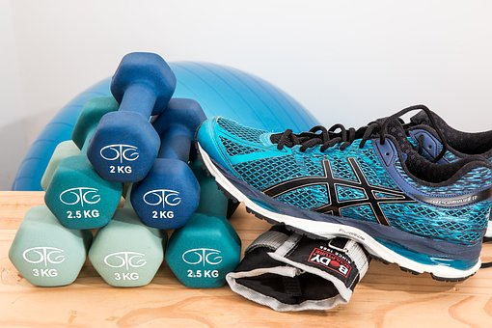
Q. What is a goal?
My goal is to exercise for 30 minutes every day.
A. Something you want to do or achieve

Slide 6

Can you think of possible personal goals?
Speak some English every day
Spend more time with family and friends
Exercise more
Eat more healthy meals
Quit smoking
Pay off all my debts
Get organised
Learn something new
Help others
Visit a new country

Slide 7
Do you have an important goal?
How can you achieve your goal?
How easy will that be?
What might stop you?
  For example:
  “I will eat more …”
  “I want to join …”
“I will contact my …”
“I will take time to …”

Slide 9


What would it mean to you to achieve your goal?
Notes:
What’

Slide 11

How did you do it?
What are some goals you have already achieved?
How did you remind yourself of your goal? Did you write down your goal, or put it up on the wall?
What did you do to succeed?
Did you do it on your own, or did you need someone else’s help?
Have you ever done something that you were really proud of? Tell us about it.
Have you ever done something really nice for someone else? What happened?

Slide 12

There was once a great leader called Moses who led his people wisely for 40 years. He loved and obeyed God.
When Moses died, his assistant Joshua became the new leader. God made Joshua a promise:
‘Just like I was with Moses, I will be with you. No one will be able to stop you all your life. I will never leave you.’
Joshua 1:5

Slide 13
Words of wisdom
God gives us that same promise if we love and follow him:
“I will be with you … I will never leave you”
Q. Does it surprise you that God makes a promise like that?
Q. Would that make a difference to you?

Slide 15

What’s one new thing you have learnt today?
Any questions?
Notes:
What’

