Slide 1

English Conversation Class
Topic: Light and Darkness
Intermediate

Slide 2
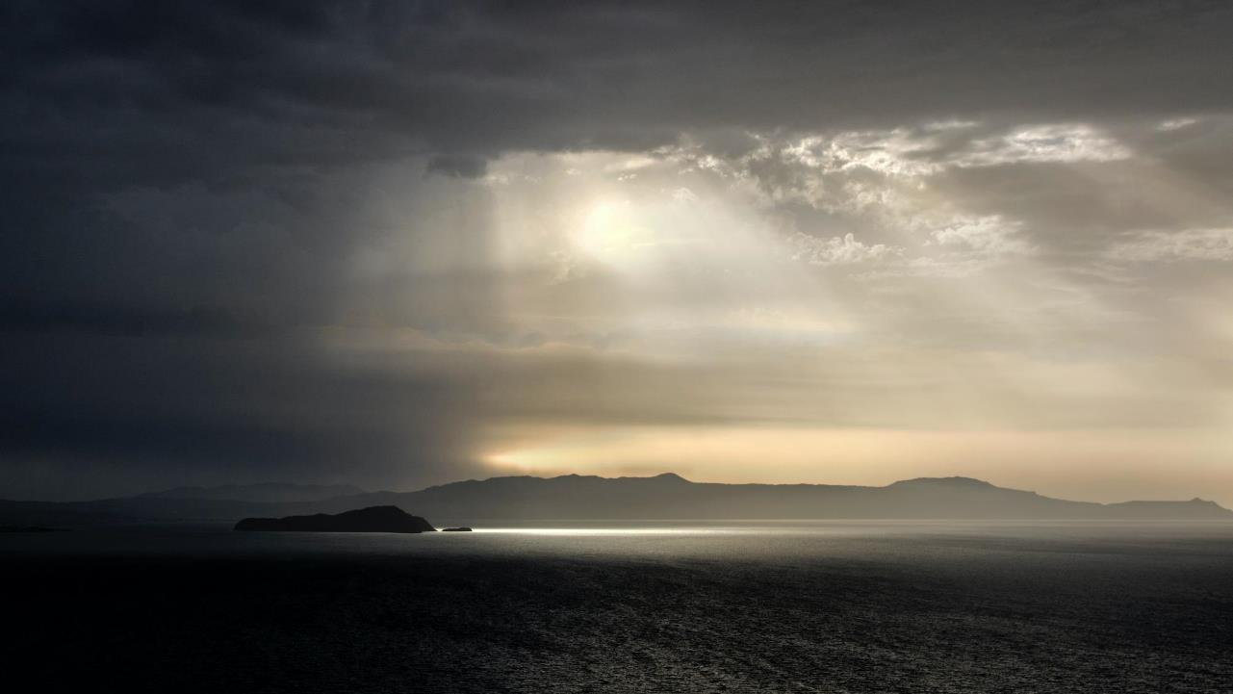
Light and Darkness

Slide 3
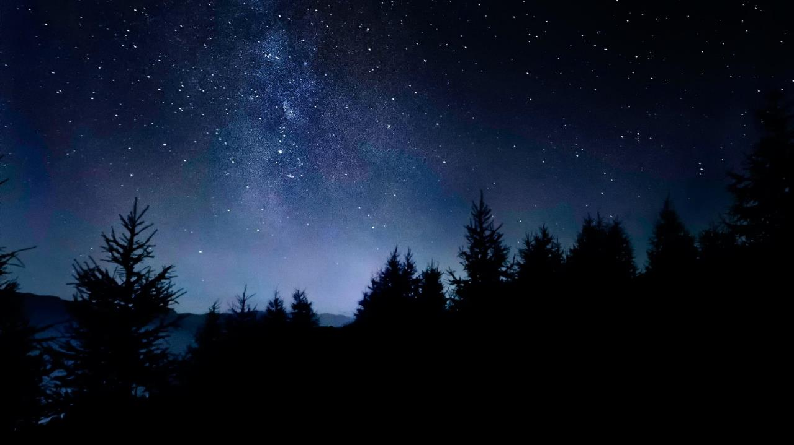
Think of two adjectives that describe darkness.
Notes:
Footer coversation

Slide 4

Think of two adjectives that describe light.
Notes:
Footer coversation

Slide 5
Did you think of these suggestions?
sad
gloomy
mysterious
frightening
lonely
unsafe
dismal
depressing
warm
happy
bright
safe
shining
sunny
sparkling
comforting

Slide 6
Notes:
Remive capitals

Slide 7
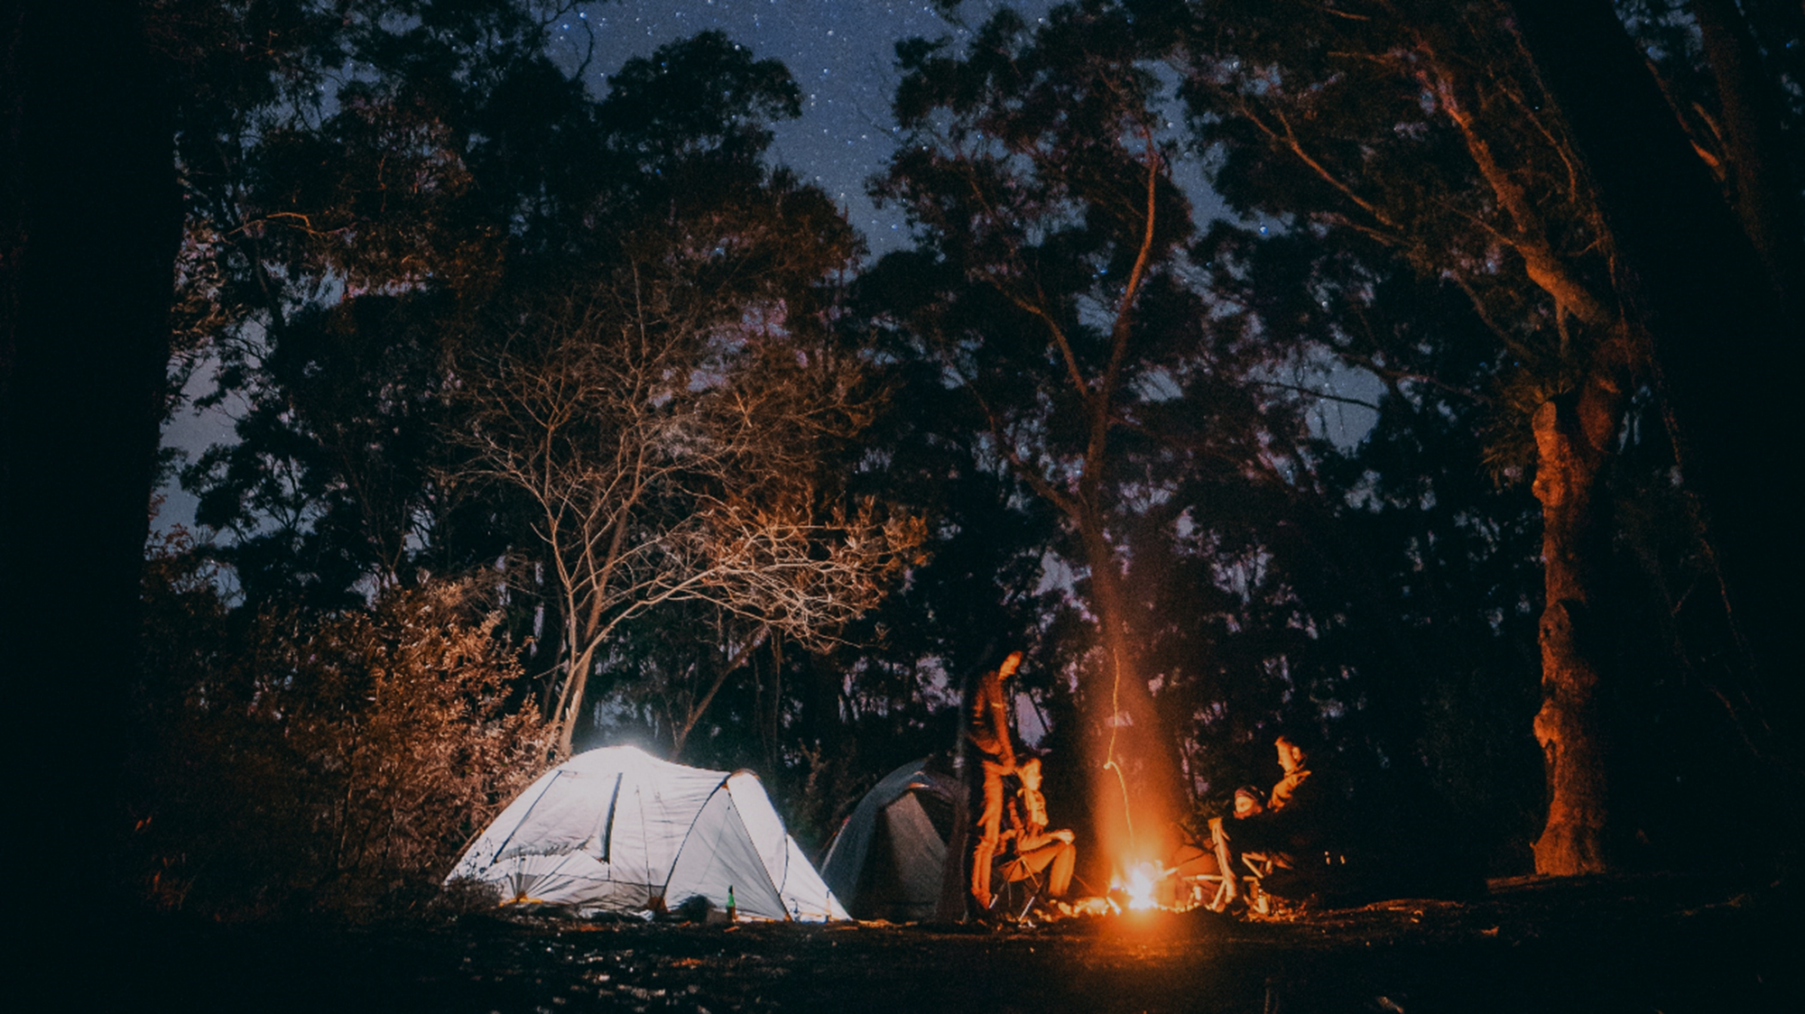
1. Have you ever camped out? What did you use for light?
2. What activities did you do at night when camping?
Notes:
Footer coversation

Slide 8
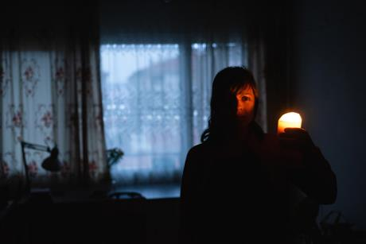
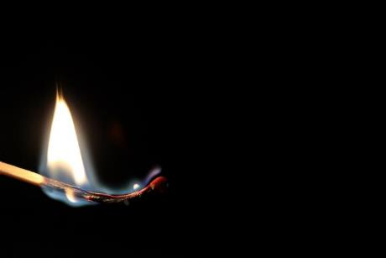
3. Were you afraid of the dark when you were a child?
Have you ever experienced a black out?
How did you feel when you were trying to find your way in the dark?
How did you feel when the lights turned back on?
Do you have a reliable power supply where you live?
VOCABULARY: Black out
When a house or building loses electricity for a time.

Slide 9
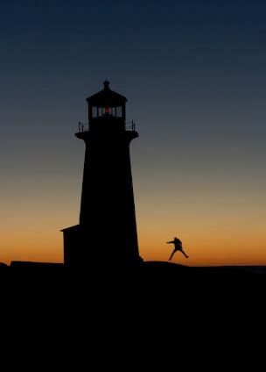
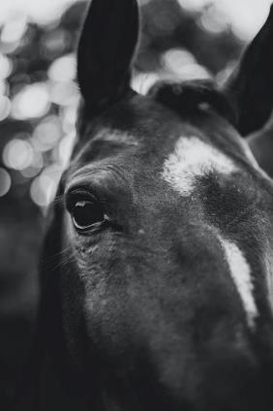
Idioms about ‘dark’
Can you use them in a sentence?
Something you do without being certain what will happen as a result
A person who keeps their ideas or skills secret
A leap in the dark
A dark horse

Slide 10
Notes:
Remove caps
Look at different subtitle

Slide 11

IT WILL SOON BE CHRISTMAS
Notes:
Footer coversation

Slide 12
Vocabulary
Festivals: special times of public celebration
Traditions: customs that are passed on from one generation to another
Decorations: objects that make something look more attractive

Slide 13
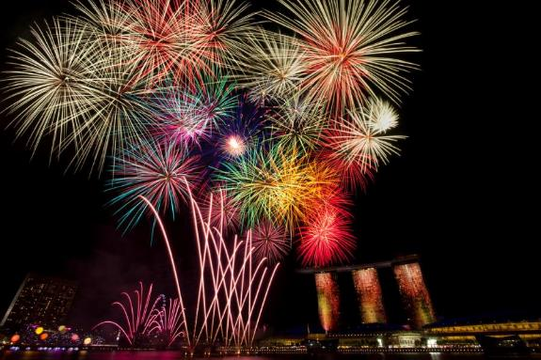
Festivals and fireworks
In your country are there festivals that use lights? Why do you think lights are used?
When are fireworks used for celebrations in your city or country?

Slide 14
Notes:
Remive capitals

Slide 15

Christmas traditions
Are there important Christmas traditions in your country?
Are Christmas lights and decorations common in shops and public places in your city or country? What sorts of decorations are used?
Do you have family traditions for Christmas? What do you do?

Slide 16
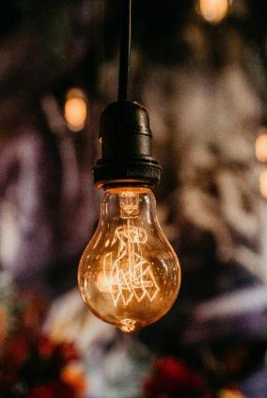
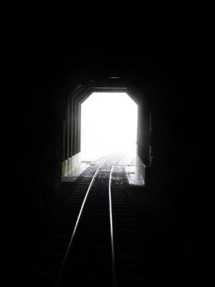
Idioms about ‘light’
Can you use them in a sentence?
Hope for the future; a reason to believe that a difficult or bad situation will end soon
A moment when you suddenly understand something
Light at the end of the tunnel
A light-bulb moment

Slide 17
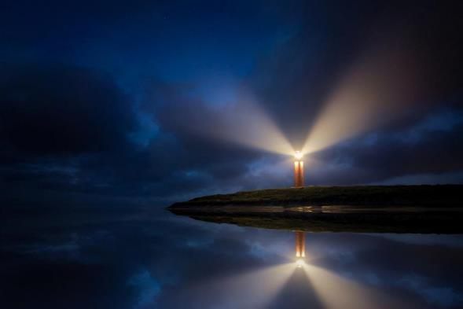
Idioms about ‘light’
Can you use them in a sentence?
A person who influences you for good
Q. Who is your guiding light?
A guiding light

Slide 18
Notes:
Remove caps
Look at different subtitle

Slide 19
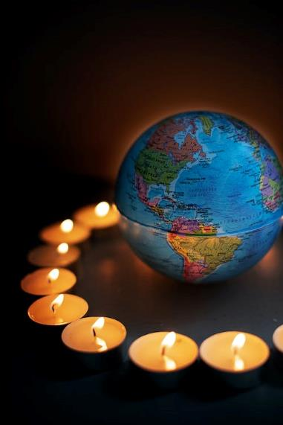
Words of wisdom
Jesus said, “I am the light of the world! Whoever follows me will never live in darkness. They will have the light that gives life”.
John 8:12
Jesus ‘turns on the light’ in our life so that we are able to see and understand God.
What do you think this means?

Slide 20

What’s one new thing you have learnt today?
Any questions?
Notes:
What’

