Slide 1


Ani Aprahamian
ASOF conference II
Dilijan, Armenia
June 26-28, 2023
Notes:
Good Afternoon…..I am ani aprahamian and in behalf of the Armenian Society of Fellows Executive Board,
I welcome you all who have traveled far from the four corners of the world to be here with us in Dilijan and the large list (>100) participants on-line!
While some of the ideas for ASOF existed in parts amongst many of us….after the 2020 war and with the encouragement of Vartan Gregorian...
We bring together scholars from all over the world to work with scholars here in Armenia, with private companies, and with the government of Armenia to transform Armenia....
we launched ASOF in 2021….
Our first conference was in 2022 in Venice on the island of SanLazarro

Slide 2
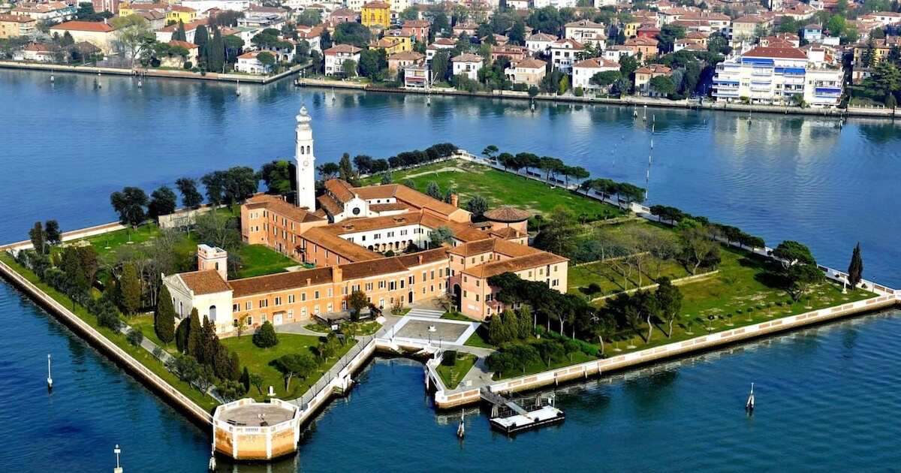

ASOF Conference I
San Lazarro, Venice
1512
Notes:
the idea of venice was important to our society of scholars...Venice and San Lazarro...

Slide 3
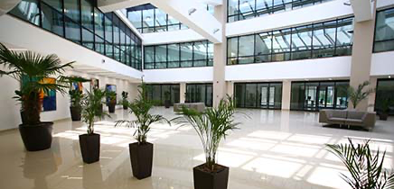
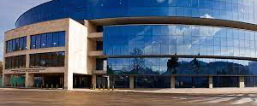



ASOF Conference II
Dilijan, Armenia
Sponsors:
Central Bank of Armenia
ASOF Board members
Cognaize
UATE
Notes:
We have these lavish

Slide 4


Slide 5


the Arts
Notes:
We want to be the inspiration for transforming Armenia…working together with you, with private companies, and the government of Armenia to achieve a new Armenian civil society

Slide 6
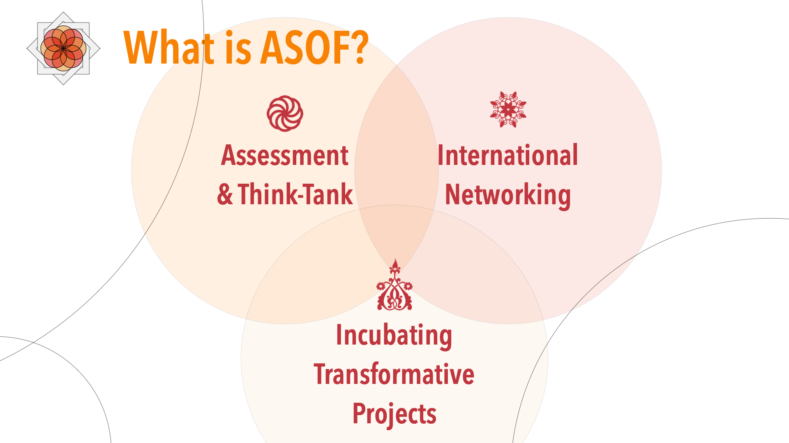
Notes:
How do we intend to do that…..

Slide 7
2022
2023
28 countries
196 disciplines
168 Experts & Scholars
259 Experts & Scholars

Slide 8


Notes:
We are a community of scholars…with one mission…..

Slide 9


Slide 10
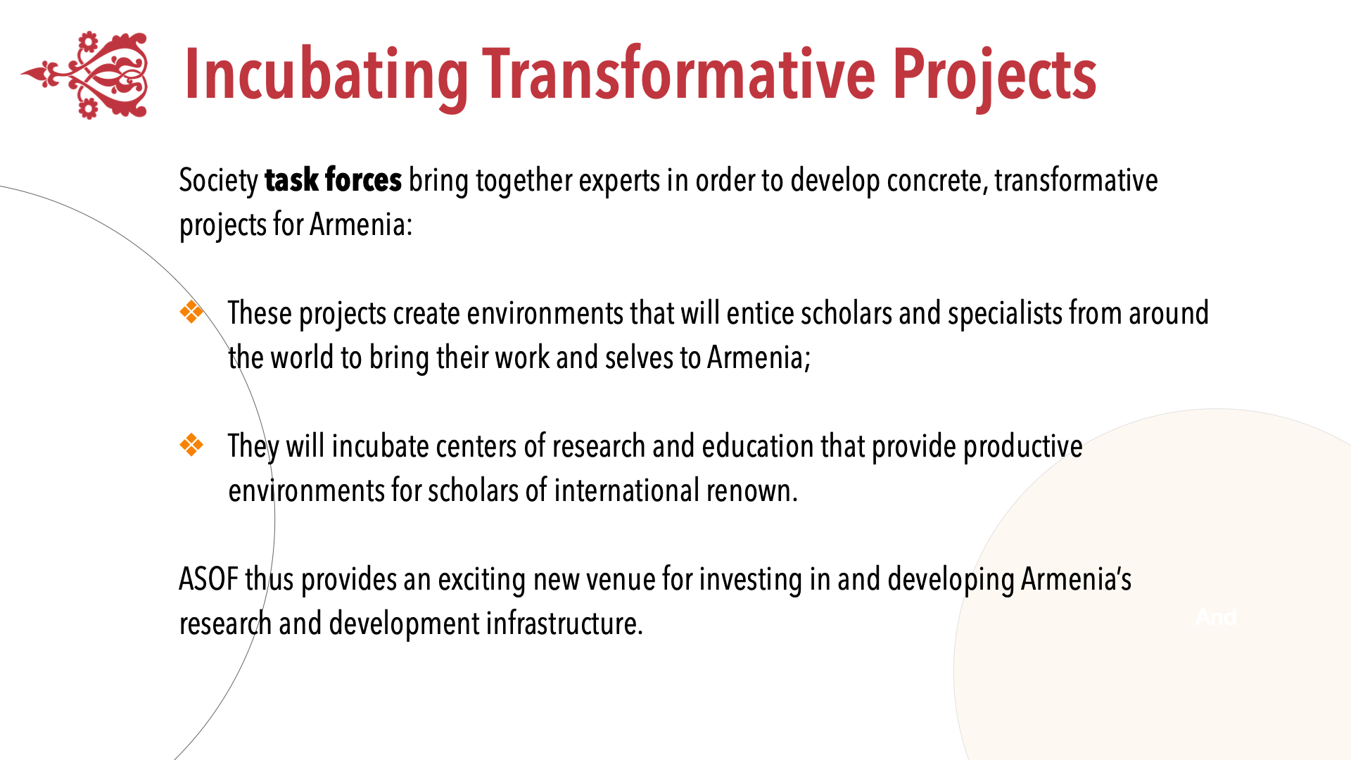

Slide 11
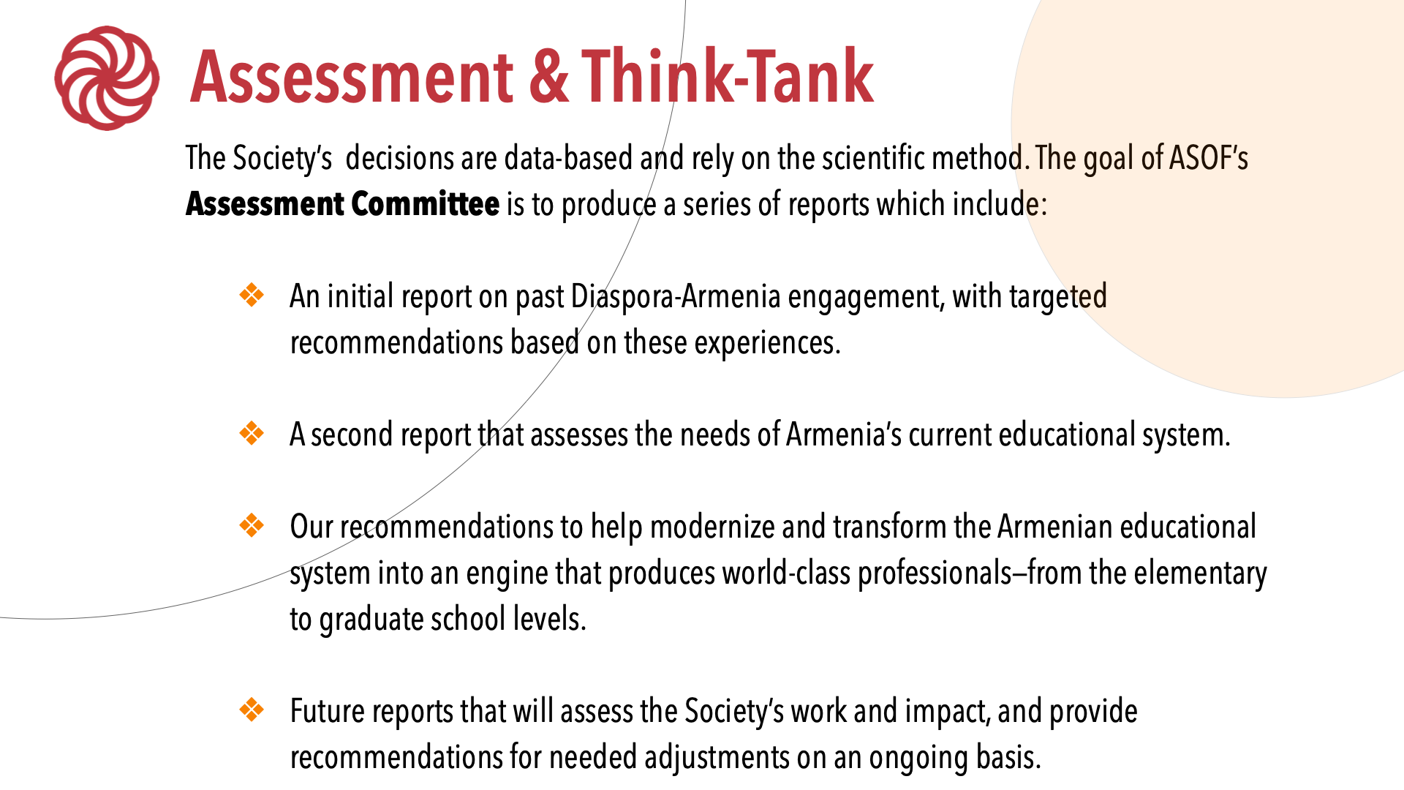

Slide 13
2023
1. Implemented
2. In process
3. In discussion/development

Slide 14
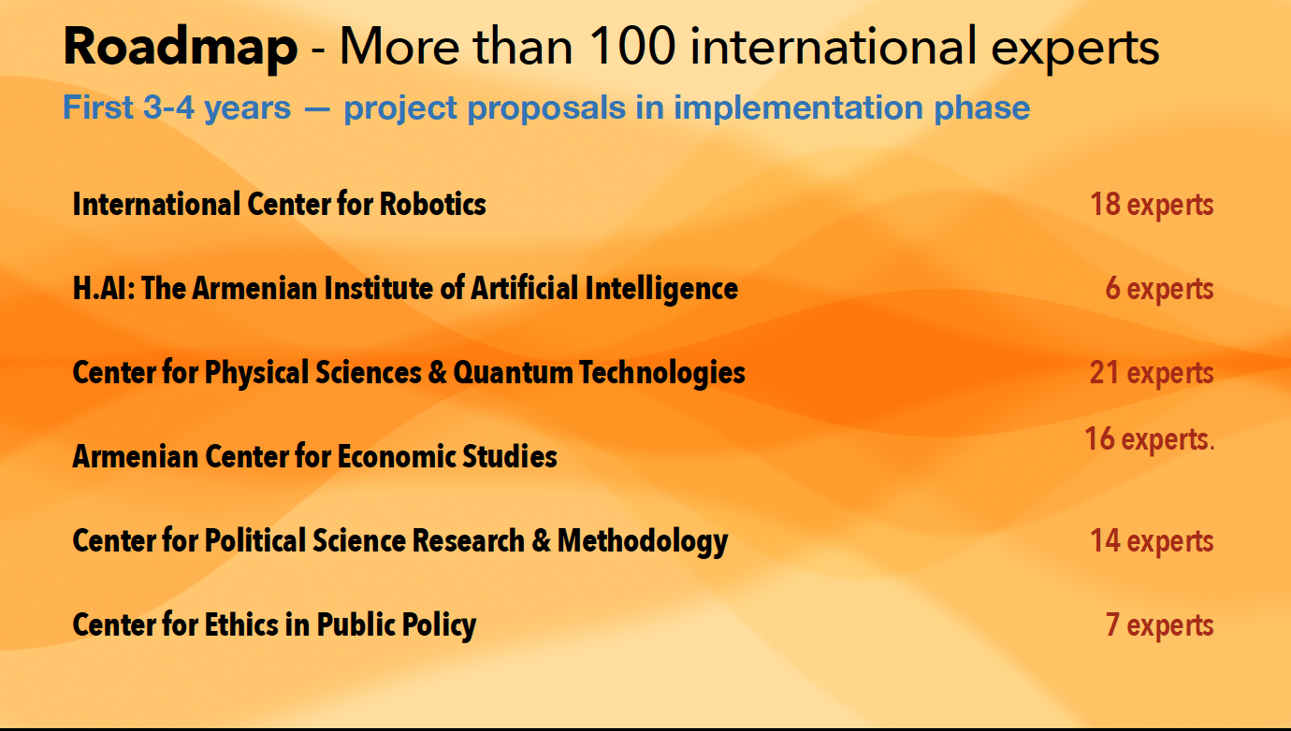

Slide 15


Slide 16
Join us to transform Armenia…
Notes:
I will end my welcome by asking you to join us to transform Armenia

