Slide 1
Mental Health Review Tribunal – Masterclass February 2021
Queensland Health Victim Support Service

Slide 2
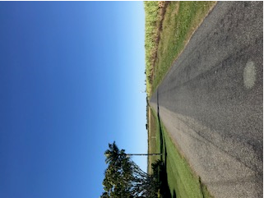
What is the road for victims & families in the forensic mental health system?

Slide 3
Support available from QHVSS to:
direct victims and their families in cases referred to the Mental Health Court (and those cases highly likely to be referred to the MHC)
direct victims and their families post MHC if the patient is placed on a Forensic Order or Treatment Support Order – includes victims with an Information Notice
direct victims and their families where a person who has harmed them has become Classified under the MHA 2016

Slide 4
QHVSS staffing: - state-wide service
6 x Allied Health clinicians (psychology / social work / occupational therapy) one in Cairns and one in Townsville
Director role with small caseload and administration officer
1 temporary AH position undertaking Restorative Practice project in collaboration with mental health services at The Prince Charles Hospital

Slide 5
April – June & July – Sept 2020 quarters
Number of clients open at end of quarter | 318 | 301
Average clients per FTE | 53 (6 VSC) | 50 (6 VSC)
Total clients when include family members | 344 | 339
Female | 61% | 59%
Male | 39% | 41%
Aboriginal and or Torres Strait Islander | 5% | 5%
Culturally and linguistically diverse | 8% | 9%
Dominant age bracket | 31-60yrs | 31-60yrs

Slide 6
April – June & July – Sept 2020 quarters
Information Notices | 157 clients (47%) had an Info Notice 150 Information Notices 7 Classified Patient Notices | 156 clients (46%) had an Info Notice 151 Information Notices 5 Classified Patient Notices
Notifications received in the quarter | 279 | 265
Average number of Notifications received per month | 93 | 88

Slide 7
Act of violence – July – Sept 2020 quarter
Homicide and Attempted Murder (40%)
Serious Violent Assault (18%)
Sexual offences (16%)
Stalking (9%)
88 family members currently being assisted in relation to a homicide

Slide 8
QHVSS clients
AMHS linked to QHVSS clients
18 % were linked to patients at Park High Secure, 8% linked to PCH, 7% linked to PAH and 9% linked to OCP (Non-OCP referrals to MHC)
Clients relationship to Patient
58% were known to the patient, 30% were family and 18% were friends, acquaintances, or neighbours.
Clients relationship to direct victim
56% of clients were direct victims of an offence and 17% are parents or step parents of direct victims

Slide 9
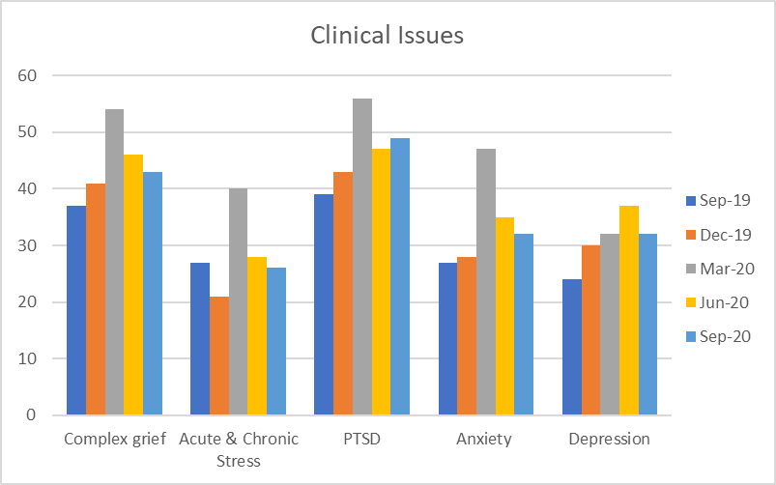
Clients clinical profile – Sept 2019 to Sept 2020

Slide 10
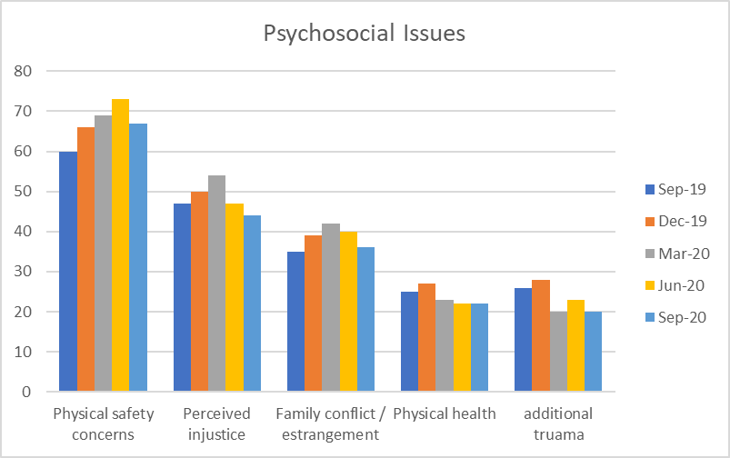
Clients psycho-social profile – Sept 2019 – Sept 2020

Slide 11
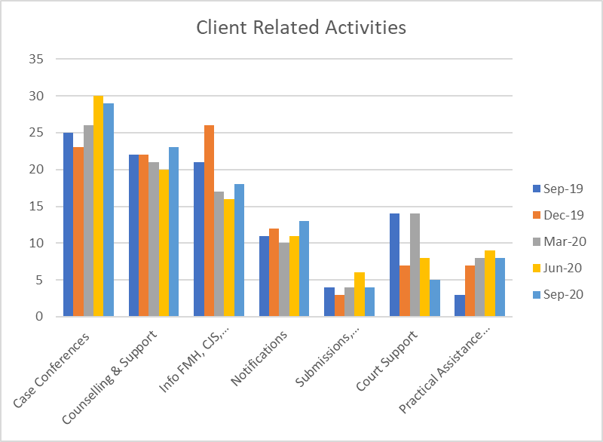
QHVSS staff – client related activity – Sept 2019 to Sept 2020

Slide 12
Information Notices – 2014 to 2020

Slide 13
Notifications – 2014 to 2020

Slide 14

Mental Health Act 2016
Chapter 1, Part 6 Principles for Victims and others

Slide 15
Chapter 1, Part 6 Principles for Victims and others
the physical, psychological, and emotional harm caused to the victim by an unlawful act must be recognised with compassion
the benefits of counselling, advice on the nature of proceedings under this Act and other support services to the recovery of the victims from the harm caused by the unlawful act must be recognised
the benefit to the victim of being advised in a timely way of proceedings under the Act against a person in relation to the unlawful act must be recognised

Slide 16
Chapter 1, Part 6 Principles for Victims and others
(d) the benefits to the victims of the timely completion of proceedings against a person in relation to the unlawful act must be recognised
(e) the benefits to the victim of being advised in a timely way of a decision to allow a person to be treated in the community must be recognised
(f) the benefits to the victim of being given the opportunity to express the victim’s views on the impact of the unlawful act to decision making entities under this Act must be recognised

Slide 17
Chapter 1, Part 7 Regard to principles
In performing a function or exercising a power under this Act, a person is to have regard to the principles mentioned in Part 5 and 6.

Slide 18
Section 27 Information Notices
Provides for victims (close relative, or others) can apply to the Chief Psychiatrist for specific information
(differs to MHA2000 where the application was to the MHRT with no timeframe)
Benefit?

Slide 19
Section 530 MHRT Reviews – VIS submissions and considerations
MHRT is to have regard to a VIS
Victims can update their VIS at their own discretion
Benefit?
Choice for victims about submitting a new VIS, or leave their existing VIS to be considered
Victims re-assured that current process results in their concerns being considered at each review

Slide 20
Section 164 and 743 – restriction on disclosing VIS at MHC and MHRT
The MHC & MHRT must not disclose a VIS to the person subject to the reference
Victim can ask for it to be disclosed to the person who harmed them, but Tribunal can decide that disclosure will adversely affect the health and wellbeing of the person
Benefit?
Relief for victims that their VIS is not disclosed to the person who harmed them
Victims can be more likely to submit a VIS if they believe the person who harmed them will not see their VIS

Slide 21
Section 324 – Tribunal must give particular information to the Chief Psychiatrist about the relevant patient
Applies if the Tribunal makes a decision to increase the extent of treatment in the community received by a relevant patient
Tribunal must give a brief explanation of the decision to the Chief Psychiatrist
Written notice is not a statement of reasons
Benefit
Intended to increase understanding and confidence for victims in decisions made by the Tribunal
Intended to assist with victims sense of safety, if they understand the reasons for increased treatment in the community

Slide 22
Schedule 1 – Information that the applicant, or the applicants nominee is entitled to receive under an information notice
3. Information about Tribunal decisions, that increases of extent of treatment in the community – brief explanation of reasons.
Example provided `authorised doctor has stated the patient has responded well to treatment during a stated time period’
Benefit?
Difference in explanations – some are more useful than others – most explanations are very brief e.g. complied with treatment

Slide 23
Schedule 1 – Information that the applicant, or the applicants nominee, is entitled to receive under an information notice
Hearing date of MHRT review
Information about transfer interstate
Date of a decision, and decision made by MHRT
Information about appeals, fact, date, nature of the appeal
Information about absences and required to return, and the fact that they have returned – needs to be relevant to safety and welfare of the person entitled to receive the information
Name of AMHS responsible for the patient
Transfer of responsibility to another AMHS, or forensic disability service
Tribunal decision to revoke a patient’s order

Slide 24
MHRT Questions
An overview of QHVSS’s process in relation to MHRT’s process.
For example:
is there liaison with victims prior to a MHRT hearing and if so, who initiates it?
if the MHRT hearing is adjourned, what does the QHVSS do and is the person told?
what is the victim told about a change in conditions or step down?
is there an education process for victims and family about what the MHRT does and its role, including around confidentiality, so that they can understand what the MHRT do?

Slide 25
MHRT Questions
The MHRT is restricted in the information that it is able to pass on to OCP for the OCP to inform the victim. The MHRT only gives “a brief explanation of the decision to increase the extent of treatment in the community received by a relevant patient”. When giving information to a victim, the Chief Psychiatrist must not include certain information, and so, the MHRT omits this information also: “details about the specific treatment and care provided to the relevant patient, including, for example, the type of medication being given to the relevant patient; and the address of a place in the community at which the relevant patient is living”.
With that in mind, what feedback does QHVSS receive from victims about the information given regarding decisions to increase the extent of treatment in the community?
Is there additional information that the MHRT could consider providing?

Slide 26
Example 1 - brief explanation of the reasons for a decision that increases the extent of treatment in the community (schedule 1)
“The Tribunal heard that xxxx has been compliant with his treatment and conditions of his LCT. He has had no incidences of concerning behaviour to indicate that the risk he poses as a result of his mental condition is unacceptable to the safety of the community.
The Tribunal therefore decided to approve authority for the authorised doctor to be able to change the category of his order to community in the future and when successful transition to his new 24 hour supported accommodation was complete.
xxxx was also authorised up to four consecutive nights absence to his family residence per month, at all times to be supervised by a responsible adult approved in advance by the treating psychiatrist”

Slide 27
Example 2 - brief explanation of the reasons for a decision that increases the extent of treatment in the community (schedule 1)
“The conditions on the forensic order have been varied to allow the patient some access to the community escorted by two health service staff members.
This is based on the clinicians recommendations, balancing the patients stable mental state, co-operation with the forensic order and treatment requirements, and the rehabilitation needs, with the ongoing need to mitigate and carefully and limit the potential for risk to the community.
The progress to leave in the community will be staged and graduated”

Slide 28
Example 3 - brief explanation of the reasons for a decision that increases the extent of treatment in the community (schedule 1)
“The conditions on the Forensic Order had required #### to only access leave between certain hours of the day, and in the case of unsupervised leave, for no more than six hours at a time. Those restrictions were removed because #### psychiatrist gave evidence that:
the risk to other people and property as a result of #### mental condition during periods of leave is at a low at present and:
greater flexibility in the timing and duration of leave would support treatment goals and rehabilitation.”

Slide 29
Example 4 - brief explanation of the reasons for a decision that increases the extent of treatment in the community (schedule 1)
“ YYYY illness has responded to a sustained period of treatment.
Yyyy has been having escorted absences on the ground of the health service and complied with all conditions.
The offence that led to the Forensic Order was very serious.
However, given the response to treatment and yyyy attitude to ongoing treatment, the level of risk and is now such that it is appropriate for yyyy to gradually commence having supervised absences in the ground and eventually off the ground, with a person approved by the treating psychiatrist to assist yyyy ongoing rehabilitation”

Slide 30
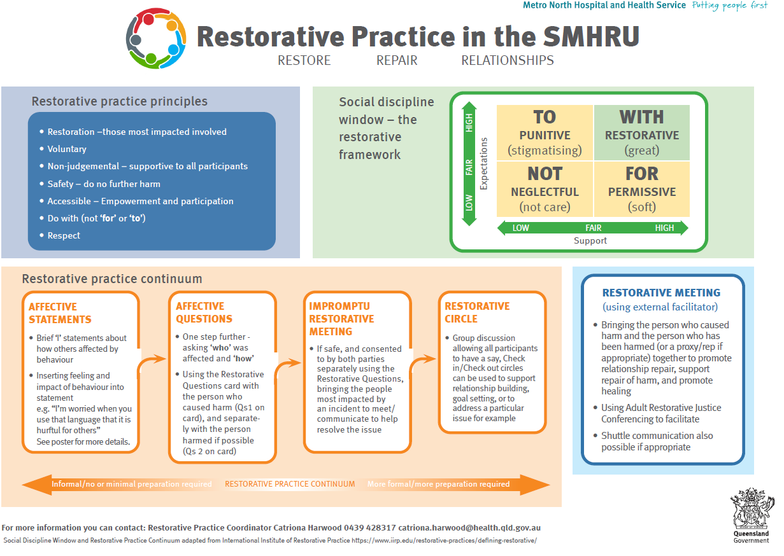
SMHRU Adapted RP Continuum (adapted with SMHRU)
Moving from left to right on the continuum, as restorative practices become more formal, they involve more people, require more planning and time (for example at the far end utilising the skills of an external DRB facilitator), and are more structured and complete. Although a formal restorative process might have dramatic impact, informal practices have a cumulative impact because they are part of everyday life (McCold & Wachtel, 2001; in IIRP; 2018).

Slide 31

Possible Outcomes for Restorative Practice in mental health
For persons harmed: an opportunity to express the impact of the harm, receive acknowledgement, consider what may repair the harm and help to improve the situation;
For person causing harm: an opportunity to recognise the harm & impact, express remorse & help to improve the situation;
For social, familial and professional care networks: to reset, re/build, re/establish healthy relationships;
For the SMHRU: to support and complement the therapeutic work already provided, reduce harmful incidents, foster mental health recovery and enhance staff well-being.

Slide 32

Questions ?

Slide 33
Contact details:
Michael Power
Email: michael.power2@health.qld.gov.au
Mobile: 0428 584 119
QHVSS
  www.health.qld.gov.au/qhvss
  Phone: 1800 208 005
  Email: victim.support@health.qld.gov.au

