Slide 1
COAT Conference update
For MHRT Member training only.
August, 2022

Slide 2
Agenda
A number of MHRT attended the COAT Conference.
They will each give us an overview of a topic presented at the Conference that is relevant to the MHRT.
Dr Kim Forrester - Procedural Justice: Why process matters.
Nikki Wawryk – Working effectively with high conflict people.
Kelvin Defranciscis – Fast and slow thinking in time poor Tribunals.

Slide 3
Procedural Justice: Why process matters
Presenter: Dr Kim Forrester
COAT Presentation:
Prof. Tom Tyler, Professor of Psychology, Yale University

Slide 4
Presentation: Procedural Justice – Why process matters
(presentation by Professor Tom Tyler –Yale University)
Goals:
Primary goal - substantive justice
Secondary goals - parties to the dispute believe, and experience, the procedure as just and a fair way to reach an appropriate decision. Want parties to abide by decision and know that the perception of fairness promotes acceptance and compliance.
In addition – Want people involved to view the system as legitimate: to abide by decisions, bring matters to the legal system and support the legal system. At community level want courts, tribunals viewed as legitimate because want them to trust the system.
Notes:
Commenced his presentation by setting out the Goals of Courts and Tribunals. Firstly, Primary goal is substantive justice – People in the legal system are legally trained. That decision makers consistently apply accepted rules to make decisions to ensure people get what they deserve. / Then there are the secondary goals / that the parties believe the process and procedures are just and fair and they experience the procedure as being a just and fair way to make a decision about their matter. Professor Tyler said research confirms that the perception of fairness promotes acceptance and compliance with decisions. People are less likely to disregard the decision, become angry, appeal. The perception also improves future interaction between the parties. In addition to the 2 preceding goals we want people/ involved in the system to see it as LEGITIMATE. He argues that if people view the system as legitimate they will bring matters to the system, accept and comply with the decisions and not try to undermine the decision or the system.

Slide 5
Goals of legitimacy and trust in the system
If people think system is a just way to address issues they are more likely to participate, not seek private vengeance, more likely to abide and less likely to undermine.
US decline in level of confidence and trust in the courts: 2018 73% to 2021 63%. Why was this? Looked at factors such as too costly, slow, judges don’t follow the law make decisions based on own prejudice.
When looking at legitimacy TRUST is a distinctive issue: independent from questions of substantive law, performance and cost.
Legitimacy matters and needs to be measured:
1. Trust and confidence (in legal authority and courts);
2. Perceived obligation to obey decisions;
3. Normative alignment
Notes:
So he proposes there is a broader goal of legitimacy and trust in the system. If people have a view the that system provides a fair and just process to determine their issue they are more likely to engage with the system and comply with the decision. He referred to a study which found a decreasing level level of trust and confidence in the US Court between 2018 and 2021. To explain that finding they looked at possible and probable causes /such as the cost of the courts and court processes, that the process was too slow, judges didn’t follow the law and made decisions based on their own prejudices. So looked at Legitimacy and trust and as indicators : trust and confidence in the system, perceived obligation to obey decisions and normative alignment ( authority shares the values of the community)

Slide 6
When measured legitimacy did it matter?
Behaviour of people in community - Factors measured :
Bring problem forward: highest if thought legitimate then lawful then effective (performance);
Willingness to support system, and;
Comply
What mattered was the court system was perceived as legitimate – whether there was trust in the courts.
Behaviour ( cooperation and compliance with the law) is driven by legitimacy and this is separate from perceptions of lawful and effective/performance.
Notes:
Conducted a National Survey looking at legitimacy through the behaviours of people and on the 3 measures: peoples inclination to bring matters forward, their willingness to support the system and their willingness to comply with the decisions. On all three the highest determinant was whether the courts were perceived as legitimate, whether the people trusted the courts. The other indicators of lawful and effective were less likely to drive the behaviours of compliance and cooperation with the law.

Slide 7
Why are people dissatisfied and discontent with the Court and Tribunal Systems?
Research -What shapes people’s views?
Looked at the tribunal experience and how people felt about the experience: ?win, ?got what they thought they deserved, how case was handled-felt the process was fair as distinct from what the outcome was.
Findings:
Procedural justice: people strongly impacted by their views about the process, how their matter was handled regardless of outcome. Short term acceptance and long term adherence shaped by process judgement distinct from judgement about outcome. Procedural justice impacts trust in authority of the system
Notes:
Professor Tylers research then examined why people were dissatisfied with courts and tribunals. What determines their views about the system. He discussed alternate systems to traditional Courts and Tribunals. Examples; If matter managed through mediation people saw that as more legitimate. Also applied to plea bargaining – participants felt the system was more legitimate. Research Considered how people saw the courts: was it based on whether they won or lost, whether they got what they thought they deserved ( THE OUTCOME) or how the case was handled – was the process fair. His findings were that peoples acceptance of a decision and their adherence to that decision were shaped by process judgements not outcome judgements . It was their trust in the system not the actual outcome that impacted on their trust in the authority of the system.

Slide 8
Procedural Justice
- Works, so should be concerned with it because builds trust and confidence in the system. Not issues like cost, substantive nature of decision that determine confidence in legal system.
What counts is that system made a decision in a fair way.
Procedural fairness matters because it drives legitimacy. Looked at ‘acceptance of decisions’ found procedural fairness was a higher factor than outcome fairness or outcome favourability.
Applies to individual and community perceptions of system legitimacy.
Legitimacy increased with perceptions of procedural fairness.
More willing to comply if perceived as fair procedure.
Notes:
So his proposition is that Procedural justice (fairness) builds trust and confidence in the system. It is not the cost or the substantive nature of decisions. What counts is the parties view the system as making decisions in a fair way. This drives legitimacy which in tern drives acceptance and compliance of a decision. If people think the procedure is fair they are more likely to accept a decision and comply regardless of whether the outcome was fair or favourable. This finding applies to individual and community perceptions and across ethnic groups . It was a finding which was consistent regardless of why the person was in the system.
The more unfair the system was perceived the lees trust people had and the less they views the authority and process as legitimate.

Slide 9
What is Procedural Justice (fairness)?
4 issues/ principles that define:
Quality of decisions:
Allowing a voice before decision
Neutrality
Quality of Treatment
Respectful
Trustworthiness
Research findings: these 4 factors matter more than winning or loosing.
Applies at the individual and community level. Whether trust courts mattered more than substantive justice, timely, cost
Notes:
There are 4 principles or factors that define Procedural justice and the research has been directed to both the experience of individuals and a survey of all Californian residents. These factors where more important than winning and loosing, costs, substantive justice and the timeliness of the process.

Slide 10
Principles
Voice: Want an opportunity to tell their story. State their case. Complained when did not feel given opportunity or decision maker distracted and not listening. Allowed to speak and feel heard.
Neutrality: Principled decision, independent, based on facts and apply the rules consistently. Problem is being SEEN to be fair – explain the process, procedure, decision before and after. In layman’s terms.
Respect : participants entitled to respect. Their case/concerns life taken seriously by decision maker. Polite, respectful explain ie right to appeal.
Trust: Most important issue is whether decision maker is sincere and benevolent with good intention. Trying to find the right outcome: how you communicate : active listening, connection, empathy, call by name, eye contact, make clear you are listening. People respond to sincere effort to take their needs and their point of view seriously.
Notes:
Voice: opportunity to speak and make their . That they were being listened to and heard
Neutrality: neutral principled decisions that were independent and based on the facts. The process was transparent and open and the importance of being seen to be fair. Ensuring the parties have information and an explaiantion of the procedure and the decision. Explain the decision and reasoned basis of the decision so people are not confused. Explain the implications of the decision.
Respect: polite, their concerns are taken seriously, what their rights are ie appeal.
Trust: Most NB issue decision maker is sincere, has good intentions and is trying to find the right outcome. Making it clear as a decision maker that you are motivated by the fairness of the process in making a determination

Slide 11
Bench card for trial judges – Procedural fairness
Introduce yourself
Greet the parties neutrally
Address timing concerns
Explain extraneous factors
Explain procedure
Use plain language
Make eye contact
Ask open ended questions
Stay on task
Personalise scripted language

Slide 12
Conclusion
Procedural Justice is an additional element to consider in relation to the design of, and conducting of, proceedings. Need a system approach. Realigned to the principles underpinning perceptions of legitimacy.
Helps secure immediate goal of acceptance of decisions and the larger issue of community support for compliance with the law and cooperation with the system . Builds commitment and promotes productive relationships between parties through a sense of reassurance and expectation of justice.
There is a different way to think about the goals of the system that is evidence based. Focus on legitimacy and build it through procedures that are experienced by the people as being a fair way to manage conflict and enforce rules .
Notes:
Conclusion Procedural Fairness is an additional element to consider and apply as it underpins the perception of the parties in the legitimacy of the process they are engaged in. It helps to secure the goals of acceptance and compliance with the decision and cooperation with the system. In addition it promotes a productive and cooperative relationship between the parties

Slide 13
Working effectively with high
conflict people
Presenter: Nikki Wawryk
COAT Presentation:
Megan Hunter, CEO & Co-founder
High Conflict Institute

Slide 14
Topics
What is the High Conflict Institute?
What is excluded from today’s summary
What is a high conflict situation?
What is a high conflict personality?
Tips on how to handle high conflict situations and people
Practical example/s
Relevance to Tribunal practice

Slide 15
What is the High Conflict Institute
Based in San Diego, USA
Provides education and training to assist in mediation and conflict resolution
Commenced in 2006 to assist courts to deal with high conflict cases, mostly in relation to family law disputes
Attempts to apply the field of psychology to legal situations
Aims to provide simple strategies that anyone can learn
More information:
  www.highconflictinstitute.com

Slide 16
Topics not covered today:
Personality disorders
Brain science
Childhood attachment theory
These factors are considered by the HCI to contribute towards the development of a high conflict personality

Slide 17
What is a high conflict situation?
Spectrum of conflict situations – low to high and each are mirror opposites
More than a loud argument
Typically involves a “high conflict person/personality”

Slide 18
What is a high conflict personality
Someone who feels victimised
Quick to blame others for their situation
Nil insight
Unable to control themselves
A drive to win and be right
Not a diagnosis
4 key characteristics:
All-or-nothing thinking
Unmanaged emotions
Extreme behaviours
Instant blamers

Slide 19
How to handle these situations
Be prepared – private working theory
Decrease stress / freezing and feel confident in dealing with high conflict situations
Understanding – person is being driven by their personality, they are not bad people, they have no insight into their behaviour
Driven by fear and desire to feel safe

Slide 20
Assertive approach is best
Cf passive or aggressive
Passive – conflict avoidance, can embolden aggression
Aggressive – will escalate conflict
Assertiveness:
  Diverts and contains conflict
  Makes the person feel safe
  Development of trust
  Don’t react, stay calm
  Matter-of-fact approach
  Emotionally unhooked
  This is a learned skill

Slide 21
What to avoid
Trying to give someone insight
Focusing on the past
Emotional confrontations or asking about emotions
Telling person they have a high conflict personality

Slide 22
Hearing Structure
Explain how hearing will run at the start
Set out that each person will have a turn to speak
“You will have a turn to tell me what outcome you want and your reasons”
“Please do not interrupt each other (I want to fully concentrate)”
Focus is on what to do now, not the past
Any questions?
Goal – to push the person from an emotional state towards problem solving / thinking

Slide 23
CARS Method
Connecting with EAR (empathy, attention, respect
Analysing choices and proposals
Responding to misinformation
Setting limits on misbehaviour
Article: https://www.highconflictinstitute.com/hci-articles/de-escalating-high-conflict-situations-in-4-steps

Slide 24
Practical Examples
Family law mediation example used by HCI
MHRT examples

Slide 25
Why is it so important to handle high conflict situations well?
Procedural fairness
Instil confidence in judicial systems / administration of justice
Future engagement in proceedings
Maintain therapeutic relationship between participants, support people
Hope for change in the future / empowerment

Slide 26
Fast and Slow Thinking in
Time Poor Tribunals
Presenter: Kelvin Defranciscis
COAT Presentation:
Justice Peter Applegarth AM
Judge, Supreme Court Queensland

Slide 27
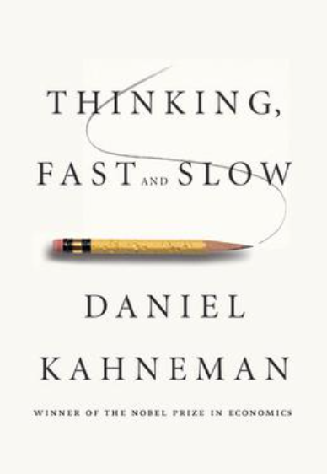
Fast and slow thinking
Intuitive thinking /system 1: going with one's first instinct and reaching decisions quickly based on automatic cognitive processes.
Cognitive thinking / system 2: allocates attention to the effortful, mental activities that demand it, including complex computations. Involves the questioning of first instinct and consideration of other possibilities.
“When all is said and done, we must face the fact that judges are human” – Jerome Frank, 1949.

Slide 28
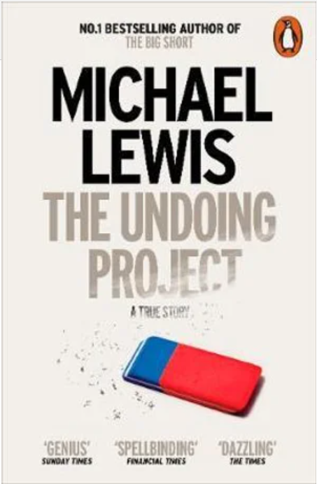
Example
Dr Donald Redelmeier, MD, MSHSR, FRCPC, FACP
Emergency room at hospital – patient brought in with multiple serious and obvious physical injuries from a car accident
Patient with a history of overactive thyroid also presenting with an arrhythmia
Be careful when there is one diagnosis that instantly pops into your mind that beautifully explains everything all at once. That is when you need to stop and check your thinking

Slide 29
Cognitive Reflection test
The original test penned by Dr. Frederick contained only the three following questions:
A bat and a ball cost $1.10 in total. The bat costs $1.00 more than the ball. How much does the ball cost?
If it takes 5 machines 5 minutes to make 5 widgets, how long would it take 100 machines to make 100 widgets?
In a lake, there is a patch of lily pads. Every day, the patch doubles in size. If it takes 48 days for the patch to cover the entire lake, how long would it take for the patch to cover half of the lake?

Slide 30
Cognitive shortcuts
Cognitive shortcuts: the automatic thought patterns that people use to make decision-making more efficient.
The availability heuristic: in which people judge likelihood by how easily examples spring to mind
The anchoring heuristic: in which people stick with initial impressions.
Framing effects: in which people make different decisions depending on how information is presented
Blind obedience: in which people stop thinking when confronted with authority
Hindsight bias: tendency, upon learning an outcome of an event - to overestimate one's ability to have foreseen the outcome
The law of small numbers (random numbers): drawing on information that can easily be called to mind. Yet experience may be unrepresentative of the reality.

Slide 31
Interrupt the intuitive thinking
Professor Emma Cunliffe:
“…for the account that I find more coherent to have occurred, what must the protagonist have done? When and how must she have done it? In what time period did it occur, according to the best and most independent evidence I can muster? How well is this account grounded in the trial record, and to what extent am I making inferences from proven facts? What evidence challenges this account, and do I disbelieve that evidence? Are there things I would expect to see if this narrative were true, but which are absent from or contradicted by the record? And, what assumptions am I making about human behaviour to get to this result?”

Slide 32
Stop and Think
Be aware of those cognitive shortcuts
Use cheat sheets or prompts to help structure and make a decision
Imagine if you had someone writing a dissenting opinion e.g. devil’s advocate
Take a break or reserve the decision

Slide 33
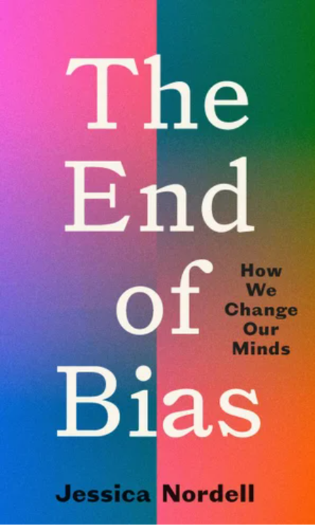
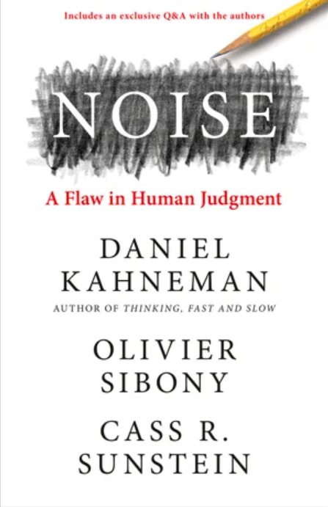

Further reading

Slide 34
For MHRT Member training only

