Slide 1


Come follow us!
https://www.enscryb.energy/
https://www.linkedin.com/company/enscryb

Slide 2



Enscryb vision
We must change how energy is balanced to increase economic value, improve resiliency, and support sustainability.
Today is a
distributed challenge
Our tomorrow is a digital solution
Our BEYOND is
Democratized future
Lack of grid capacity requires flexibility
Resiliency against severe weather
Curtailed renewable generation
Multiple markets for revenue stacking
Hyper localization of DER assets
Hybrid control edge and central
Multiple owners, nested control
Near real-time optimization
AI-driven market learning and dispatch
Highly localized economic models
Real-time consumer-based trading
System operation at the edge
Balancing from the edge up

Slide 3






Enscryb at-a-glance
A platform that enables real-time energy planning and cost savings in an era of increasing market volatility, demand and renewable production
Today’s offering
Digital toolset for power flexibility and DER planning
with digital twin and intelligent simulation
Launched October 2024
Key Value Cases
Investment financial planning
Revenue stacking strategy
Value stream stacking
  Backup generation
  Lower net costs
Target customers
1. C & I Asset owners
2. Muni/Coop/Community
3. Engineer / developers
4. Retailers/ Aggregators
5. Grid Operators
Team
Lean team of experts with
50+ years of expertise in
energy disciplines from
multiple global regions.
Business model
Software subscription + consultant led integration
and training
Business traction
2024 Pre-revenue;
4 customer POCs
2025 first deals landed
Projecting €.5M orders
DER: Distributed Energy Resource, generation, load, pricing, storage

Slide 4

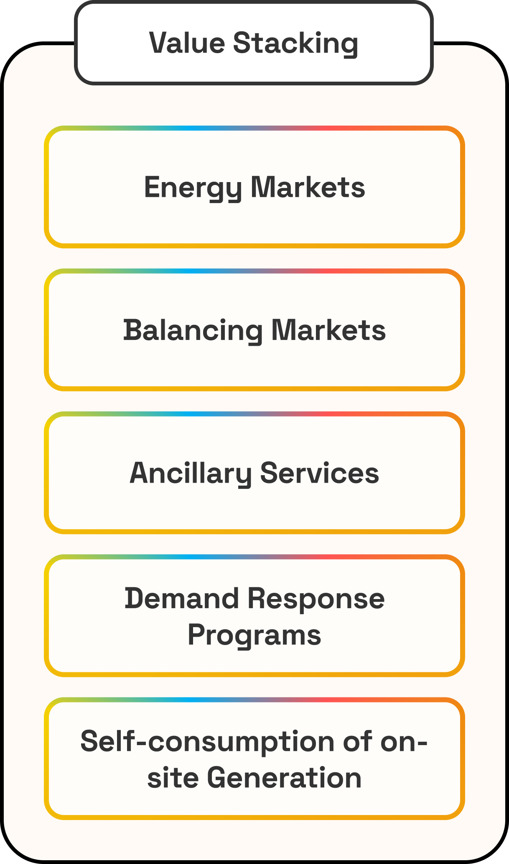
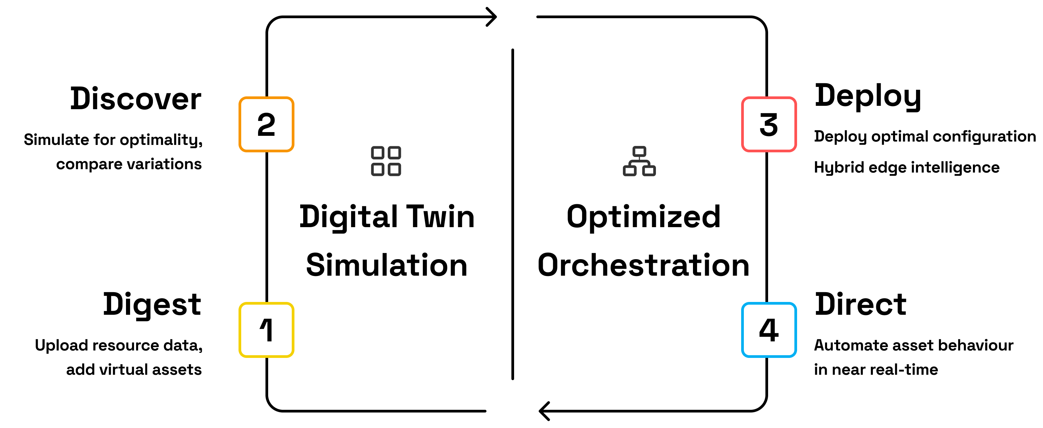
Enscryb at work
We help customers plan investments and operations for optimal economic outcomes
Orchestrate defined
optimal outcome
Based on Nokia Bell Labs Technology
Simulate using digital
twin technology
Continuous learning and optimization

Slide 5
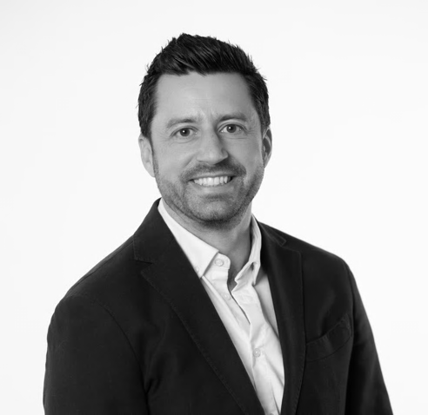
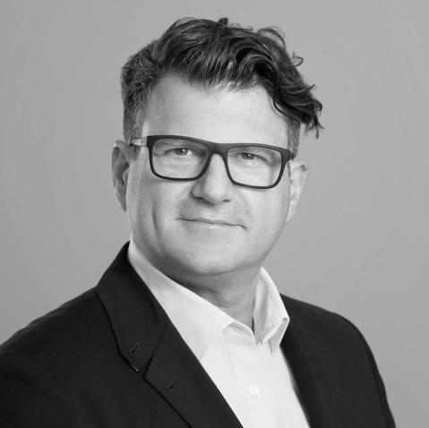
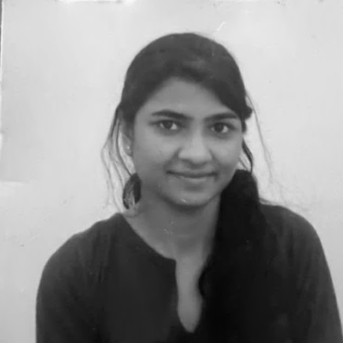
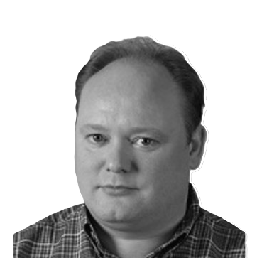
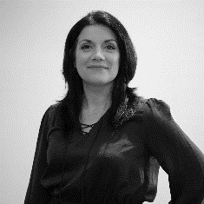
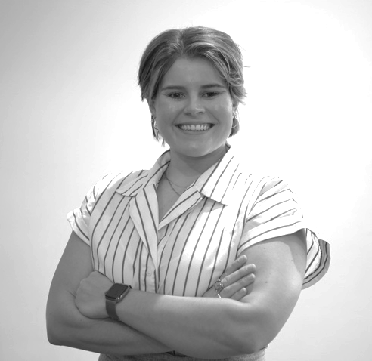
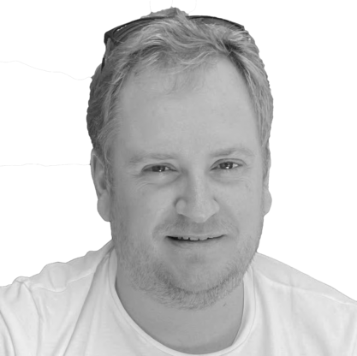
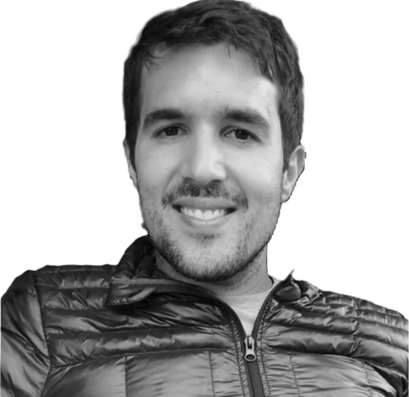
Key team members
Stavros Sachinis
Chief Commercial Officer
15 years in energy
Alto Kemeny
Chief Operations Officer
Geethupriya
Vijayamurthy
Head of Product Development
Marc Roelands, PhD
Technical Product Advisor
Liana Jo Ault
CEO
30 years in technology
13 Years in Global Energy
MsC in Energy Policy (2025)
+ 2 FTE
+ 7 contract
Anastasia Grilley, PMP
Head of Customer Delivery
Anton Dries, PhD
Technical Architecture Lead
Jesus Contreras-Ocana, PhD
Optimization Scientist
15 years in energy
50+ years of energy experience

Slide 6


