Slide 1

Heat Event Production Karaoke party in Miami
Price List for DJ setup

Slide 2
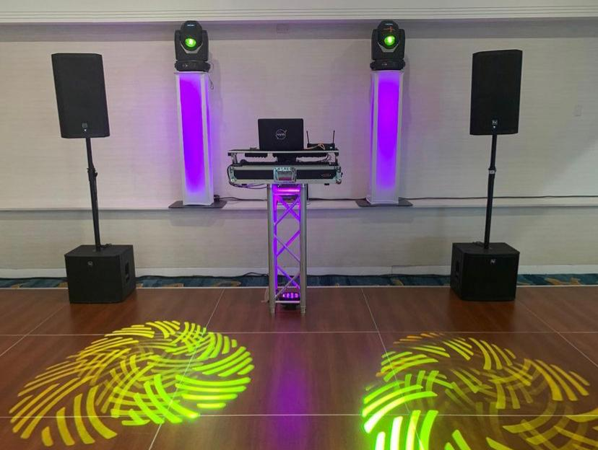
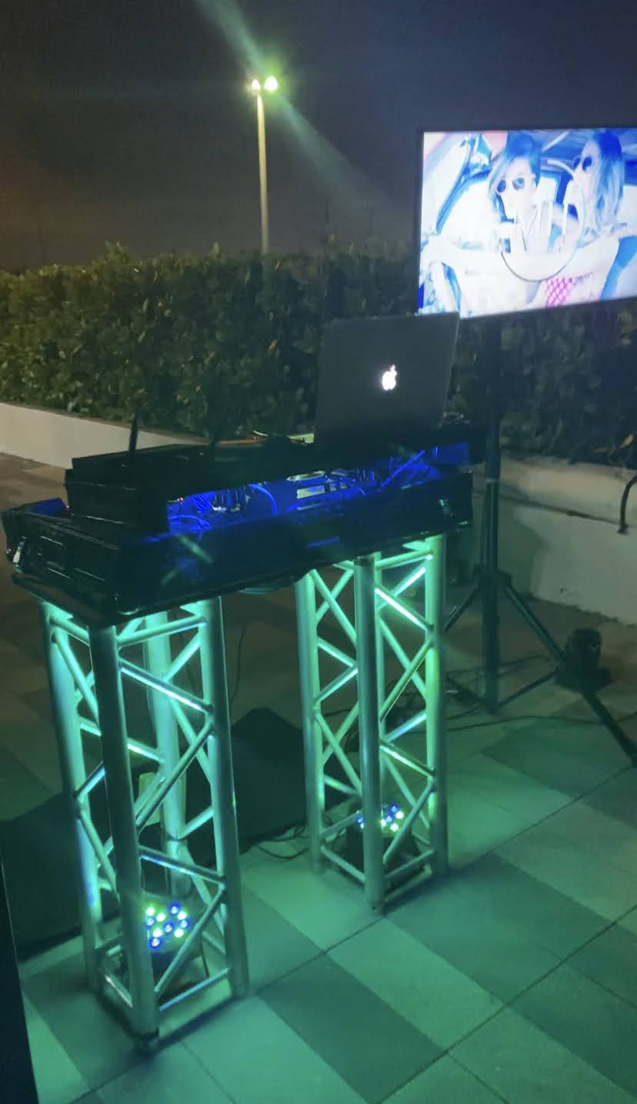
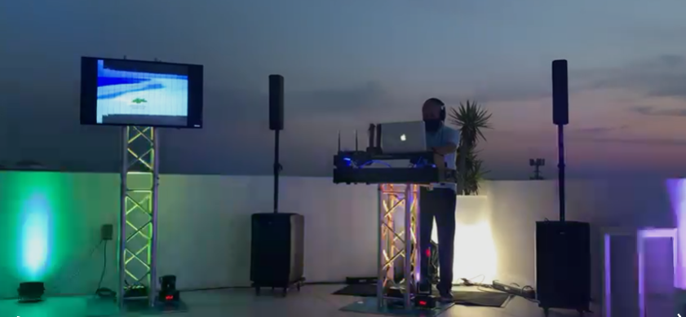
Silver Package US$ 160.00 per hour / Min 4 hours.
DJ boot with truss stand. 45” LED Screen attached. Wireless Microphones. RCF Sound system. 6 PAR Lights. 2 Moving Heads. DJ & Karaoke Service
*Hotels and buildings will have a $120 delivery fee

Slide 3
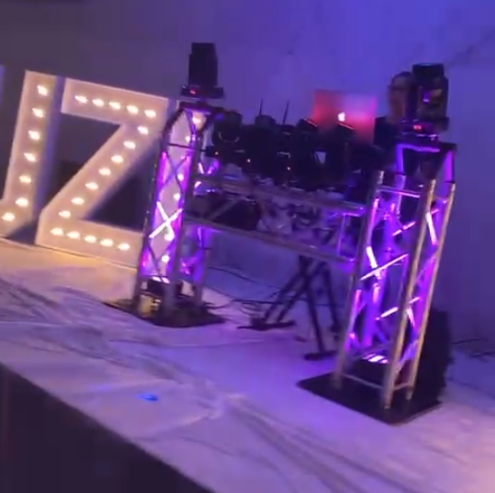
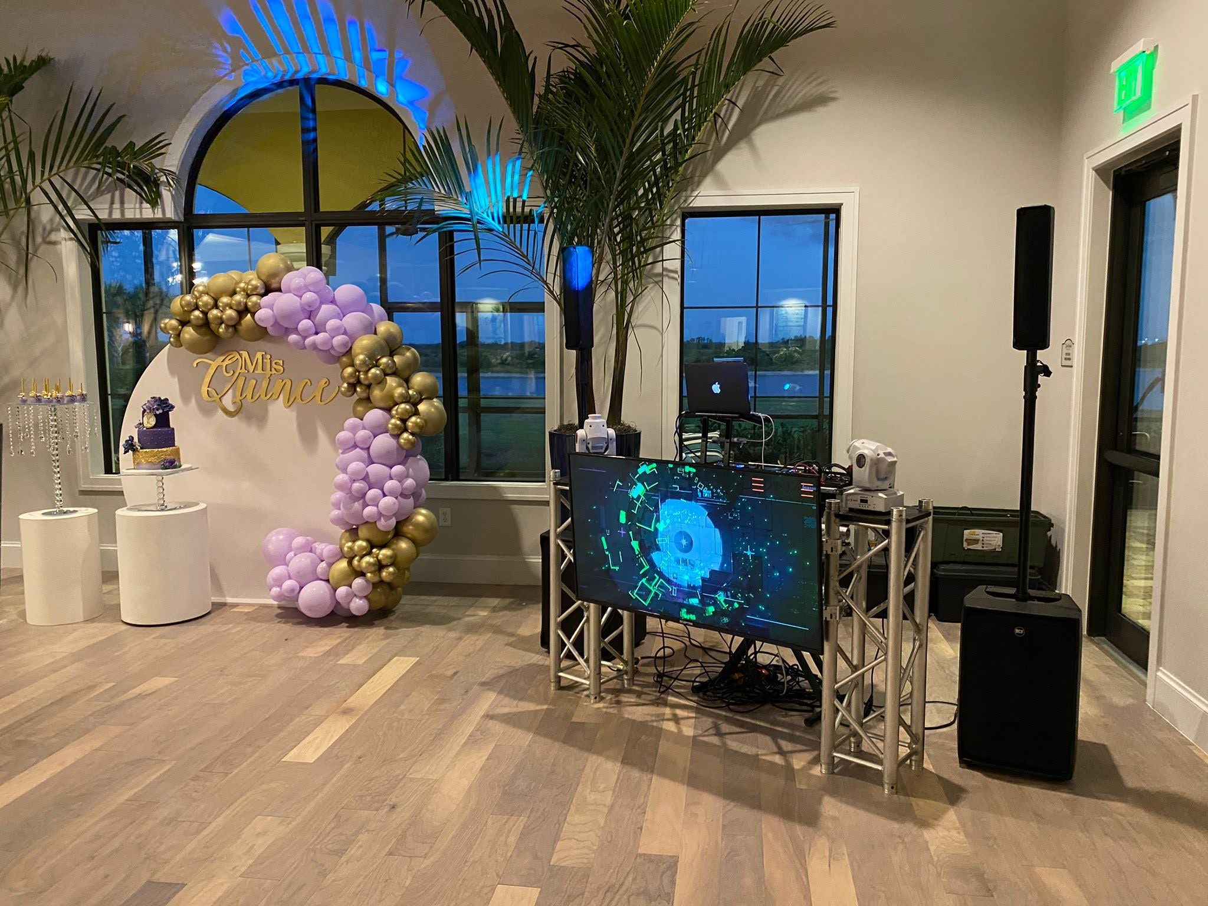
gold Package US$ 195.00 per hour / Min 4 hours.
DJ boot with 3 trusses and 65” LED Screen attached. Wireless Microphones. RCF Sound system. 6 PAR Lights. 4-6 Moving Heads. DJ & Karaoke Service
*Hotels and buildings will have a $120 delivery fee

Slide 4
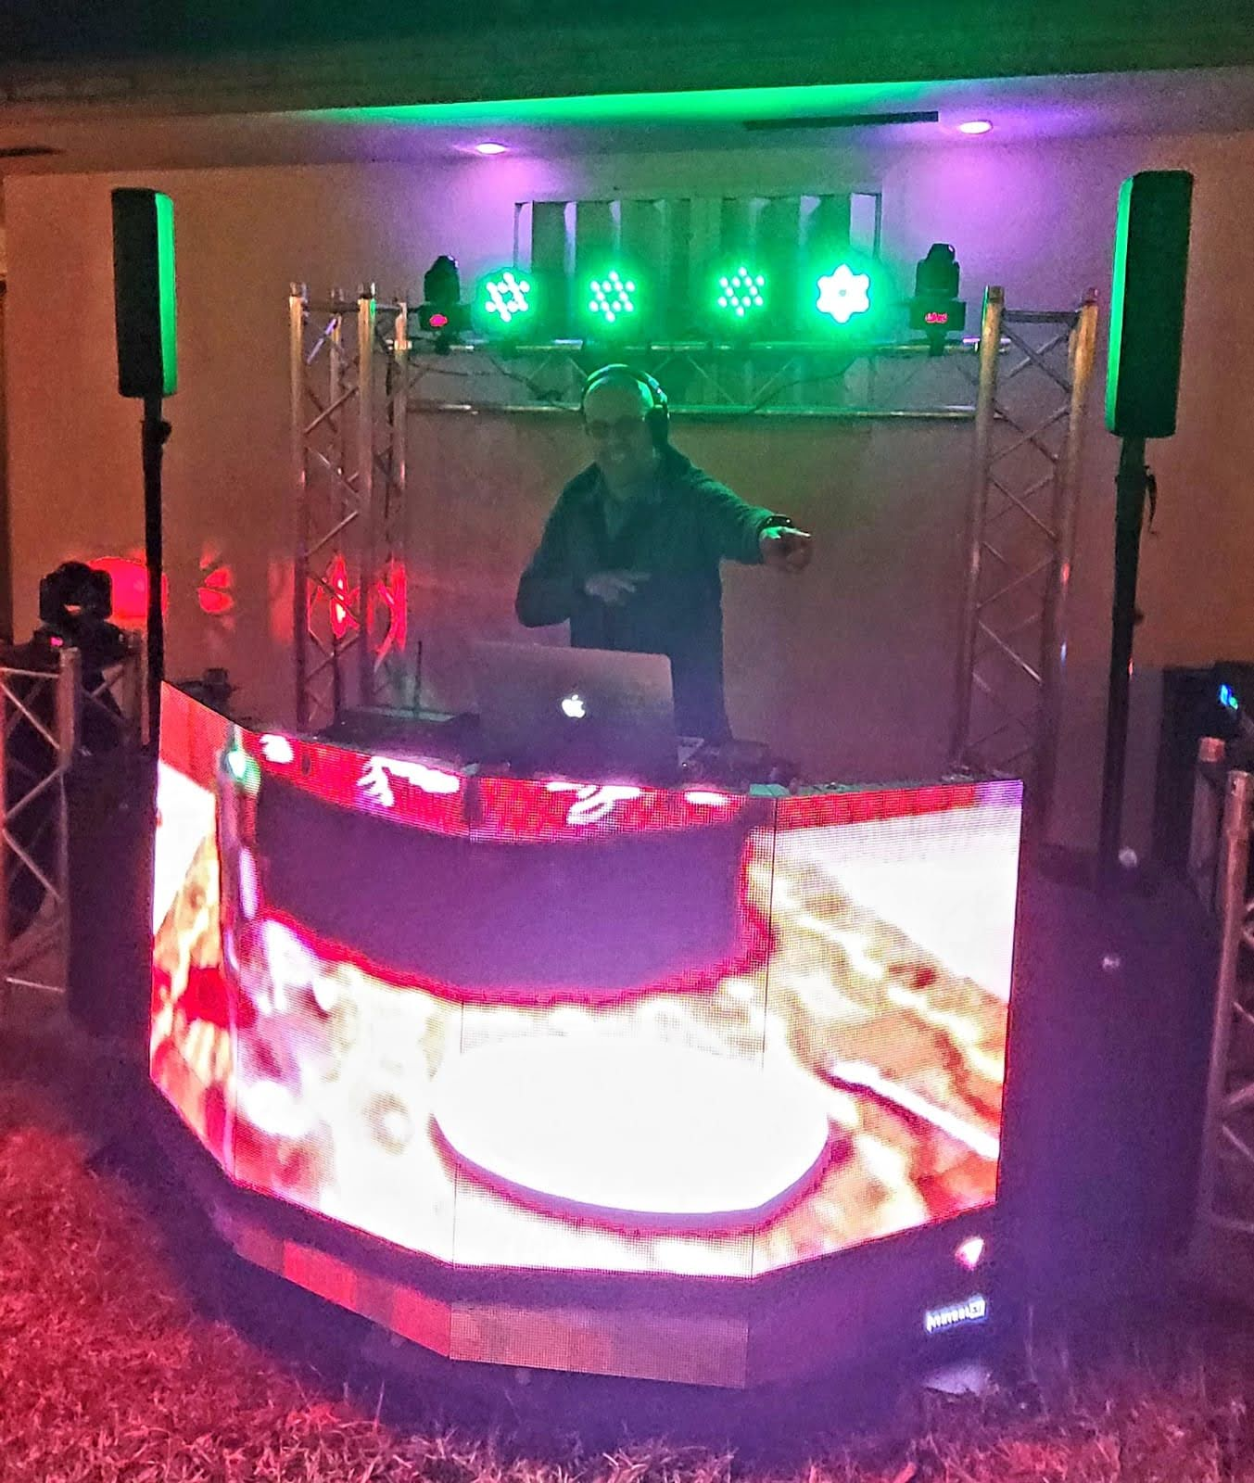
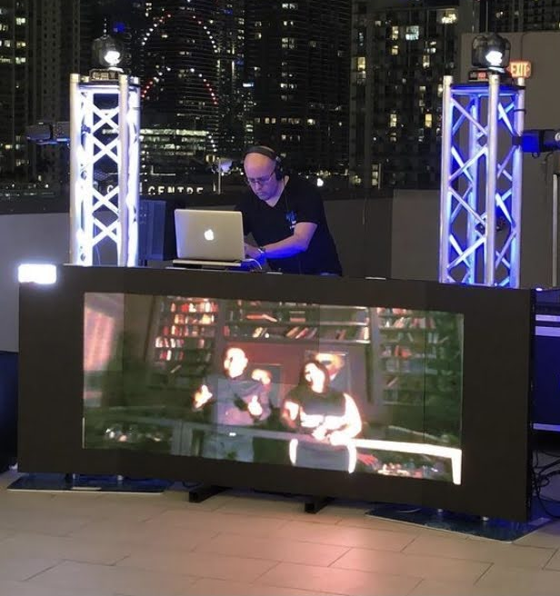
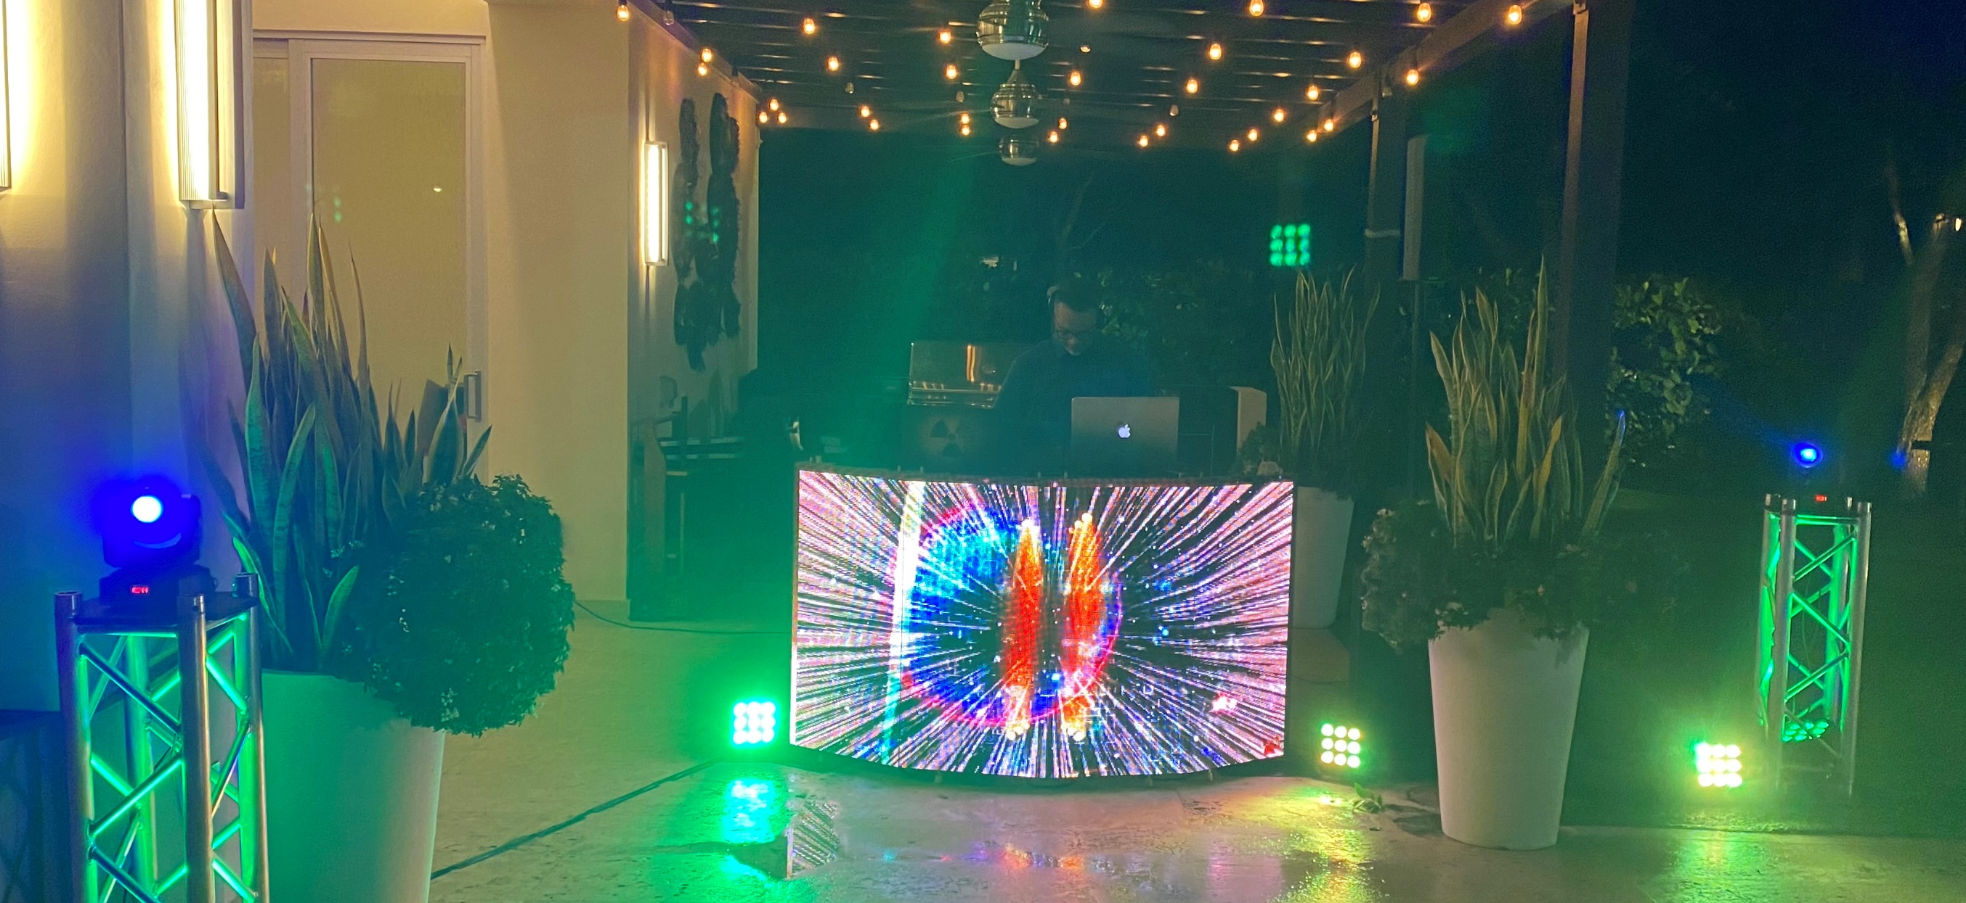
Platinum Package US$ 320.00 per hour / Min 4 hours.
Curved DJ boot with P3 led screens. trusses for lightning. Wireless Microphones. RCF Sound system + subwoofers. 6-10 PAR Lights. 4-8 Moving Heads. DJ & Karaoke Service
*Hotels and buildings will have a $120 delivery fee

Slide 5
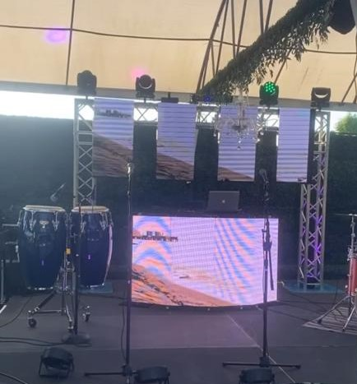
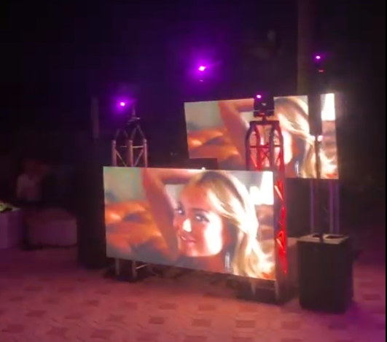
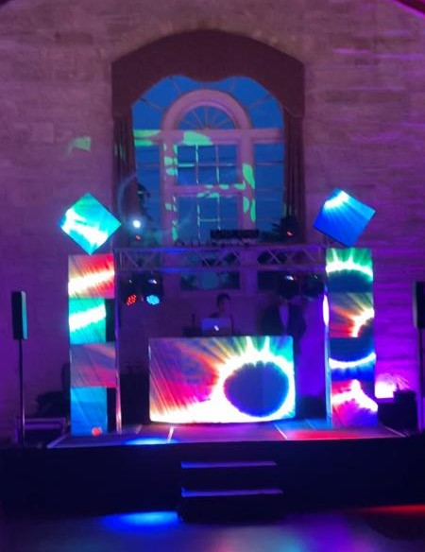
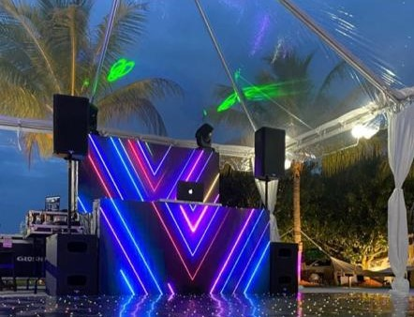
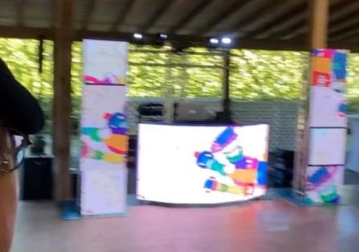
Platinum+ Package US$ 2350.00 / 5 hours Video /DJ Service.
Curved DJ boot plus LED screen on the background or multi columns with 18 P3 led panels. trusses for structural support. Wireless Microphones. RCF Sound system + subwoofers. 6-10 PAR Lights. 4-8 Moving Heads. Lightning show/ scenes controlled by DMX DJ & Karaoke Service
*Hotels and buildings will have a $120 delivery fee

Slide 6
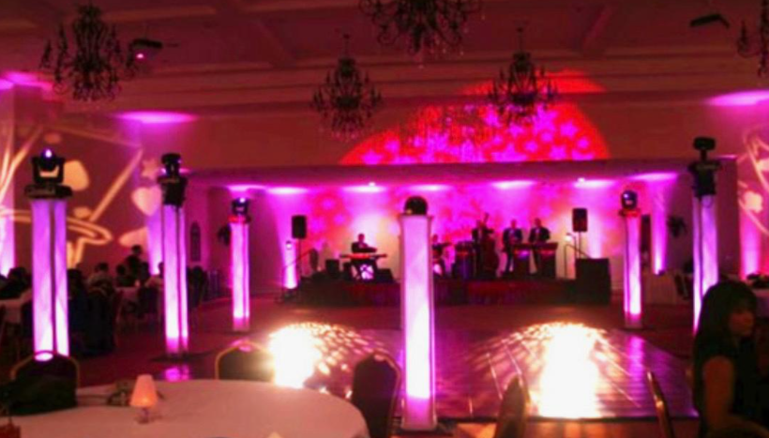
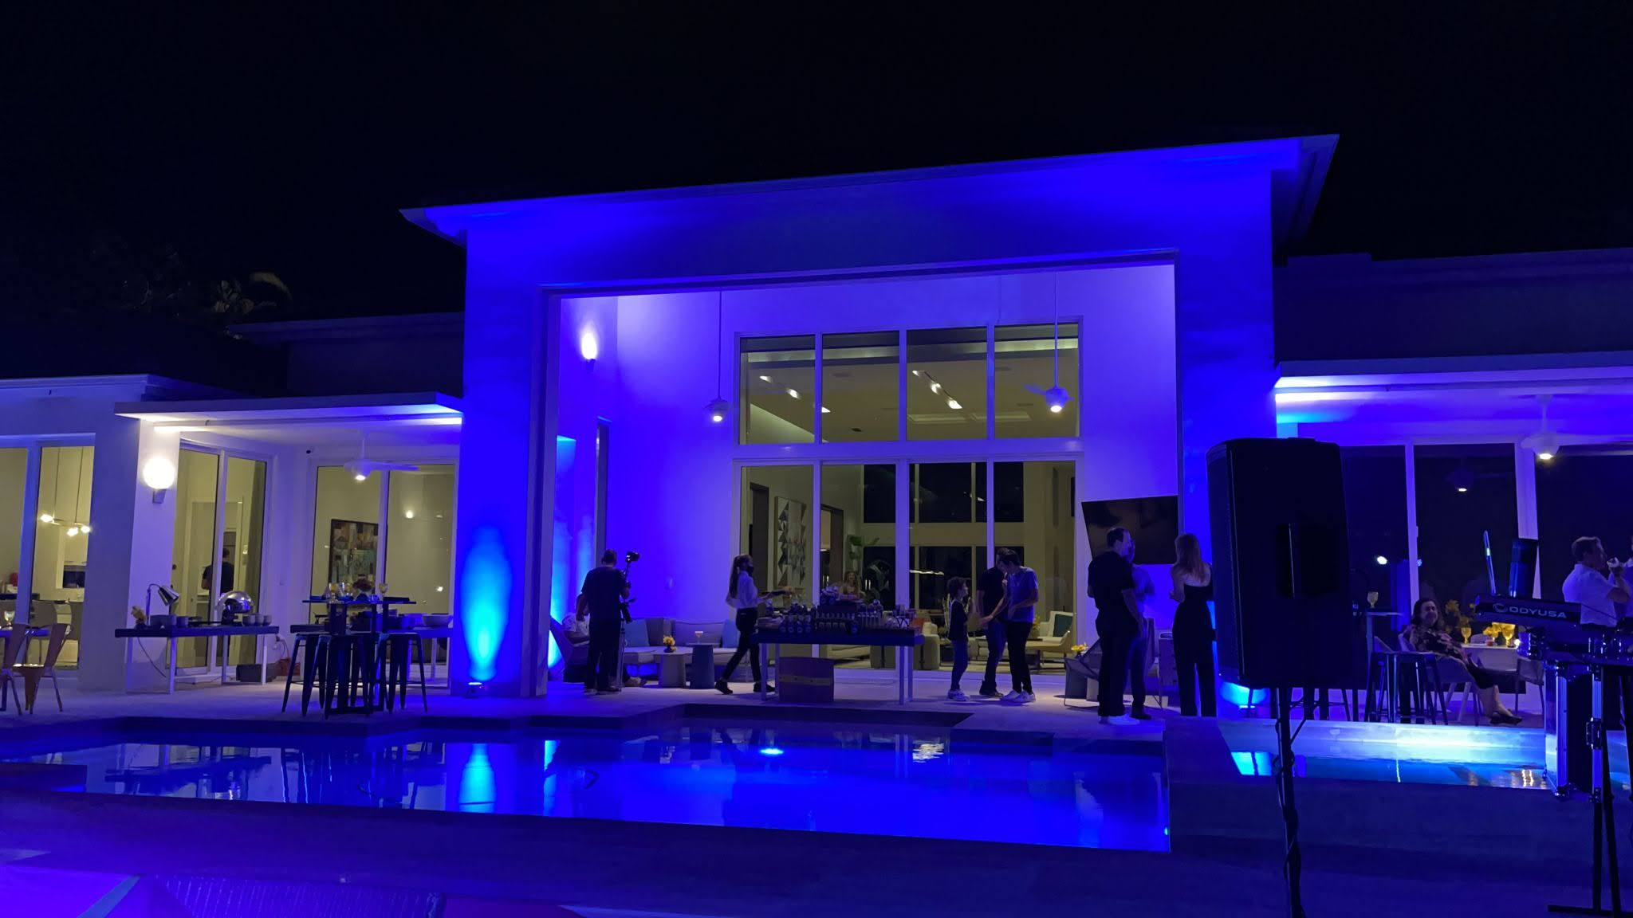
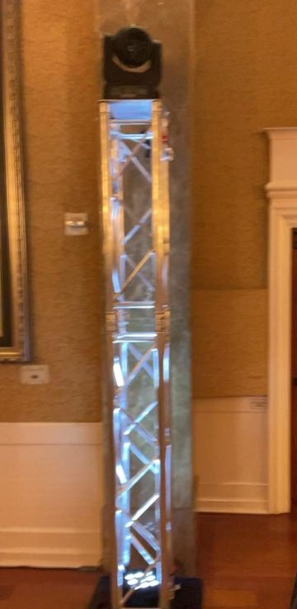
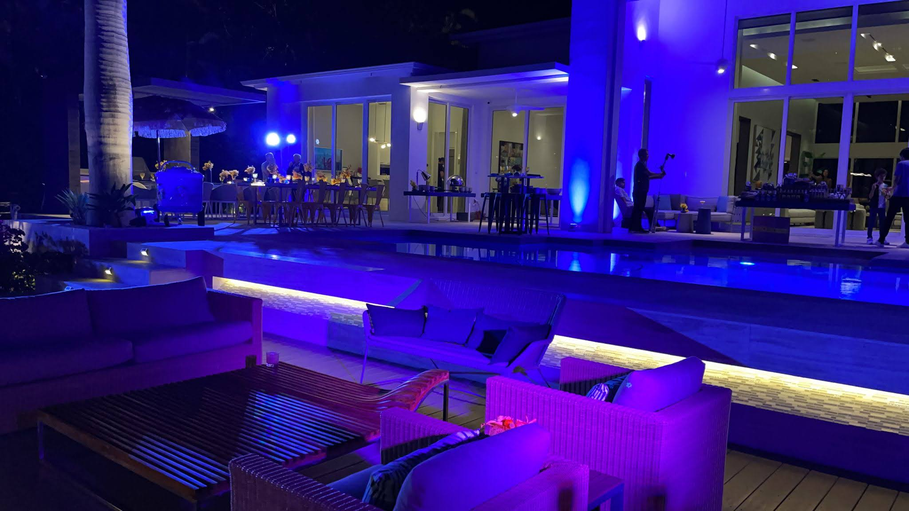
Up-light services
$45.00 per wireless fixture
$30.00 per Wired Fixture
Up-light services
$105.00 per 6’ to 8’ Truss with Base.
$85.00 / Hour DMX programing and operation
$75.00 per Moving head BEAM / WASH / SPOT

