Slide 1
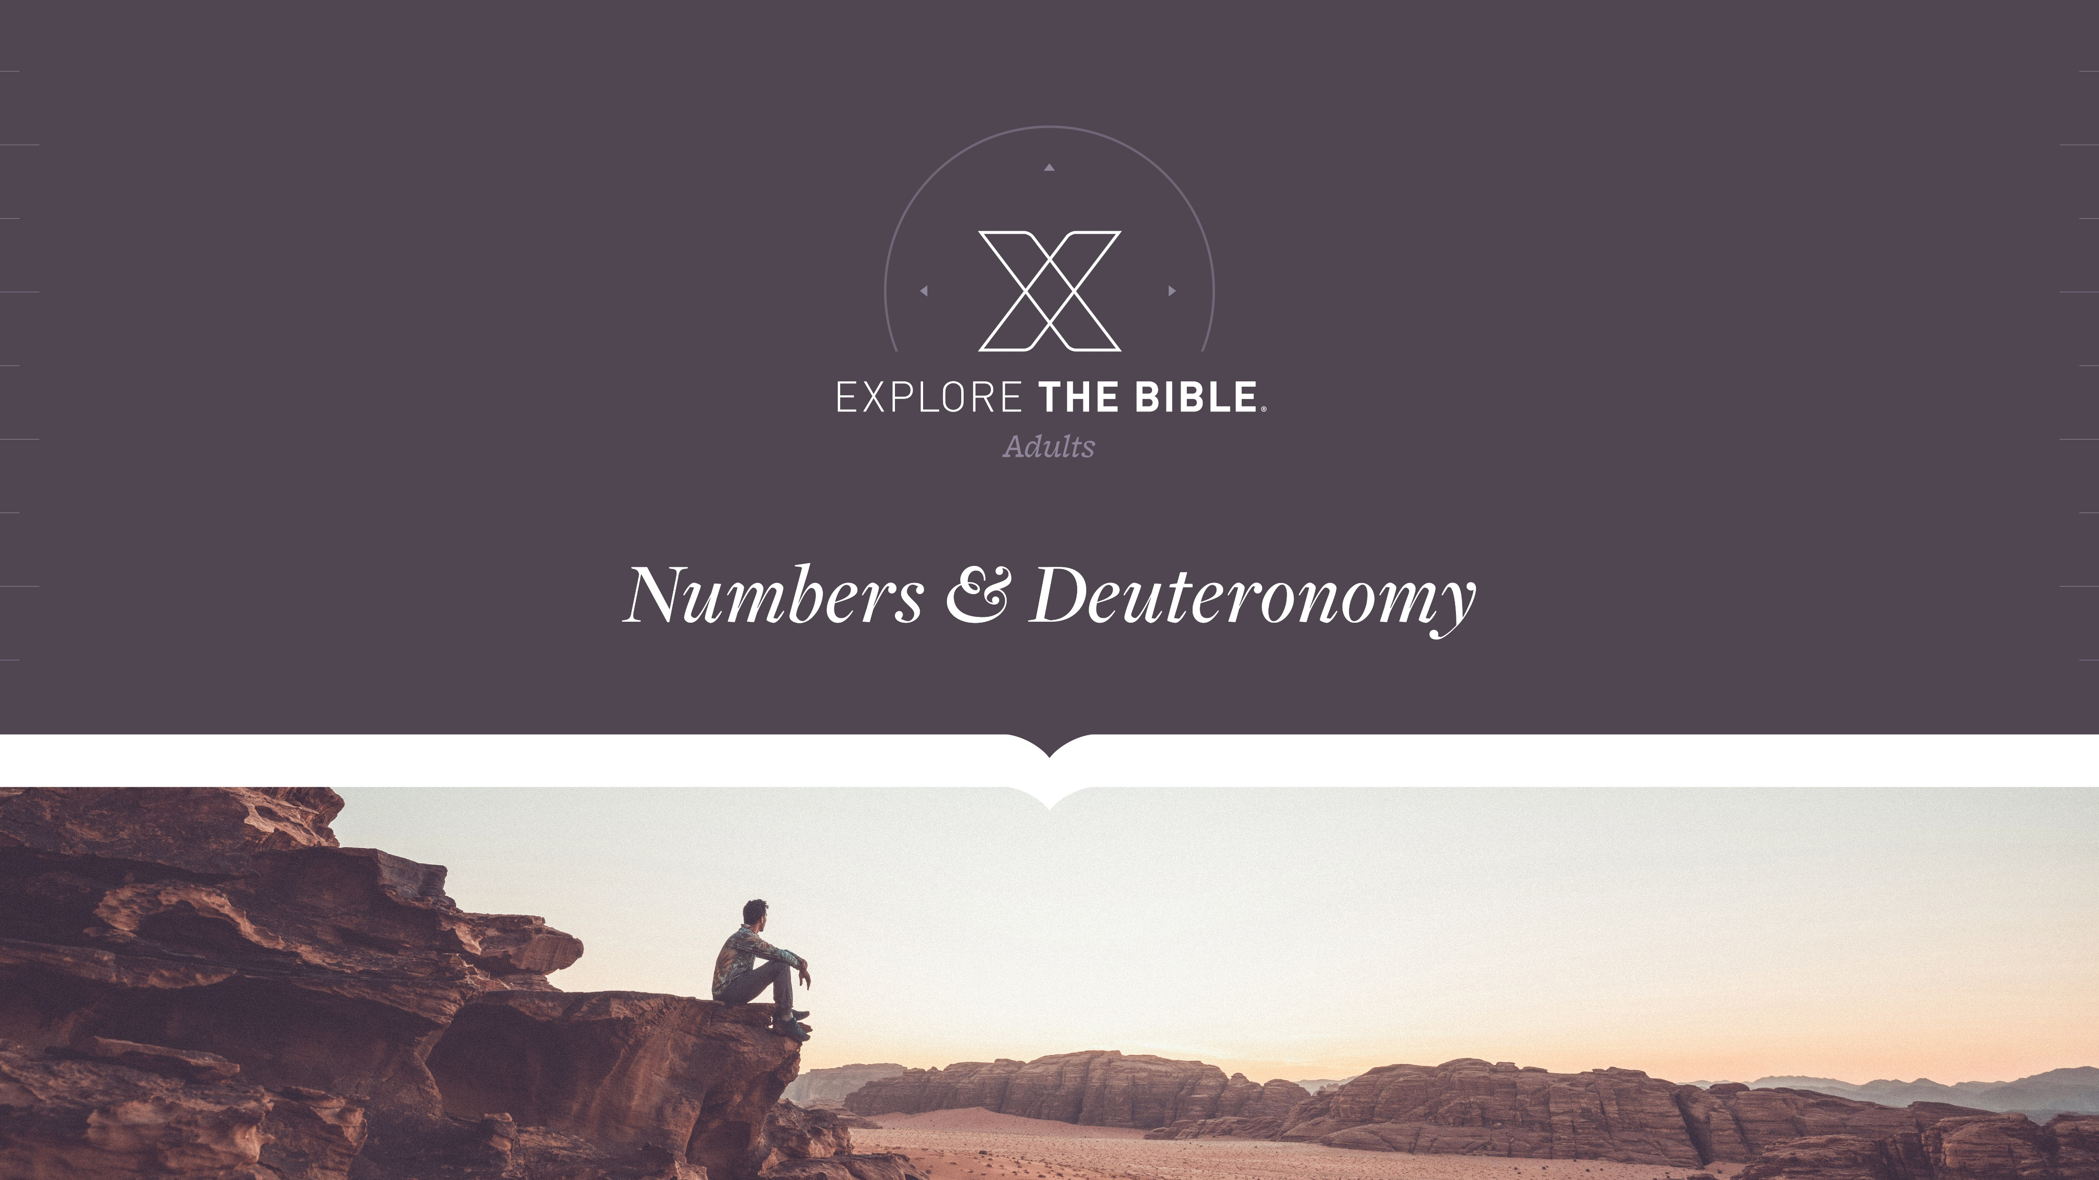
Session 7

Slide 2

MAIN IDEA:
God’s plans require believers to act on the instructions He gives.
God’s Care
(Psalm 23:1-6)

Slide 3
Introduction
Why is it important to follow the plan when doing construction? What happens when we don’t?
Apart from God, how do people create a “plan” for their lives?

Slide 4
Instructions Given
The Land (Numbers 33:50-53)
The Task (Numbers 33:54-56)
The Plan (Numbers 34:13-15)

Slide 5
The Land (Numbers 33:50-53)
⁵⁰ The Lord spoke to Moses in the plains of Moab by the Jordan across from Jericho, ⁵¹ “Tell the Israelites: When you cross the Jordan into the land of Canaan, ⁵² you must drive out all the inhabitants of the land before you, destroy all their stone images and cast images, and demolish all their high places.
⁵³ You are to take possession of the land and settle in it because I have given you the land to possess.

Slide 6
The Land (Numbers 33:50-53)
Following God often requires believers to remove potential distractions.
Why was it important to destroy the idols and high places devoted to false gods?
What are some things that distract you? How do you work around those distractions?

Slide 7
The Task (Numbers 33:54-56)
⁵⁴ You are to receive the land as an inheritance by lot according to your clans. Increase the inheritance for a large clan and decrease it for a small one. Whatever place the lot indicates for someone will be his. You will receive an inheritance according to your ancestral tribes.
⁵⁵ But if you don’t drive out the inhabitants of the land before you, those you allow to remain will become barbs for your eyes and thorns for your sides; they will harass you in the land where you will live. ⁵⁶ And what I had planned to do to them, I will do to you.”

Slide 8
The Task (Numbers 33:54-56)
Believers can expect to encounter challenges while following God.
What principles do you glean from these verses that can help you live a life of obedience to God?
Which produces more satisfaction: A job done easily or a job that requires effort? Why?

Slide 9
The Plan (Numbers 34:13-15)
¹³ So Moses commanded the Israelites, “This is the land you are to receive by lot as an inheritance, which the Lord commanded to be given to the nine and a half tribes.
¹⁴ For the tribe of Reuben’s descendants and the tribe of Gad’s descendants have received their inheritance according to their ancestral families, and half the tribe of Manasseh has received its inheritance.
¹⁵ The two and a half tribes have received their inheritance across the Jordan east of Jericho, toward the sunrise.”

Slide 10
The Plan (Numbers 34:13-15)
We can trust God to keep His promises.
How do God’s promises serve as a motivator to remain faithful to Him? Should they? Explain.
What promises do you need God to fulfill in your life? How can you be confident in His words?

Slide 11
CHALLENGE
How does reflecting on those promises increase your faith?
What actions can you take to safeguard yourself from the influence of beliefs and practices that are contrary to what God has outlined in His Word?

