Slide 1
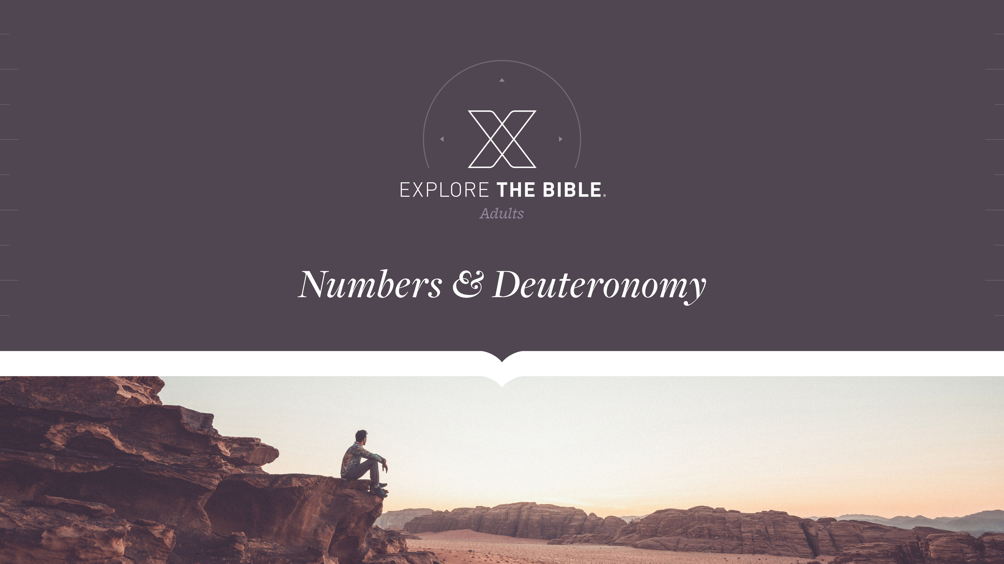
Session 12

Slide 2

MAIN IDEA:
Believers are to be characterized by a wholehearted commitment to God.
God’s Care
(Psalm 23:1-6)

Slide 3
Introduction
  In what situation have you had so many options that it was overwhelming to pick only one? How did you eventually decide?
  What’s the best choice you’ve made in the last six months? What choice would you take back?

Slide 4
Fully Committed
The Command (Deuteronomy 30:11-14)
The Commitment (Deuteronomy 30:15-18)
The Challenge (Deuteronomy 30:19-20)

Slide 5
The Command (Deuteronomy 30:11-14)
¹¹ “This command that I give you today is certainly not too difficult or beyond your reach. ¹² It is not in heaven so that you have to ask, ‘Who will go up to heaven, get it for us, and proclaim it to us so that we may follow it?’ ¹³ And it is not across the sea so that you have to ask, ‘Who will cross the sea, get it for us, and proclaim it to us so that we may follow it?’ ¹⁴ But the message is very near you, in your mouth and in your heart, so that you may follow it.

Slide 6
The Command (Deuteronomy 30:11-14)
We can trust God to give us the ability to obey His commands.
  If people think God’s truths are confusing and unattainable, how might that affect their openness to God’s Word?
  How can you respond to people who say it is too difficult to know God’s will or to obey His commands?

Slide 7
The Commitment (Deuteronomy 30:15-18)
¹⁵ See, today I have set before you life and prosperity, death and adversity. ¹⁶ For I am commanding you today to love the Lord your God, to walk in his ways, and to keep his commands, statutes, and ordinances, so that you may live and multiply, and the Lord your God may bless you in the land you are entering to possess.
¹⁷ But if your heart turns away and you do not listen and you are led astray to bow in worship to other gods and serve them, ¹⁸ I tell you today that you will certainly perish and will not prolong your days in the land you are entering to possess across the Jordan.

Slide 8
The Commitment (Deuteronomy 30:15-18)
People must choose whether they will follow God or not.
  How are people today fooled into thinking there is no penalty for sin?
  How has following God changed you for the better? How has straying from Him caused pain?

Slide 9
The Challenge (Deuteronomy 30:19-20)
¹⁹ I call heaven and earth as witnesses against you today that I have set before you life and death, blessing and curse. Choose life so that you and your descendants may live, ²⁰ love the Lord your God, obey him, and remain faithful to him. For he is your life, and he will prolong your days as you live in the land the Lord swore to give to your ancestors Abraham, Isaac, and Jacob.”

Slide 10
The Challenge (Deuteronomy 30:19-20)
Our desire to follow God influences our descendants’ choices to follow Him.
  What does it mean for you to say God “is your life”? In this context, what does it mean for you to “choose life”?
  Who would you call as a character witness in court? What would that person say about you?

Slide 11
CHALLENGE
      How can you help people with little Bible knowledge to better understand God’s Word?
      Do you sense you are not as close to God as you once were? What changes will you make this week to renew your commitment to God?

