Slide 1
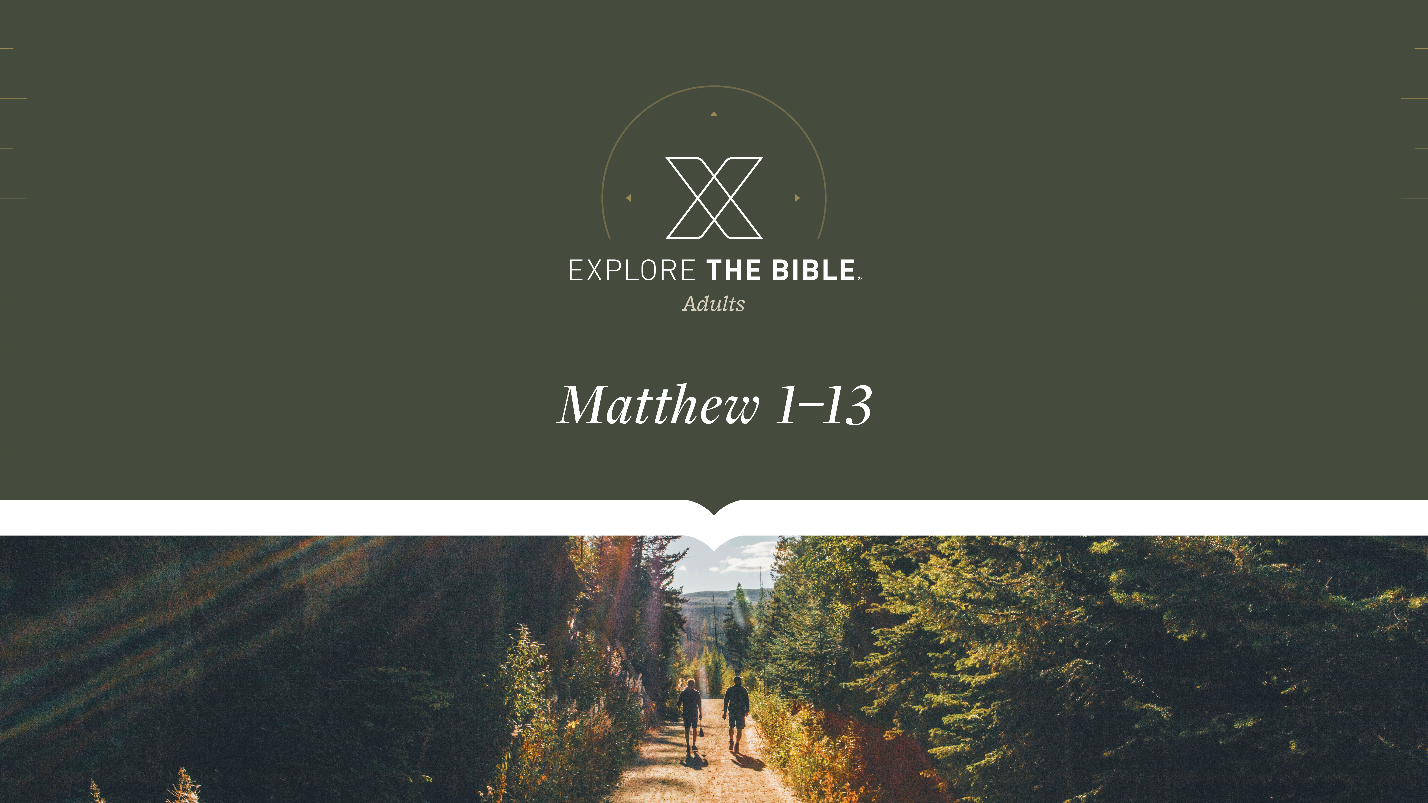
Session 3

Slide 2

MAIN IDEA:
Jesus the Savior is worthy of worship.
God’s Care
(Psalm 23:1-6)

Slide 3
Introduction
  How do you think the worth of something is determined?
  What are some things that you can buy or activities that you can do that are “worth it”?

Slide 4
Worship the King
Seeking the King (Matthew 2:1-3)
Finding the King ( Matthew 2:4-8)
Worshiping the King (Matthew 2:9-12)

Slide 5
Seeking the King (Matthew 2:1-3)
After Jesus was born in Bethlehem of Judea in the days of King Herod, wise men from the east arrived in Jerusalem, ² saying, “Where is he who has been born king of the Jews? For we saw his star at its rising and have come to worship him.”
³ When King Herod heard this, he was deeply disturbed, and all Jerusalem with him.

Slide 6
Seeking the King (Matthew 2:1-3)
We can recognize Jesus as the one, true King.
  What do you think of when you imagine the wise men? How much is based on the Bible and how much is based on tradition?
  In what ways is Jesus a king?

Slide 7
Finding the King ( Matthew 2:4-8)
⁴ So he assembled all the chief priests and scribes of the people and asked them where the Messiah would be born. ⁵ “In Bethlehem of Judea,” they told him, “because this is what was written by the prophet: ⁶ And you, Bethlehem, in the land of Judah, are by no means least among the rulers of Judah: Because out of you will come a ruler who will shepherd my people Israel.”
⁷ Then Herod secretly summoned the wise men and asked them the exact time the star appeared. ⁸ He sent them to Bethlehem and said, “Go and search carefully for the child. When you find him, report back to me so that I too can go and worship him.”

Slide 8
Finding the King ( Matthew 2:4-8)
We can know that Jesus is King because His birth fulfilled Old Testament prophecy.
  How do you know something is true? What sources do you rely on?
  How can you help people come to know Jesus as their King?

Slide 9
Worshiping the King (Matthew 2:9-12)
⁹ After hearing the king, they went on their way. And there it was—the star they had seen at its rising. It led them until it came and stopped above the place where the child was. ¹⁰ When they saw the star, they were overwhelmed with joy.
¹¹ Entering the house, they saw the child with Mary his mother, and falling to their knees, they worshiped him. Then they opened their treasures and presented him with gifts: gold, frankincense, and myrrh. ¹² And being warned in a dream not to go back to Herod, they returned to their own country by another route.

Slide 10
Worshiping the King (Matthew 2:9-12)
We acknowledge Jesus as King through our worship.
  How do you feel when you reach the end of a long trip? Why?
  What gifts can you offer to Jesus as an act of worship?

Slide 11
CHALLENGE
      How can you keep your focus on Him during this season?
      List things you feel have value and worth in life. What order would you rank each item as to its value today and for the future? Where does Jesus fall?

