Slide 1

Session 3

Slide 2

MAIN IDEA:
Jesus is the Messiah, the Savior of the world sent by God.
God’s Care
(Psalm 23:1-6)

Slide 3
Introduction
Who is the best leader you’ve ever followed? What did you learn from that person?
What are the traits of leaders you want to follow?

Slide 4
Following Jesus
Know the Messiah (Matthew 16:13-20)
Embrace His Mission (Matthew 16:21-23)
Become His Disciple (Matthew 16:24-26)

Slide 5
Know the Messiah (Matthew 16:13-20)
¹³ When Jesus came to the region of Caesarea Philippi, he asked his disciples, “Who do people say that the Son of Man is?” ¹⁴ They replied, “Some say John the Baptist; others, Elijah; still others, Jeremiah or one of the prophets.” ¹⁵ “But you,” he asked them, “who do you say that I am?”
¹⁶ Simon Peter answered, “You are the Messiah, the Son of the living God.”¹⁷ Jesus responded, “Blessed are you, Simon son of Jonah, because flesh and blood did not reveal this to you, but my Father in heaven. ¹⁸ And I also say to you that you are Peter, and on this rock I will build my church, and the gates of Hades will not overpower it.
¹⁹ I will give you the keys of the kingdom of heaven, and whatever you bind on earth will have been bound in heaven, and whatever you loose on earth will have been loosed in heaven.” ²⁰ Then he gave the disciples orders to tell no one that he was the Messiah.

Slide 6
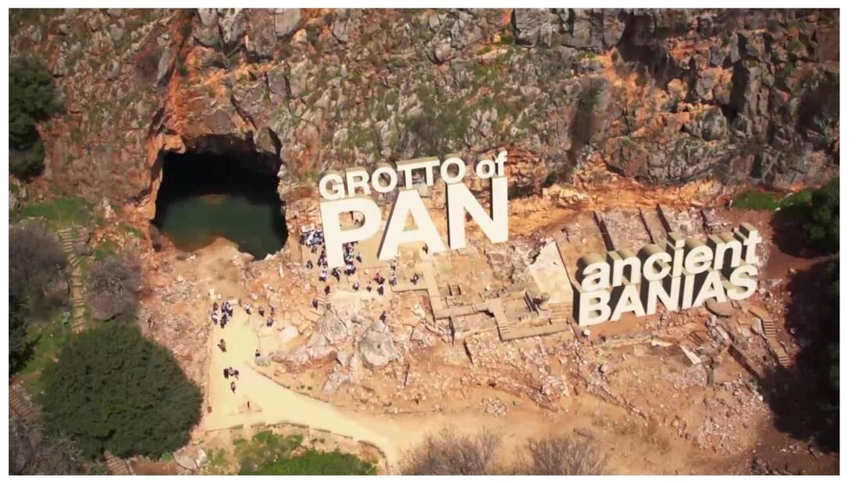

Slide 7
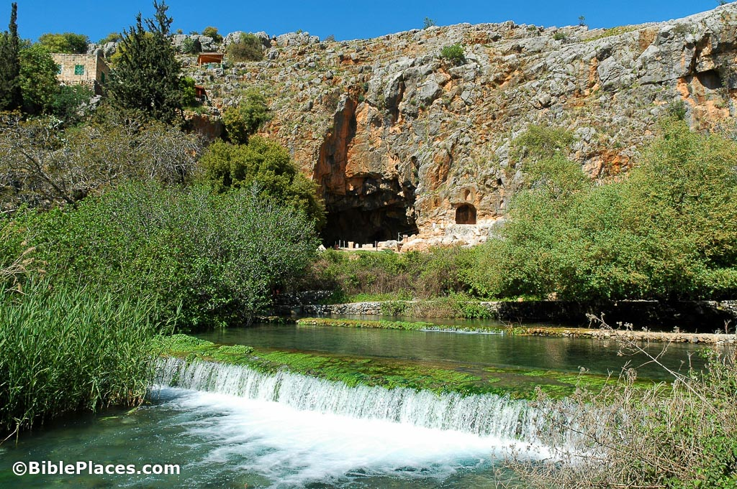

Slide 8
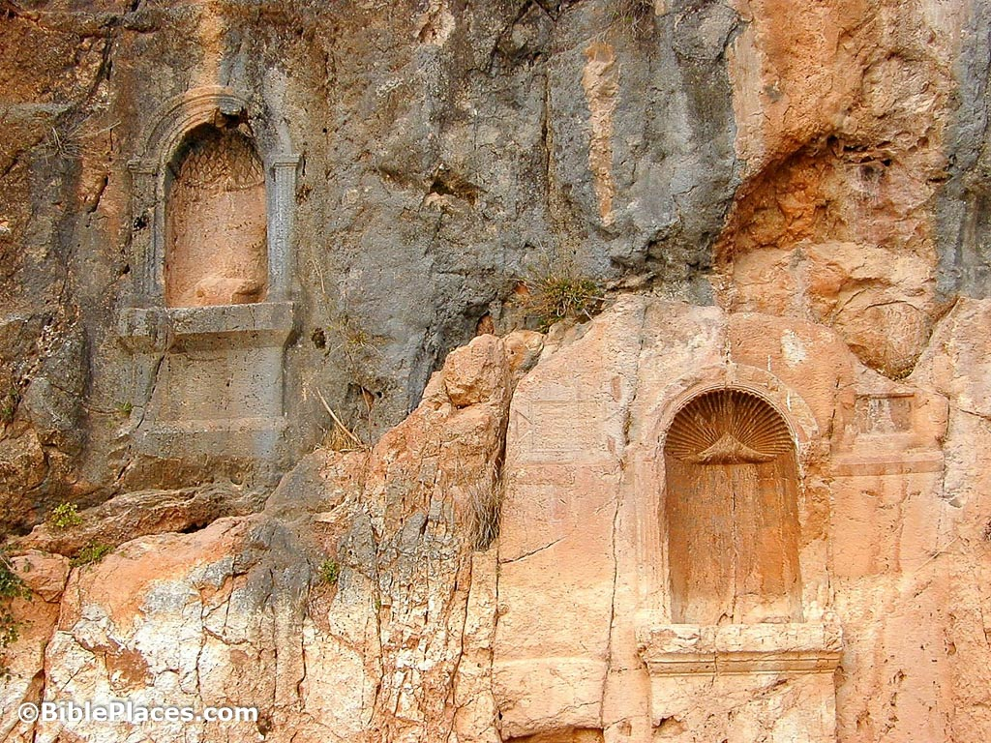

Slide 9
Know the Messiah (Matthew 16:13-20)
We cannot follow Jesus fully until we know and accept His true identity.
When have you experienced a case of mistaken identity? How did you resolve it?
Why is it important to understand who Jesus is?

Slide 10
Embrace His Mission (Matthew 16:21-23)
²¹ From then on Jesus began to point out to his disciples that it was necessary for him to go to Jerusalem and suffer many things from the elders, chief priests, and scribes, be killed, and be raised the third day. ²² Peter took him aside and began to rebuke him, “Oh no, Lord! This will never happen to you!”
²³ Jesus turned and told Peter, “Get behind me, Satan! You are a hindrance to me because you’re not thinking about God’s concerns but human concerns.”

Slide 11
Embrace His Mission (Matthew 16:21-23)
We cannot follow Jesus fully until we accept His mission as Messiah and Savior.
What does it feel like to be rebuked? How is it helpful? How is it discouraging?
How do we let our own agendas replace God’s greater plans?

Slide 12
Become His Disciple (Matthew 16:24-26)
²⁴ Then Jesus said to his disciples, “If anyone wants to follow after me, let him deny himself, take up his cross, and follow me.
²⁵ For whoever wants to save his life will lose it, but whoever loses his life because of me will find it.
²⁶ For what will it benefit someone if he gains the whole world yet loses his life? Or what will anyone give in exchange for his life?

Slide 13
Become His Disciple (Matthew 16:24-26)
We cannot follow Jesus fully until we sacrifice our personal agendas to Him.
What is the highest price you’ve ever paid for an experience? How did you decide the price was worth the value?
What does it mean to deny ourselves and to carry our cross?

Slide 14
CHALLENGE
Why do you think people hold these opinions about Jesus?
Create a list of the costs of not following Jesus. Which will you choose?

