Slide 1
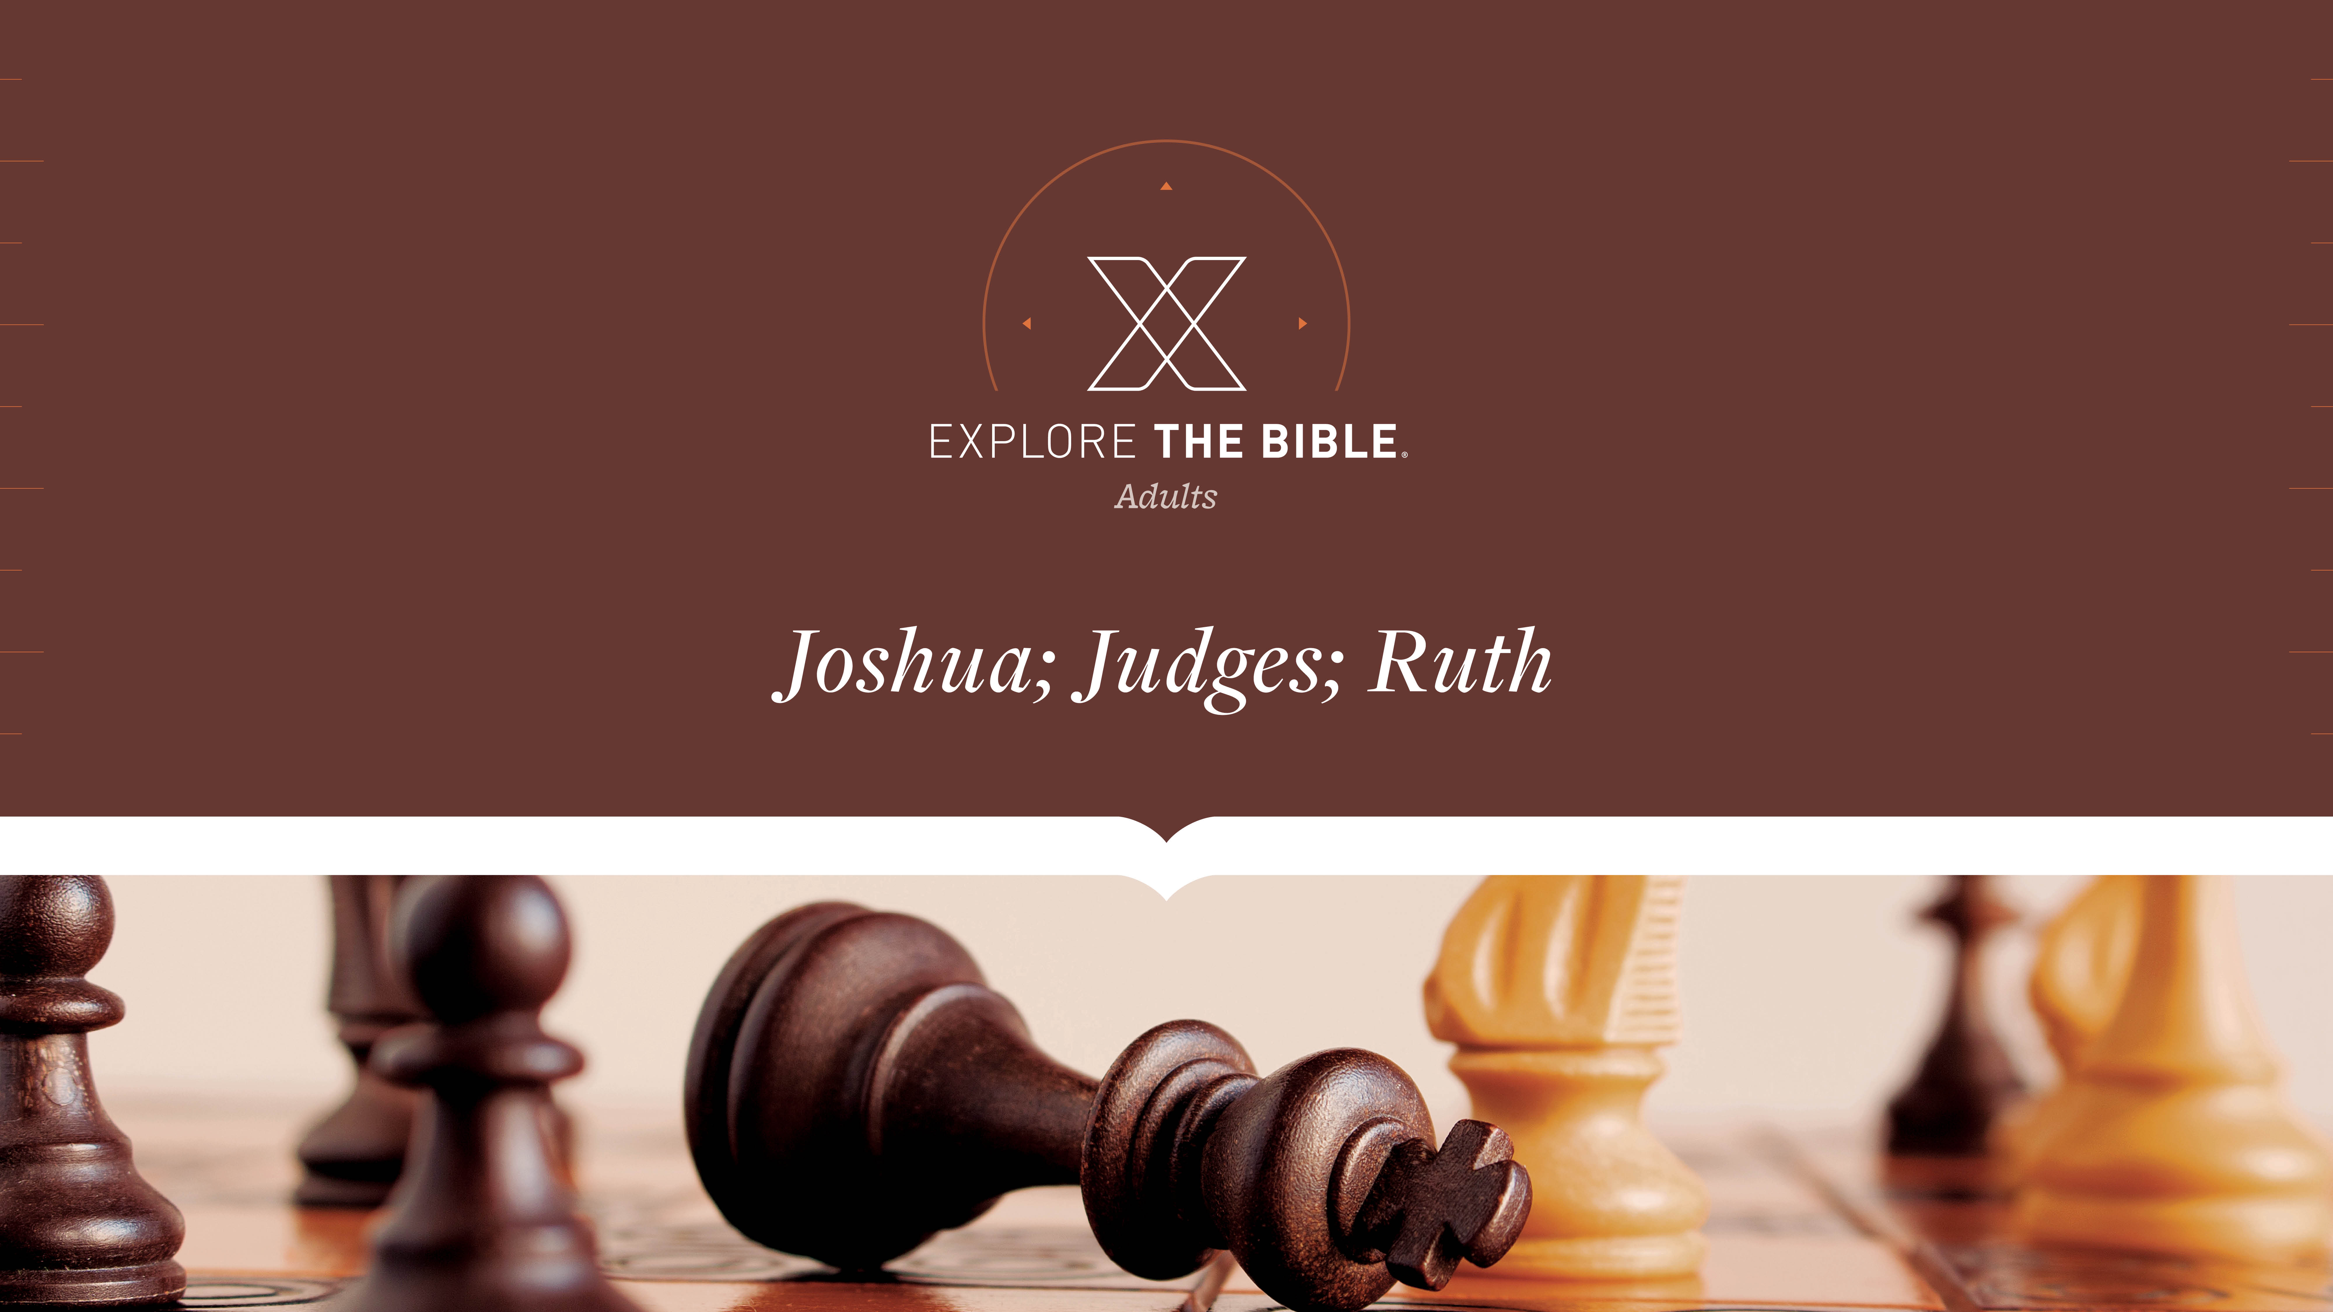
Session 14
Session 2

Slide 2

MAIN IDEA:
God used Rahab, an imperfect person, to accomplish His plans.
God’s Care
(Psalm 23:1-6)

Slide 3


Introduction
When have you felt like the wrong person for a job? How did you overcome that?
Why does God so often use unlikely, imperfect people to accomplish His purposes?

Slide 4
Amazing Grace
A Bold Act (Joshua 2:4-7)
A Kind Action (Joshua 2:8-13)
A Daring Escape (Joshua 2:14-16)
A Firm Assurance (Joshua 2:17-21)

Slide 5
A Bold Act (Joshua 2:4-7)
⁴ But the woman had taken the two men and hidden them. So she said, “Yes, the men did come to me, but I didn’t know where they were from. ⁵ At nightfall, when the city gate was about to close, the men went out, and I don’t know where they were going. Chase after them quickly, and you can catch up with them!”
⁶ But she had taken them up to the roof and hidden them among the stalks of flax that she had arranged on the roof. ⁷ The men pursued them along the road to the fords of the Jordan, and as soon as they left to pursue them, the city gate was shut.

Slide 6
A Bold Act (Joshua 2:4-7)
Following God often requires leaving one’s comfort zone and stepping out in faith.
When have you been forced into taking a step of faith? How was it a good thing?
What is the relationship between boldness and faith?

Slide 7
A Kind Action (Joshua 2:8-13)
⁸ Before the men fell asleep, she went up on the roof ⁹ and said to them, “I know that the Lord has given you this land and that the terror of you has fallen on us, and everyone who lives in the land is panicking because of you.
¹⁰ For we have heard how the Lord dried up the water of the Red Sea before you when you came out of Egypt, and what you did to Sihon and Og, the two Amorite kings you completely destroyed across the Jordan.

Slide 8
A Kind Action (Joshua 2:8-13)
¹¹ When we heard this, we lost heart, and everyone’s courage failed because of you, for the Lord your God is God in heaven above and on earth below.
¹² Now please swear to me by the Lord that you will also show kindness to my father’s family, because I showed kindness to you. Give me a sure sign ¹³ that you will spare the lives of my father, mother, brothers, sisters, and all who belong to them, and save us from death.”

Slide 9
A Kind Action (Joshua 2:8-13)
We can be encouraged that God’s acts will always demonstrate His character.
How would you define “kindness”?
How should our beliefs about God impact the way we treat others?

Slide 10
A Daring Escape (Joshua 2:14-16)
⁴ The men answered her, “We will give our lives for yours. If you don’t report our mission, we will show kindness and faithfulness to you when the Lord gives us the land.”
¹⁵ Then she let them down by a rope through the window, since she lived in a house that was built into the wall of the city. ¹⁶ “Go to the hill country so that the men pursuing you won’t find you,” she said to them. “Hide there for three days until they return; afterward, go on your way.”

Slide 11
A Daring Escape (Joshua 2:14-16)
Relying on God’s grace leads to security, even in difficult times.
What are you willing to risk for your faith?
Why does faith in God require obedient action?

Slide 12
A Firm Assurance (Joshua 2:17-21)
¹⁷ The men said to her, “We will be free from this oath you made us swear, ¹⁸ unless, when we enter the land, you tie this scarlet cord to the window through which you let us down. Bring your father, mother, brothers, and all your father’s family into your house.
¹⁹ If anyone goes out the doors of your house, his death will be his own fault, and we will be innocent. But if anyone with you in the house should be harmed, his death will be our fault. ²⁰ And if you report our mission, we are free from the oath you made us swear.” ²¹ “Let it be as you say,” she replied, and she sent them away. After they had gone, she tied the scarlet cord to the window.

Slide 13
A Firm Assurance (Joshua 2:17-21)
We can be assured of God’s work in our lives by regularly reflecting on what He has done in the past.
What are some basic principles you live by? What makes them important?
What are some signs that remind us of God’s grace in our lives?

Slide 14
CHALLENGE
How does relying on God’s grace lead to security during difficult times?
How do God’s acts in your life demonstrate His character?

