Slide 1
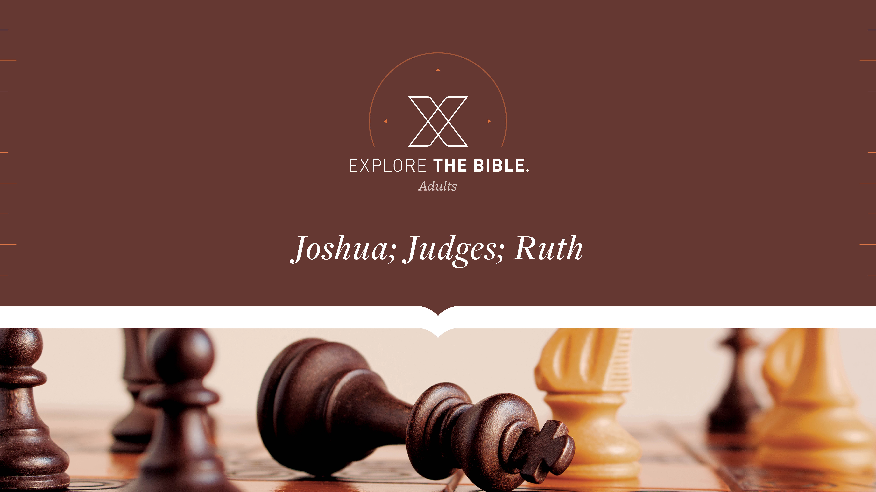
Session 14
Session 3

Slide 2

MAIN IDEA:
God instructed the people to set up a memorial as a reminder of His Power.
God’s Care
(Psalm 23:1-6)

Slide 3


Introduction
  What moments in your life deserve a monument because of God’s presence and work?
  What are some prominent memorials you can think of? Why are they significant, and what impact do they have on people today?

Slide 4
Remembering God’s Works
Dry Ground (Joshua 3:14-17)
Memorial Stones (Joshua 4:1-7)
Lasting Reminders (Joshua 4:8-9)

Slide 5
Dry Ground (Joshua 3:14-17)
¹⁴ When the people broke camp to cross the Jordan, the priests carried the ark of the covenant ahead of the people.
¹⁵ Now the Jordan overflows its banks throughout the harvest season. But as soon as the priests carrying the ark reached the Jordan, their feet touched the water at its edge ¹⁶ and the water flowing downstream stood still, rising up in a mass that extended as far as Adam, a city next to Zarethan. The water flowing downstream into the Sea of the Arabah—the Dead Sea—was completely cut off, and the people crossed opposite Jericho.

Slide 6
Dry Ground (Joshua 3:14-17)
¹⁷ The priests carrying the ark of the Lord’s covenant stood firmly on dry ground in the middle of the Jordan, while all Israel crossed on dry ground until the entire nation had finished crossing the Jordan.

Slide 7
Dry Ground (Joshua 3:14-17)
We can be sure that God never fails to provide perfectly for His people during their time of need.
  When have you encountered a flood? What concerned you most about the water?
  Why are barriers an important part of our spiritual journey?

Slide 8
Memorial Stones (Joshua 4:1-7)
4 After the entire nation had finished crossing the Jordan, the Lord spoke to Joshua: ² “Choose twelve men from the people, one man for each tribe, ³ and command them: Take twelve stones from this place in the middle of the Jordan where the priests are standing, carry them with you, and set them down at the place where you spend the night.”

Slide 9
Memorial Stones (Joshua 4:1-7)
⁴ So Joshua summoned the twelve men he had selected from the Israelites, one man for each tribe, ⁵ and said to them, “Go across to the ark of the Lord your God in the middle of the Jordan. Each of you lift a stone onto his shoulder, one for each of the Israelite tribes, ⁶ so that this will be a sign among you.
In the future, when your children ask you, ‘What do these stones mean to you?’ ⁷ you should tell them, ‘The water of the Jordan was cut off in front of the ark of the Lord’s covenant. When it crossed the Jordan, the Jordan’s water was cut off.’ Therefore these stones will always be a memorial for the Israelites.”

Slide 10
Memorial Stones (Joshua 4:1-7)
We should establish memorials in our lives that consistently remind us of God’s work on our behalf.
  What is the danger of not remembering important events in our lives?
  What are some milestones that could remind people of God’s work in their lives?

Slide 11
Lasting Reminders (Joshua 4:8-9)
⁸ The Israelites did just as Joshua had commanded them. The twelve men took stones from the middle of the Jordan, one for each of the Israelite tribes, just as the Lord had told Joshua. They carried them to the camp and set them down there.
⁹ Joshua also set up twelve stones in the middle of the Jordan where the priests who carried the ark of the covenant were standing. The stones are still there today.

Slide 12
Lasting Reminders (Joshua 4:8-9)
God expects believers to remember and testify to what He has done for them.
  What are some “tricks” people use to avoid forgetting things?
  How can previous experiences with God strengthen a person’s faith? How can we pass on our faith to future generations?

Slide 13
CHALLENGE
      What significant things has God done over the years in your church? How could you share these things with others?
      How could you make memorials of these things in your life to help you remember what God has done and give you opportunities to testify to others of God’s faithfulness and goodness?

