Slide 1
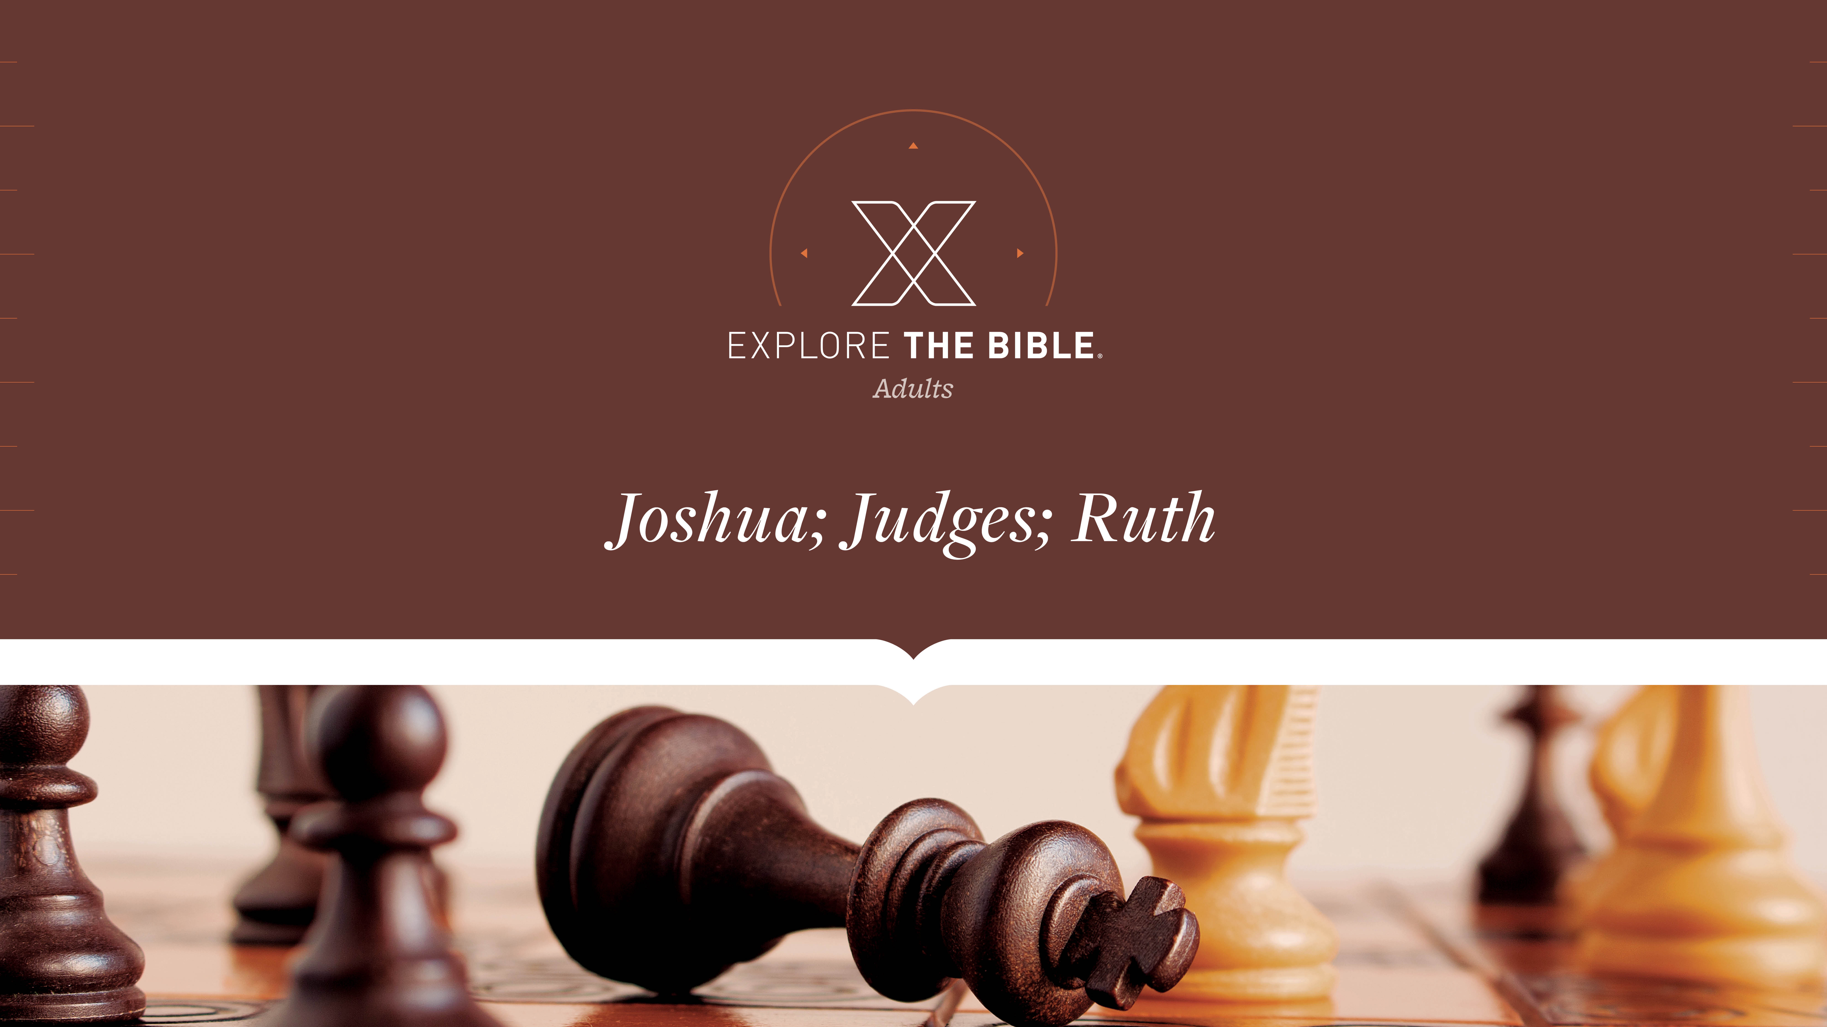
Session 14
Session 4

Slide 2

MAIN IDEA:
God gave His people victory when they trusted and obeyed Him.
God’s Care
(Psalm 23:1-6)

Slide 3


Introduction
When have you taken a “leap” by trusting God about something?
What is involved in learning to trust someone?

Slide 4
Winning Strategy
Instructions Obeyed (Joshua 6:12-14)
Victory Assured (Joshua 6:15-19)
Walls Destroyed (Joshua 6:20-21)
Promises Kept (Joshua 6:22-25)

Slide 5
Instructions Obeyed (Joshua 6:12-14)
¹² Joshua got up early the next morning. The priests took the ark of the Lord, ¹³ and the seven priests carrying seven rams’ horns marched in front of the ark of the Lord. While the rams’ horns were blowing, the armed men went in front of them, and the rear guard went behind the ark of the Lord.
¹⁴ On the second day they marched around the city once and returned to the camp. They did this for six days.

Slide 6
Instructions Obeyed (Joshua 6:12-14)
We should obey God’s directions, even when they don’t make sense.
When have you felt like you were going around in circles? What makes that so frustrating for us?
How do God’s unusual instructions test our faith?

Slide 7
Victory Assured (Joshua 6:15-19)
¹⁵ Early on the seventh day, they started at dawn and marched around the city seven times in the same way. That was the only day they marched around the city seven times. ¹⁶ After the seventh time, the priests blew the rams’ horns, and Joshua said to the troops, “Shout! For the Lord has given you the city. ¹⁷ But the city and everything in it are set apart to the Lord for destruction. Only Rahab the prostitute and everyone with her in the house will live, because she hid the messengers we sent.
¹⁸ But keep yourselves from the things set apart, or you will be set apart for destruction. If you take any of those things, you will set apart the camp of Israel for destruction and make trouble for it. ¹⁹ For all the silver and gold, and the articles of bronze and iron, are dedicated to the Lord and must go into the Lord’s treasury.”

Slide 8
Victory Assured (Joshua 6:15-19)
We experience victory in life when we obey God completely.
How do you know if you’re “winning” in life? What scorecard do you use?
Why did God set the treasures of Jericho apart for Himself?

Slide 9
Walls Destroyed (Joshua 6:20-21)
²⁰ So the troops shouted, and the rams’ horns sounded. When they heard the blast of the ram’s horn, the troops gave a great shout, and the wall collapsed. The troops advanced into the city, each man straight ahead, and they captured the city.
²¹ They completely destroyed everything in the city with the sword—every man and woman, both young and old, and every ox, sheep, and donkey.

Slide 10
Walls Destroyed (Joshua 6:20-21)
We can trust God to do what only He can do.
Who do you trust most in life? Why?
What potential victory is God asking you to trust Him to provide?

Slide 11
Promises Kept (Joshua 6:22-25)
²² Joshua said to the two men who had scouted the land, “Go to the prostitute’s house and bring the woman out of there, and all who are with her, just as you swore to her.” ²³ So the young men who had scouted went in and brought out Rahab and her father, mother, brothers, and all who belonged to her. They brought out her whole family and settled them outside the camp of Israel.
²⁴ They burned the city and everything in it, but they put the silver and gold and the articles of bronze and iron into the treasury of the Lord’s house. ²⁵ However, Joshua spared Rahab the prostitute, her father’s family, and all who belonged to her, because she hid the messengers Joshua had sent to spy on Jericho, and she still lives in Israel today.

Slide 12
Promises Kept (Joshua 6:22-25)
We can live in victory by trusting in God’s promises .
Who is the most famous member of your family tree? Why is that person significant?
What victories does God promise His people today?

Slide 13
CHALLENGE
What are ways that you can demonstrate trust and obedience to God?
Is there anything happening in your life right now where you are struggling to trust God’s promises and obey Him?

