Slide 1
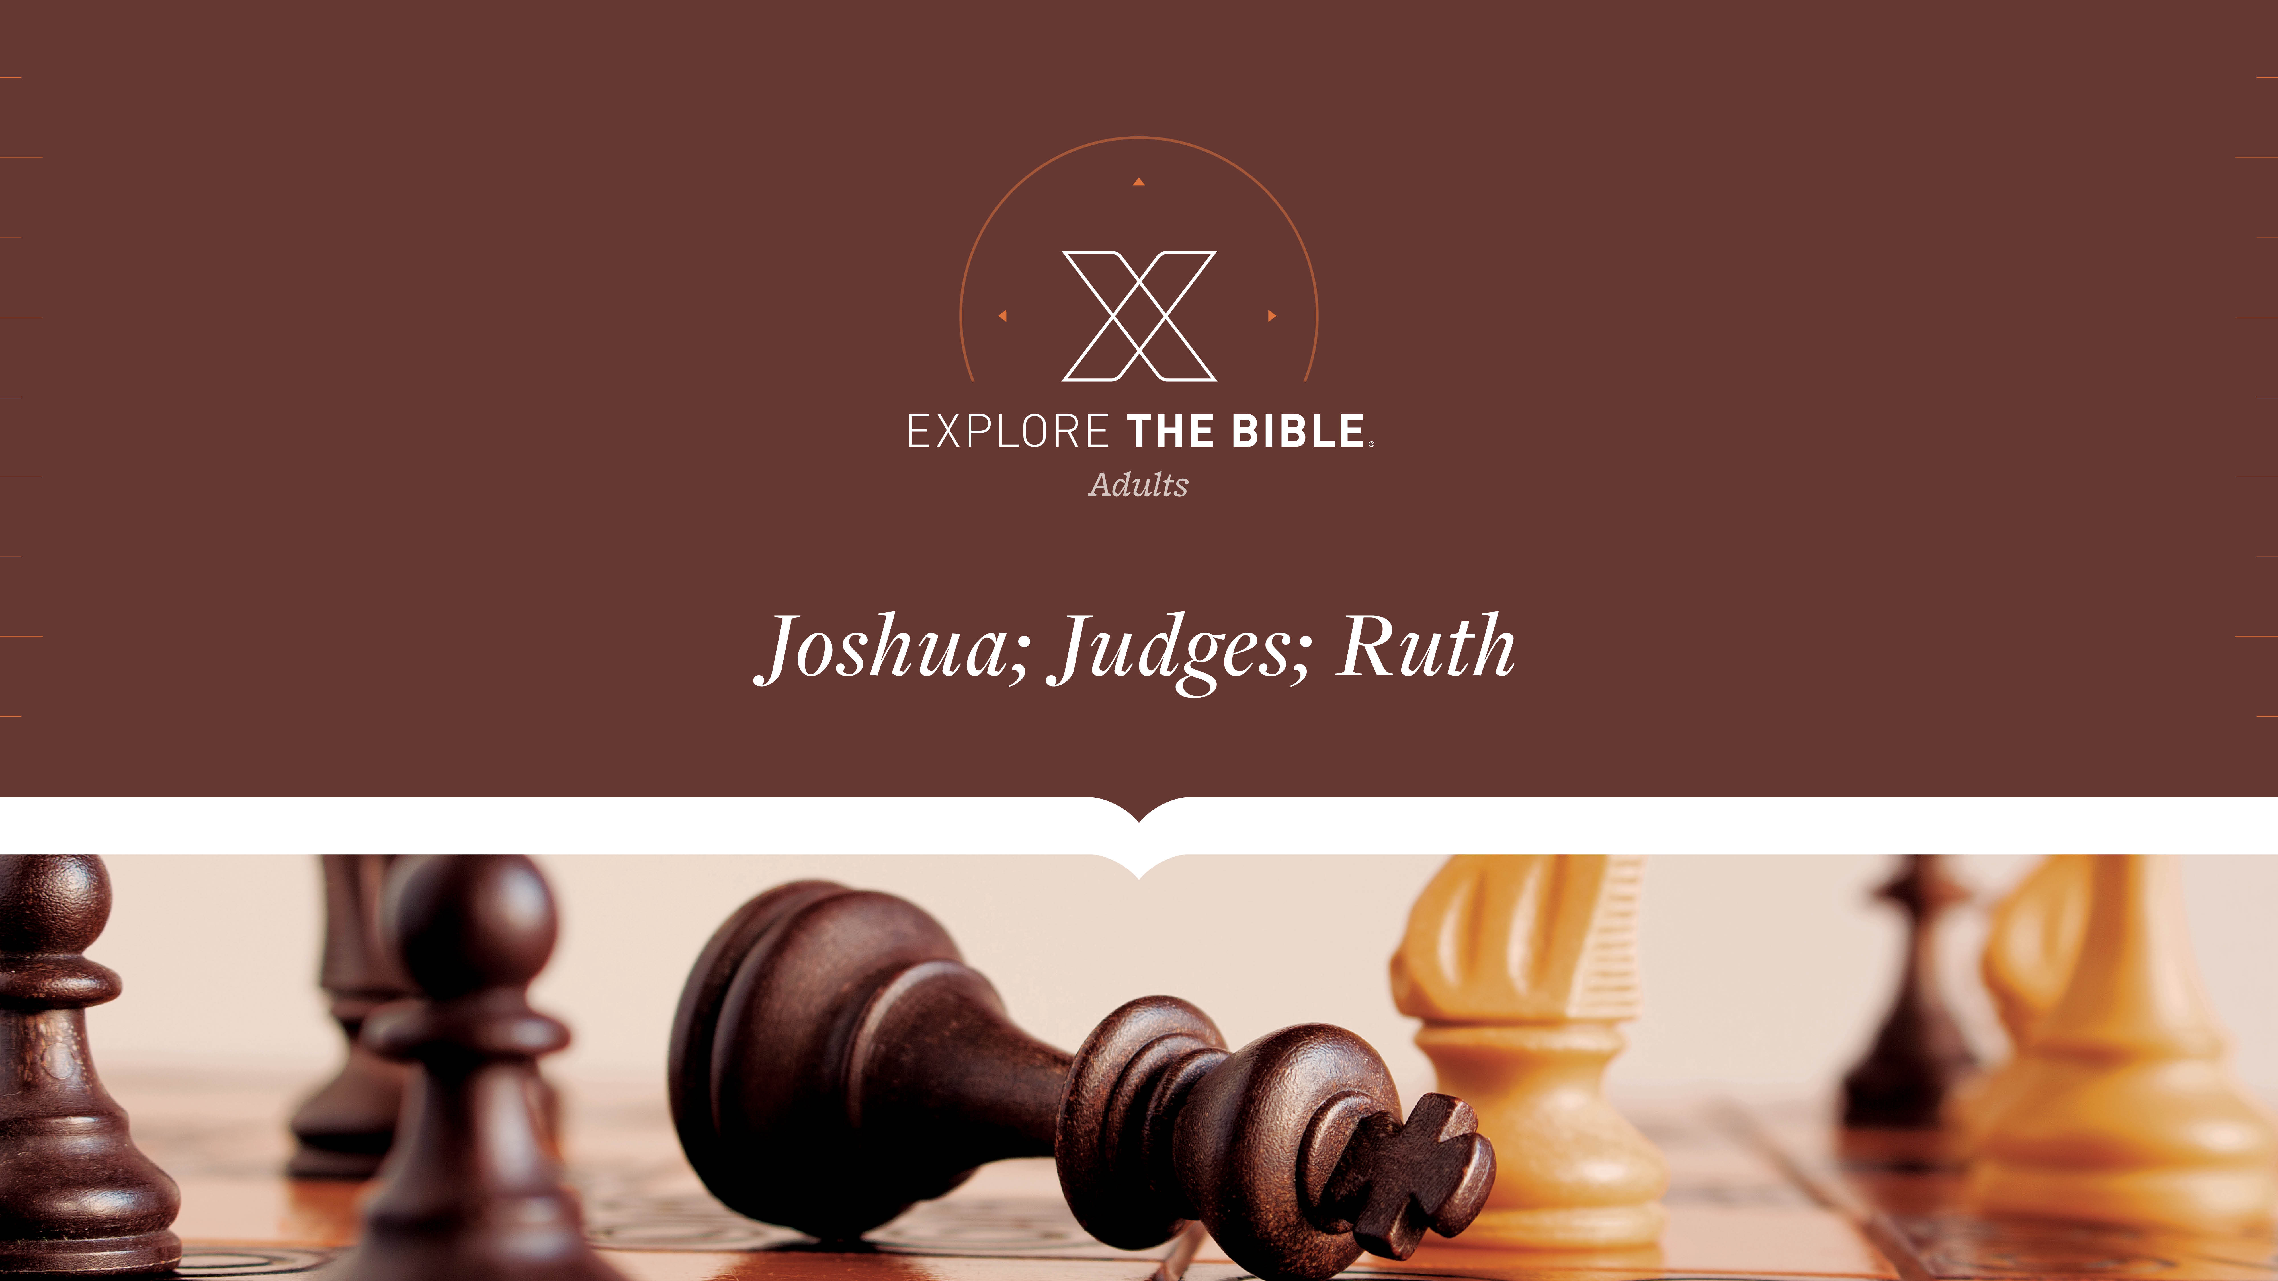
Session 14
Session 5

Slide 2

MAIN IDEA:
Achan’s actions were discovered and judged because he dishonored God.
God’s Care
(Psalm 23:1-6)

Slide 3


Introduction
  When have you thought you got away with something, only to be caught later?
  What should be a person’s motivation to confess sin and seek forgiveness?

Slide 4
Sin Revealed
Covenant Violated (Joshua 7:10-15)
Achan Revealed (Joshua 7:16-19)
Confession Made (Joshua 7:20-23)

Slide 5
Covenant Violated (Joshua 7:10-15)
¹⁰ The Lord then said to Joshua, “Stand up! Why have you fallen facedown? ¹¹ Israel has sinned. They have violated my covenant that I appointed for them. They have taken some of what was set apart. They have stolen, deceived, and put those things with their own belongings.
¹² This is why the Israelites cannot stand against their enemies. They will turn their backs and run from their enemies, because they have been set apart for destruction. I will no longer be with you unless you remove from among you what is set apart.

Slide 6
Covenant Violated (Joshua 7:10-15)
¹³ “Go and consecrate the people. Tell them to consecrate themselves for tomorrow, for this is what the Lord, the God of Israel, says: There are things that are set apart among you, Israel. You will not be able to stand against your enemies until you remove what is set apart.
¹⁴ In the morning, present yourselves tribe by tribe. The tribe the Lord selects is to come forward clan by clan. The clan the Lord selects is to come forward family by family. The family the Lord selects is to come forward man by man. ¹⁵ The one who is caught with the things set apart must be burned, along with everything he has, because he has violated the Lord’s covenant and committed an outrage in Israel.”

Slide 7
Covenant Violated (Joshua 7:10-15)
We should recognize that sin always dishonors God and negatively impacts our relationship with Him.
  When have you suffered because of someone else’s actions? When have others suffered because of something you did?
  Why is it important for us to recognize sin’s impact on us and our relationship with God?

Slide 8
Achan Revealed (Joshua 7:16-19)
¹⁶ Joshua got up early the next morning. He had Israel come forward tribe by tribe, and the tribe of Judah was selected. ¹⁷ He had the clans of Judah come forward, and the Zerahite clan was selected. He had the Zerahite clan come forward by heads of families, and Zabdi was selected.
¹⁸ He then had Zabdi’s family come forward man by man, and Achan son of Carmi, son of Zabdi, son of Zerah, of the tribe of Judah, was selected. ¹⁹ So Joshua said to Achan, “My son, give glory to the Lord, the God of Israel, and make a confession to him. I urge you, tell me what you have done. Don’t hide anything from me.”

Slide 9
Achan Revealed (Joshua 7:16-19)
We should acknowledge that God is always aware of our sins.
  When have you been excited to be chosen for something? When have you dreaded being chosen for something?
  What might prevent one from confessing and seeking the Lord’s forgiveness?

Slide 10
Confession Made (Joshua 7:20-23)
²⁰ Achan replied to Joshua, “It is true. I have sinned against the Lord, the God of Israel. This is what I did: ²¹ When I saw among the spoils a beautiful cloak from Babylon, five pounds of silver, and a bar of gold weighing a pound and a quarter, I coveted them and took them. You can see for yourself. They are concealed in the ground inside my tent, with the silver under the cloak.”
²² So Joshua sent messengers who ran to the tent, and there was the cloak, concealed in his tent, with the silver underneath. ²³ They took the things from inside the tent, brought them to Joshua and all the Israelites, and spread them out in the Lord’s presence.

Slide 11
Confession Made (Joshua 7:20-23)
We honor God by repenting and confessing our sins to Him.
  When have you “come clean” about something you did? How did it make you feel?
  Why is it important for us to view sin as seriously as God does?

Slide 12
CHALLENGE
      How can you encourage others who might be struggling with sin?
      How does knowing that God is always aware of your sin affect how you deal with your sin? How does repenting and confessing your sin honor God?

