Slide 1
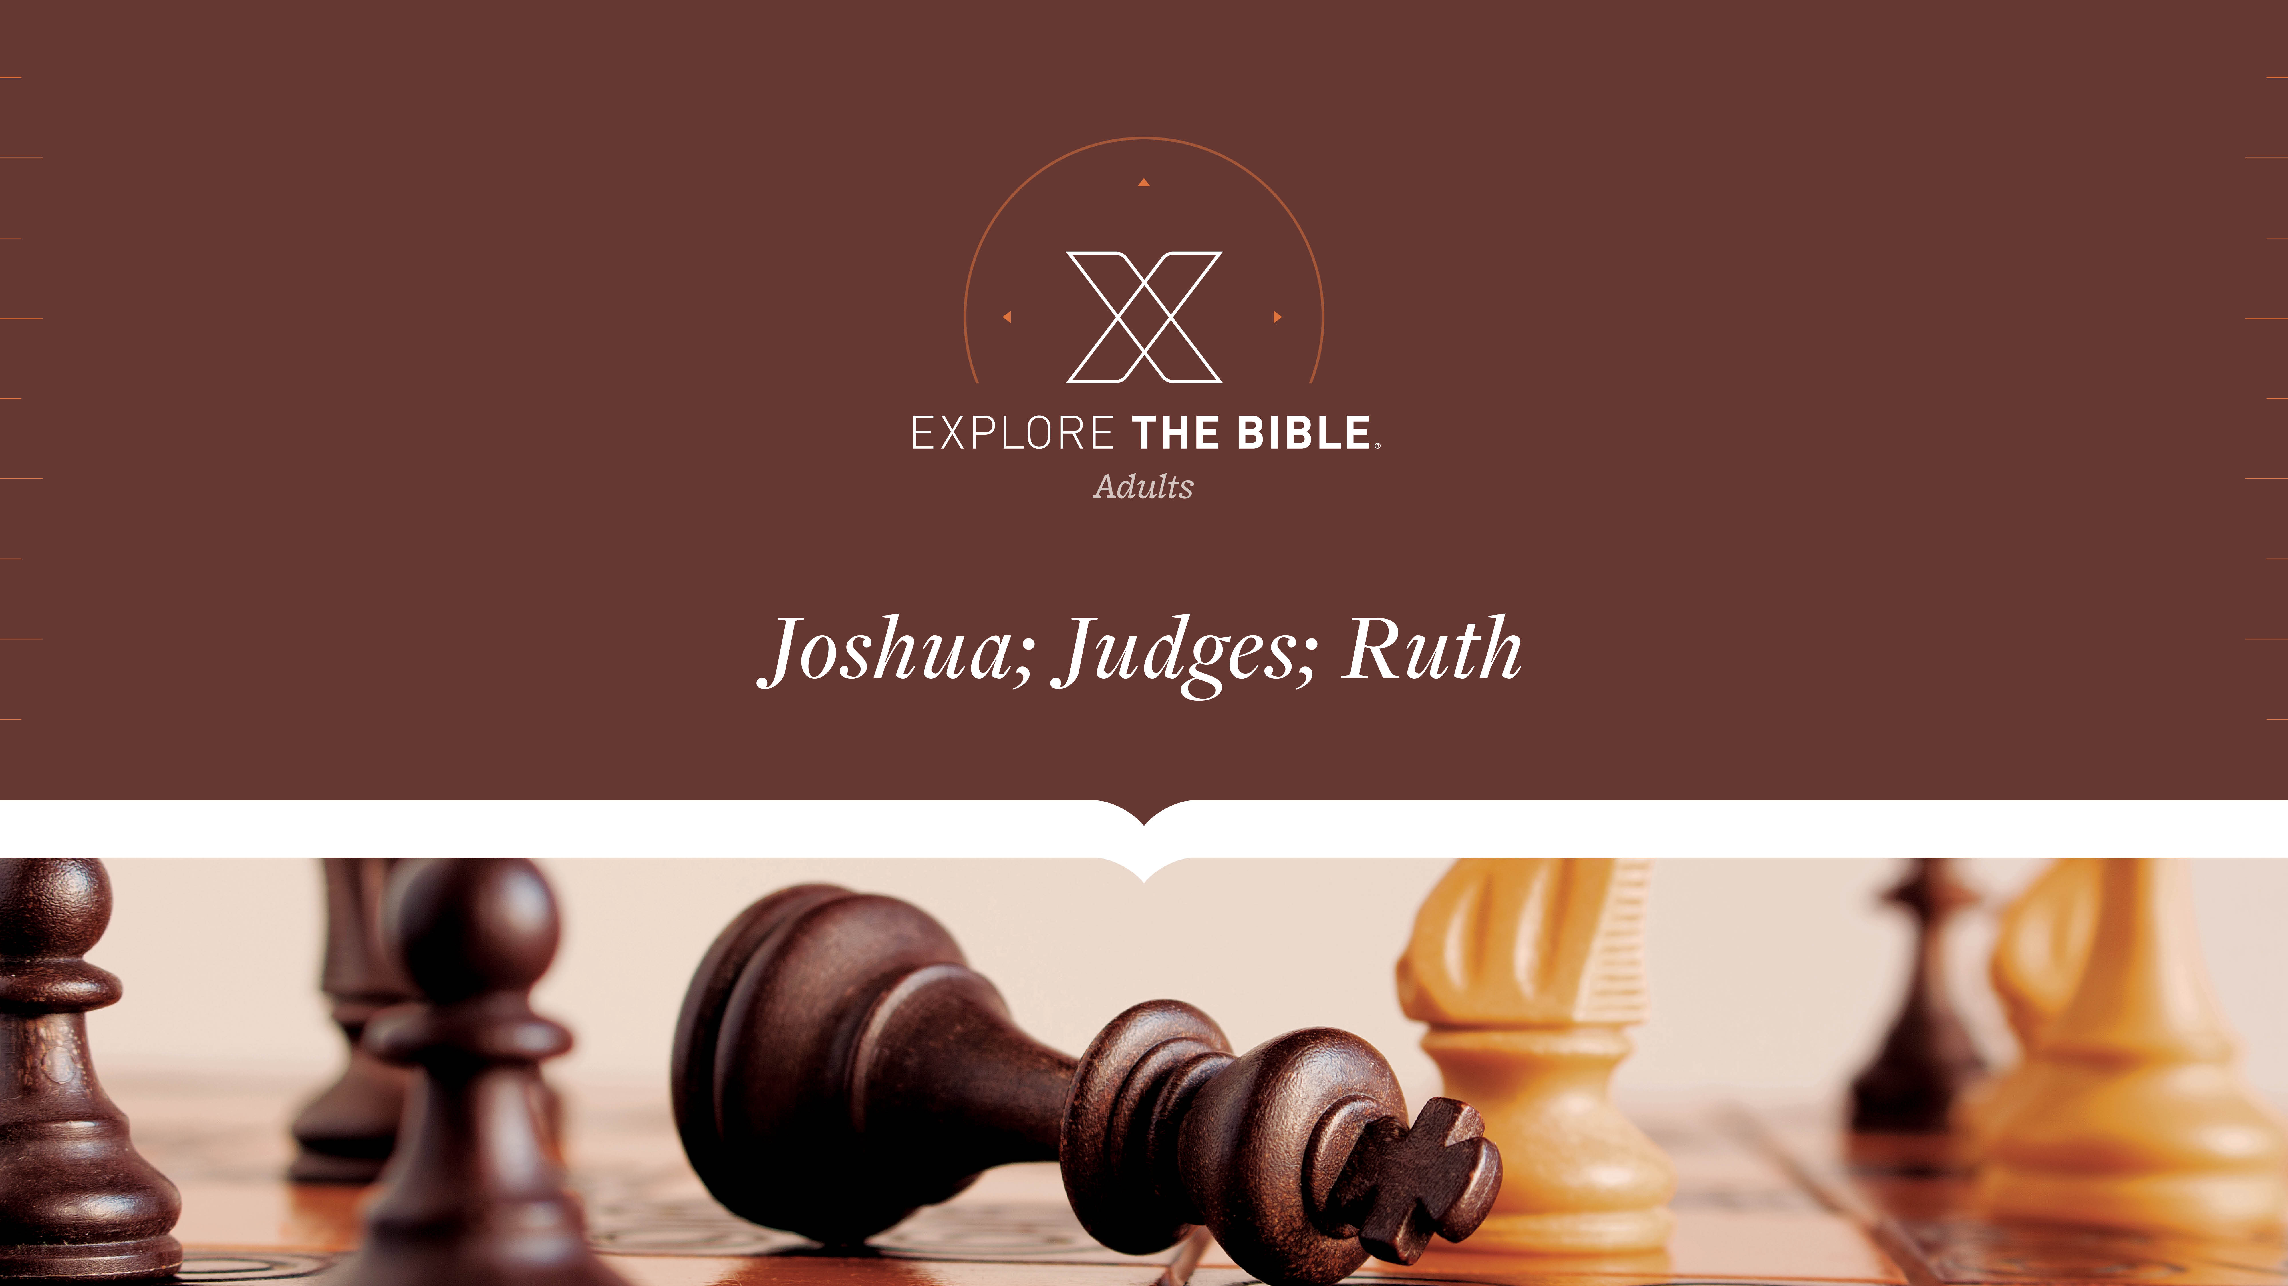
Session 14
Session 6

Slide 2

MAIN IDEA:
Caleb followed the Lord completely and received what God had promised him decades earlier.
God’s Care
(Psalm 23:1-6)

Slide 3


Introduction
  Would you rate your patience as “high,” “medium,” or “low” in most cases? Why?
  What have you learned about trusting God’s timing?

Slide 4
Unwavering Determination
Obedience (Joshua 14:1-5)
Devotion (Joshua 14:6-9)
Inheritance (Joshua 14:10-15)

Slide 5
Obedience (Joshua 14:1-5)
The Israelites received these portions that the priest Eleazar, Joshua son of Nun, and the family heads of the Israelite tribes gave them in the land of Canaan. ² Their inheritance was by lot as the Lord commanded through Moses for the nine and a half tribes, ³ because Moses had given the inheritance to the two and a half tribes beyond the Jordan. But he gave no inheritance among them to the Levites.
⁴ The descendants of Joseph became two tribes, Manasseh and Ephraim. No portion of the land was given to the Levites except cities to live in, along with pasturelands for their cattle and livestock. ⁵ So the Israelites did as the Lord commanded Moses, and they divided the land.

Slide 6
Obedience (Joshua 14:1-5)
We will face daily opportunities to obey or disobey God’s instructions.
  Do you read instructions or do things on your own? How does that usually work out?
  How was the dividing of the land a demonstration of trust in God and His wisdom?

Slide 7
Devotion (Joshua 14:6-9)
⁶ The descendants of Judah approached Joshua at Gilgal, and Caleb son of Jephunneh the Kenizzite said to him, “You know what the Lord promised Moses the man of God at Kadesh-barnea about you and me. ⁷ I was forty years old when Moses the Lord’s servant sent me from Kadesh-barnea to scout the land, and I brought back an honest report.
⁸ My brothers who went with me caused the people to lose heart, but I followed the Lord my God completely. ⁹ On that day Moses swore to me, ‘The land where you have set foot will be an inheritance for you and your descendants forever, because you have followed the Lord my God completely.’

Slide 8
Devotion (Joshua 14:6-9)
We can be assured that God knows and rewards those who follow Him wholeheartedly.
  What is a hobby or sport you are “devoted” to following? Why?
  What does it look like to follow the Lord wholeheartedly?

Slide 9
Inheritance (Joshua 14:10-15)
¹⁰ “As you see, the Lord has kept me alive these forty-five years as he promised, since the Lord spoke this word to Moses while Israel was journeying in the wilderness. Here I am today, eighty-five years old. ¹¹ I am still as strong today as I was the day Moses sent me out. My strength for battle and for daily tasks is now as it was then.
¹² Now give me this hill country the Lord promised me on that day, because you heard then that the Anakim are there, as well as large fortified cities. Perhaps the Lord will be with me and I will drive them out as the Lord promised.”

Slide 10
Inheritance (Joshua 14:10-15)
¹³ Then Joshua blessed Caleb son of Jephunneh and gave him Hebron as an inheritance. ¹⁴ Therefore, Hebron still belongs to Caleb son of Jephunneh the Kenizzite as an inheritance today because he followed the Lord, the God of Israel, completely. ¹⁵ Hebron’s name used to be Kiriath-arba; Arba was the greatest man among the Anakim. After this, the land had rest from war.

Slide 11
Inheritance (Joshua 14:10-15)
We can be assured by God’s presence and aid when we follow him wholeheartedly.
  How do you respond to challenges in life? What is the greatest challenge you’ve overcome?
  Which of God’s promises do you rely upon when facing unknown challenges?

Slide 12
CHALLENGE
      What can you do to prepare for these situations before you face them?
      What should you remember and do in order to make the right decision and obey God?

