Slide 1
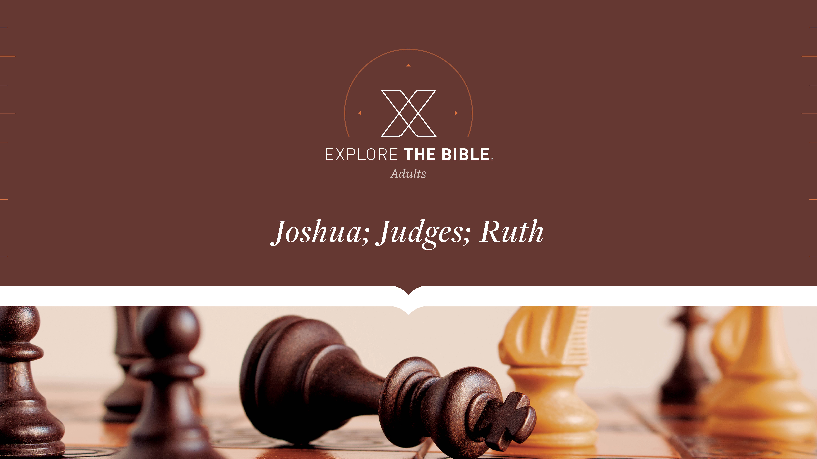
Session 14
Session 7

Slide 2

MAIN IDEA:
In his farewell address, Joshua challenged the people to choose the Lord over the gods of the Canaanites.
God’s Care
(Psalm 23:1-6)

Slide 3


Introduction
  When did you last fly? What do you recall about the flight attendant’s instructions?
  Why are people tempted to ignore warnings of potential danger?

Slide 4
Vital Decision
Challenge (Joshua 24:14-18)
Warning (Joshua 24:19-24)

Slide 5
Challenge (Joshua 24:14-18)
¹⁴ “Therefore, fear the Lord and worship him in sincerity and truth. Get rid of the gods your ancestors worshiped beyond the Euphrates River and in Egypt, and worship the Lord.
¹⁵ But if it doesn’t please you to worship the Lord, choose for yourselves today: Which will you worship—the gods your ancestors worshiped beyond the Euphrates River or the gods of the Amorites in whose land you are living? As for me and my family, we will worship the Lord.”
¹⁶ The people replied, “We will certainly not abandon the Lord to worship other gods!

Slide 6
Challenge (Joshua 24:14-18)
¹⁷ For the Lord our God brought us and our ancestors out of the land of Egypt, out of the place of slavery, and performed these great signs before our eyes. He also protected us all along the way we went and among all the peoples whose lands we traveled through.
¹⁸ The Lord drove out before us all the peoples, including the Amorites who lived in the land. We too will worship the Lord, because he is our God.”

Slide 7
Challenge (Joshua 24:14-18)
Each person must consider how he or she will respond to the Lord.
  What are some decisions that require a commitment in your life? Why were you willing to make the commitment?
  Why is it important to consciously choose whom you will serve?
  How does your decision to serve the Lord influence people around you?

Slide 8
Warning (Joshua 24:19-24)
¹⁹ But Joshua told the people, “You will not be able to worship the Lord, because he is a holy God. He is a jealous God; he will not forgive your transgressions and sins. ²⁰ If you abandon the Lord and worship foreign gods, he will turn against you, harm you, and completely destroy you, after he has been good to you.”
²¹ “No!” the people answered Joshua. “We will worship the Lord.”
²² Joshua then told the people, “You are witnesses against yourselves that you yourselves have chosen to worship the Lord.” “We are witnesses,” they said. ²³ “Then get rid of the foreign gods that are among you and turn your hearts to the Lord, the God of Israel.” ²⁴ So the people said to Joshua, “We will worship the Lord our God and obey him.”

Slide 9
Warning (Joshua 24:19-24)
We’re to put away any idols that might demand our devotion that rightfully belongs to the Lord.
  How do you feel when you’re told you can’t accomplish some task?
  What idols or false ideas compete for your loyalty and attention?

Slide 10
CHALLENGE
      What does it look like in your context to be wholeheartedly devoted to the Lord?
      Who might you influence this week to encourage their devotion to the Lord?

