Slide 1
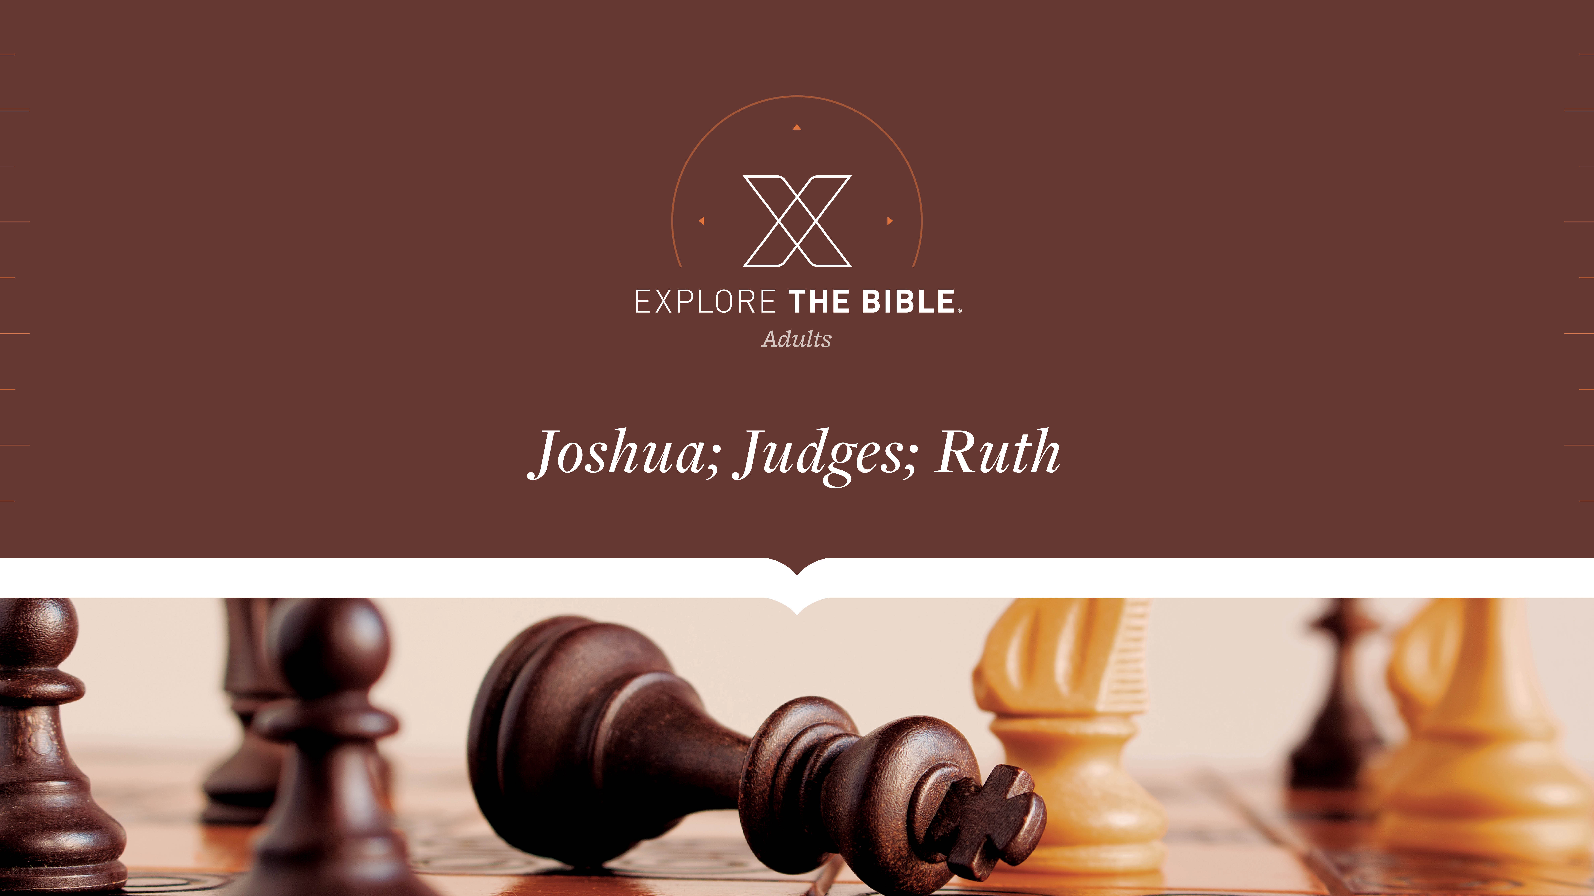
Session 14
Session 8

Slide 2

MAIN IDEA:
After Joshua’s death, Israel fell into a cycle of sin, judgment, confession, and restoration.
God’s Care
(Psalm 23:1-6)

Slide 3


Introduction
  When have you seen someone’s good intentions fall flat?
  What factors might cause people to break their commitments, and how can we guard against this in our own lives?

Slide 4
Consequences
The Evil (Judges 2:11-15)
The Cycle (Judges 2:16-19)
The Declaration (Judges 2:20-23)

Slide 5
The Evil (Judges 2:11-15)
¹¹ The Israelites did what was evil in the Lord’s sight. They worshiped the Baals ¹² and abandoned the Lord, the God of their ancestors, who had brought them out of Egypt. They followed other gods from the surrounding peoples and bowed down to them. They angered the Lord, ¹³ for they abandoned him and worshiped Baal and the Ashtoreths.
¹⁴ The Lord’s anger burned against Israel, and he handed them over to marauders who raided them. He sold them to the enemies around them, and they could no longer resist their enemies. ¹⁵ Whenever the Israelites went out, the Lord was against them and brought disaster on them, just as he had promised and sworn to them. So they suffered greatly.

Slide 6
The Evil (Judges 2:11-15)
God’s people must guard against the danger of forgetting what the Lord has done for them.
  What are some things you never want to forget? Why are they so important?
  What factors contribute to a person or group abandoning God?

Slide 7
The Cycle (Judges 2:16-19)
¹⁶ The Lord raised up judges, who saved them from the power of their marauders, ¹⁷ but they did not listen to their judges. Instead, they prostituted themselves with other gods, bowing down to them. They quickly turned from the way of their ancestors, who had walked in obedience to the Lord’s commands. They did not do as their ancestors did.
¹⁸ Whenever the Lord raised up a judge for the Israelites, the Lord was with him and saved the people from the power of their enemies while the judge was still alive. The Lord was moved to pity whenever they groaned because of those who were oppressing and afflicting them. ¹⁹ Whenever the judge died, the Israelites would act even more corruptly than their ancestors, following other gods to serve them and bow in worship to them. They did not turn from their evil practices or their obstinate ways.

Slide 8
The Cycle (Judges 2:16-19)
Believers can be assured that God’s faithfulness to act on behalf of His people is rooted in His character, not in ours.
  When have you felt stuck in a rut? How did you get out of it?
  What does God’s providing a deliverer tell us about His character?

Slide 9
The Declaration (Judges 2:20-23)
²⁰ The Lord’s anger burned against Israel, and he declared, “Because this nation has violated my covenant that I made with their ancestors and disobeyed me, ²¹ I will no longer drive out before them any of the nations Joshua left when he died.
²² I did this to test Israel and to see whether or not they would keep the Lord’s way by walking in it, as their ancestors had.” ²³ The Lord left these nations and did not drive them out immediately. He did not hand them over to Joshua.

Slide 10
The Declaration (Judges 2:20-23)
Believers can expect their obedience to God to be tested.
  When you hear the word “test,” what comes to mind? When can a test turn out to be a good thing?
  When and how has God tested you? How is your faith stronger as a result?

Slide 11
CHALLENGE
      How might you guard against the danger of forgetting what the Lord has done for you?
      Why is it essential that you always remember that God’s faithfulness to act on behalf of His people is rooted in His character, not in ours?

