Slide 1
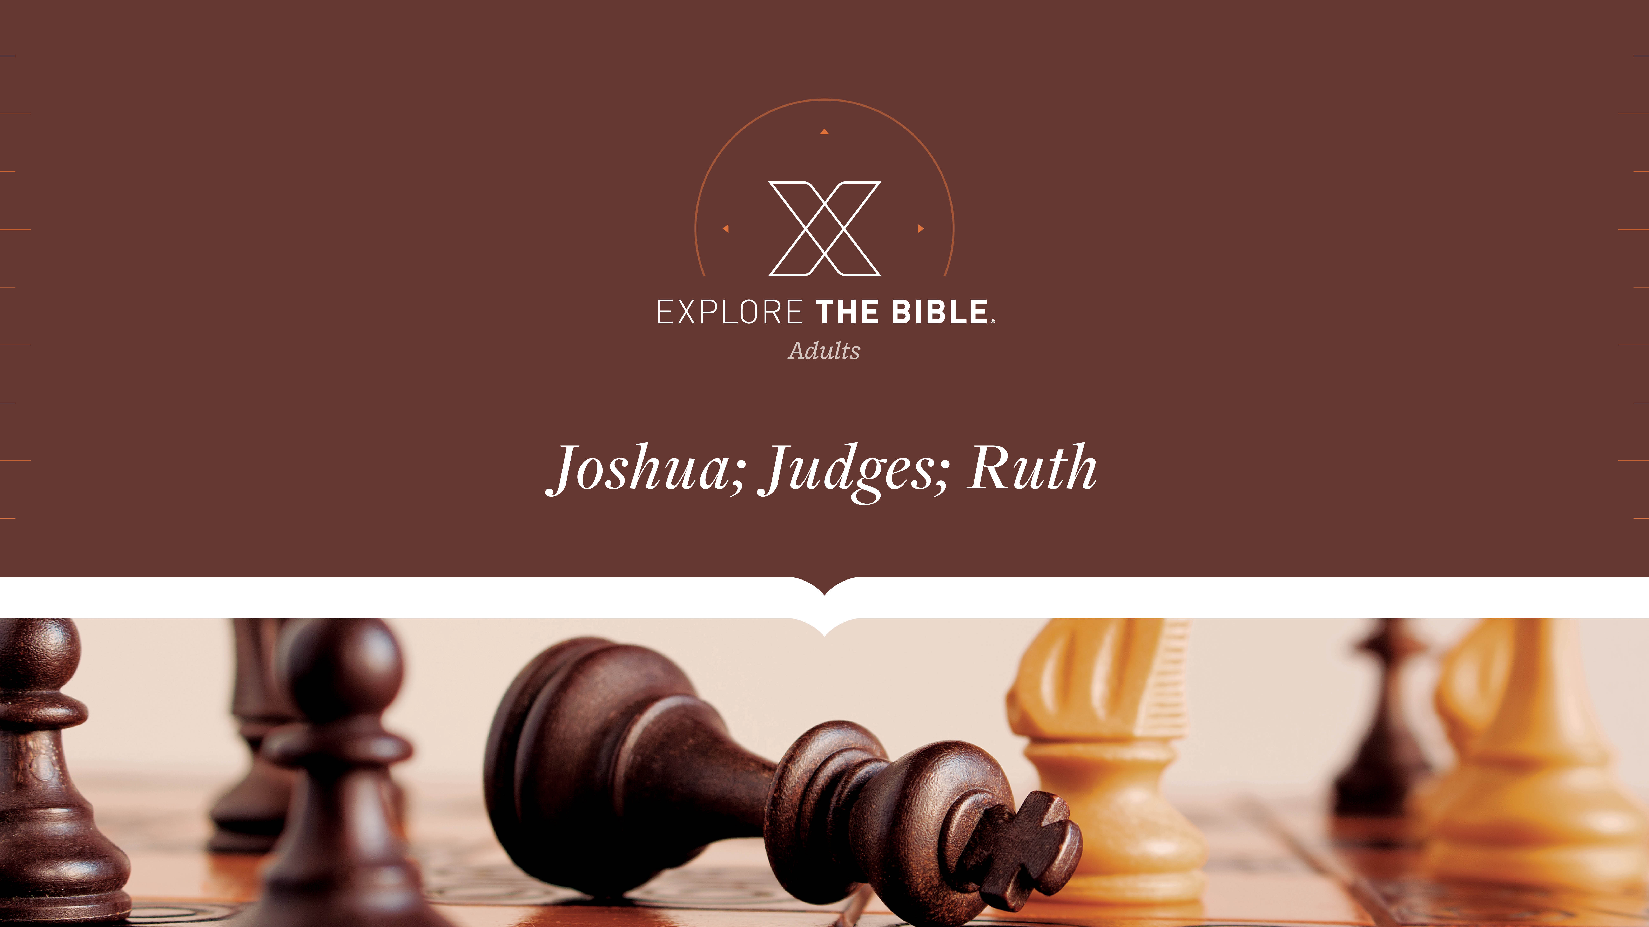
Session 14
Session 9

Slide 2

MAIN IDEA:
Though Gideon considered himself inadequate, God called him to deliver his people from the Midianites.
God’s Care
(Psalm 23:1-6)

Slide 3


Introduction
  When have you felt inadequate at a task? Where did you turn for help?

Slide 4
Called
Oppression (Judges 6:1-4,7-10)
Commission (Judges 6:11-14)
Reassurance (Judges 6:15-16)

Slide 5
Oppression (Judges 6:1-4, 7-10)
¹ The Israelites did what was evil in the sight of the LORD. So the LORD handed them over to Midian seven years,
² and they oppressed Israel. Because of Midian, the Israelites made hiding places for themselves in the mountains, caves, and strongholds.
³ Whenever the Israelites planted crops, the Midianites, Amalekites, and the people of the east came and attacked them.

Slide 6
Oppression (Judges 6:1-4, 7-10)
⁴ They encamped against them and destroyed the produce of the land, even as far as Gaza. They left nothing for Israel to eat, as well as no sheep, ox, or donkey.
⁷When the Israelites cried out to him because of Midian,
⁸ the Lord sent a prophet to them. He said to them, “This is what the Lord God of Israel says: ‘I brought you out of Egypt and out of the place of slavery.
⁹ I rescued you from the power of Egypt and the power of all who oppressed you. I drove them out before you and gave you their land.

Slide 7
Oppression (Judges 6:1-4, 7-10)
¹⁰ I said to you: I am the Lord your God. Do not fear the gods of the Amorites whose land you live in. But you did not obey me.

Slide 8
Oppression (Judges 6:1-4, 7-10)
We can anticipate that when people turn their backs on God, they will experience undesirable consequences.
  How do people respond to desperate situations? How do you respond?
  What outcomes should we anticipate if we live in disobedience to God?

Slide 9
Commission (Judges 6:11-14)
¹¹ The angel of the Lord came, and he sat under the oak that was in Ophrah, which belonged to Joash, the Abiezrite. His son Gideon was threshing wheat in the winepress in order to hide it from the Midianites.
¹² Then the angel of the Lord appeared to him and said, “The Lord is with you, valiant warrior.”
¹³ Gideon said to him, “Please, my lord, if the Lord is with us, why has all this happened? And where are all his wonders that our ancestors told us about? They said, ‘Hasn’t the Lord brought us out of Egypt?’ But now the Lord has abandoned us and handed us over to Midian.”
¹⁴ The Lord turned to him and said, “Go in the strength you have and deliver Israel from the grasp of Midian. I am sending you!”

Slide 10
Commission (Judges 6:11-14)
We can be encouraged to know that God calls unlikely people to do great things for Him.
  How might our circumstances impact our response to God’s calling?
  Why do people get frustrated with God? How do you think God feels about that?

Slide 11
Reassurance (Judges 6:15-16)
¹⁵ He said to him, “Please, Lord, how can I deliver Israel? Look, my family is the weakest in Manasseh, and I am the youngest in my father’s family.”
¹⁶ “But I will be with you,” the Lord said to him. “You will strike Midian down as if it were one man.”

Slide 12
Reassurance (Judges 6:15-16)
Believers should trust God when being called upon to take a specific action for Him.
  What is the benefit of tackling hard jobs?
  How does the assurance of God's presence
  negate our excuse of inadequacy?

Slide 13
CHALLENGE
      How can believers be encouraged by the truth that God calls unlikely people to do great things for Him?
      How can doubting God be turned into trusting God?

