Slide 1
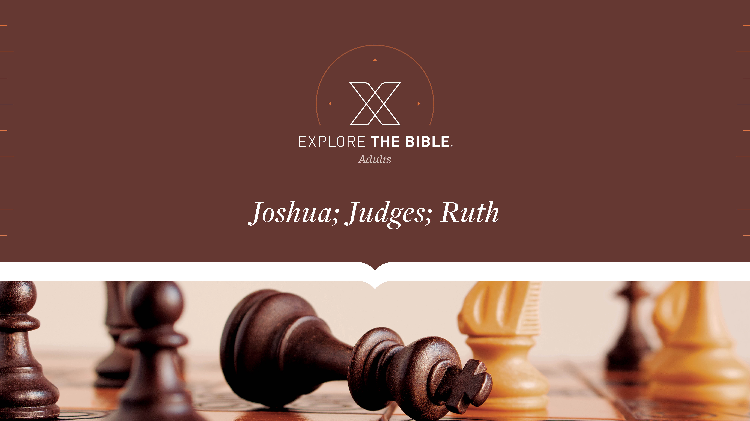
Session 14
Session 10

Slide 2

MAIN IDEA:
God provided victory and brought Himself glory through Gideon’s army.
God’s Care
(Psalm 23:1-6)

Slide 3


Introduction
  Why do stories of people rising from humble circumstances to achieve success resonate so strongly with us?

Slide 4
Called
Too Many (Judges 7:1-3)
Still Too Many (Judges 7:4-8)
Just Right (Judges 7:19-23)

Slide 5
Too Many (Judges 7:1-3)
¹ Jerubbaal (that is, Gideon) and all the troops who were with him, got up early and camped beside the spring of Harod. The camp of Midian was north of them, below the hill of Moreh, in the valley.
² The Lord said to Gideon, “You have too many troops for me to hand the Midianites over to them, or else Israel might elevate themselves over me and say, ‘I saved myself.’
³ Now announce to the troops, ‘Whoever is fearful and trembling may turn back and leave Mount Gilead.’” So twenty-two thousand of the troops turned back, but ten thousand remained..

Slide 6
Too Many (Judges 7:1-3)
Believers dishonor God when they seek the glory that belongs to Him alone.
  How often does fear determine your decisions? Why is that dangerous?
  In what ways might we try to do God's work by our might and for our glory?

Slide 7
Still Too Many (Judges 7:4-8)
⁴ Then the Lord said to Gideon, “There are still too many troops. Take them down to the water, and I will test them for you there. If I say to you, ‘This one can go with you,’ he can go. But if I say about anyone, ‘This one cannot go with you,’ he cannot go.”
⁵ So he brought the troops down to the water, and the Lord said to Gideon, “Separate everyone who laps water with his tongue like a dog. Do the same with everyone who kneels to drink.”
⁶ The number of those who lapped with their hands to their mouths was three hundred men, and all the rest of the troops knelt to drink water.

Slide 8
Still Too Many (Judges 7:4-8)
⁷ The Lord said to Gideon, “I will deliver you with the three hundred men who lapped and hand the Midianites over to you. But everyone else is to go home.”
⁸ So Gideon sent all the Israelites to their tents but kept the three hundred troops, who took the provisions and their rams’ horns. The camp of Midian was below him in the valley.

Slide 9
Still Too Many (Judges 7:4-8)
Believers need to trust that God's way of doing things is always best.
  What makes it hard to believe that God always has our best interests in mind?
  When have you had to trust God despite not understanding what He was doing or asking?

Slide 10
Just Right (Judges 7:19-23)
¹⁹ Gideon and the hundred men who were with him went to the outpost of the camp at the beginning of the middle watch after the sentries had been stationed. They blew their rams’ horns and broke the pitchers that were in their hands.
²⁰ The three companies blew their rams’ horns and shattered their pitchers. They held their torches in their left hands and their rams’ horns to blow in their right hands, and they shouted, “A sword for the Lord and for Gideon!”
²¹ Each Israelite took his position around the camp, and the entire Midianite army began to run, and they cried out as they fled.

Slide 11
Just Right (Judges 7:19-23)
²² When Gideon’s men blew their three hundred rams’ horns, the Lord caused the men in the whole army to turn on each other with their swords. They fled to Acacia House in the direction of Zererah as far as the border of Abel-meholah near Tabbath.
²³ Then the men of Israel were called from Naphtali, Asher, and Manasseh, and they pursued the Midianites.

Slide 12
Just Right (Judges 7:19-23)
Believers should pray for God to do what only He can do
  What is something only God can do in your life right now? What keeps you from trusting Him with that?
  How should knowing that God acts in unpredictable ways impact how we live?

Slide 13
CHALLENGE
      What results from such an approach? (Doing God's work by one’s own might and for one's own glory.)
      Why is it sometimes difficult to trust that God’s ways of doing things are always best?

