Slide 1
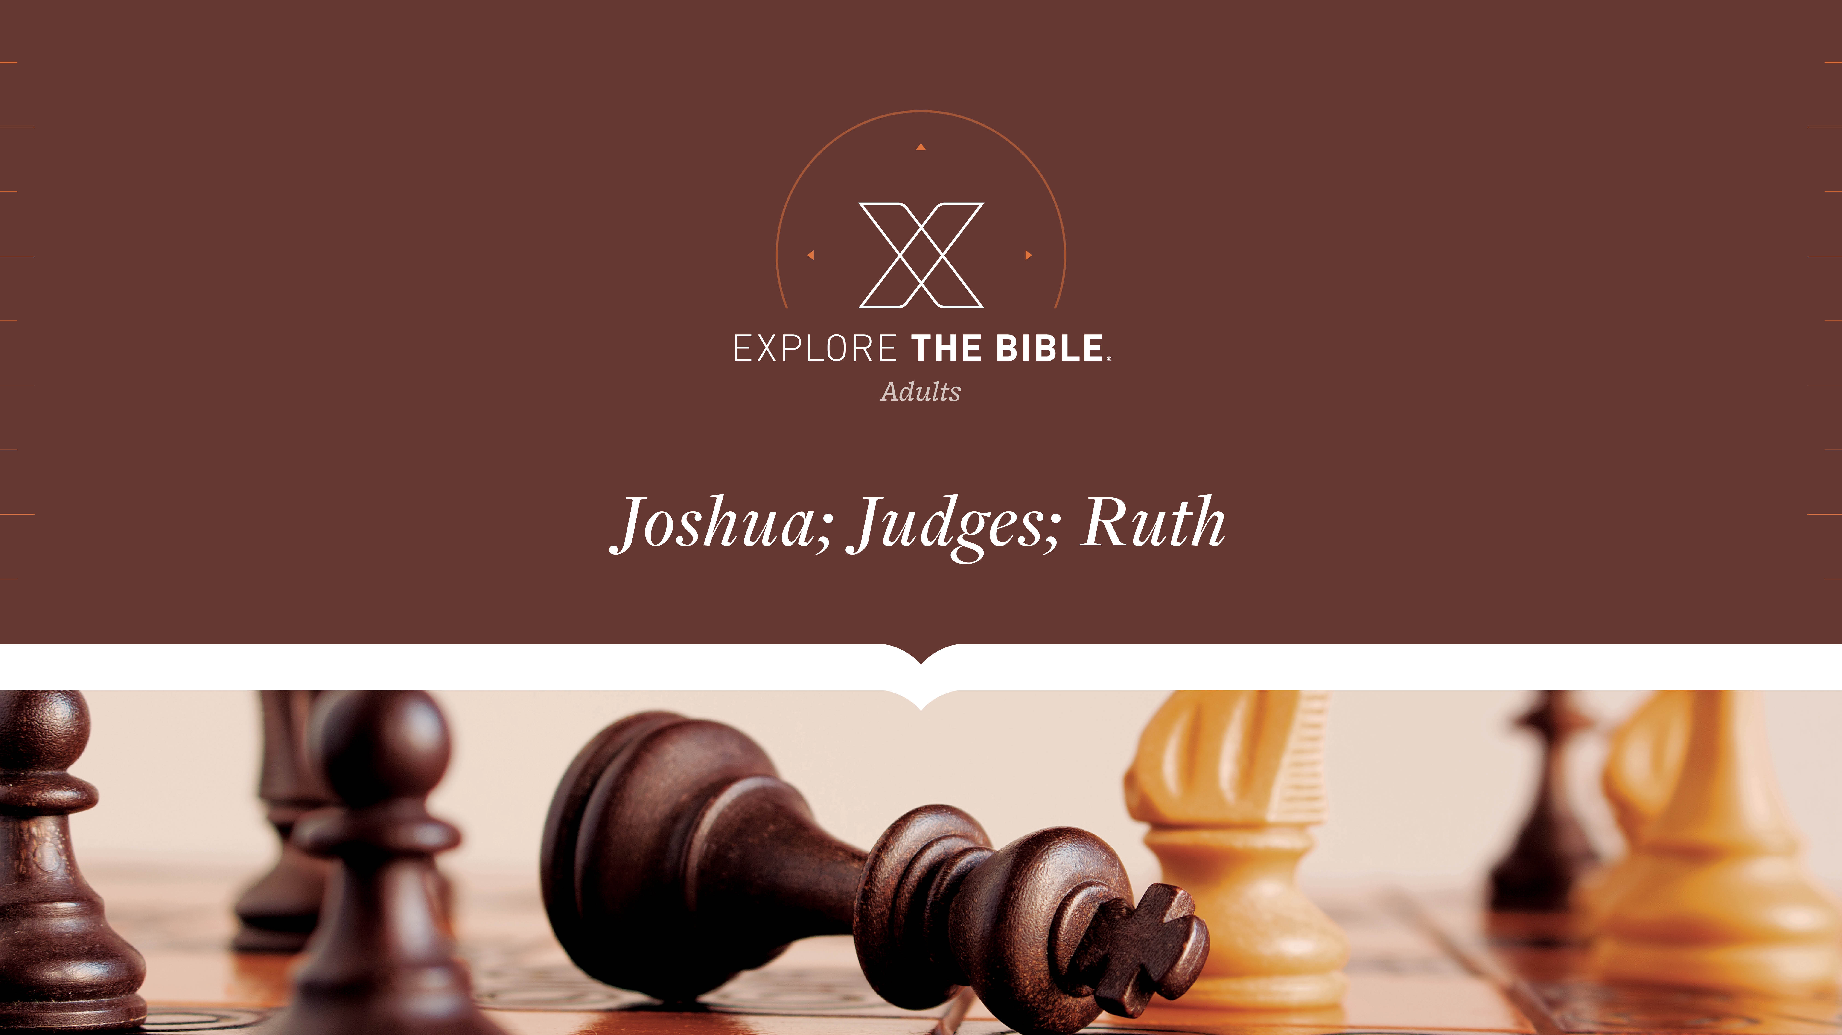
Session 14
Session 13

Slide 2

MAIN IDEA:
Boaz played the role of kinsman-redeemer
by marrying Ruth, pointing to Jesus as the Ultimate Redeemer.
God’s Care
(Psalm 23:1-6)

Slide 3


Introduction
  What has provided you a sense of hope when everything seemed out of control?

Slide 4
Called
Future Unclear (Ruth 3:8-10)
Future Secured (Ruth 3:11-13)
Future Redeemed (Ruth 4:13-17)

Slide 5
Future Unclear (Ruth 3:8-10)
⁸ At midnight, Boaz was startled, turned over, and there lying at his feet was a woman!
⁹ So he asked, “Who are you?”
“I am Ruth, your servant,” she replied. “Take me under your wing, for you are a family redeemer.”
¹⁰ Then he said, “May the Lord bless you, my daughter. You have shown more kindness now than before, because you have not pursued younger men, whether rich or poor.

Slide 6
Future Unclear (Ruth 3:8-10)
When believers face times of uncertainty, we will have to step out in faith.
  How has God’s guidance through moments of uncertainty influenced your faith?
  Where do you see God working in the events that brought Ruth and Boaz together?

Slide 7
Future Secured (Ruth 3:11-13)
¹¹ Now don’t be afraid, my daughter. I will do for you whatever you say, since all the people in my town know that you are a woman of noble character.
¹² Yes, it is true that I am a family redeemer, but there is a redeemer closer than I am.
¹³ Stay here tonight, and in the morning, if he wants to redeem you, that’s good. Let him redeem you. But if he doesn’t want to redeem you, as the Lord lives, I will. Now lie down until morning.”

Slide 8
Future Secured (Ruth 3:11-13)
We can turn to God with our fears and trust Him to respond.
  How does insecurity give rise to fear? How do you find peace in chaotic times?
  What might keep us from trusting God with our fears?

Slide 9
Future Redeemed (Ruth 4:13-17)
¹³ Boaz took Ruth and she became his wife. He slept with her, and the Lord granted conception to her, and she gave birth to a son.
¹⁴ The women said to Naomi, “Blessed be the Lord, who has not left you without a family redeemer today. May his name become well known in Israel.
¹⁵ He will renew your life and sustain you in your old age. Indeed, your daughter-in-law, who loves you and is better to you than seven sons, has given birth to him.”

Slide 10
Future Redeemed (Ruth 4:13-17)
¹⁶ Naomi took the child, placed him on her lap, and became a mother to him.
¹⁷ The neighbor women said, “A son has been born to Naomi,” and they named him Obed. He was the father of Jesse, the father of David.

Slide 11
Future Redeemed (Ruth 4:13-17)
We can be assured of God’s continual care for us since he demonstrated it in His redemptive plan.
  Why is it important to nurture solid character and a good reputation?
  How does God’s provision impact the way you view the needs of your family during life’s uncertainties?

Slide 12
CHALLENGE
      How can your group encourage others who are anxious and afraid to trust in the Lord? How can you communicate this week God’s redemptive love as their source of strength?
      How can knowing God’s providential care defeat fear’s domination and renew your faith so you can experience God’s peace and joy through seasons of uncertainty?

