Slide 1
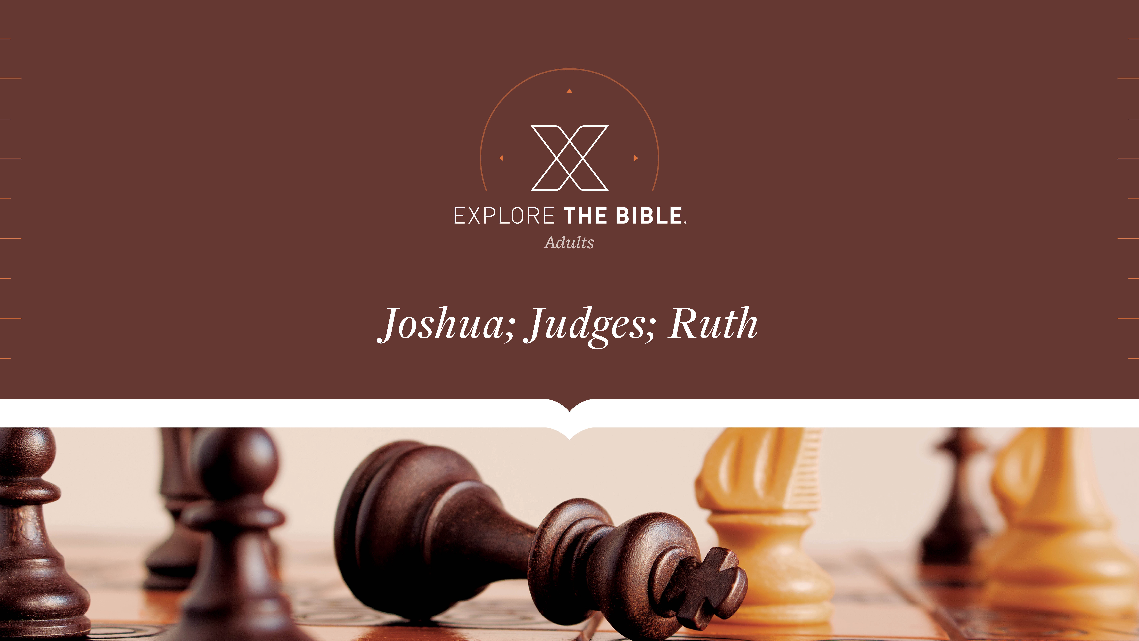
Session 14
Session 11

Slide 2

MAIN IDEA:
Samson’s physical strength could not save him from the consequences of his weak moral character.
God’s Care
(Psalm 23:1-6)

Slide 3


Introduction
  How has understanding the principle of cause and effect influenced the choices you make in life?
  How can the people with whom we choose to associate impact our ability to remain faithful to God?

Slide 4
Called
I. Strength Departed (Judges 16:16-20)
II. Samson Defeated (Judges 16:21-25)
III. Philistines Destroyed (Judges 16:26-31)

Slide 5
Strength Departed (Judges 16:16-20)
¹⁶ With such nagging she prodded him day after day until he was sick to death of it.
¹⁷ So he told her everything. “No razor has ever been used on my head,” he said, “because I have been a Nazirite dedicated to God from my mother’s womb. If my head were shaved, my strength would leave me, and I would become as weak as any
other man.”
¹⁸ When Delilah saw that he had told her everything, she sent word to the rulers of the Philistines, “Come back once more; he has told me everything.” So the rulers of the Philistines returned with the silver in their hands.

Slide 6
Strength Departed (Judges 16:16-20)
¹⁹ After putting him to sleep on her lap, she called for
someone to shave off the seven braids of his hair, and so
began to subdue him. And his strength left him.
²⁰ Then she called, “Samson, the Philistines are upon you!”
He awoke from his sleep and thought, “I’ll go out as before and shake myself free.” But he did not know that the Lord had left him.

Slide 7
Strength Departed (Judges 16:16-20)
Believers should avoid putting themselves in situations
that will tempt them to sin.
• How does sin desensitize us to God’s work in our lives?
• How can the people with whom we choose to
associate impact our ability to remain faithful to God?

Slide 8
Samson Defeated (Judges 16:21-25)
²¹ The Philistines seized him and gouged out his eyes. They brought him
down to Gaza and bound him with bronze shackles, and he was forced to
grind grain in the prison.
²² But his hair began to grow back after it had been shaved.
²³ Now the Philistine leaders gathered together to offer a great sacrifice to
their god Dagon. They rejoiced and said:
Our god has handed over our enemy Samson to us.

Slide 9
Samson Defeated (Judges 16:21-25)
²⁴ When the people saw him, they praised their god and said:
Our god has handed over to us
our enemy who destroyed our land
and who multiplied our dead.
²⁵ When they were in good spirits, they said, “Bring Samson here to entertain us.” So they brought Samson from prison, and he entertained them. They had him stand between the pillars.

Slide 10
Samson Defeated (Judges 16:21-25)
Believers who compromise their faithfulness to God will
eventually be put to shame.
• How have you seen God bring restoration out of a
devastating situation?
• What do you think was Samson’s greatest loss and why?

Slide 11
Philistines Destroyed (Judges 16:26-31)
²⁶ Samson said to the young man who was leading him by
the hand, “Lead me where I can feel the pillars supporting
the temple, so I can lean against them.”
²⁷ The temple was full of men and women; all the leaders of
the Philistines were there, and about three thousand men
and women were on the roof watching Samson entertain
them.
²⁸ He called out to the Lord, “Lord God, please remember
me. Strengthen me, God, just once more. With one act of
vengeance, let me pay back the Philistines for my two eyes.”

Slide 12
Philistines Destroyed (Judges 16:26-31)
²⁹ Samson took hold of the two middle pillars supporting the
temple and leaned against them, one on his right hand and
the other on his left.
³⁰ Samson said, “Let me die with the Philistines.” He pushed
with all his might, and the temple fell on the leaders and all
the people in it. And those he killed at his death were more
than those he had killed in his life.
³¹ Then his brothers and his father’s whole family came
down, carried him back, and buried him between Zorah and
Eshtaol in the tomb of his father Manoah. So he judged
Israel twenty years.

Slide 13
Philistines Destroyed (Judges 16:26-31)
Believers can be confident that God does not abandon
them, in spite of their sin.
  Do you believe that God responds to imperfect prayers?
  In light of Samson’s story, how would you counsel someone who is experiencing the consequences of sinful choices?

Slide 14
CHALLENGE
• How can your Bible study group encourage
one another to avoid putting yourselves in
situations that will tempt you to sin?
• How does God’s faithfulness to you affect
your faithfulness to Him?

