Slide 1
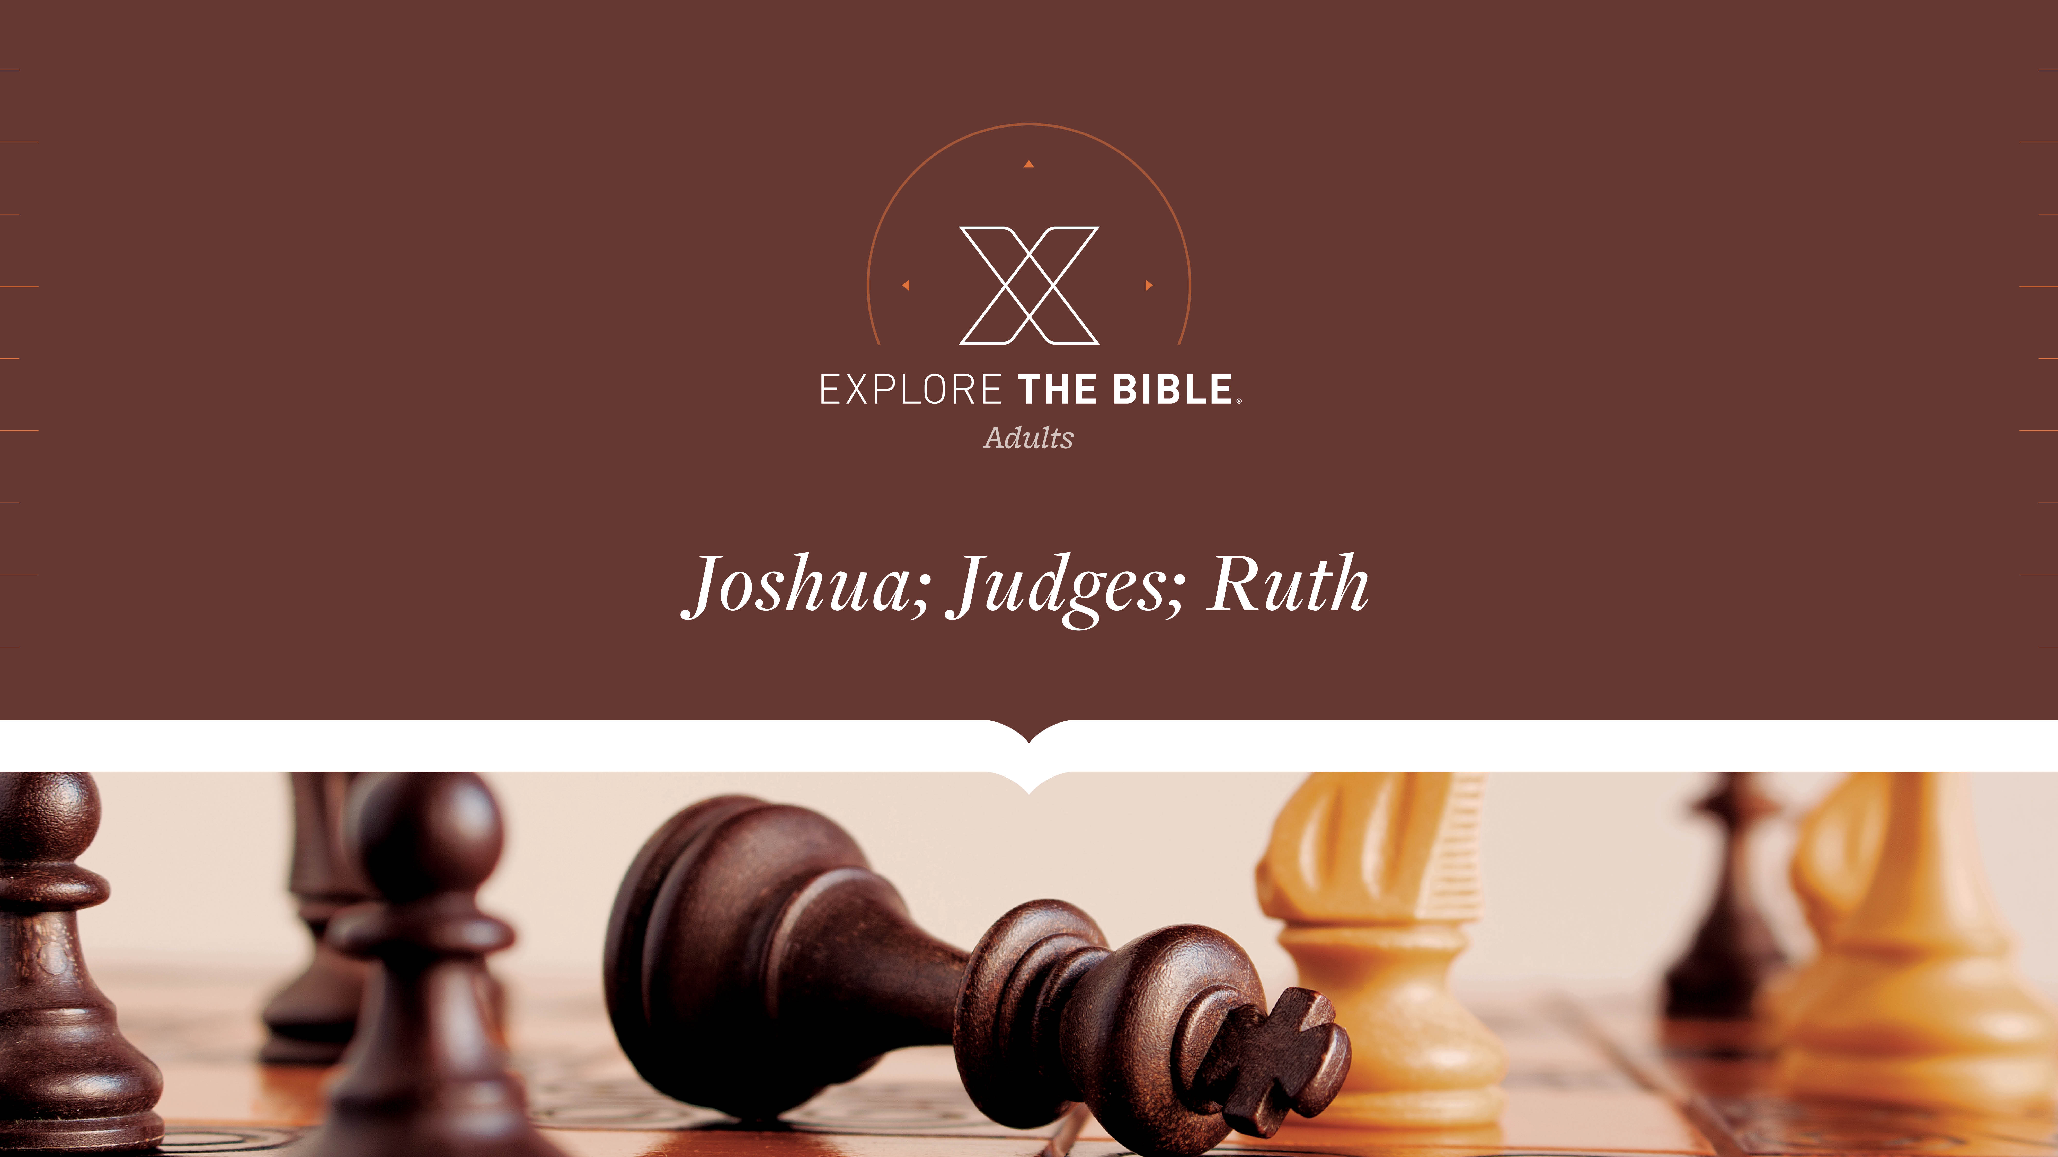
Session 14
Session 12

Slide 2

MAIN IDEA:
In the midst of Naomi’s tragedy, God demonstrated His care and sovereignty.
God’s Care
(Psalm 23:1-6)

Slide 3


Introduction
  How might faith in God’s care and control help a person navigate grief and fear?

Slide 4
Called
I. Loss (Ruth 1:11-15)
II. Loyalty (Ruth 1:16-18)
III. Provision (Ruth 2:5-12)

Slide 5
Loss (Ruth 1:11-15)
¹¹ But Naomi replied, “Return home, my daughters. Why do
you want to go with me? Am I able to have any more sons who
could become your husbands?
¹² Return home, my daughters. Go on, for I am too old to have
another husband. Even if I thought there was still hope for me
to have a husband tonight and to bear sons,
¹³ would you be willing to wait for them to grow up? Would
you restrain yourselves from remarrying? No, my daughters,
my life is much too bitter for you to share, because the Lord’s
hand has turned against me.”

Slide 6
Loss (Ruth 1:11-15)
¹⁴ Again they wept loudly, and Orpah kissed her mother-in-law,
but Ruth clung to her.
¹⁵ Naomi said, “Look, your sister-in-law has gone back to her
people and to her gods. Follow your sister-in-law.”

Slide 7
Loss (Ruth 1:11-15)
Believers will suffer loss.
  How does sin desensitize us to God’s work in our lives?
  How can bitterness affect our decisions?
  Why does loss draw some people closer to God , while others struggle with anger toward God? How can the church community be a source of compassion to both?

Slide 8
Loyalty (Ruth 1:16-18)
¹⁶ But Ruth replied:
Don’t plead with me to abandon you
or to return and not follow you.
For wherever you go, I will go,
and wherever you live, I will live;
your people will be my people,
and your God will be my God.
¹⁷ Where you die, I will die,
and there I will be buried.
May the Lord punish me,
and do so severely,

Slide 9
Loyalty (Ruth 1:16-18)
if anything but death separates you and me.
¹⁸ When Naomi saw that Ruth was determined to go with her, she stopped
talking to her.

Slide 10
Loyalty (Ruth 1:16-18)
We need to allow others to minister to us.
  • What role does loyalty play in our relationship with God and
  others? What value does society place on loyalty?
  • How can loyalty be a way to view God’s protection and
  provision?

Slide 11
Provision (Ruth 2:5-12)
⁵ Boaz asked his servant who was in charge of the harvesters,
“Whose young woman is this?”
⁶ The servant answered, “She is the young Moabite woman
who returned with Naomi from the territory of Moab.
⁷ She asked, ‘Will you let me gather fallen grain among the
bundles behind the harvesters?’ She came and has been on
her feet since early morning, except that she rested a little in
the shelter.”
⁸ Then Boaz said to Ruth, “Listen, my daughter. Don’t go and
gather grain in another field, and don’t leave this one, but
stay here close to my female servants.

Slide 12
Provision (Ruth 2:5-12)
⁹ See which field they are harvesting, and follow them. Haven’t
I ordered the young men not to touch you? When you are
thirsty, go and drink from the jars the young men have filled.”
¹⁰ She fell facedown, bowed to the ground, and said to him,
“Why have I found favor with you, so that you notice me,
although I am a foreigner?”
¹¹ Boaz answered her, “Everything you have done for your
mother-in-law since your husband’s death has been fully
reported to me: how you left your father and mother and your
native land, and how you came to a people you didn’t
previously know.

Slide 13
Provision (Ruth 2:5-12)
¹² May the Lord reward you for what you have done, and
may you receive a full reward from the Lord God of Israel,
under whose wings you have come for refuge.”

Slide 14
Provision (Ruth 2:5-12)
Believers can be confident in God’s sovereign ability to
provide for our needs.
  Why is it important to nurture solid character and a good
reputation?
  How does God’s provision impact the way you view the
needs of your family during life’s uncertainties?

Slide 15
CHALLENGE
      What specific ways could your group minister to others most effectively during difficult seasons?
      Who has walked alongside you through the pain? What are some life lessons you have learned from God and those He has graciously placed in your life?

