Slide 1
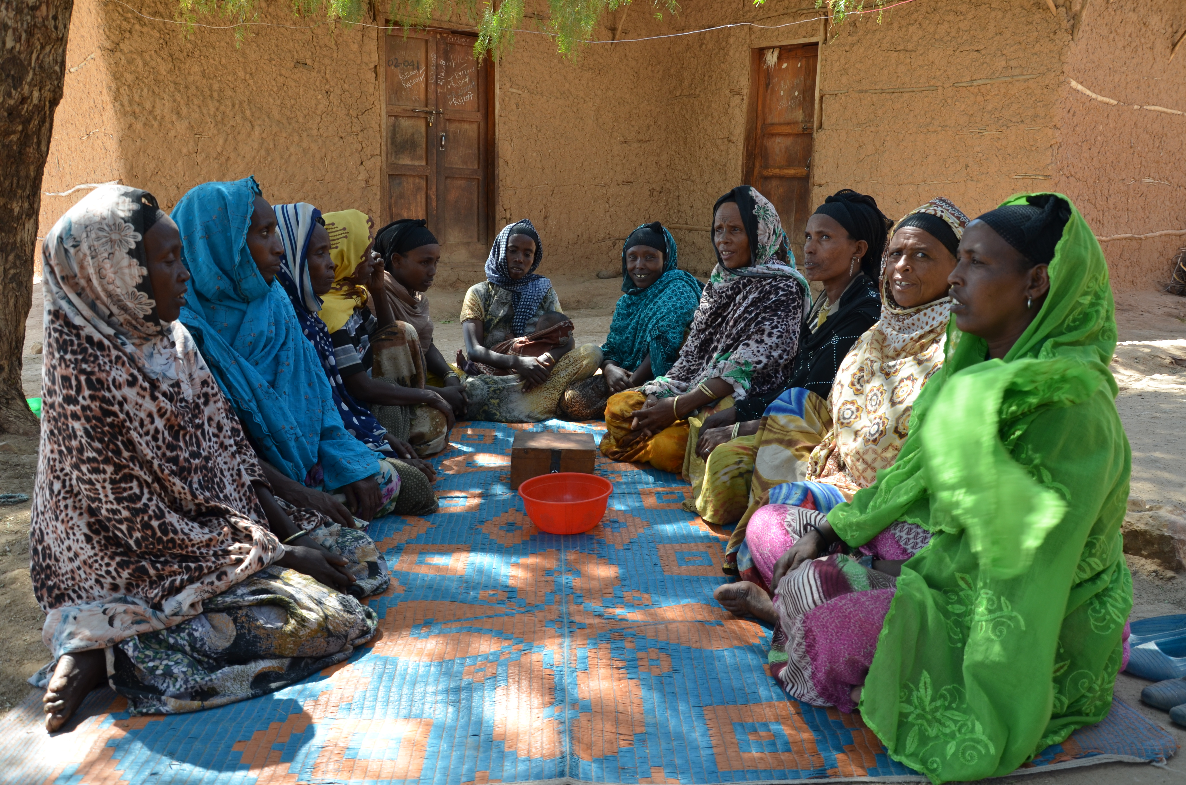
Savings Groups and the SAVIX database

Slide 2
Savings Groups
Voluntary and autonomous
Around 20 members
Regular meetings
Pool savings distribute loans
Very poor
Rural areas
SG+ Vehicles for complementary services
Multidimensional poverty.

Slide 3
The SAVIX database
Quarterly information of over 5 million members from 200000 savings groups over several quarters in more than 50 countries.
Based on a reporting system (the SAVIX MIS)
1,200 projects worldwide report to SAVIX
Developed by VSL Associates (Hugh Allen ++)
Supported by the Bill & Melinda Gates Foundation, CARE, Catholic Relief Services, Oxfam America and Plan International.
How can this be used for Academic Research with practical relevance?
Big data

Slide 4
The SAVIX Project at CERSEM UiA:
Agreement with FAHU
Centre for Research on Social Enterprises and Microfinance (CERSEM, https://cersem.uia.no/)
Funding from FAHU and University of Agder/CERSEM
From January 2018 to June 2021
Database proved workable April 2018

Slide 5
The SAVIX Project at CERSEM: objectives
In the interest of both practitioners and academics, the project seeks to provide research findings to answer the general question of “How can development actors contribute to poverty alleviation in a cost-effective way through the use of savings groups?”:
What are the group-level characteristics that enhance better group performance?
What type of delivery/implementation mechanisms facilitate better group performance including group survival?
How is the macro-economic environment influencing the possible success of savings groups?

Slide 6
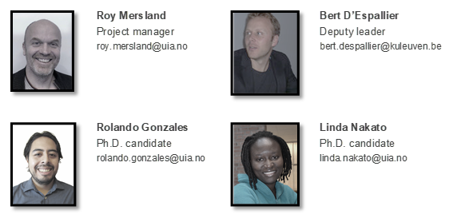
The SAVIX Project at CERSEM: team members

Slide 7
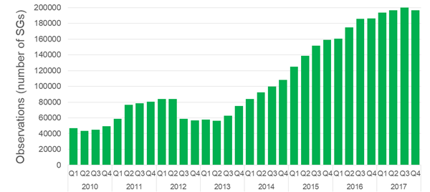
The SAVIX database
The SAVIX is an unbalanced panel dataset that contains quarterly information from 2010-Q1 to 2017-Q4.

Slide 8
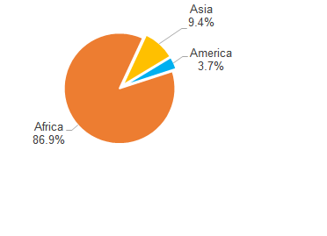
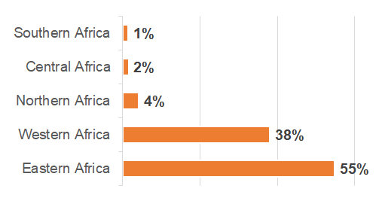
SGs in the SAVIX database: countries and regions

Slide 9
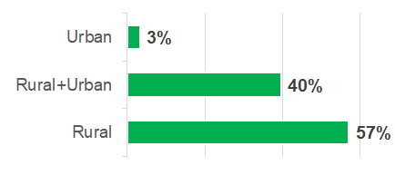
SGs in the SAVIX database: Urban and rural

Slide 10
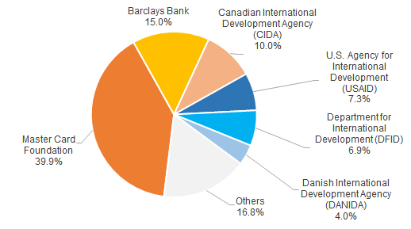
SGs in the SAVIX database: donors

Slide 11
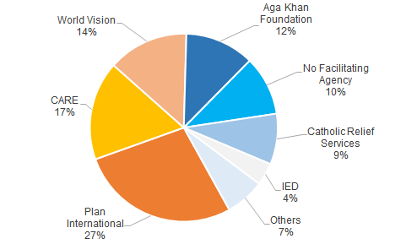
SGs in the SAVIX database: agencies

Slide 12
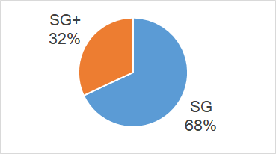

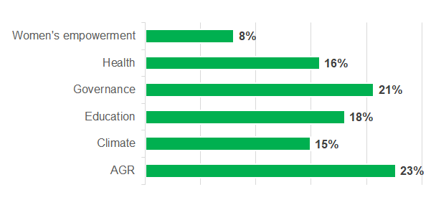
SGs in the SAVIX database: SGs+

Slide 13
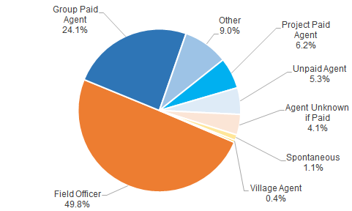
SGs in the SAVIX database: group formation

Slide 14
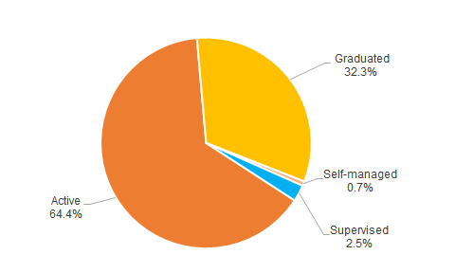
SGs in the SAVIX database: group status

Slide 15
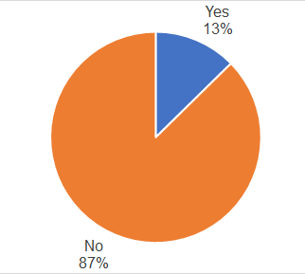
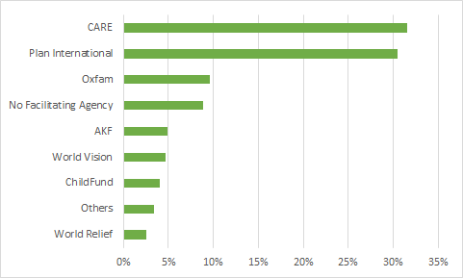
SGs in the SAVIX database: Financial Linkages
UNCERTAIN NUMBERS
OBS
OBS

Slide 16
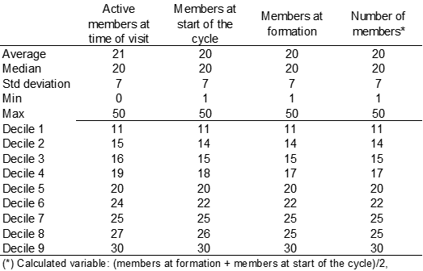
SGs in the SAVIX database: members
Very stable membership

Slide 17
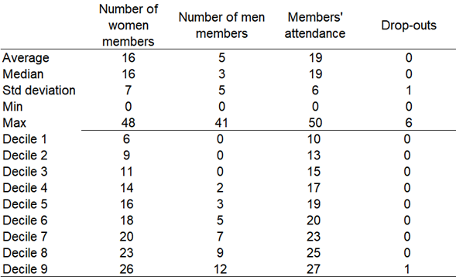
SGs in the SAVIX database: members
Much more men than expected

Slide 18
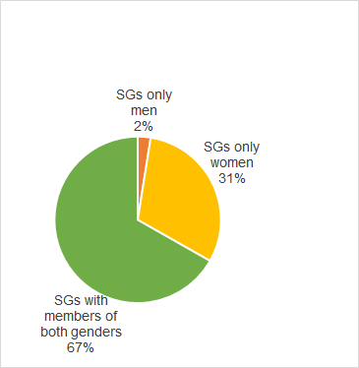
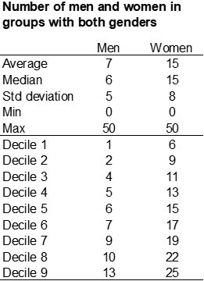
SGs in the SAVIX database: gender of members

Slide 19
Financial Performance Indicators:
ROS = (loan fund cash in box at bank + bank balance + property now + value of loans outstanding – net value of savings – property at start of cycle - debts)/net value of savings
ROA = (loan fund cash in box at bank + bank balance + property now + value of loans outstanding – net value of savings – property at start of cycle - debts)/(cash in box+ bank balance + value of loans outstanding + property now)
Equity per member = cash in box + bank balance + value of loans outstanding + property now + cash in other funds + value of loans past due -debts)/active members at time of visit
Average savings = net value of savings/active members at time of visit
Average assets per member = (loan fund cash in box at bank + bank balance + value of loans outstanding + property now + cash in other funds + value of loans past due)/active members at time of visit
Savings to loans outstanding = net value of savings/value of loans outstanding
Risk = write off since start of cycle + value of loans past due
Members investment = net value of savings + cash in other funds

Slide 20
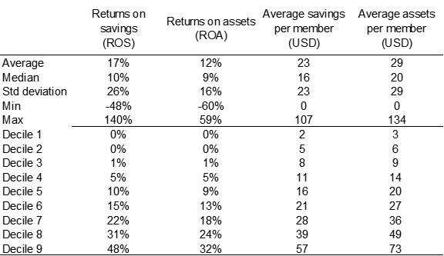
SGs in the SAVIX database: SGs’ performance
Lower returns than expected. Need to include time in cycle dimension

Slide 21
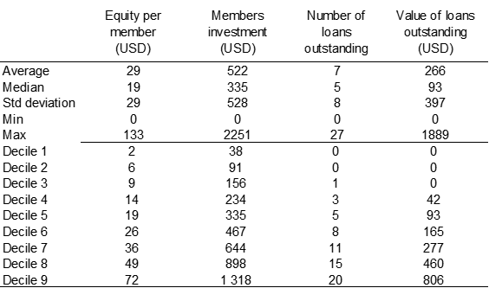
SGs in the SAVIX database: SGs’ performance

Slide 22
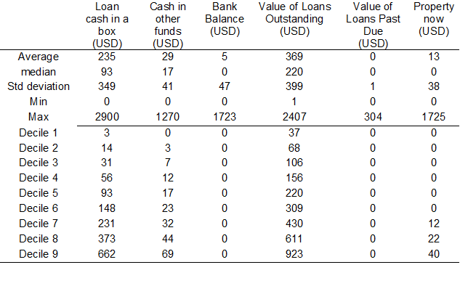
Balance sheet: Assets
What is this?

Slide 23
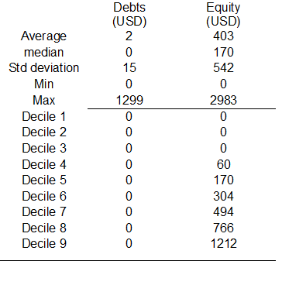
Balance sheet: Liabilities & Equity

Slide 24

Crosstabs (SG plus)
Provision of SG+ does not seem to influence returns

Slide 25

Crosstabs (SG plus)
Maybe some negative influence on savings patterns with SG+ ??

Slide 26
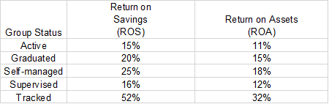
Crosstabs (Group status)
PRELIMINARY: Long term donor intervention seems not to be needed

Slide 27
Current Research Projects
Currently the project team at UiA/KU Leuven is processing the SAVIX database and working parallelly on 3 projects based on the SAVIX information:
A report with descriptive statistics of the SAVIX meant for practitioners. (Will be presented at EMW in Luxembourg)
A research study about the micro and macro determinants of the success of savings groups. (“one million regressions”)
A research study about the impact of financial linkages on the performance of SGs.
The SAVIX data was also crossed with the World Bank’s information of World Development Indicators. It is possible to include this and other type of macro-economic indicators in the analysis of the SAVIX savings groups.

Slide 28
A few ideas out of many we can carry out based on the SAVIX database
Your ideas
Gender studies (group level as well as trainer level (name of trainer)
Informal insurance mechanisms (other funds in cash box)
“Coffee clubs or savings banks?”
What influences group dynamics (coming to meetings, drop out etc.)
  E.g. study only groups that have changes in membership numbers)
Elite capture (loans to a few)
Influence of providing SG+
Influence of different types of SG+ (business vs social)
Self esteem effects (measured by group names)
Effects of different delivery mechanisms
Differences depending on implementing agency / donor
Contextual factors influencing groups (East vs West Africa etc)

