Slide 1


Education Moment
Opportunity Loss
Notes:
In BNI, we talk about VCP … Visibility which leads to Credibility with becomes Profitability
V or Visibility is when the other members know who you are and what you do.
Attendance at each week’s meeting is the bare minimum needed to achieve Visibility.

Slide 2
Opportunity Loss
the loss of potential gain from other alternatives when one alternative is chosen
Notes:
Opportunity Loss: The New Oxford American Dictionary defines it as "the loss of potential gain from other alternatives when one alternative is chosen."

Slide 3

What Opportunities Can You Lose
By Not Attending BNI
* Take 60 Seconds to discuss with the person next to you *
Notes:
In BNI terms you could say: “how much business did you lose by not attending your BNI Meeting for that week?”
Well, you really don’t know, but you will have lost the opportunity to get more business by not being there.
*Take 60 Seconds to discuss with the person next to you, what opportunities you may lose when you are not here for a meeting – * Allow members to discuss for 60 seconds

Slide 4

The opportunity to train your Referral Marketing Team
to bring in referrals or a new client
Notes:
The opportunity to train your Referral Marketing Team to bring in referrals or a new client

Slide 5

The opportunity to get new business from someone in the room
that may require your product or service
Notes:
The opportunity to get new business from someone in the room that may require your product or service

Slide 6

The opportunity to gain credibility with a fellow referral partner
for you and your business
Notes:
The opportunity to gain credibility with a fellow referral partner for you and your business

Slide 7

The opportunity to build a relationship with a new referral partner
Notes:
The opportunity to build a relationship with a new referral partner

Slide 8
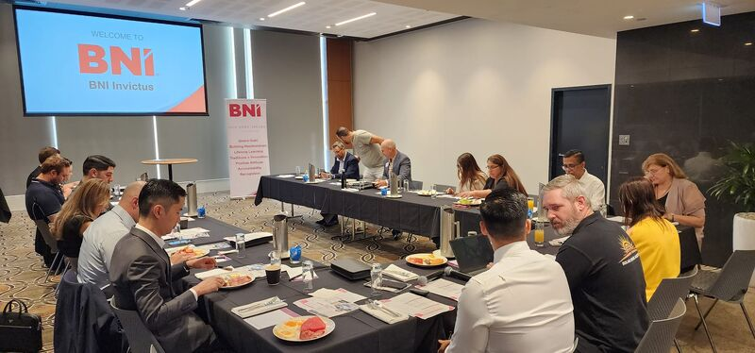
The opportunity to meet a possible new client
who is a visitor, guest or sub
Notes:
The opportunity to meet a possible new client who is a visitor, guest or sub

Slide 9

The opportunity to learn something new to help your business
Notes:
The opportunity to learn something new to help your business

Slide 10
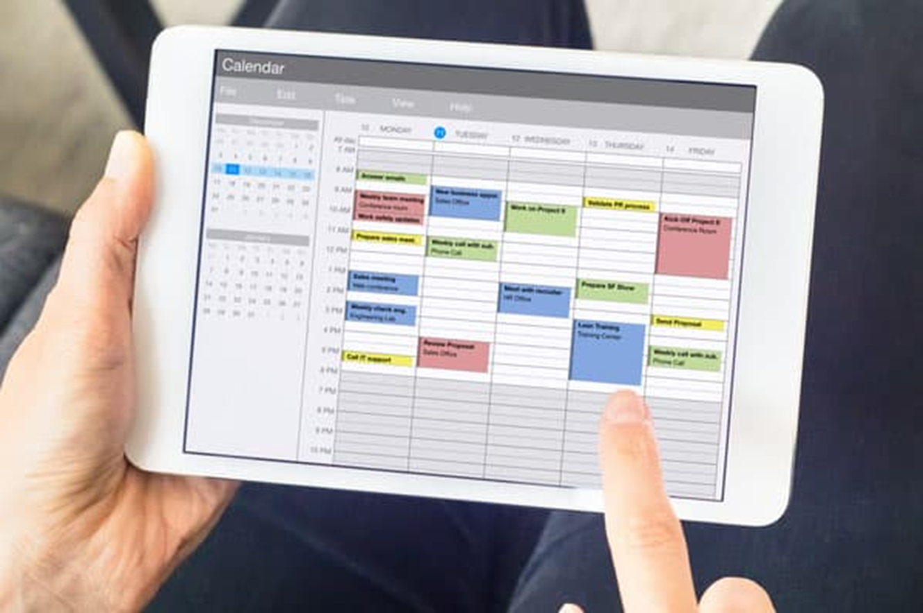

ACTION:
Enter your weekly meeting as a business appointment
for the whole year.
Notes:
Diarise your BNI Meeting in your Calendar each week for the year, as a business meeting with your Referral Marketing Team.
The simplest way to counter Opportunity Loss is to be there for your meeting each week … you never know what you might miss out on.

