Slide 1
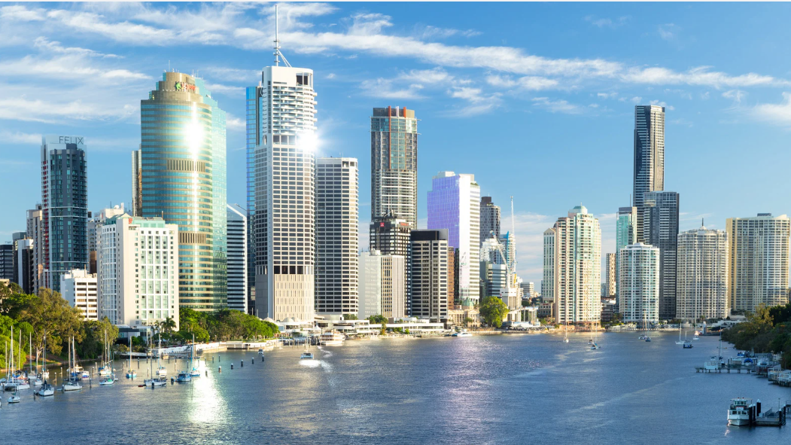
Inviting “Open Category” Visitors to the Chapter
Notes:
The focus is to shift mindset from “inviting” to “creating opportunity,” and give members simple, natural ways to bring visitors — especially ahead of Visitor Days or themed meetings.

Slide 2
Visitors = Growth, Energy & Opportunity
New People = New Energy
Visitors expand your network
Visitors do business in the room, even if they don’t join
Visitors are the best “Givers Gain” that you can bring to your fellow members.
Notes:
When you invite a visitor, you’re not just helping the chapter grow — you’re creating new opportunity.
Visitors bring energy, curiosity, and fresh networks into the room. Even if they don’t join, they may refer, collaborate, or bring someone else who will.
BNI chapters with consistent visitor flow grow faster — and make more money.

Slide 3

Common Errors
Ruling them “out” yourself
Trying to talk them into joining beforehand
Saying too much as part of the invite
Worrying about a “NO”
Taking it too seriously
Only asking those you think will join

Slide 4

Things that work for others
Talk up the business opportunity “Our business group is looking for a landscape gardener. Would you be interested in coming along for a look? And then……be quiet and let me speak

Slide 5
Things that work for others
Ask everyone, and be fine with NO
Be cheeky and fun, particularly with people you already know “Mate, can you just do me a favour and come to one of these meetings with me. I just need to bring a few visitors in the next few weeks.”

Slide 6
Who believes they have a responsibility to invite visitors?
Notes:
Ask the room to share their tips and tricks

Slide 7
If they want to know more
“We meet at ………… at …….. The next meeting is ……….. Or the same time the week after. “Let me know which suits, and I’ll register you.” And then again…….be quiet and let them speak

Slide 8
Handling Objections
Firstly, don’t push too hard; if you have to twist their arm, move on
“You actually don’t have to join; plenty of people just come along for a look” “And the worst thing that will happen is that you get to hand out a bunch of business cards, and get to meet some other business owners in the area.”

Slide 9
What are some different ways you could invite people without it feeling like a hard sell?
Notes:
Ask the room to share their tips and tricks

Slide 10
Who Should You Invite?
Business Suppliers of:
Neighbours
You
?
?
Friends
Family
Personal Suppliers of:
Event Attendees
Clients
?

Slide 11
How many visitors do we think we need to have 10 more members?

Slide 12
Follow Up:
Pick one Open Category
Invite all that you know or you have had contact with
Make 3 phone calls by tomorrow.

