Slide 1
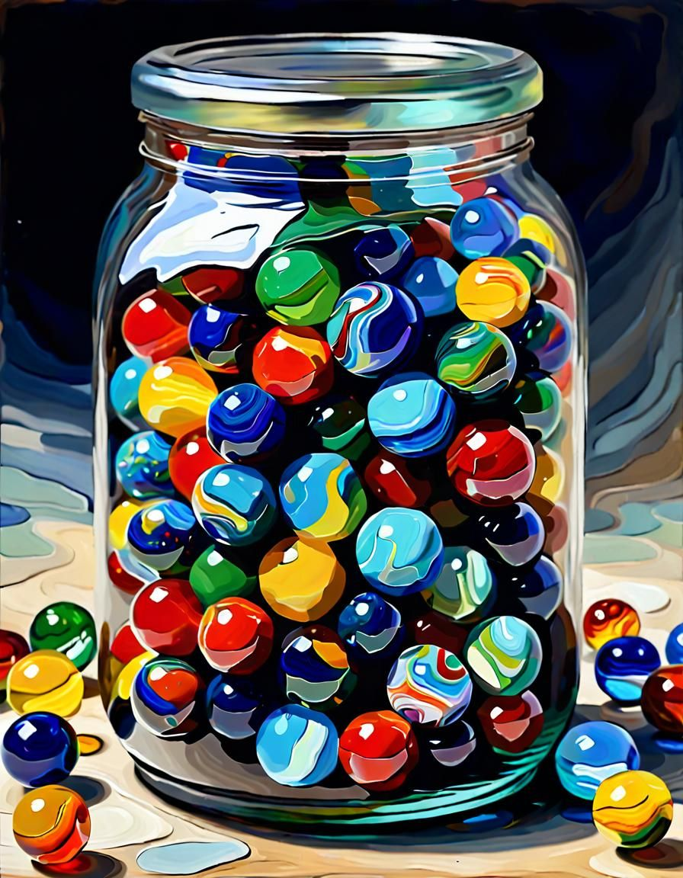
Building Trust
One Marble at a Time
Becoming a trusted referral partner in BNI

Slide 2
The Marble Jar Story
“Brené Brown tells the story of her daughter’s teacher who had a ‘marble jar’ in the classroom. Every time the class made a good choice — showed kindness, worked together, or showed respect — the teacher added marbles to the jar. When trust or teamwork was broken, marbles were taken out.”
Our BNI relationships are like marble jars too. Each small act of trustworthiness adds a marble; each letdown takes one away.”

Slide 3

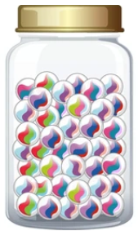
Trust in BNI = Your Marble Jar
New member
Established, trusted BNI member

Slide 4

Ways to Add Marbles
✅ Show Up Consistently: Attend meetings, be engaged, and stay visible.
✅ Follow Through: Do what you say you’ll do — every time.
✅ Give Good Referrals: Listen, understand others’ businesses, and refer thoughtfully.
✅ Show Gratitude: Recognize others’ efforts publicly (Thank You for Closed Business).
✅ Share Positivity: Be supportive — celebrate others’ wins.

Slide 5
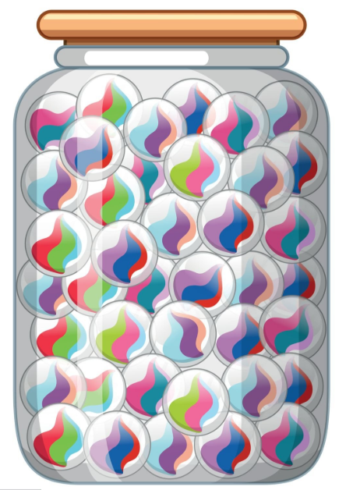
The Payoff — A Full Marble Jar
“When your jar fills up, people want to refer you. You’re seen as reliable, professional, and trustworthy.”
“BNI’s philosophy of Givers Gain works because we each take time to fill each other’s jars — one marble at a time.”

Slide 6
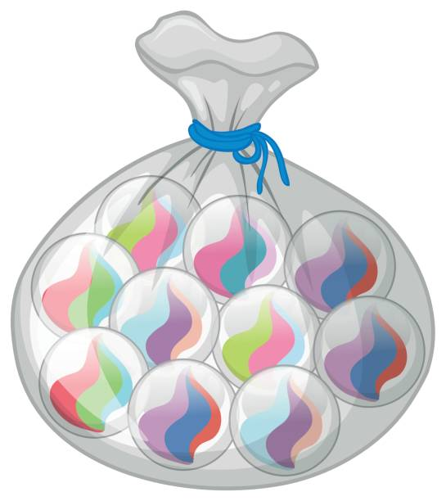
So….. grab your bag of marbles
“Ask yourself this week: What’s one thing I can do to add a marble to someone’s jar in this room?
It might be a message of appreciation, a thoughtful introduction, or simply showing up prepared.”
“Trust doesn’t just happen — we build it, marble by marble.”

