Slide 1


Slide 2
Purpose of Inviting
Increase the number of visitors to the BNI chapter by connecting with professionals in specific roles, initially focusing on symbiotic professions who will benefit by being associated with you, with the intent to expand as needed eg
  Copy writers
  AI
How
Streamline the LinkedIn outreach process through detailed steps, including using scripts for follow-up and response tracking via a shared spreadsheet.

Slide 3
List of Professions
🔗 Top Symbiotic & Referral Professions for Web Developers (Highly Relevant)
These professionals often collaborate directly with web developers or serve the same clientele:
Digital Marketing Strategist
SEO Specialist (Search Engine Optimisation)
Social Media Consultant/Manager
Graphic Designer
Copywriter
Marketing Consultant
Branding Specialist
Advertising Specialist (Digital/Traditional)
Content Writer / Blogger
Public Relations Consultant
App Developer
Software Developer
Cloud Services Provider
ERP Software Consultant
Data Security Specialist
Email Marketing Specialist

Slide 4
(Frequently collaborate with web developers on projects or product builds.)
AI Software Engineer – Builds AI-powered apps, needs front-end/back-end collabs.
Machine Learning Engineer – Works with devs to integrate ML sites or tools.
MLOps Engineer – Helps deploy AI models in live web platforms.
Cloud Architect (AI Focus) – Designs infrastructure for AI features in web apps.
Data Scientist – Provides insights/models that can be embedded into websites.
NLP Engineer – Works on chatbots/search tools – useful for AI-enhanced sites.
Less client-facing, but valuable for referrals or project collaboration.)
Data Engineer – Supports backend pipelines – less likely to network.
Deep Learning Specialist – R&D-heavy, usually internal or academic roles.
Computer Vision Engineer – Specialised, usually B2B or niche product work.
AI Researcher – Typically academic or big tech; less likely to network locally.
AI Ethicist / Responsible AI Lead – Often tied to policy/legal teams or NGOs.
AI Policy Analyst – Government/corporate policy work, not BNI-fit.
Robotics Engineer – More industrial/mechanical than digital.

Slide 5
Instructions
Target Audience:
Focus on connecting with (target professionals - coordinate with Rob) located in the Greater Brisbane area.
See list of professionals here:
https://drive.google.com/file/d/17iMjSikfcaeZbZwK83_W5GMSXvWrBL2Q/view?usp=drive_link
Exclude: Video Production, Photographer, Google Ads,Illustrators/Animators
Daily Connection Limit:
Limit connections to 30-40 people per day to avoid triggering LinkedIn’s restrictions.
Search Parameters:
Use LinkedIn’s search to filter by:
  Job title: “Copy Writer”
  Location: Greater Brisbane area ; Brisbane, Brisbane City
  Connection Degree: Focus on 2nd and 3rd-degree connections (to reach new contacts, not those already connected).
  Exclude Specific Contacts: Avoid reaching out to “Anthony Kuluz”, as he is already associated with BNI in South Brisbane, making outreach to him unnecessary.

Slide 6
Instructions Continue
Connection Request:
Send a personalised connection request message to each identified lead.
Rob provided a script that Jill should follow in these messages, including a brief introduction and the purpose of connecting.
Follow-Up Script:
Follow a multi-step follow-up process:
  Day 1: Send the initial connection request.
  After a connection is accepted: Send the Day 2 script.
  Day 3 Follow-up: If no response is received but the connection request is accepted, follow up with another message (Day 3 - Follow up), referencing the initial outreach and reiterating the invitation.
Tracking:
Use a spreadsheet to track the leads. +

Slide 7
Script
Day 1 - Message 1
After Responding positively - Message 2
Day 3 - Follow Up
Day 5 - Any Questions
Day 7 - Introducing b2b websites
Day 14 - Here are my contact details.
Connection/Invite to BNI
Hi, I am a member of a group of business professionals that meets on Wednesday morning. Members look for referrals for each other. We all meet at the Aspley Hornets, Aspley. Some members want to meet Copy Writers. If you're interested, please accept my connection request. Thanks.
Register you for Meeting
Thanks for accepting my connection request. We would love to have you as a guest at next week’s meeting. Can I please have your best email address and mobile number to register you for next week’s meeting
On response register them in BNI connect
Hi [Name] 👋
Thanks so much for accepting my connection request—really appreciate it! I just wanted to follow up on my last message and share a little more about our group.
We’ve built a great community of professionals who genuinely enjoy connecting and supporting one another—much like what I’ve experienced in BNI. A few of our members are especially looking to connect with people in [insert profession] which made me think of you.
I’d love to learn more about your work in [insert profession]. It’s always interesting to hear what’s happening in the field from someone in the mix.
We’d be thrilled to have you as a guest at next week’s meeting. If you're open to joining, just send over your best email and mobile number, and I’ll get you registered and share all the details.
Also, if there's a particular area you're interested in exploring or if there's anything you need support with, feel free to reach out—I’m happy to help however I can!
Looking forward to hearing more about your journey 😊
Warm regards,
Rob

Slide 8
Follow Up (No Response)
Day 3. Follow Up
Just thought I would follow up on my last message and talk about some of our group. As I mentioned there were some members who wanted to meet people in your industry. They include businesses in the following industries: Real Estate, Finance and Health and Wellness.
Day 7 Just thought I’d tell you a bit about me.
I just thought I would tell you a bit about my business. b2b websites is an outcome focused, full stack web design and development agency based in Brisbane. With a team of 12 individuals and 150,000 hours experience in this world of an interactive Web, 2.5 b2b has your back. We have good referral sources for people in your industry. We give referrals regularly and collaborate often. I’d love to get on the phone and have a chat about your business.
Day 14 Here are my contact details, please reach out if you ever need help.
Hey, I understand you are busy. Thanks for connecting. If your circumstances change I would love to have you join us at a meeting. Please reach out if you have any questions or if you need an introduction to someone.

Slide 9
Frequency
Frequency:
Everyday
Reach out - (Algorithm)
at least 5 target leads MWF - 1st week
at least 10 target leads MWF - 2nd week
at least 10 target leads daily - 3rd week
at least 20 target leads daily - 4th week
at least 30 target leads daily - 5th week
at least 30-40 target leads daily - 6th week

Slide 10
To Summarise
Focusing on symbiotic professions who will benefit by being associated with you
Connection Request:
Connection/Invite to BNI
Limit connections to 30-40 people per day to avoid triggering LinkedIn’s restrictions.
Register them for Meeting
Follow Up
Day 3. Follow Up Just thought I would follow up on my last message
Day 7 Just thought I’d tell you a bit about me.
Day 14 Here are my contact details, please reach out if you ever need help.

Slide 11
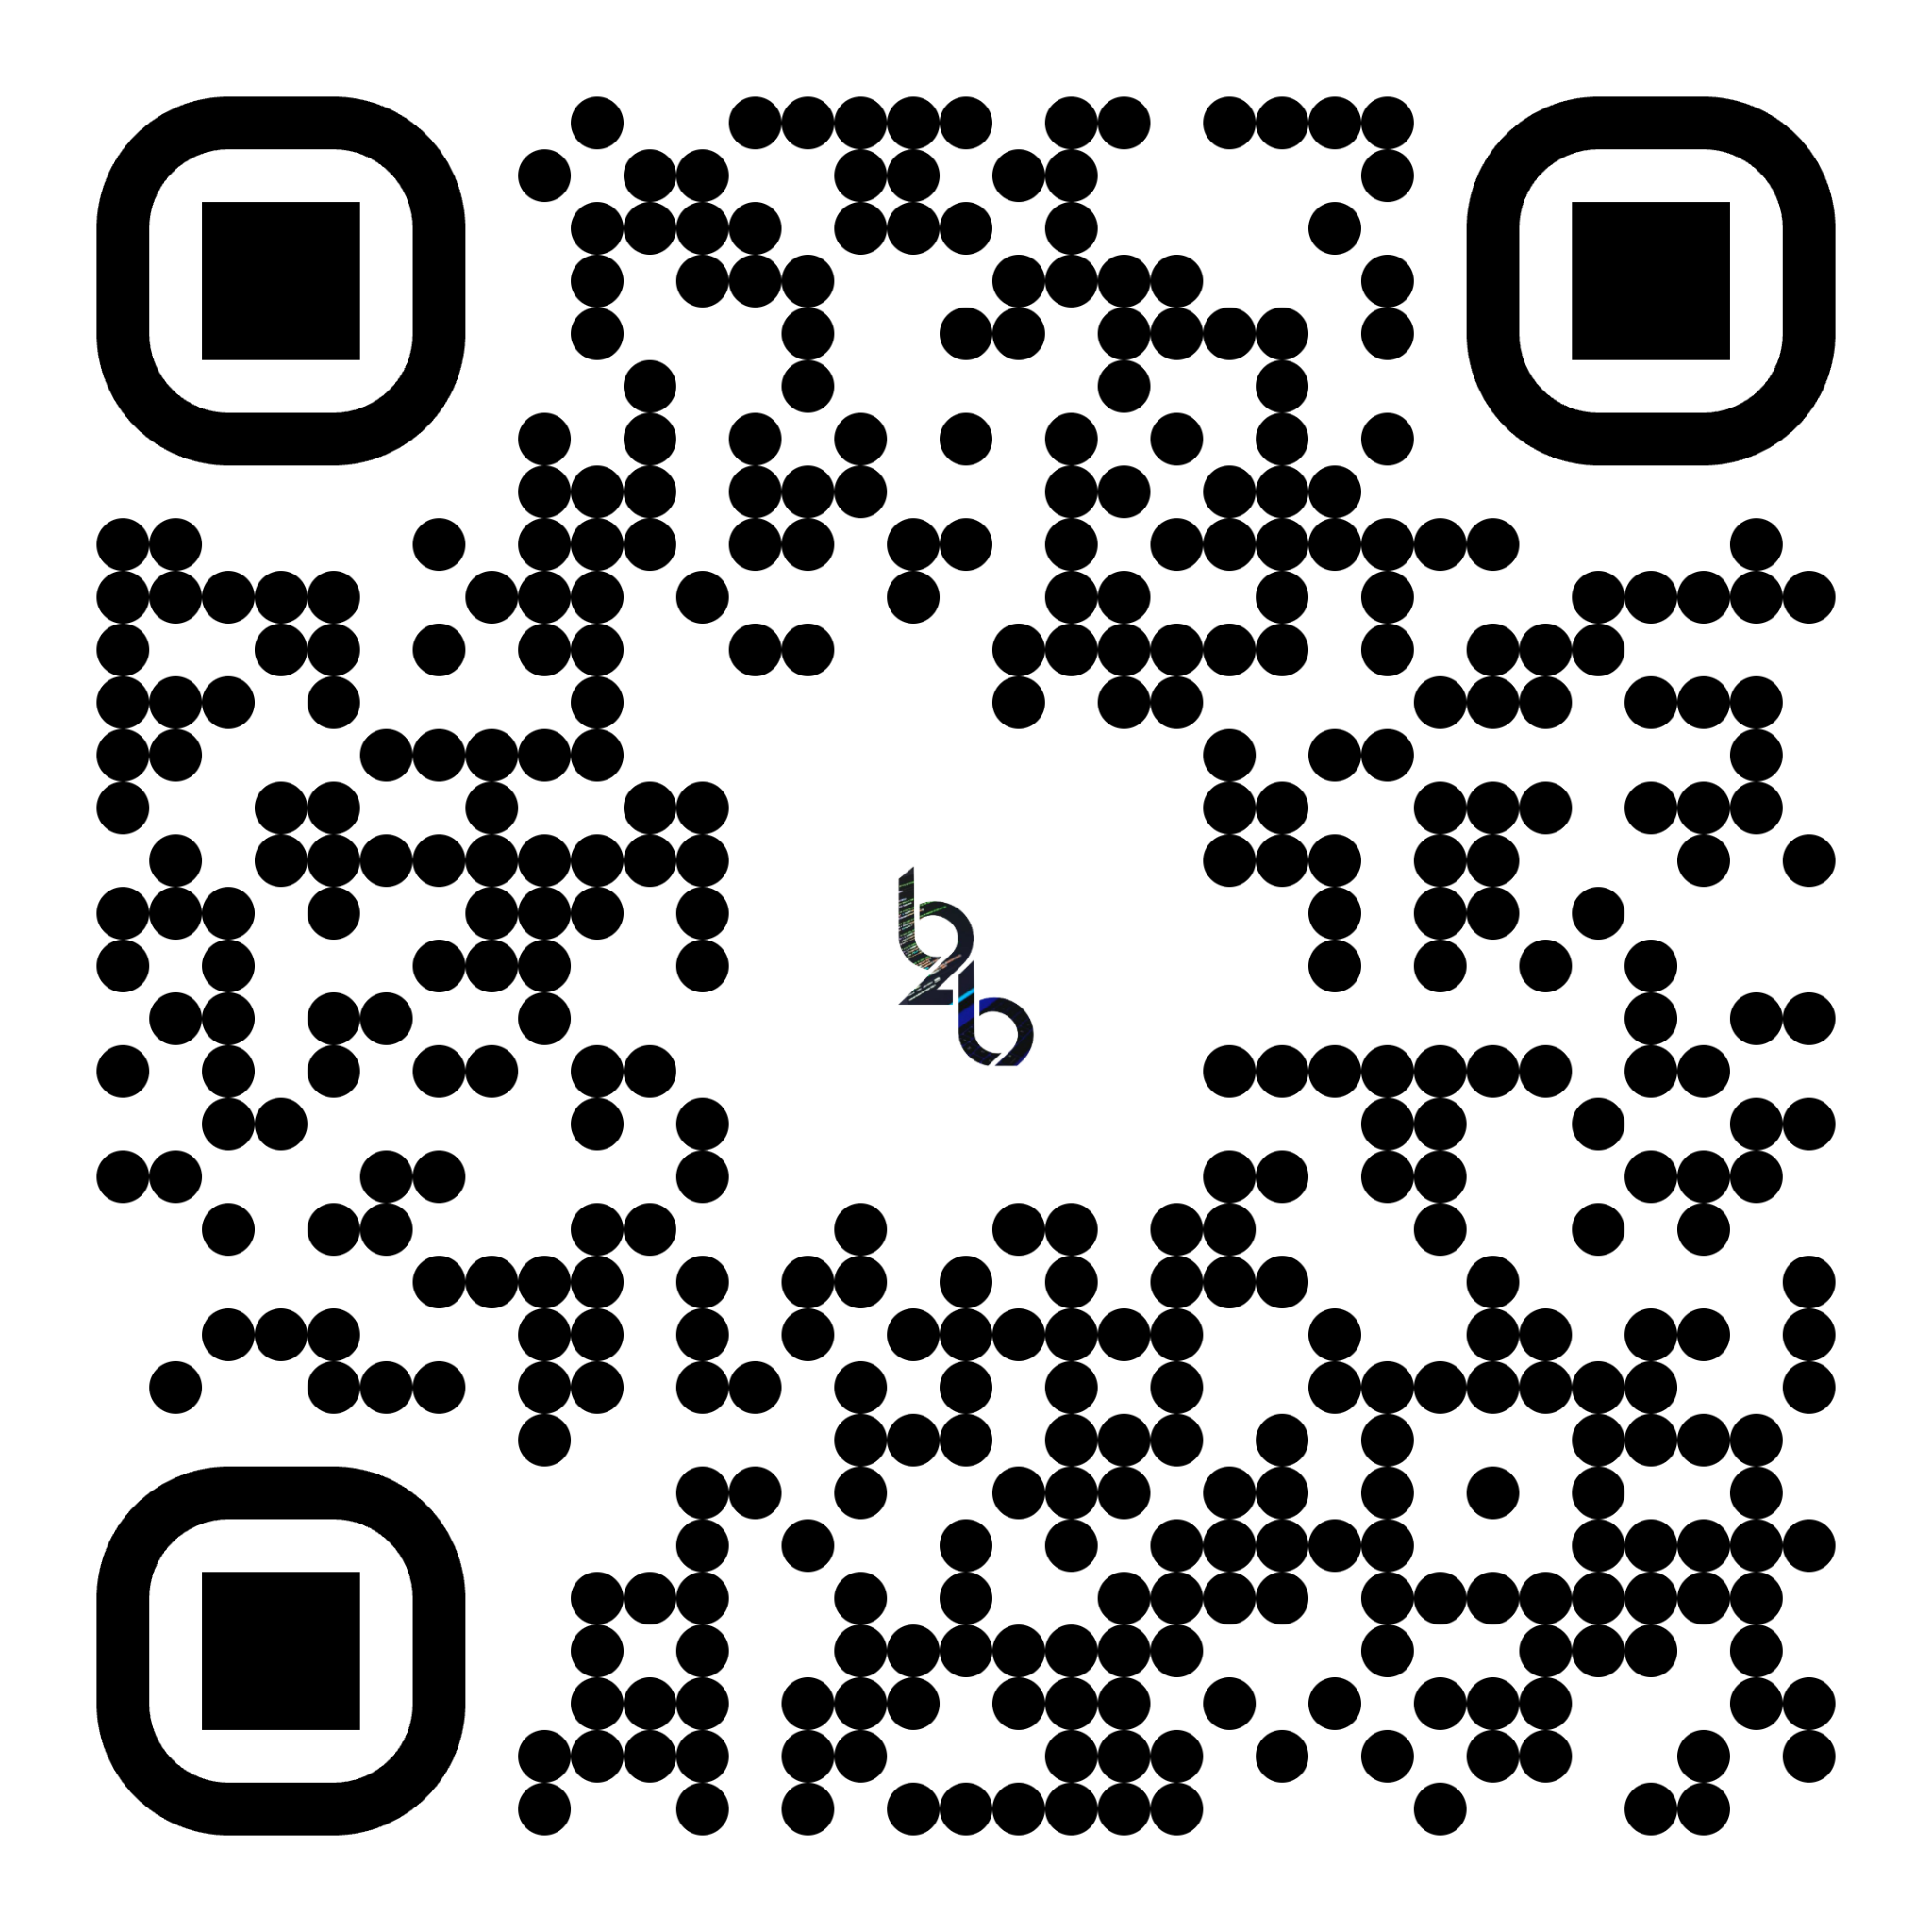
https://www.bniseqeducation.com.au/

