Slide 1

Notes:
Building on our unpacking of the GAINS profile, today we are focused on NETWORKS - or 'who do you know'?

Slide 2
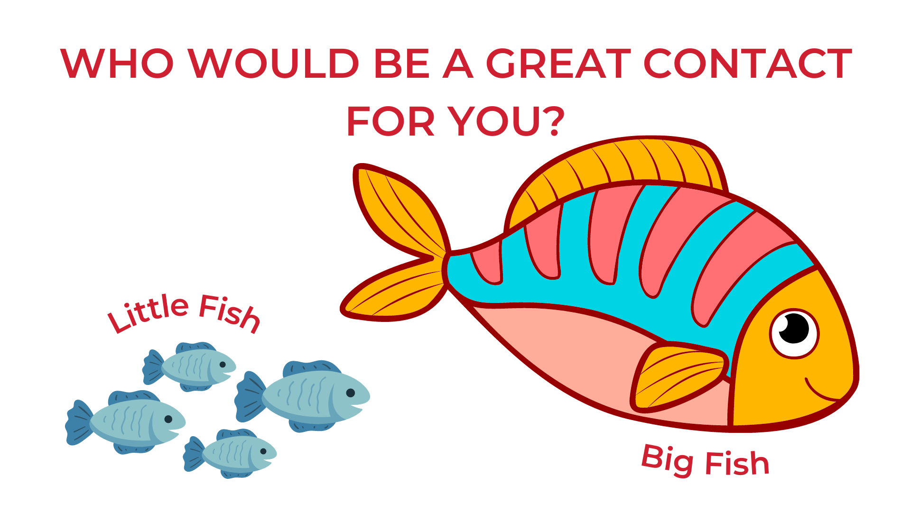
Notes:
Take a moment to think right now ... who would be a great contact for you in your business? Who could send you lots of clients, or a referral partner? And where would you find your dream client, who might know them?

Slide 3
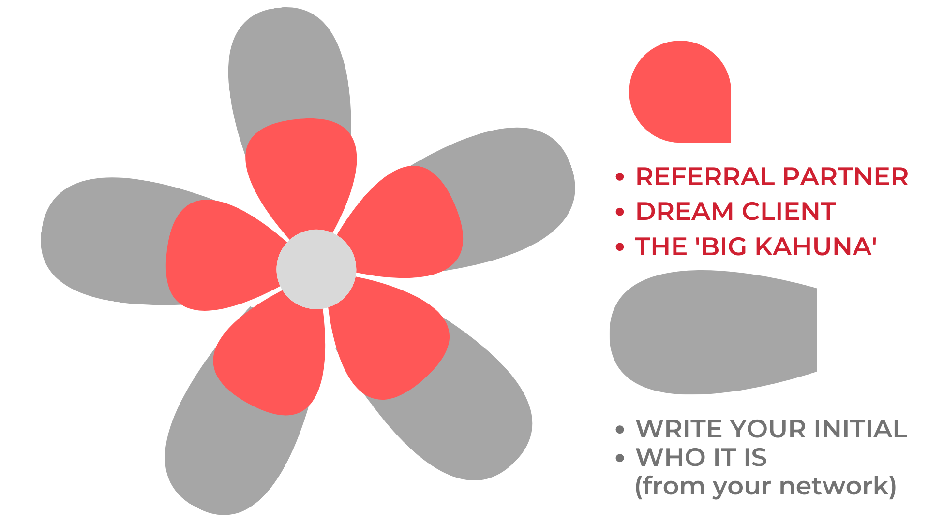
Notes:
We're going back to a primary school activity. On your piece of paper ... I want you to draw a flower. It should have a centre circle - inside that please write your name. Now draw 5 petals around your flower - inside each petal please write a different referral partner or dream client or your BIG KAHUNA.
Give participants a minute to write them.
Now add 5 petal extensions.
When I say GO, we are going to buzz around the room and read one anothers. If you know someone that fits the criteria, please write your name and who it is.
GO!

Slide 4
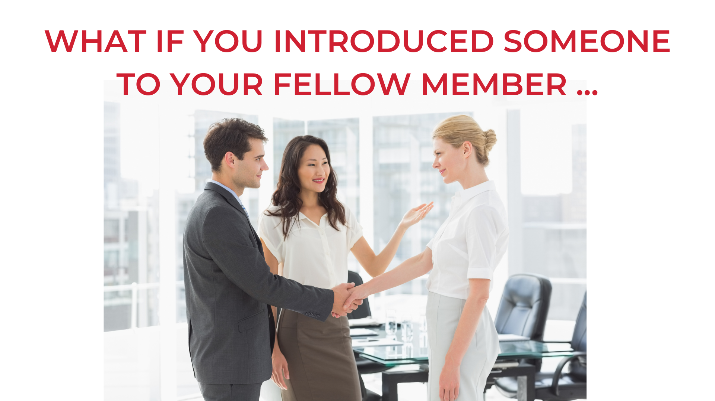
Notes:
Just want to finish on this final message about your networks.
BNI is not about your business reaching the members in this room. It is about who the people in this room can introduce you to.
So ... 'what if you introduced someone to your fellow member ...'

Slide 5
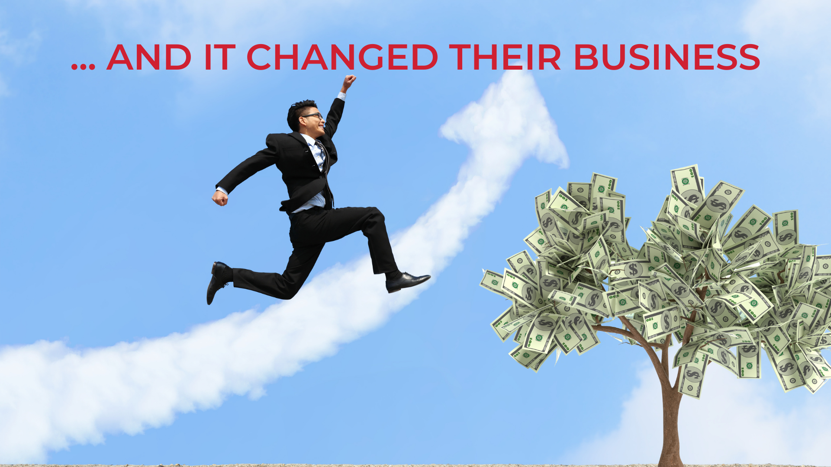
Notes:
... ' and it changed their business trajectory ...'

Slide 6

Notes:
...'which in turn, changed their life for the better?'
How would that make you feel to have been the person who made that introduction???
#GiversGain

