Slide 1

Education Moment
Visitor, Guest or Sub
Notes:
In BNI, we talk about VCP … Visibility which leads to Credibility with becomes Profitability
V or Visibility is when the other members know who you are and what you do.
Attendance at each week’s meeting is the bare minimum needed to achieve Visibility.

Slide 2

Why do we invite people to BNI?
Notes:
Opportunity Loss: The New Oxford American Dictionary defines it as "the loss of potential gain from other alternatives when one alternative is chosen."

Slide 3
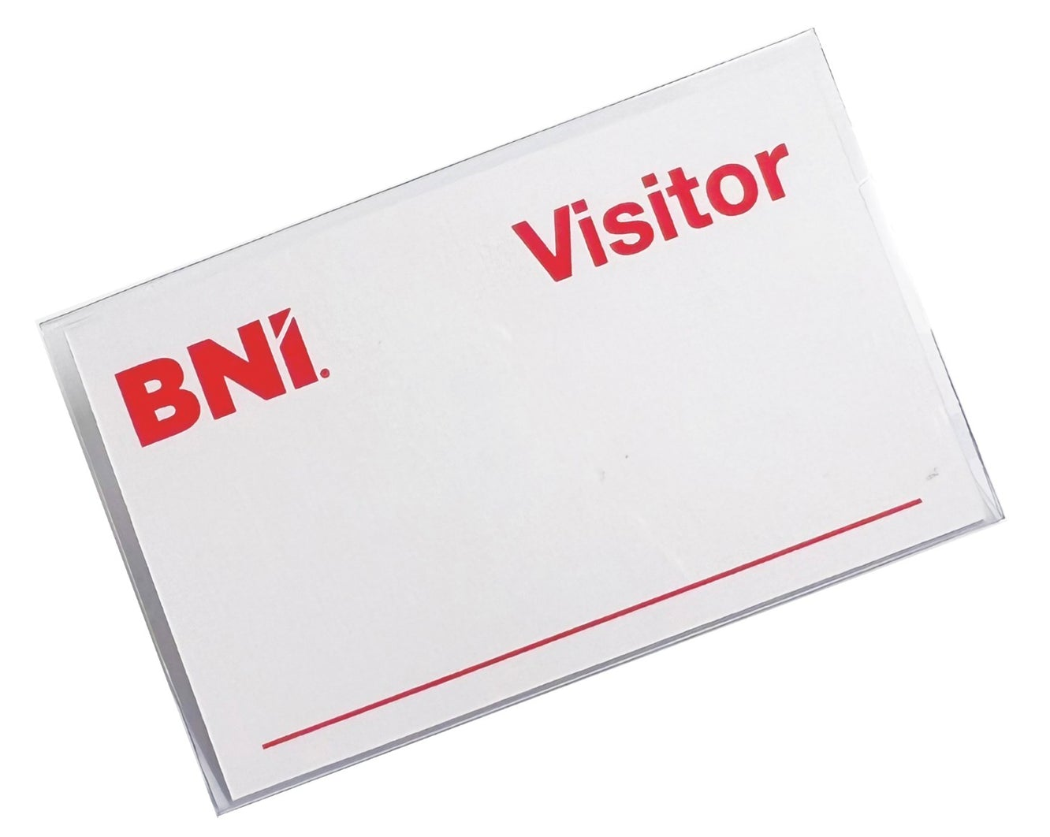
What Is A VISITOR???
In BNI …
a "visitor" is someone
who is not a current member
but is invited to attend a meeting to potentially become a member
Notes:
The opportunity to train your Referral Marketing Team to bring in referrals or a new client

Slide 4
Don’t prejudge!
Members come from all walks of life and professions
Until they see what BNI is we can’t tell who is a potential member or that they will want to apply to join.
Notes:
The opportunity to train your Referral Marketing Team to bring in referrals or a new client

Slide 5
Category Already Filled?
That’s Okay …
But there is some etiquette
1. Speak to the member
2. Let the visitor know
If the visitor sees value in BNI, we can connect them to another Chapter
Notes:
The opportunity to train your Referral Marketing Team to bring in referrals or a new client

Slide 6
Not All Visitors Will Want To Join
And that’s okay!!!
Visitors often make connection with members, which may result in business being passed
Notes:
The opportunity to train your Referral Marketing Team to bring in referrals or a new client

Slide 7
Visitors & the BNI Traffic Lights
First Visit Only
Once Every 6 Months
Notes:
The opportunity to train your Referral Marketing Team to bring in referrals or a new client

Slide 8
What Is A GUEST???
Guest
A “guest" is someone
who is a BNI member,
BNI Director or a visitor who has already attended the Chapter once in the last 6 months
Notes:
The opportunity to train your Referral Marketing Team to bring in referrals or a new client

Slide 9
Guests have no potential to become a member
Guest
eg: husband on visit #2
eg: member at BNI Bayside
eg: Director Consultant
Notes:
The opportunity to train your Referral Marketing Team to bring in referrals or a new client

Slide 10
What Is A SUBSTITUTE???
Substitute
A “Substitute" or “Sub”
is someone who attends the Chapter meeting in place of a BNI member (to fill their absence).
Notes:
The opportunity to train your Referral Marketing Team to bring in referrals or a new client

Slide 11
Kill Two Birds With One Stone!!!
Substitute
A “Substitute" or “Sub”
can also be considered a Visitor
IF
they are visiting the Chapter
for the first time and
they are not a BNI member
Notes:
The opportunity to train your Referral Marketing Team to bring in referrals or a new client

Slide 12
A Sub Is A Sub Is A Sub
Substitute
A “Substitute" or “Sub”
attends the meeting in place of the member.
They are NOT representing their own business and their Member Presentation is about the business they are substituting for.
At BNI Redlands, Substitutes are offered the opportunity to introduce themselves during Visitor Introductions. This courtesy is not offered at all Chapters.
Notes:
The opportunity to train your Referral Marketing Team to bring in referrals or a new client

Slide 13

Visitors are the life blood of BNI
Having visitors in our room every week …
adds energy
bring potential business
introduces us to a possible new member
It’s everyone’s responsibility to bring visitors.
ACTION:
Who will you bring along next week?
Notes:
Diarise your BNI Meeting in your Calendar each week for the year, as a business meeting with your Referral Marketing Team.
The simplest way to counter Opportunity Loss is to be there for your meeting each week … you never know what you might miss out on.

