Slide 1


Education Moment
BNI National Conference Takeaways

Slide 2
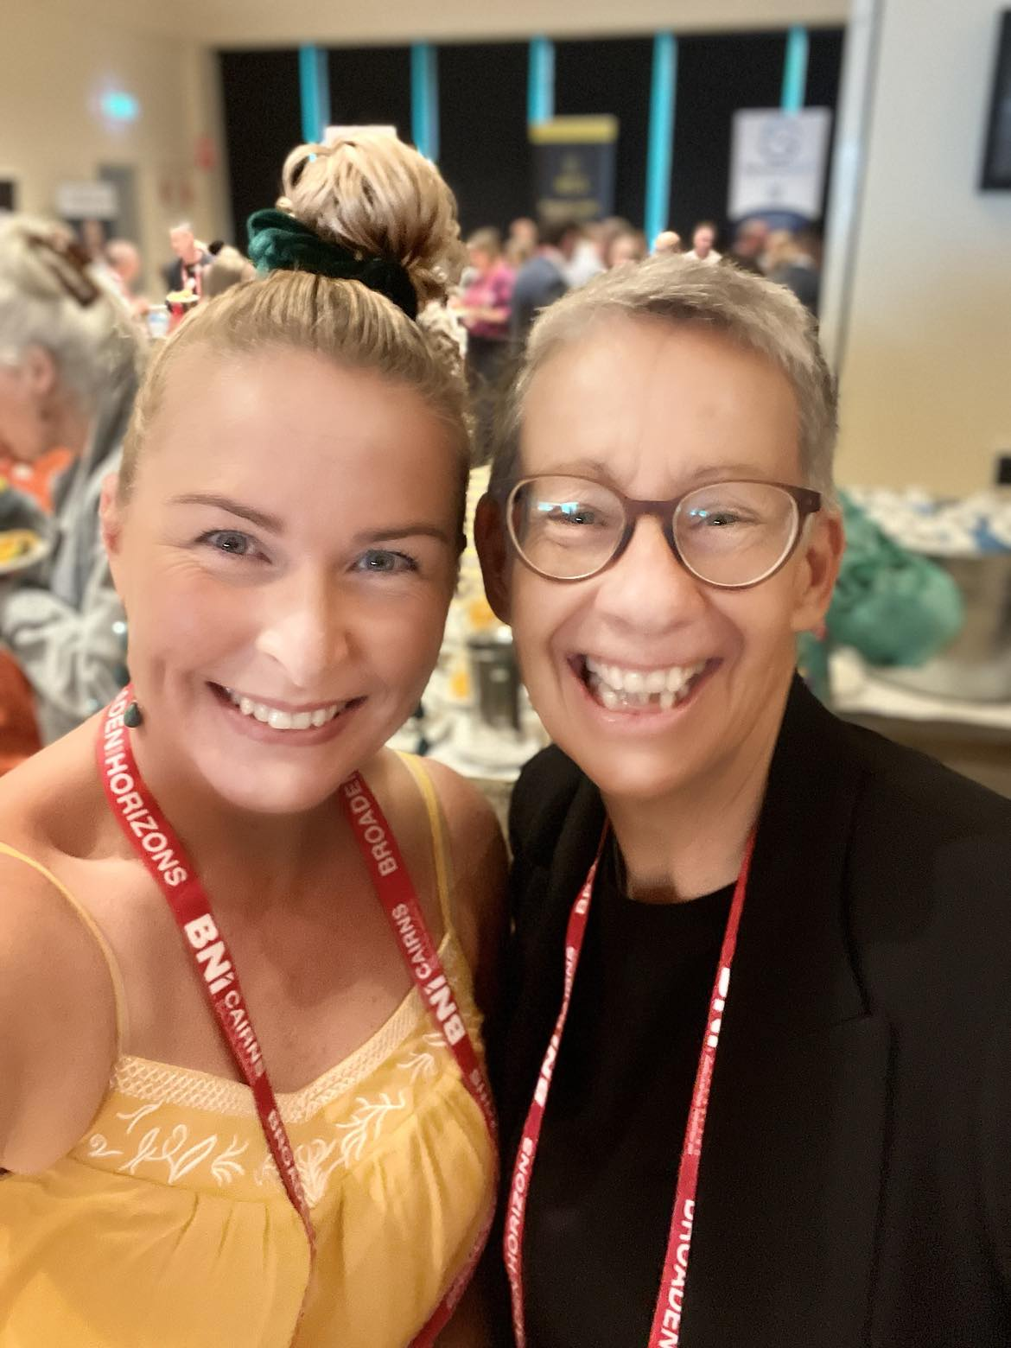

Cindy Koehler - Mind Garage
www.mindgarage.com.au
No matter what happens in life,
or no matter the hand you are dealt,
you can only control your …
ATTITUDE
&
EFFORT

Slide 3




4 Frames of Mind & Belief Patterns
Can’t Do
Can’t Happen
Can Do
Can’t Happen
apathy
withdrawal
procrastination
anger
frustration
‘fight’ or ‘flight’
Can’t Do
Can Happen
Can Do
Can Happen
anxiety
stress
sadness
depression
ACTIVATION!!
ACTION!!!

Slide 4


Slide 5

When individuals embrace
“CAN DO”
“CAN HAPPEN”
extraordinary things
can happen

Slide 6

What do you want to create?
What will light you up?
What is your vision
for the next 2-5 years?

Slide 7

What
“CAN’T DO”
is no longer
working for you

Slide 8
MONEY
BAD HABITS
LACK OF KNOWLEDGE
FEAR of the UNKNOWN
FEAR of FAILURE
DOUBT
DISTRACTION
TIME
IMPOSTER SYNDROME
GREED
SELF WORTH

Slide 9
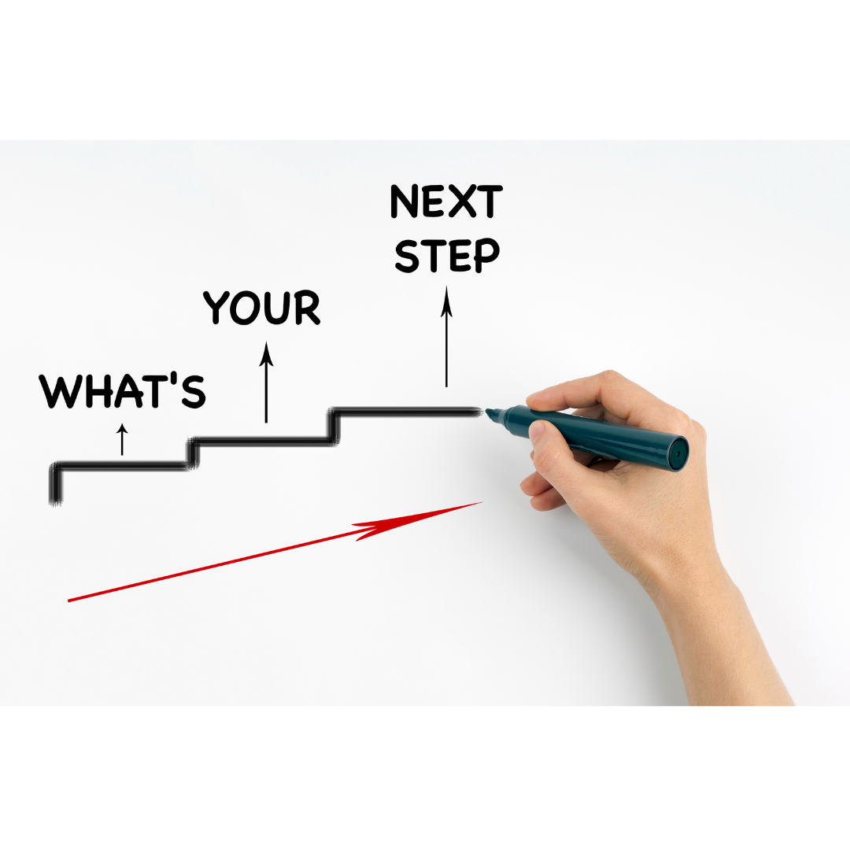
1.
2.
3.
SCARY

Slide 10

BNI National Conference – Sydney 2025
Day One (DNA Team) | Day Two (Members Day) | Day Three (DNA & Members)
Gala Awards Night | Keynote Speaker Sponsor Presentations 5 Additional Speakers Mindset Trainer Financial Coach LinkedIn Specialist Communication Coach Success Coach Food Breaks Lots of Open Networking Sponsor Stands | Keynote Speaker - Workshop Sponsor Presentations 5 Additional Speakers Executive Coach HR Specialist Leadership Coach Profit Coach Breakout Workshops Food Breaks Lots of Open Networking Sponsor Stands
BNI National Conference in 2026 is in ...
MONACO!!!!

